Slide 1
CS 6150 : Lecture 5 DP, Greedy

Slide 2

Last week
How to solve recurrences (recursion tree)
Median in linear time (almost median)
Intro to dynamic programming
HW1 out! Due in ~1 week! (check TA office hrs)

Slide 3

General views of DP
Recursion done “right”
Think top-down, implement bottom-up
“Overlapping subproblems” – remember answers
Be aware of memory!

Slide 4

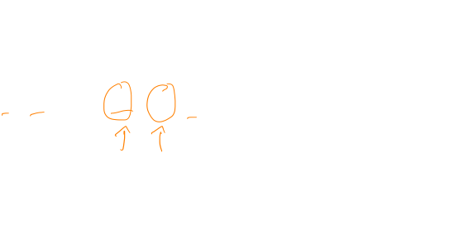
Eg: longest inc subsequence
Problem (LIS): given an array A[0 … N-1], find “sub-array” of largest size that is in increasing order.
45 | 9 | 16 | 5 | 13 | 7 | -1 | 21 | 32 | 4

Slide 5
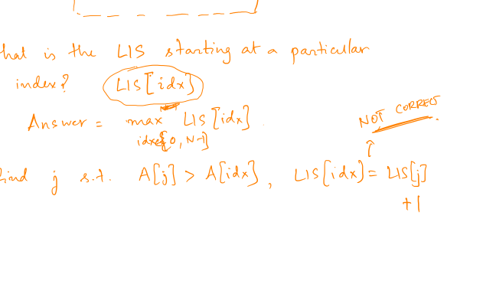
LIS
45 | 9 | 16 | 5 | 13 | 7 | -1 | 21 | 32 | 4

Slide 6
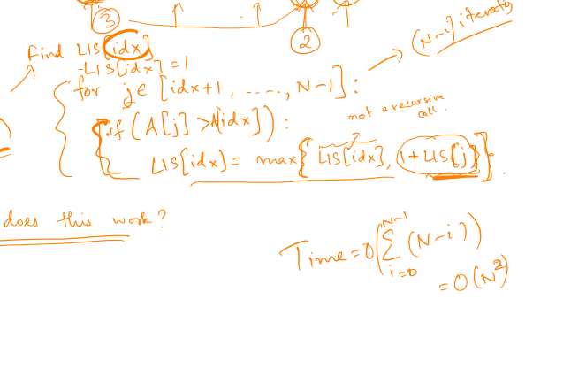
LIS – Algorithm
45 | 9 | 16 | 5 | 13 | 7 | -1 | 21 | 32 | 4

Slide 7
LIS – Algorithm
45 | 9 | 16 | 5 | 13 | 7 | -1 | 21 | 32 | 4

Slide 8
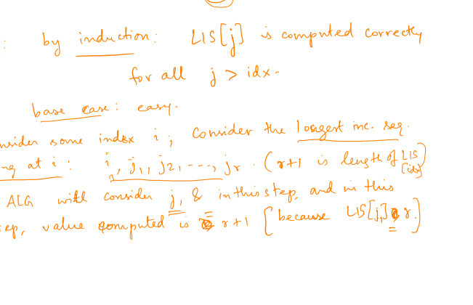
LIS – Proof
45 | 9 | 16 | 5 | 13 | 7 | -1 | 21 | 32 | 4

Slide 9
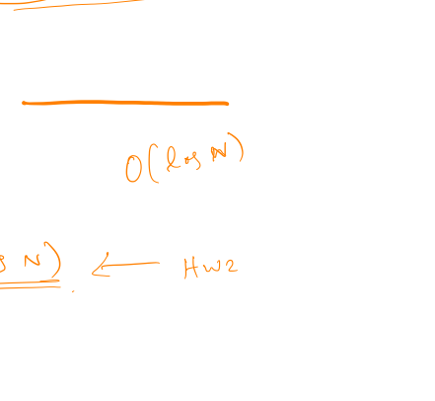
LIS – Can we do faster?
45 | 9 | 16 | 5 | 13 | 7 | -1 | 21 | 32 | 4
Subroutine: in a sub-array, find the index ‘i’ such that (a) A[i] > x, and (b) has max value of LIS[.]
A clever data structure?

Slide 10

Overview of DP
Recursion done “right”
Common technique (e.g. shortest paths, …)
Be aware of memory usage

Slide 11

Another example -- coin change
50
25
10
5
1
Problem. Generate change for 72c using the “fewest” number of coins

Slide 12
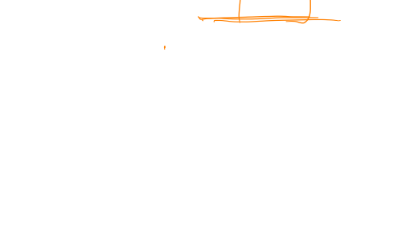
Greedy algorithm
50
25
10
5
1
ALGORITHM:
While balance > 0:
add the coin of largest value <= balance
Is this correct? Is this always correct?

Slide 13
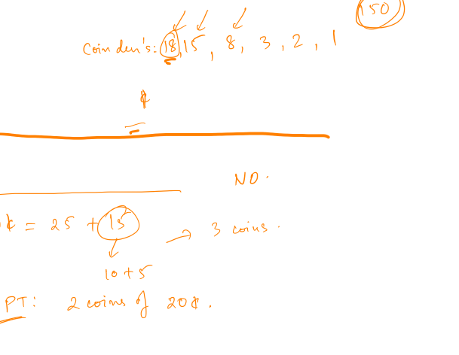
New coin
50
25
20
10
5
1
Is the greedy algorithm correct?

Slide 14
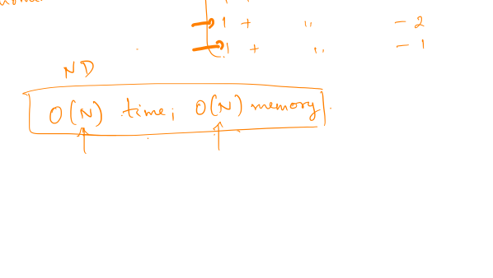
Dynamic programming

Slide 15

What about greedy?
Greedy mantra: pick best option at “present” state
Almost never works
Often provides insight + suggests other methods
Sometimes “almost works” (+ easy to implement!)

Slide 16
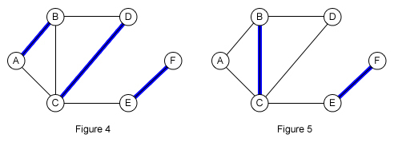
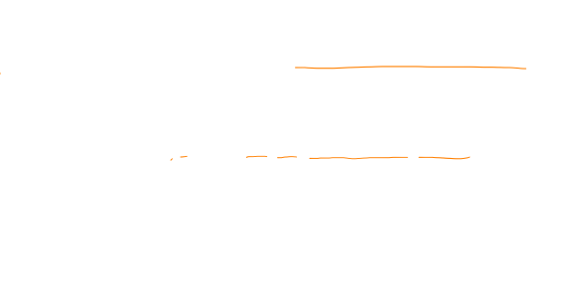
Creating project pairs
Each person gives out list of “acceptable” partners (assume symmetry)
Goal: form as many pairs as possible

Slide 17

Greedy/lazy instructor
While there exists an acceptable pair, form it, remove those two nodes, recurse
Question: is this algorithm optimal?

Slide 18

Greedy is suboptimal

Slide 19
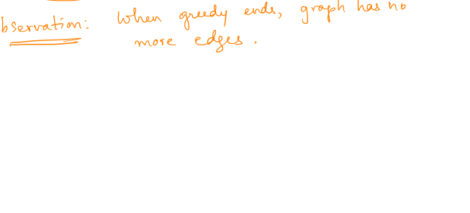
Greedy is OK
Theorem: the greedy algorithm produces at least (1/2) the max possible number of pairs.

Slide 20
Two claims
Claim 1: #(matched vertices) in greedy >= #(matching pairs) in OPT solution
Claim 2: #(matching pairs) in greedy >= (1/2) #(matching vertices) in greedy

Slide 21
Greedy review
Greedy mantra: pick best option at “present” state
Almost never works
Often provides insight + suggests other methods
Sometimes “almost works” (+ easy to implement!)

Slide 22
Next class
More greedy
Local search

