Slide 1
CS 6150 : Lecture 6 Greedy Algorithms

Slide 2
Last class
Longest increasing subsequence (Dyn. programming)
Coin change – DP vs Greedy (space vs. accuracy)
Reading exercise: “Knapsack” problem
Greedy algorithms – creating project pairs (“matching”)

Slide 3
Greedy recap
Greedy mantra: pick best option at “present” state
Almost never works
Often provides insight + suggests other methods
Sometimes “almost works” (+ easy to implement!)

Slide 4
Greedy pairing
While there exists an acceptable pair, form it, remove those two nodes, recurse
Theorem: if the optimum number of pairs is k, this algorithm produces at least k/2 pairs.

Slide 5
Reasoning about Greedy

Slide 6
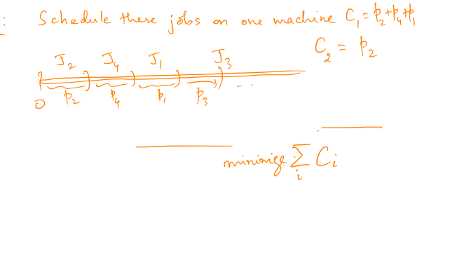
Scheduling jobs
Objective: find the schedule that minimizes the sum of the completion times.

Slide 7
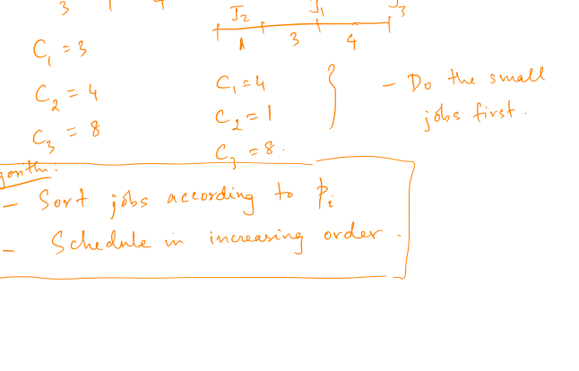
Algorithm

Slide 8
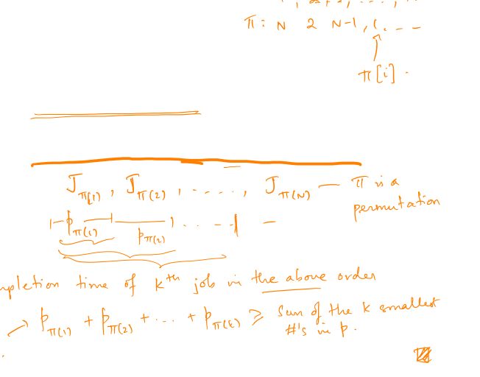
Why optimal?
Consider any feasible schedule.
Claim: sum of completion times >= that of Greedy

Slide 9
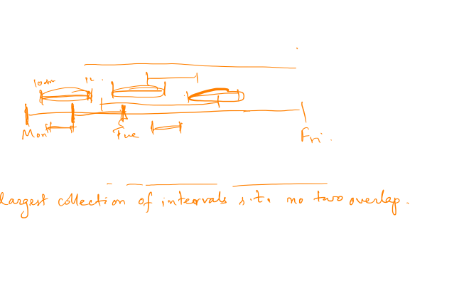
Maximizing credits/semester!
CS 6150, CS 6280, CS 6297, …
Constraint: cannot take two courses whose timings overlap! (assume every course meets once)
Objective: maximize # of distinct courses taken.

Slide 10
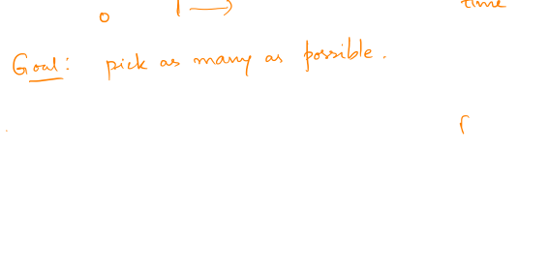
Visualizing

Slide 11
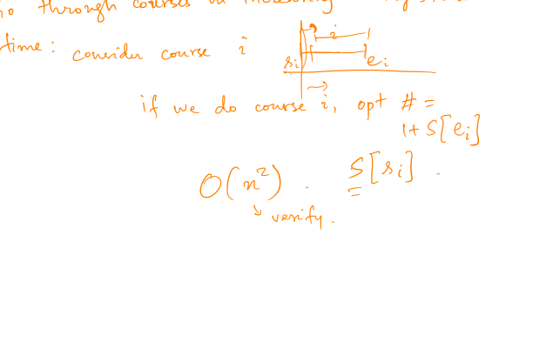
A DP algorithm

Slide 12
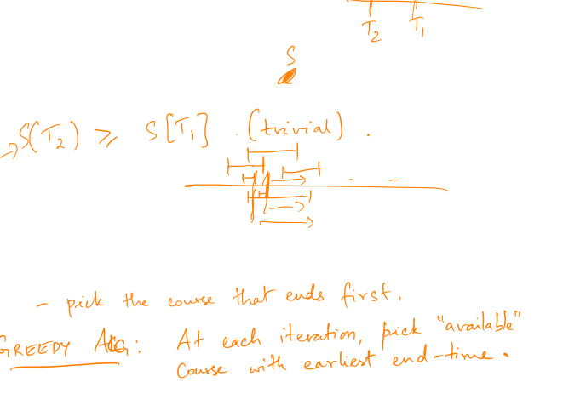
Observation
What can be said about NC(T) values?
What is a “safe” way to pick the first course? (and still be as good as optimum)

Slide 13
Picking the next course

Slide 14
Greedy algorithm

Slide 15
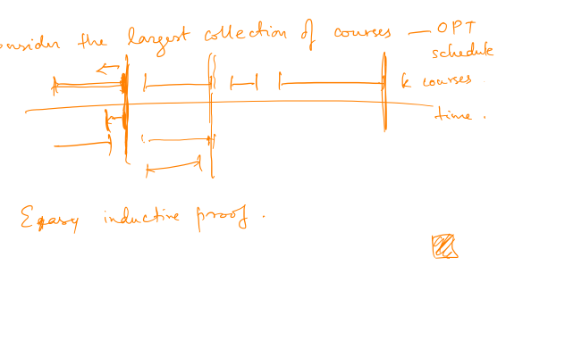
Correctness proof
Inductive claim: the j’th course in the OPT schedule has end time >= j’th course in Greedy schedule.

Slide 16

Local Search
Idea: start with some solution, try to improve

Slide 17


Optimizing a fn over a grid
Find: (x, y) that minimize f(x, y) = x² + y² + 2x + 4xy

Slide 18

Optimizing a fn over a grid
Find: (x, y) that minimize f(x, y) = x² + y² + 2x + 4xy

Slide 19
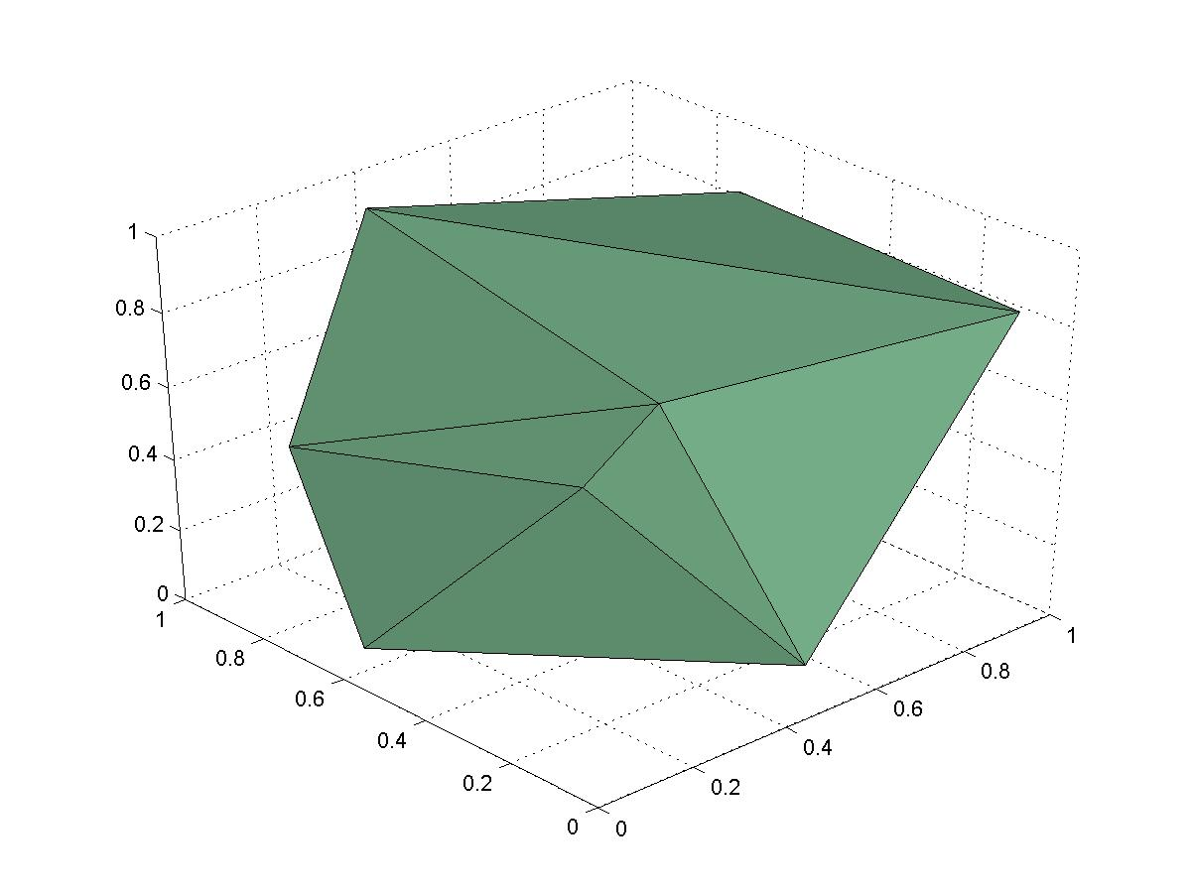
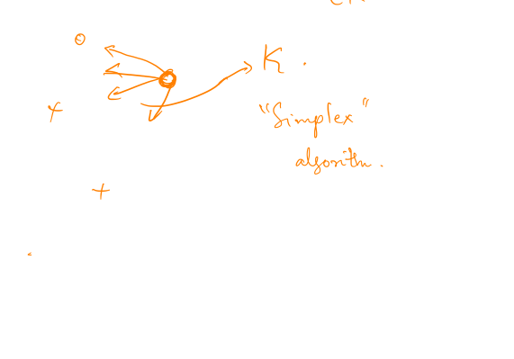
Optimizing a fn over a polytope
“Simplex” algorithm : maximize linear fn over P

Slide 20

Local search – overview
Works “reasonably” for many problems – clustering, optimization, partitioning, …
Used frequently in practice
Non-trivial to prove guarantees (except in simple cases)

Slide 21
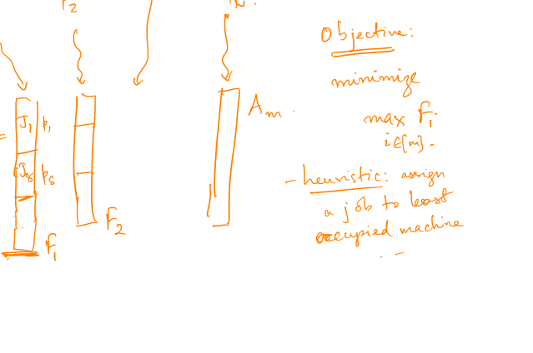
Scheduling jobs – m machines

Slide 22
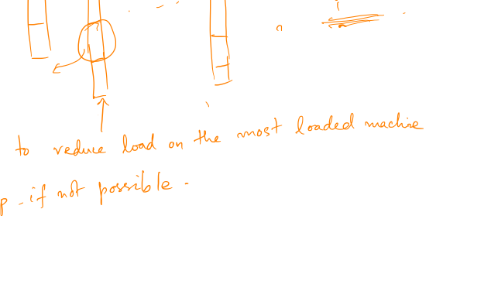

Local search algorithm
Theorem: the final schedule is at most twice as long as the optimal schedule!

Slide 23
