Slide 1

CS 6150 : Lecture 7 Review, NP Completeness

Slide 2
Announcements
Homework 1 due on Thursday!
Mailing list for TAs + instructor:
cs6150-tas@list.eng.utah.edu

Slide 3
Last few weeks -- recap

Slide 4

Paradigms
Divide & Conquer
analyzing running times – recursion
median in O(n) time
proofs by induction
Dynamic programming
recursion++
many examples – longest Inc Seq, Fibonacci, ..

Slide 5

Paradigms
Greedy algorithms
build solution, do best at each step
coin change, matching, taking classes, …
way to analyze: look at what algorithm does, compare with optimum
Local search
start with some solution, keep improving…
optimizing fn over grid, scheduling on diff machines

Slide 6

What next?

Slide 7
But first…

Slide 8

Are there limits?
How quickly can we sort N numbers?
Are there natural problems we cannot solve quickly?

Slide 9
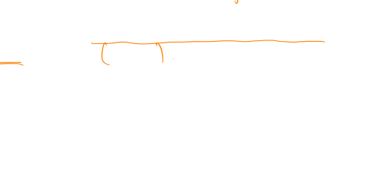
Sorting
Merge sort
Can we do O(N)?
Theorem. Any algorithm for sorting that only works by “comparisons” must take n log n steps in the worst case

Slide 10

Sorting by comparisons
Comparisons: is A[i] <= A[j]?
Theorem. Any algorithm for sorting that only works by “comparisons” must take n log n steps in the worst case

Slide 11

Sorting without comparing?
Say you have N numbers between [1, 100N]

Slide 12

Sorting by comparisons
Theorem. Any algorithm for sorting that only works by “comparisons” must take n log n steps in the worst case
How can any such algorithm look?
Compare elements, do some manipulations, …

Slide 13
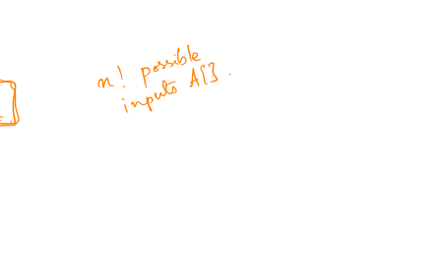
Sorting by comparisons
Theorem. Any algorithm for sorting that only works by “comparisons” must take n log n steps in the worst case
Main idea.
fix some numbers b₁ < b₂ < … < b_{N}
Input: array A[] is a re-ordering of b’s
Key: what happens if we consider a different order?

Slide 14
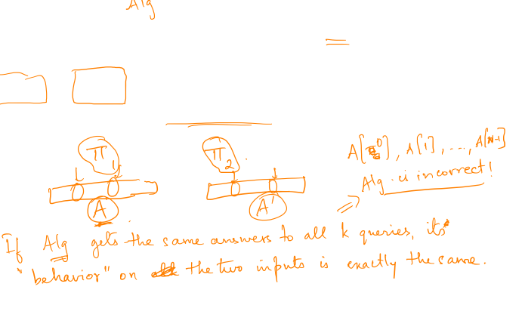
Sorting by comparisons
Consider an algorithm that performs ‘k’ comparisons.
Claim. if 2^{k} < n!, then there exist two different permutations with “same answers” to all comparisons!

Slide 15
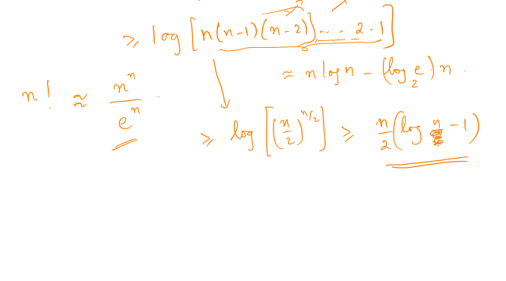
Number of comparisons needed
2^{k} >= n!

Slide 16
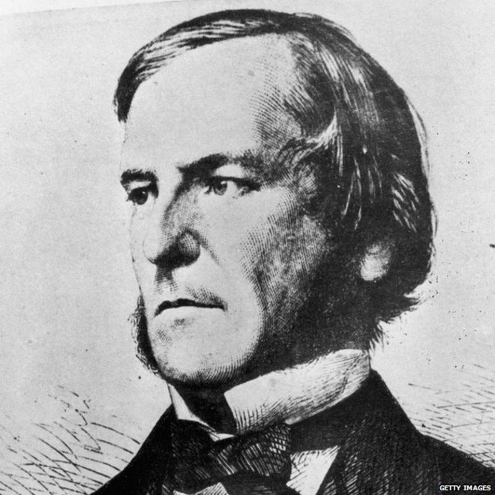
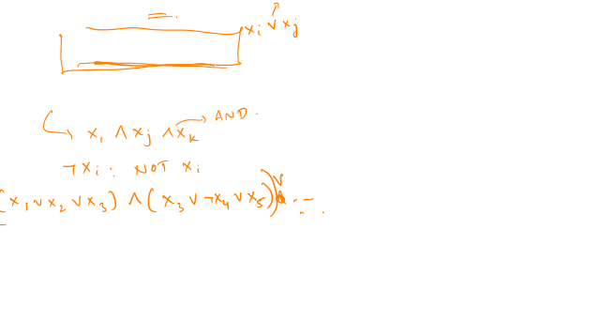
Boolean satisfiability
variables x_{i} in {T, F}
OR, AND, NOT
Boolean “formula”
Definition. a formula is “satisfiable” if there exist x₁, x₂, …, x_{n} that make it TRUE

Slide 17
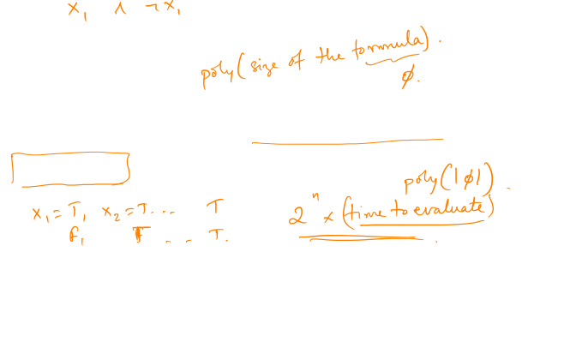
Boolean satisfiability
Satisfiability problem. given a formula in n variables, x₁, x₂, …, x_{n} determine if it is satisfiable.

Slide 18
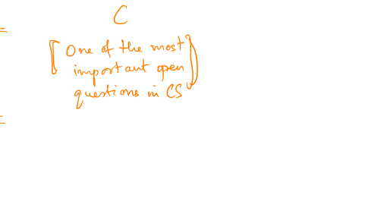
Fundamental qn of CS
Does there exist an algorithm for SAT that runs in time poly(n)?
(a.k.a. P vs NP question)
Why so significant?
(Can exhaustive search be avoided?)

Slide 19
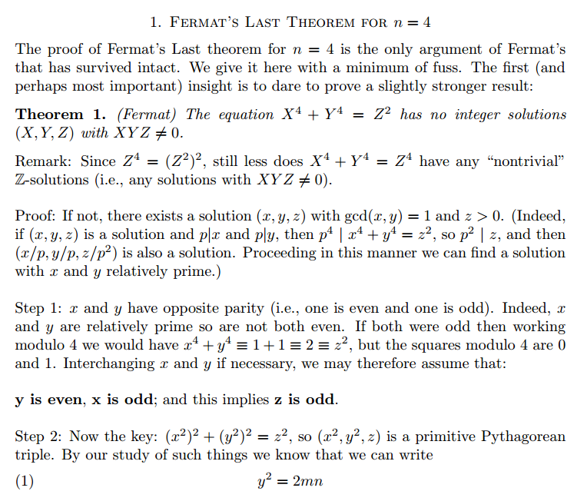

Philosophy – solving vs verifying
Prove that x⁴ + y⁴ = z⁴ has no integer solutions

Slide 20
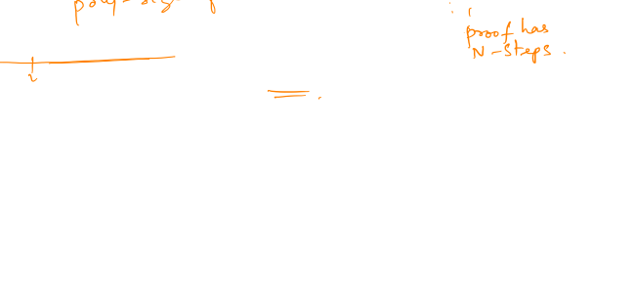
What is verifying?
Check if step2 follows from step1, axioms
Check if step3 follows from step1, step2, axioms
…
[Cook-Levin theorem] any “verification” problem reduces to SAT

Slide 21
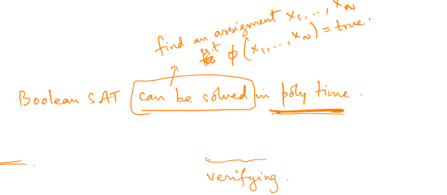
P vs NP
Can “solving time” be polynomial in “checking time”?
Can the “creative process” be automated?

Slide 22
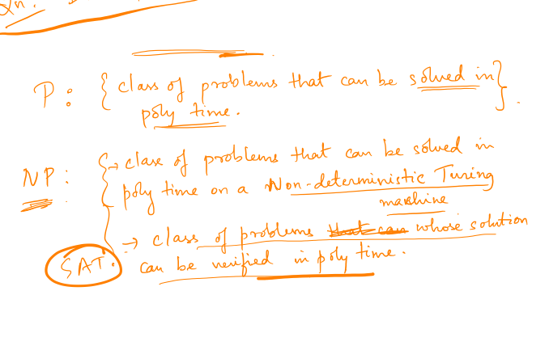
What are P and NP
“Classes”/set of problems

Slide 23

So what if SAT is not in P?
Many other problems are not in P either..
“Reductions”: if SAT cannot be solved efficiently, neither can problem X

Slide 24
