Slide 1
CS 6150 : Lecture 8 NP Completeness

Slide 2

Last class
Lower bounds/limits of efficient algorithms (e.g., sorting via comparisons)
Definitions of P, NP (informal)
Boolean satisfiability problem (given formula in n T/F variables, is there an assignment?)
P vs NP ⬄ is there a poly time alg for SAT?
“Reductions” between problems

Slide 3
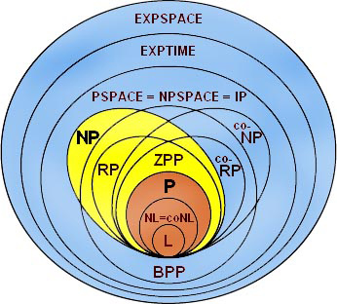

P, NP recap
P : set of all problems that can be solved efficiently (poly time)
NP : set of all problems for which solution can be “verified” easily (more powerful – puzzles, math theorems, …)

Slide 4

Decision problems
Answer is YES/NO
E.g. is formula satisfiable? does graph have an independent set of size k?
Nice abstraction. allows thinking of problem Q as simply the “set of YES instances”

Slide 5
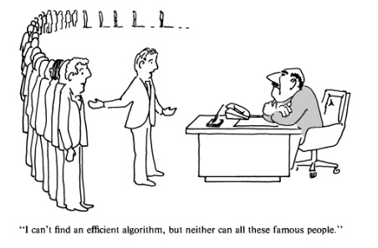
Reductions
Goal. Say that one problem is “as hard as” another

Slide 6
Reductions
Helps order problems by “difficulty”
Equivalence classes among problems (surprising!)

Slide 7
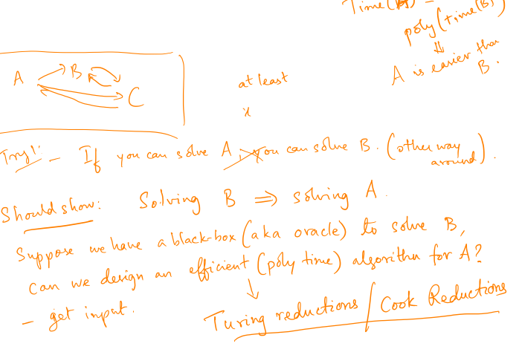
Reductions – first try
Want to say: Problem B is “as difficult” as problem A

Slide 8
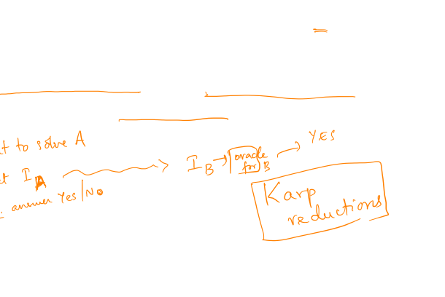
Stronger reductions
“Instance transformations”: Every instance I_{A} of problem A can be transformed to instance I_{B} of B s.t.
I_{A} is a YES instance for A ⬄ I_{B} is a YES instance for B
and |I_{B}| = poly(|I_{A}|)

Slide 9
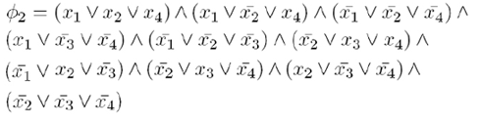
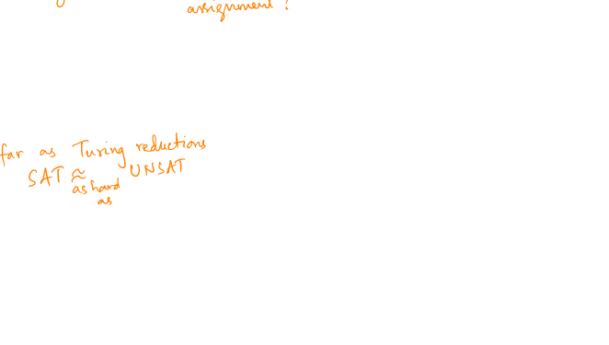
Cook/Turing vs. Karp reductions
SAT.
UNSAT.

Slide 10
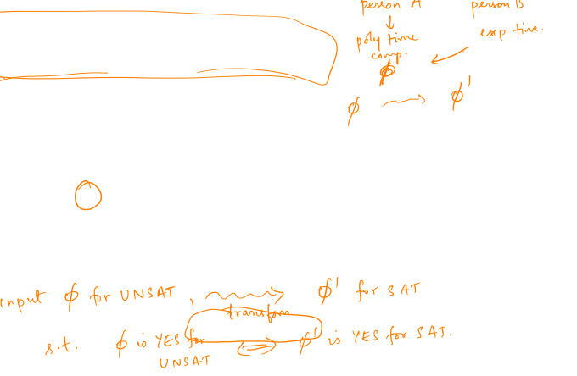
NP vs Co-NP question
Is there a (Karp) reduction from UNSAT to SAT?
“Resolution”

Slide 11
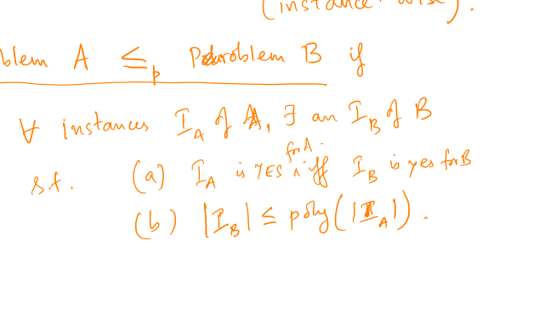
Polynomial time reductions

Slide 12
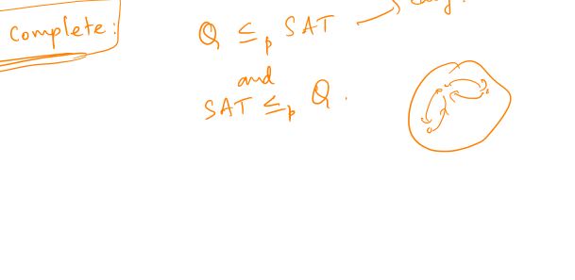
NP-hard and NP-complete

Slide 13
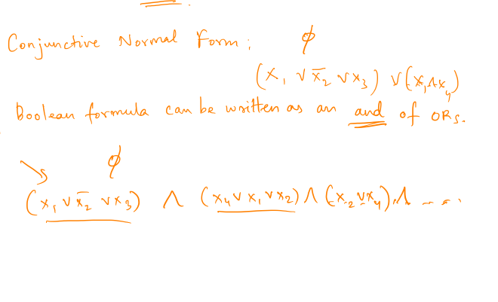
Cook/Levin theorem
Theorem. Boolean (CNF) Satisfiability is NP-complete.

Slide 14
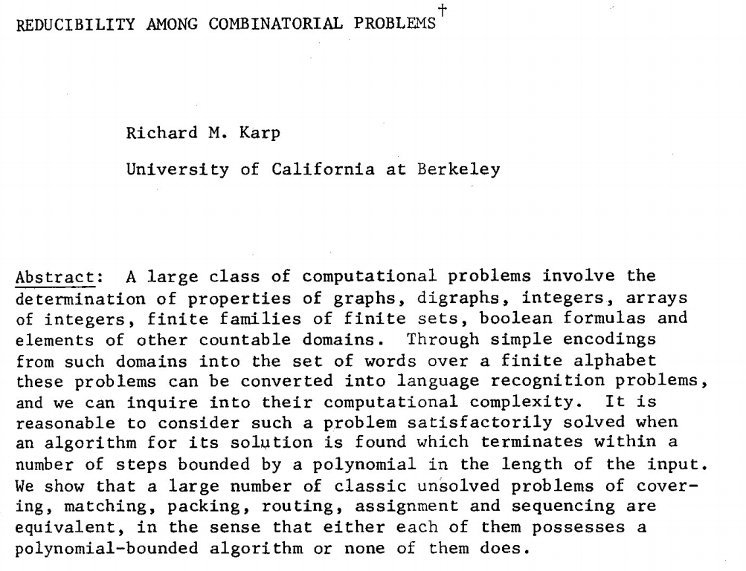

Reductions

Slide 15
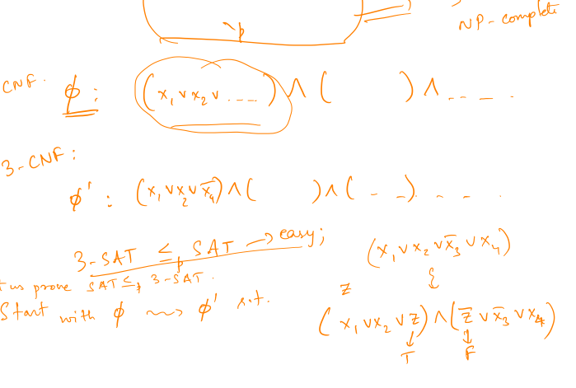
Simple: SAT < 3-SAT

Slide 16
Simple: SAT < 3-SAT

Slide 17
3-SAT < Independent Set

Slide 18
3-SAT < Independent Set

Slide 19
Vertex Cover < Subset sum

Slide 20
Vertex Cover < Subset sum

Slide 21
Subset sum < Parallel scheduling

Slide 22
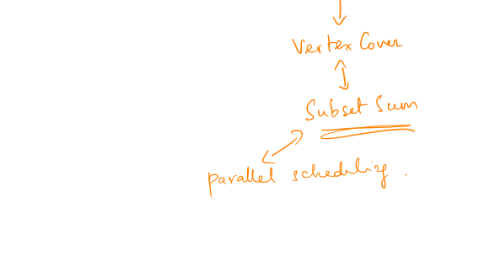
Chains of reductions!

