Slide 1
CS 6150 : Lecture 9 Fun with reductions

Slide 2

Last week
Lower bounds/limits of efficient algorithms (e.g., sorting via comparisons)
Definitions of P, NP (informal), co-NP
Boolean satisfiability problem, “CNF”
“Reductions” between problems

Slide 3

P, NP recap
P : set of all problems that can be solved efficiently (poly time)
NP : set of all problems for which solution can be “verified” easily (more powerful – puzzles, math theorems, …)

Slide 4

Decision problems
Answer is YES/NO
E.g. is formula satisfiable? does graph have an independent set of size k?
Nice abstraction. allows thinking of problem Q as simply the “set of YES instances”

Slide 5

Reductions
Goal. Say that one problem is “easier than” another
problem-A ≤_{p} problem-B
Implication. for any instance I of A,
time_{A}(|I|) <= poly(|I|) * time_{B}(poly(|I|))

Slide 6

Cook/Turing vs. Karp reductions
Cook/Turing: “Oracles”
Karp: for every instance I_{A}, produce instance I_{B} (poly |I_{A}|), s.t. I_{A} is YES instance iff I_{B} is.
SAT. to/from UNSAT.
Hard to provide “witness” of unsatisfiability

Slide 7
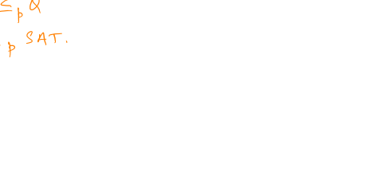
NP hard and NP complete
NP hard:
NP complete:

Slide 8
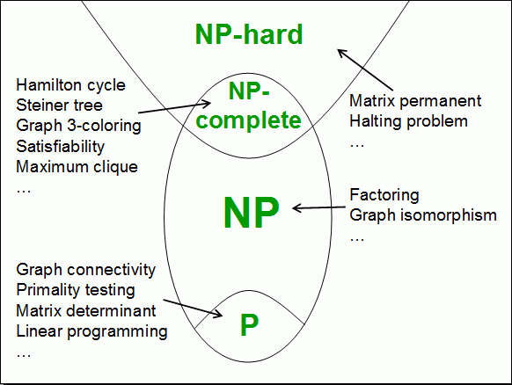


Slide 9
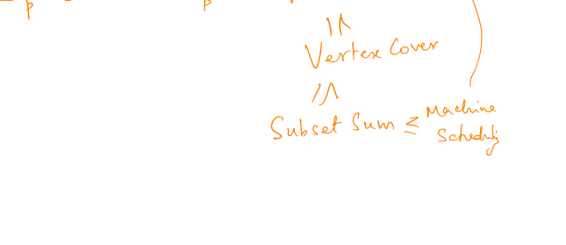
Chain of reductions!
All problems in “equivalence class” (NP complete)

Slide 10
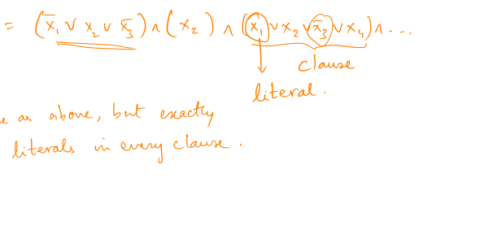
Reduction: SAT ≤_{p} 3-SAT
CNF formula : (Conjunctive Normal Form – AND of ORs)
3-CNF formula : (AND of 3 ORs)

Slide 11
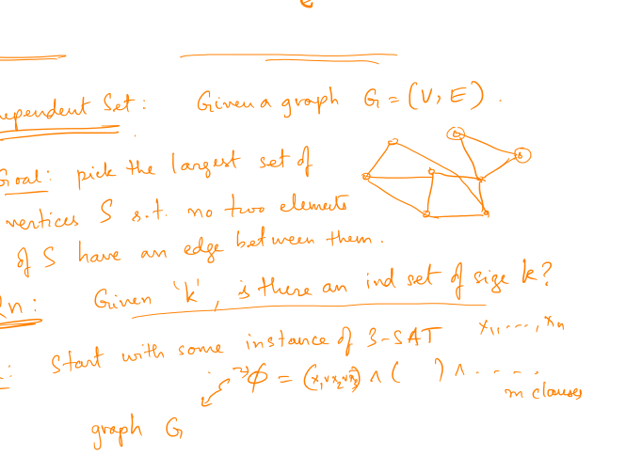
3-SAT ≤_{p} Independent Set

Slide 12
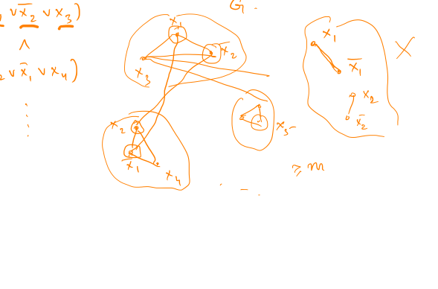
3-SAT ≤_{p} Independent Set

Slide 13
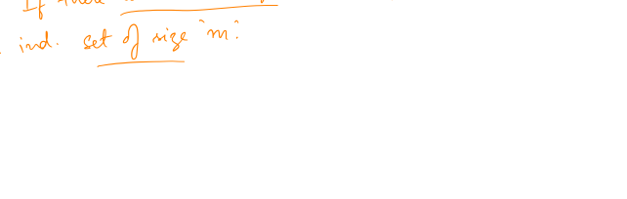
3-SAT ≤_{p} Independent Set

Slide 14
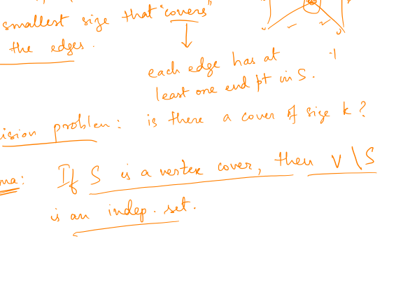
Vertex Cover

Slide 15
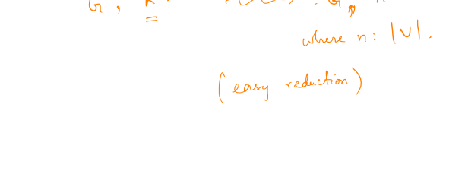
Vertex Cover

Slide 16
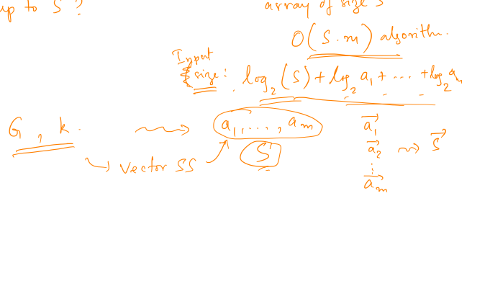
Vertex Cover ≤_{p} Subset sum

Slide 17
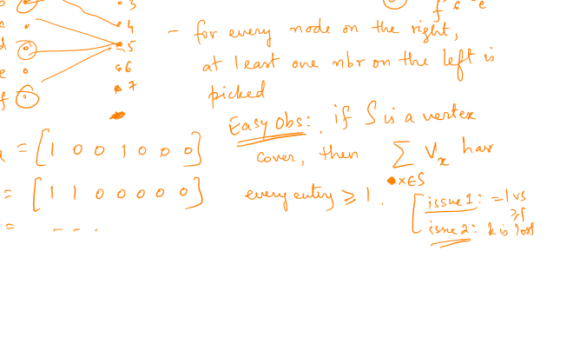
Vertex Cover ≤_{p} Subset sum

Slide 18
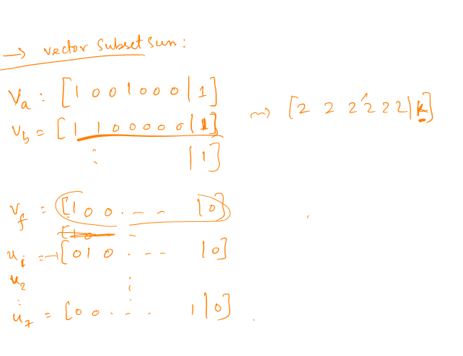
Vertex Cover ≤_{p} Subset sum

Slide 19
Subset sum ≤_{p} Parallel scheduling

Slide 20
Subset sum ≤_{p} Parallel scheduling

Slide 21
“Coping” with NP hardness
Hard => hopeless?
Approximation algorithms (decision -> optimization)

Slide 22
Can we always approximate well?
Can approximate well => P=NP
“Gap problems”: given G, tell between
max-independent-set has size > n^{(1/2)}
max-independent-set has size < n^{(1/3)}

