Slide 1


Constrained Interpolation for Guided Logic Synthesis
Ana Petkovska
LAP, I&C, EPFL
joint work with David Novo, Alan Mishchenko and Paolo Ienne
November 04, 2014
San Jose, CA

Slide 2
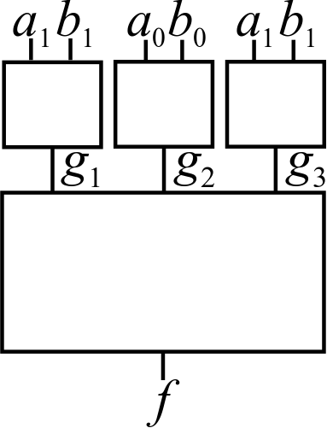
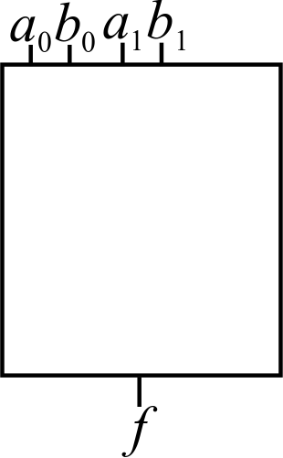
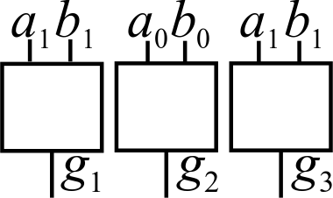
Craig Interpolation for Generating a Dependency Function
base
functions
dependency
function
(interpolant)
target
function

Slide 3
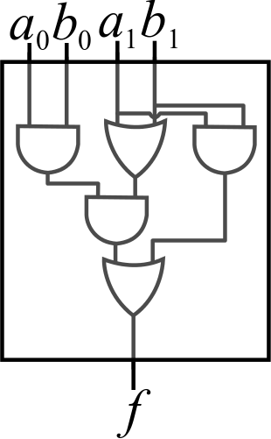
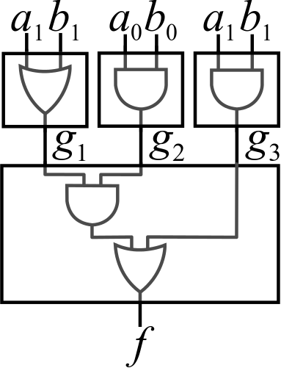
Craig Interpolation for Generating a Dependency Function
base
functions
dependency
function
(interpolant)
target
function

Slide 4
Craig Interpolation
First proposed by W. Craig for first-order logic
Exploited by the model-checking community
McMillan’s system for building interpolants
But, also by the EDA community
Functional decomposition [Lin’08, Lee’08]
Functional dependency [Backes’09, Jiang’10]
Engineering Change Order (ECO) [Wu’10, Tang’11]
Notes:
Backes – synthesis of cyclic dependencies
Jiang – exploration of functional dependency
Lin – Ashenhurst decomposition
Lee – Bi-decomposition

Slide 5
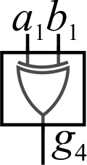
Craig Interpolation for Generating a Dependency Function
base
functions
dependency
function
(interpolant)
target
function
Notes:
The interpolation is not an optimisation problem and thus, often, it omits base functions potentially required for an optimal implementation of the target function.

Slide 6
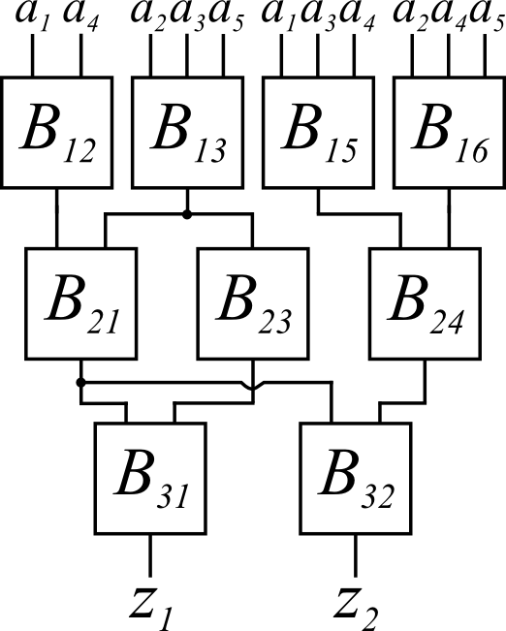
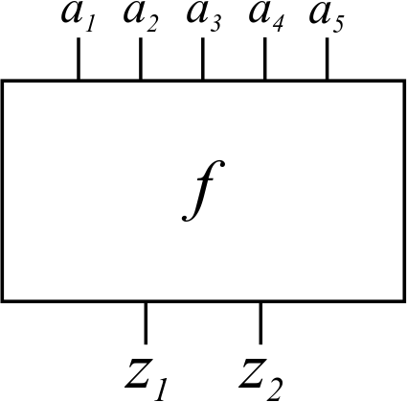
Why is this important?
For logic synthesis heuristics based on global restructuring [Verma’07, Verma’09]
Require the target function to be recomposed with some specific or all base functions from a set

Slide 7
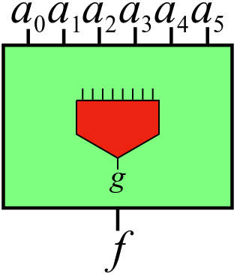
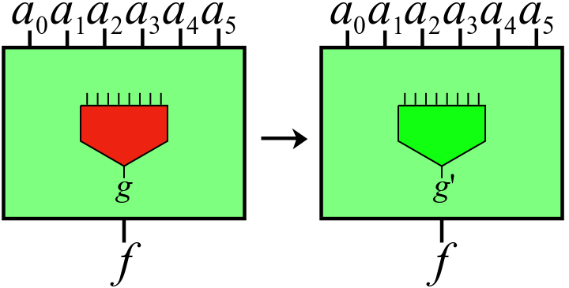
Why is this important?
For synthesis-based Engineering Change Order (ECO) algorithms [Wu’10, Tang’11]
Should maximise the reuse of logic from the old implementation for building the patch

Slide 8
Outline
The Standard Interpolation Method (background)
The Carving Interpolation Method (our work)
Imposing a Single Base Function
Imposing a Set of Base Functions
Conclusions

Slide 9
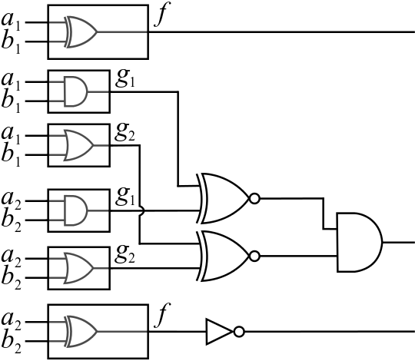
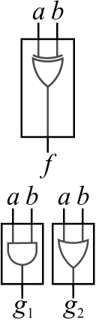

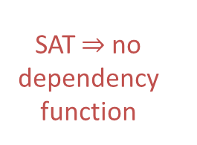

The Standard Interpolation Method
Construct a Dependency Logic Network (DLN)
UNSAT a dependency function exists
1
the copies of $f$ evaluate
to different values
same values
SAT no dependency function
1
same values
1
J.-H. R. Jiang, C.-C. Lee, A. Mishchenko, and C.-Y. R. Huang, “To SAT or not to SAT: Scalable exploration
of functional dependency,” IEEE Transactions on Computers, 2010.

Slide 10
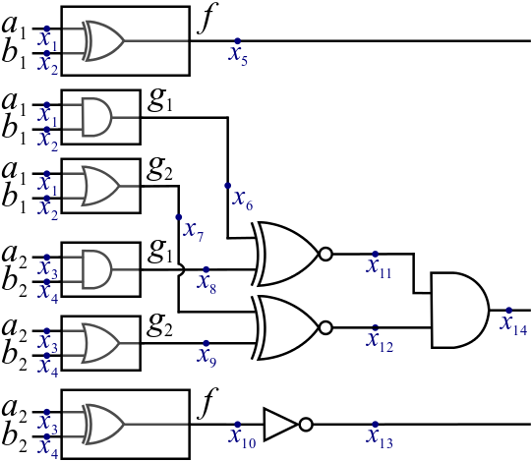
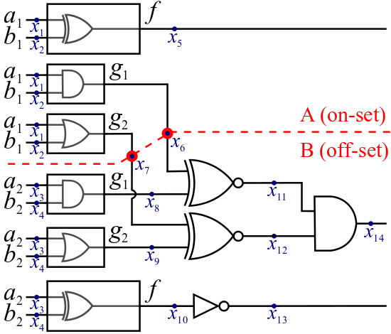
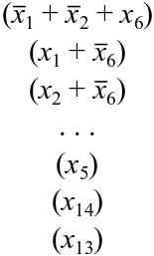
The Standard Interpolation Method
Introduce a variable for each signal
Convert the DLN to CNF clauses
J.-H. R. Jiang, C.-C. Lee, A. Mishchenko, and C.-Y. R. Huang, “To SAT or not to SAT: Scalable exploration
of functional dependency,” IEEE Transactions on Computers, 2010.

Slide 11
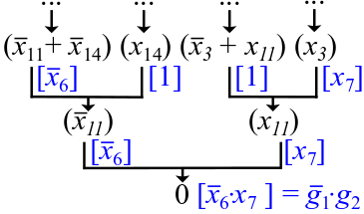
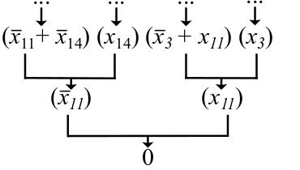
The Standard Interpolation Method
Give the CNF clauses to a SAT solver
Receive a refutation proof
Generate the interpolant (the dependency function) using McMillan’s interpolation system
J.-H. R. Jiang, C.-C. Lee, A. Mishchenko, and C.-Y. R. Huang, “To SAT or not to SAT: Scalable exploration
of functional dependency,” IEEE Transactions on Computers, 2010.

Slide 12
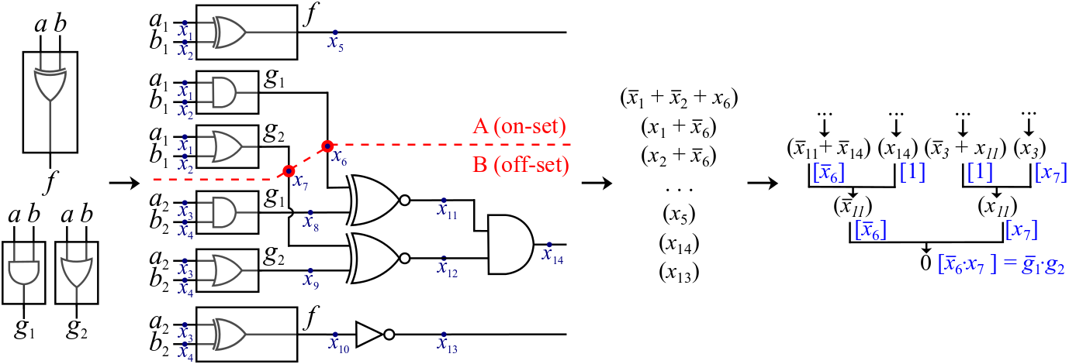


The Standard Interpolation Method
DLN
$$C(x_{1}, …, x_{13})$$
$$I={\overline{g}}_{1}⋅g_{2}$$

Slide 13
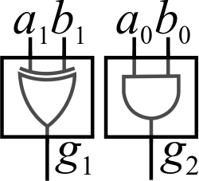
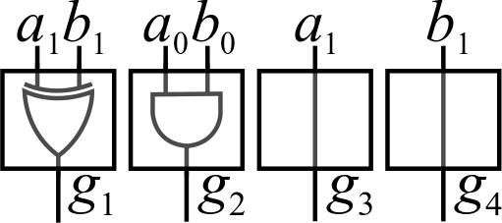

Motivating Example
$$s_{1}=a_{1}⊕b_{1}⊕(a_{0}⋅b_{0})$$
implemented using:
Reconstruct: $c_{1}=\left(a_{1}⋅b_{1}\right)+(a_{0}⋅b_{0}⋅\left(a_{1}+b_{1}\right))$

Slide 14


Motivating Example
$$c_{1}=\left(a_{1}⋅b_{1}\right)+(a_{0}⋅b_{0}⋅\left(a_{1}+b_{1}\right))$$
auxiliary
essential
$$h_{1}=\left(g_{3}⋅g_{4}\right)+(g_{2}⋅(g_{3}+g_{4}))$$
$$h_{2}=\left(g_{3}⋅g_{4}\right)+(g_{2}⋅(g_{3}⊕g_{4}))$$
$$h_{3}=\left(g_{3}⋅g_{4}\right)+(g_{2}⋅g_{1})$$
area-optimal solution
Notes:
Unfortunately, since the interpolation is not an optimization technique and depends on the proof that it receives, the standard interpolation method might return arbitrarily any of the three dependency functions, while we are interested in h3.

Slide 15
Outline
The Standard Interpolation Method (background)
The Carving Interpolation Method (our work)
Imposing a Single Base Function
Imposing a Set of Base Functions
Conclusions

Slide 16

Imposing a Single Base Function
DLN
$$C(x_{1}, …, x_{13})$$
Notes:
Assume that we want to impose the base function g1 (with the variable x6).

Slide 17
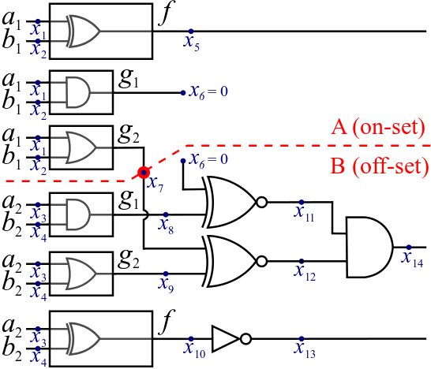
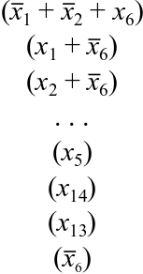





Imposing a Base Function
$$C(x_{1}, …, x_{13})$$
$$C_{{\overline{x}}_{6}}\left(x_{1}, …,0, …, x_{13}\right)≡$$
$$C_{x_{6}}(x_{1}, …,1, …, x_{13})≡$$
Notes:
C is UNSAT. Thus, both Cxi’ and Cxi, in which we assumed that xi evaluates to 0 and 1, respectively, are also UNSAT for any assignment of X.

Slide 18






Imposing Out a Base Function
$$C(x_{1}, …, x_{n})$$
Interpolation
$$C_{{\overline{x}}_{i}}(x_{1}, …,0, …, x_{n})$$
$$I_{{\overline{x}}_{i}}$$
Shannon
Expansion
$${I={\overline{x}}_{i}⋅I}_{{\overline{x}}_{i}}+x_{i}⋅I_{x_{i}}$$
Interpolation
$$C_{x_{i}}(x_{1}, …,1, …, x_{n})$$
$$I_{x_{i}}$$
Notes:
These two interpolants represent the cofactors of a feasible interpolant I for the set of clauses C with respect to xi, so that is why we can connect them to form the interpolant I in which the variable xi is imposed.

Slide 19
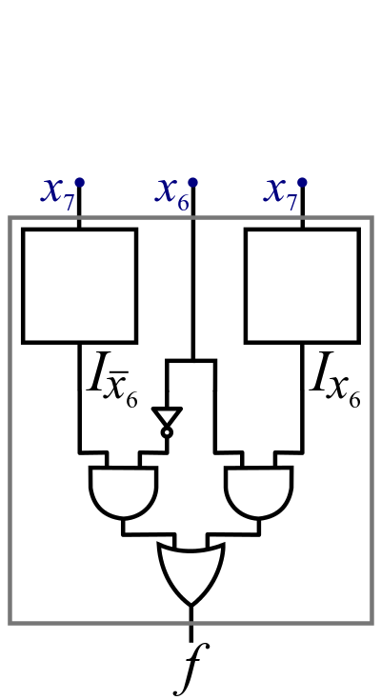
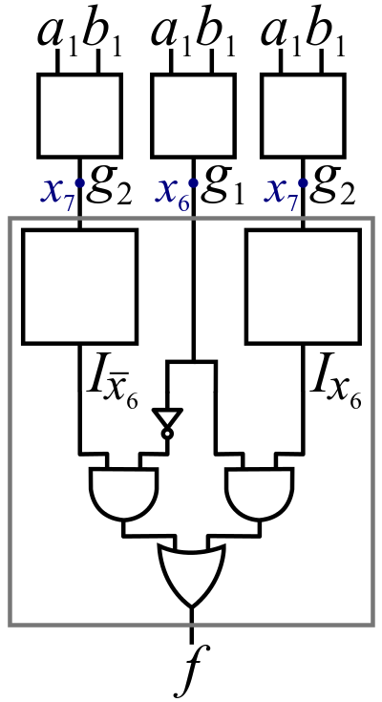


Imposing Out a Base Function
$${I={\overline{x}}_{6}⋅I}_{{\overline{x}}_{6}}+x_{6}⋅I_{x_{6}}$$
$$I$$

Slide 20
Experimental Setup
Implemented into ABC
Uses the integrated version of MiniSat which provides UNSAT proofs
Benchmarks
Arithmetic circuits
The large combinatorial MCNC benchmarks

Slide 21
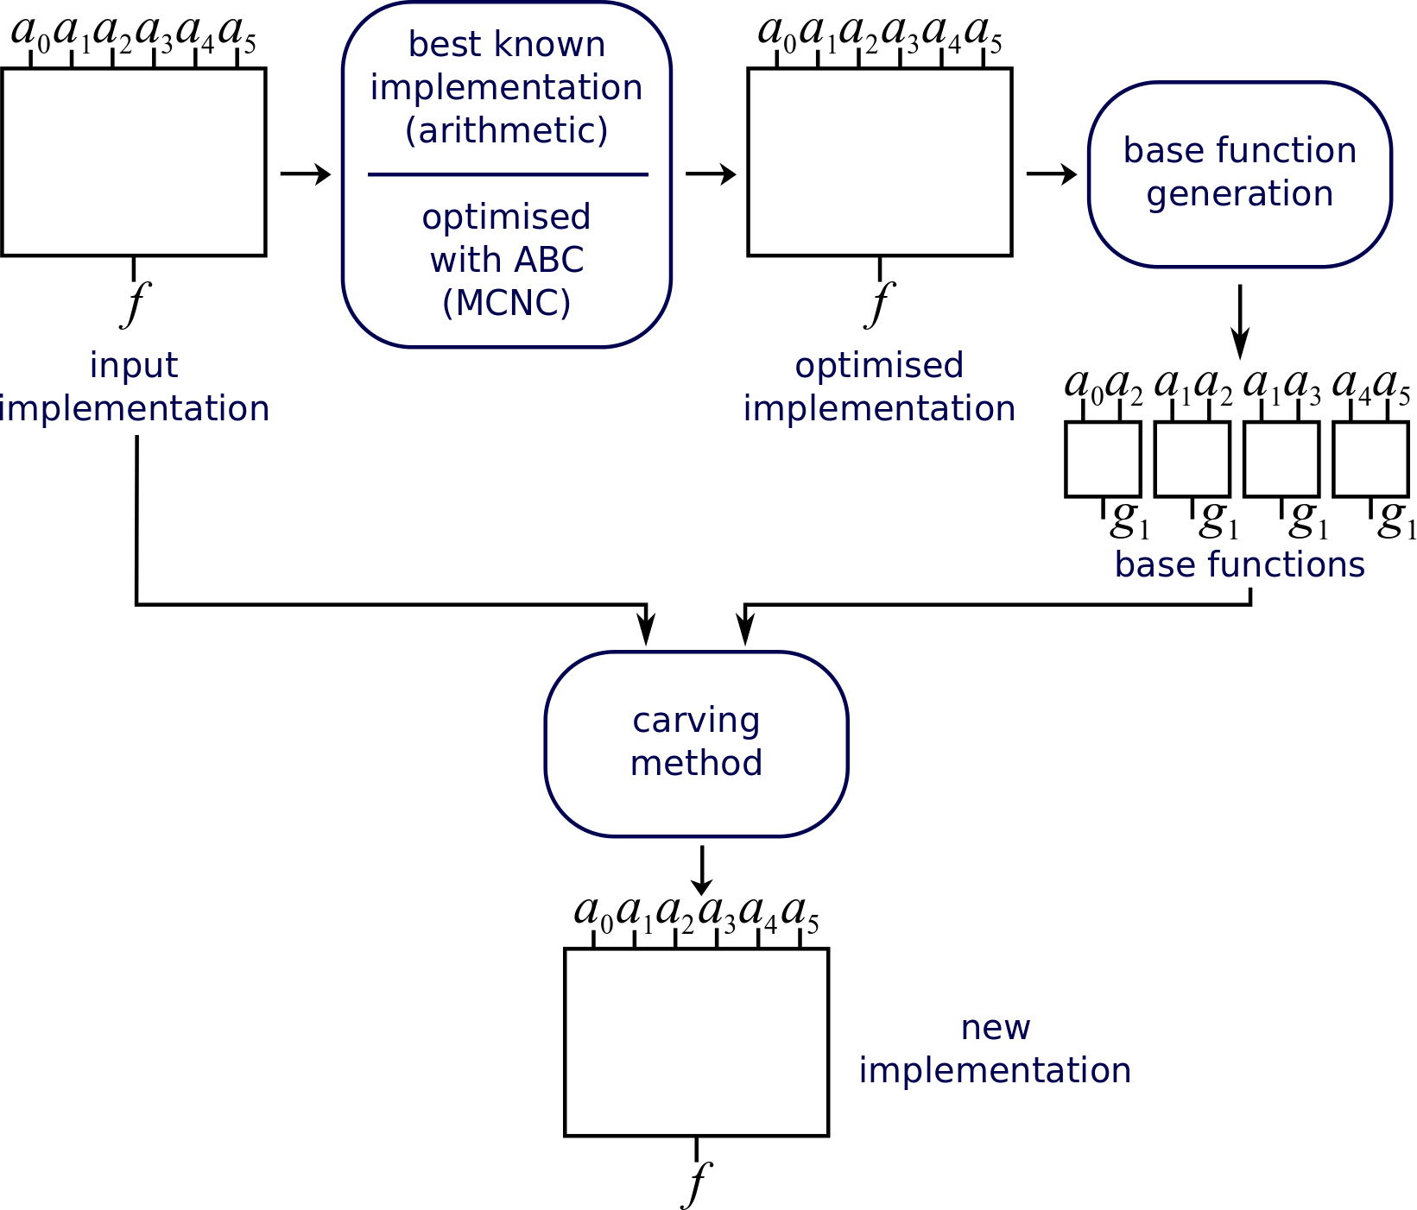
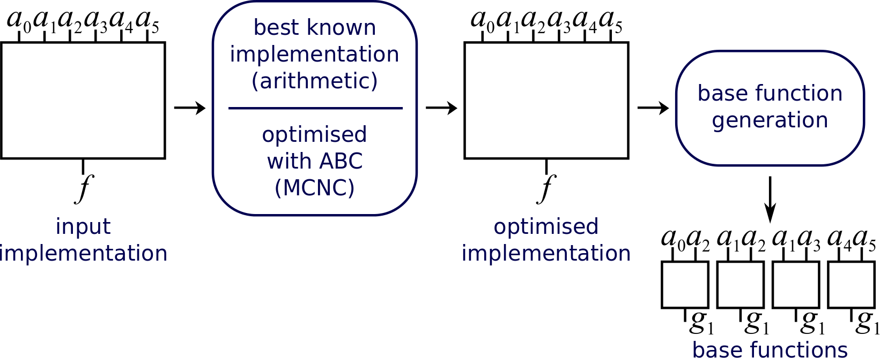
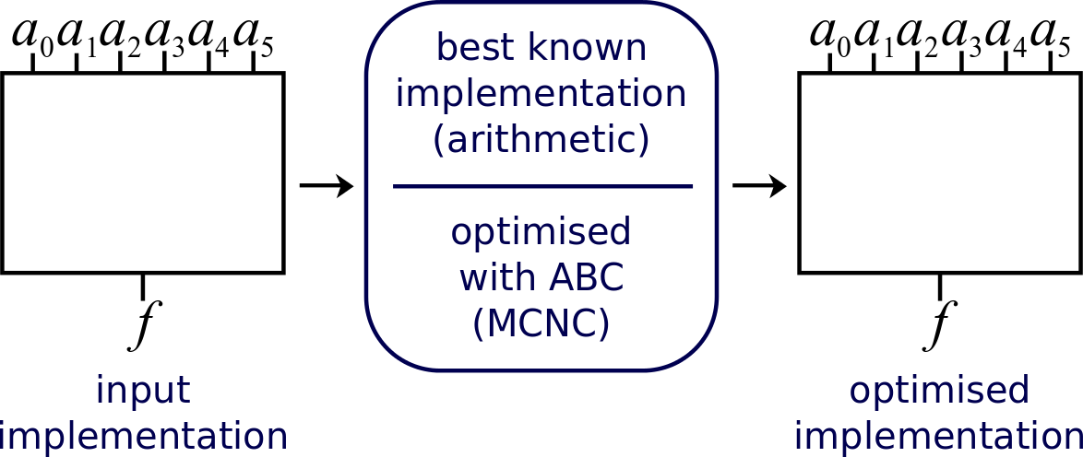
Experimental Setup
Notes:
Since the carving technique is general and not tied to any purpose or logic synthesis heuristic, we provide as input both an input and an optimised implementation of the circuit.
The optimised implementation, serves as a reference goal which we want to achieve using the carving method. Thus, we use it to compute the set of base functions for reconstructing the circuit.

Slide 22
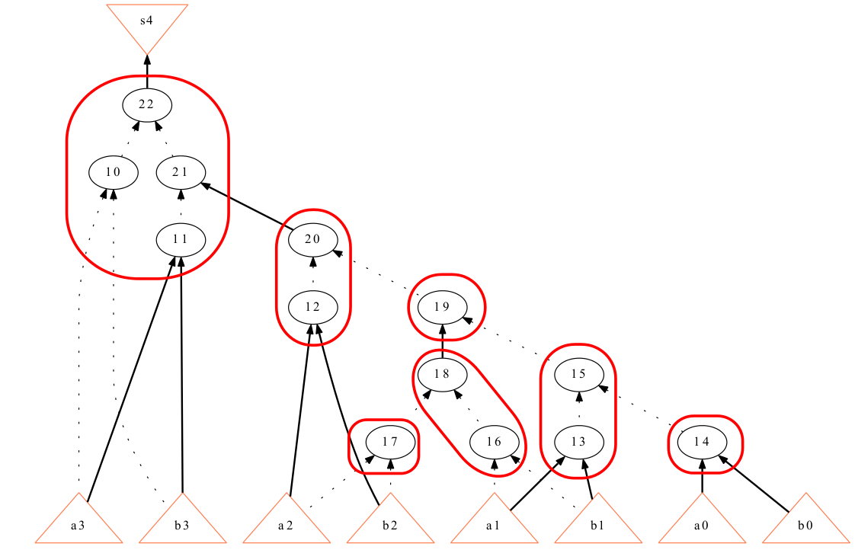
Experimental Setup (Base Function Generation)
Generate the base functions as non-overlapping k-input cuts of the optimised implementation

Slide 23
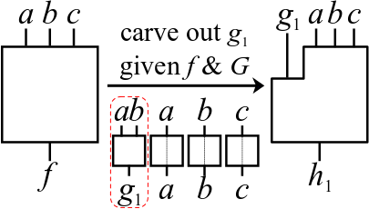
Experimental Setup (Imposing a Single Base Function)

Slide 24
Imposing a Single Base Function (Failure Rate)
Percentage of disconnected
imposed base functions
 | Standard Method | Carving Method
Arithmetic Circuits | 55.71% | 0.00%
Large MCNC (area-optimised) | 59.12% | 0.15%
Large MCNC (delay-optimised) | 56.40% | 0.15%

Slide 25
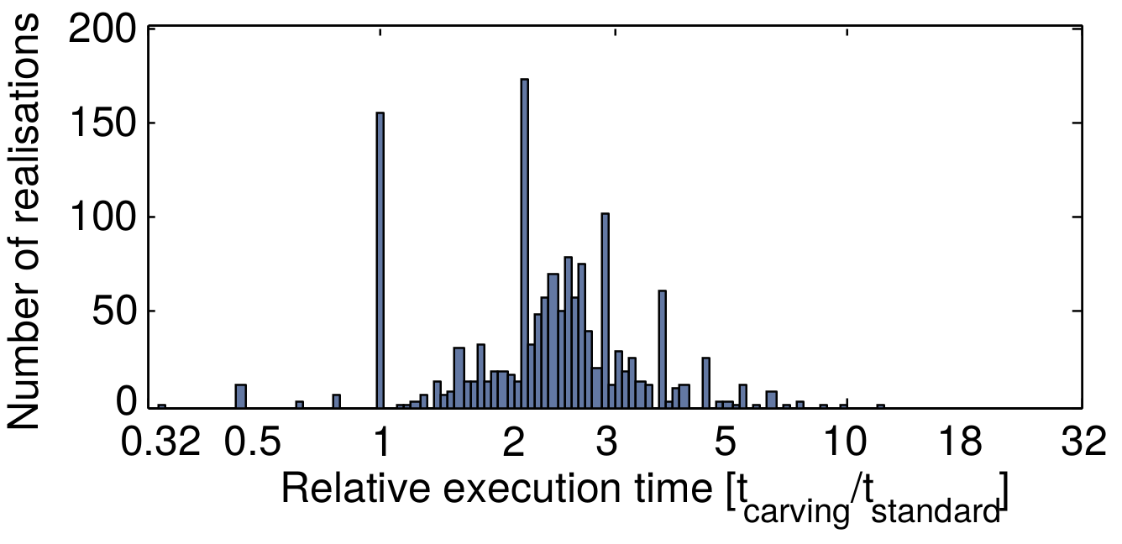
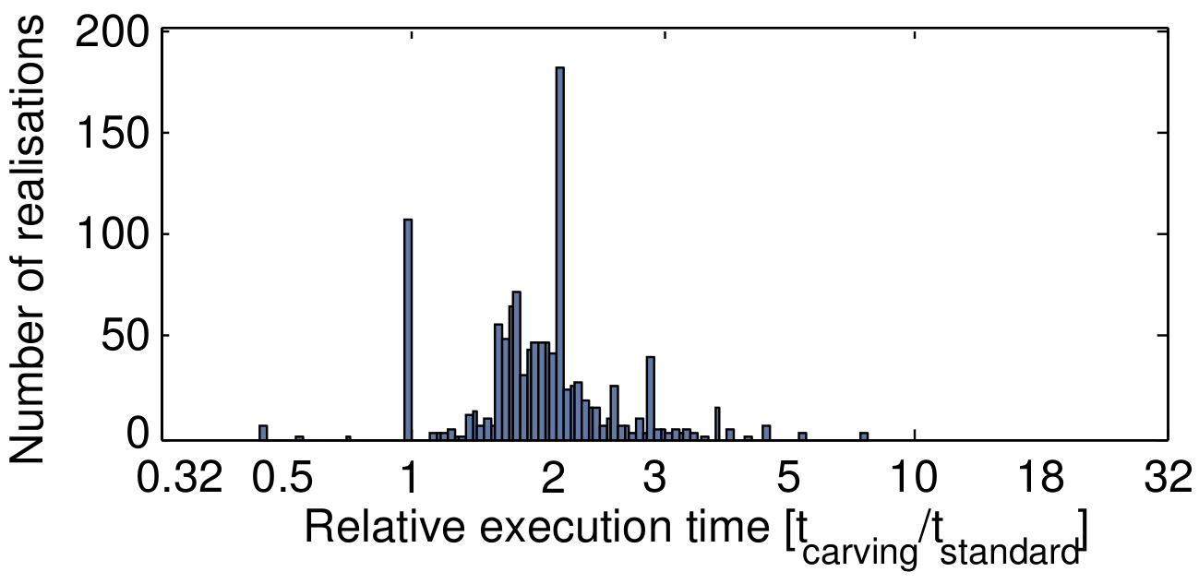
Imposing a Single Base Function (Relative Runtime)
Arithmetic
benchmarks
2x slower
Area-optimized MCNC
benchmarks

Slide 26
Outline
The Standard Interpolation Method (background)
The Carving Interpolation Method (our work)
Imposing a Base Function
Imposing a Set of Base Functions
Conclusions

Slide 27
Iterative Layering as Motivation
A brick is a function with few inputs and one output
A layer is a set of bricks on which the input function functionally depends
functionally depends on
Iterative Layering
functionally depends on
functionally depends on

Slide 28
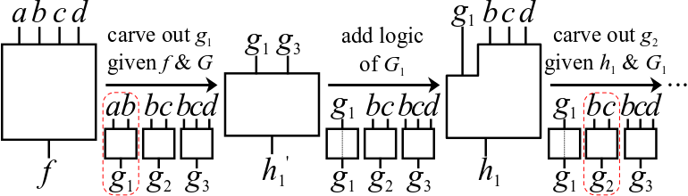
Imposing a Set of Base Functions (Standard Carving Method)
Carve out all base functions
(2n interpolants for n base functions)
target
function
set of base
functions
dependency
function
dependency
function
target
function
set of base
functions

Slide 29
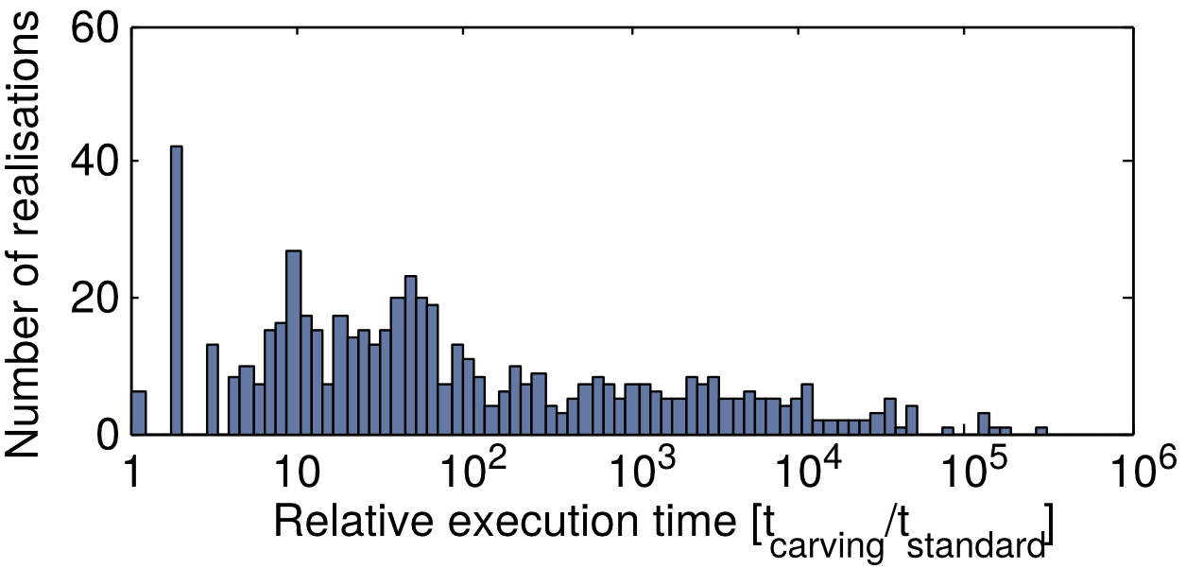
Imposing a Set of Base Functions (Relative Runtime – Standard Carving Method)
Arithmetic Circuits
(Standard Carving Method)

Slide 30

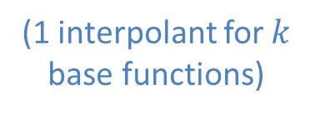
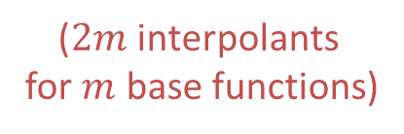
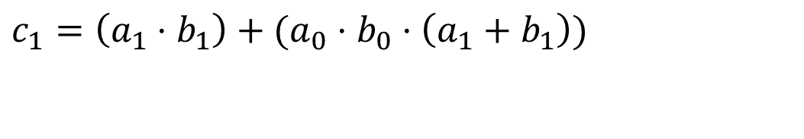
Imposing a Set of Base Functions (Optimised Carving Method)
Carve out only the auxiliary base functions
$$c_{1}=\left(a_{1}⋅b_{1}\right)+(a_{0}⋅b_{0}⋅\left(a_{1}+b_{1}\right))$$
Divide
Interpolate
auxiliary
essential
2.1
2.2
carving
method
standard
method
($2m$ interpolants
for $m$ base functions)
(1 interpolant for $k$
base functions)
$$≤2n=2(m+k)$$

Slide 31
Experimental Setup
Implemented into ABC
Uses the integrated version of MiniSat which provides SAT assignments and UNSAT proofs
Benchmarks
Arithmetic circuits
The large combinatorial MCNC benchmarks
Generate base functions as k-input cuts
Motivation from the Iterative Layering algorithm [Verma’09]

Slide 32
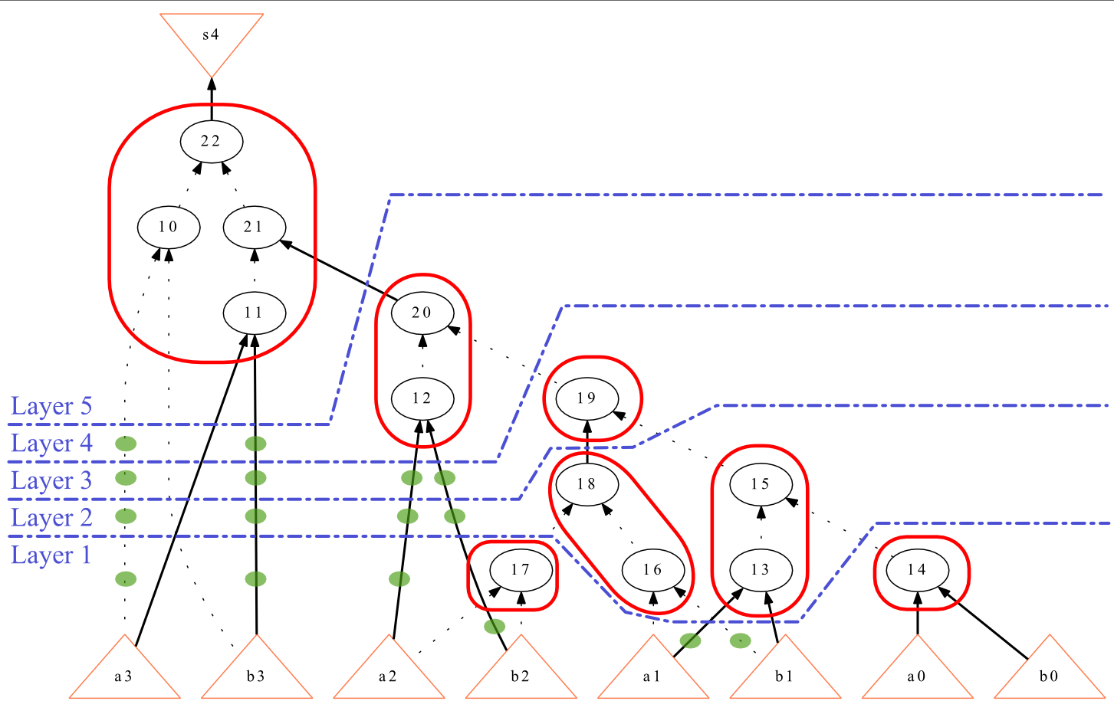
Experimental Setup (Base Functions & Layers Generation)

Slide 33
Imposing a Set of Base Functions (Failure Rate)
Layers with at least one omitted base function
 | Standard Method | Carving Method
 |  | Basic | Optimised
Arithmetic Circuits | 74.59% | 0.26% | 0.07%
Large MCNC (area-optimised) | 81.82% | 83.33% | 54.55%
Large MCNC (delay-optimised) | 92.89% | 83.76% | 76.14%
Disconnected base functions among all layers
 | Standard Method | Carving Method
 |  | Basic | Optimised
Arithmetic Circuits | 64.02% | 0.17% | 0.04%
Large MCNC (area-optimised) | 34.00% | 26.55% | 19.85%
Large MCNC (delay-optimised) | 77.56% | 34.30% | 30.77%

Slide 34
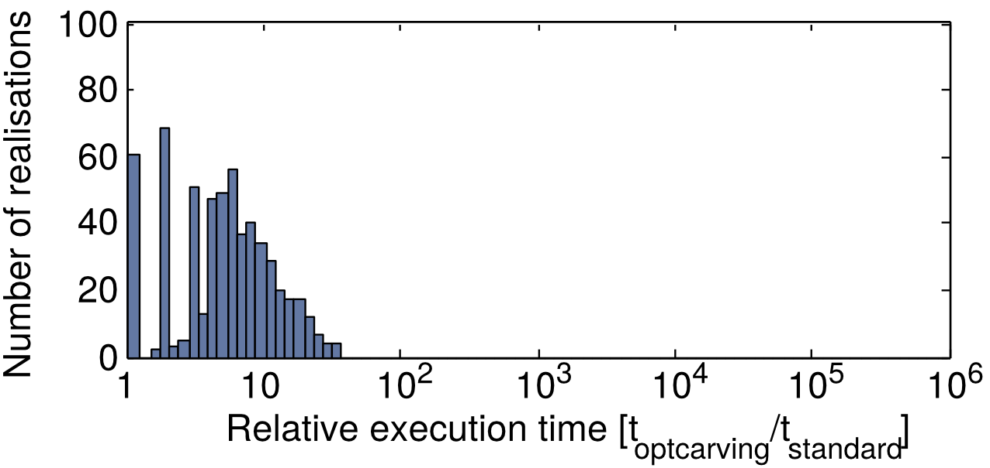
Imposing a Set of Base Functions (Relative Runtime)
Arithmetic Circuits
(Standard Carving Method)
Arithmetic Circuits
(Optimised Carving Method)

Slide 35
Outline
The Standard Interpolation Method (background)
The Carving Interpolation Method (our work)
Carving Out a Base Function
Carving Out a Set of Base Functions
Conclusions

Slide 36
Conclusions
The carving technique successfully includes a single desired base function
more than 99% success rate
the same base function is used on average in 43% of the cases by the standard interpolation method
Runtime: slower due to the generation of multiple interpolants (multiple SAT solver calls) – 2x for each imposed base function
We propose an optimised hybrid technique for imposing a set of base functions
Improves both the runtime and the success rate

Slide 37
THANK YOU FOR YOUR ATTENTION QUESTIONS?

