Slide 1
Output Hazard-Free Transition Tests for Silicon Calibrated Scan Based Delay Testing
Adit D. Singh
Gefu Xu
Auburn University

Slide 2
IC Testing is a Difficult Problem
Need 2³ = 8 input patterns to exhaustively test a 3-input NAND
2^{N} tests needed for N-input circuit
Many ICs have > 100 inputs
Only a very few input combinations can be applied in practice
3-input NAND
2¹⁰⁰ = 1.27 x 10³⁰
Applying 10³⁰ tests at 10⁹ per second (1 GHZ) will require 10²¹ secs = 400 billion centuries!
Notes:
View it as a slide show first. It will highlight important aspects of your presentation, and give you an example of a presentation that lives up to ITC presentation standards and guidelines.
Virus checker: When we created this presentation guide it contained no known viruses. This file was checked by McAfee VShield 4.x software before being distributed to authors. You should use a good, up to date virus checker on this file, and any other file you import from an outside source. Make sure your virus checker’s data files are up to date, too. Keep in mind: the version of this file you are reading may be different from the version we checked!
Confidentiality: We respect your copyright, and do not distribute your presentation before the conference. However, we cannot promise strict confidentiality of your presentation before the conference, because others have read access to our FTP sites. Do not include confidential information in your presentation.
Test Slide: A test slide is included as a “hidden slide” after the end of this presentation. If you want to do a trial projection, ensure that your projector projects the entire slide, and that aspect ratios are correct. We will use the same test slide at the conference for setup of our projection equipment.

Slide 3
How well must we test?
Approximate order-of-magnitude estimates
Number of parts per typical system: 100
Acceptable system defect rate: 1% (1 per 100)
Therefore, required part reliability
  1 defect in 10,000
  100 Defects Per Million (100 DPM)
Requirement ~100 DPM for commercial ICs
~500 DPM for ASICs
Notes:
View it as a slide show first. It will highlight important aspects of your presentation, and give you an example of a presentation that lives up to ITC presentation standards and guidelines.
Virus checker: When we created this presentation guide it contained no known viruses. This file was checked by McAfee VShield 4.x software before being distributed to authors. You should use a good, up to date virus checker on this file, and any other file you import from an outside source. Make sure your virus checker’s data files are up to date, too. Keep in mind: the version of this file you are reading may be different from the version we checked!
Confidentiality: We respect your copyright, and do not distribute your presentation before the conference. However, we cannot promise strict confidentiality of your presentation before the conference, because others have read access to our FTP sites. Do not include confidential information in your presentation.
Test Slide: A test slide is included as a “hidden slide” after the end of this presentation. If you want to do a trial projection, ensure that your projector projects the entire slide, and that aspect ratios are correct. We will use the same test slide at the conference for setup of our projection equipment.

Slide 4
How well must we test?
Assume 2 million ICs manufactured with 50% yield
1 million GOOD >> shipped
1 million BAD >> test escapes cause defective
parts to be shipped
For 100 BAD parts in 1M shipped (DPM=100)
Test must detect 999,900
out of the 1,000,000 BAD parts
For 100 DPM: Needed Test Coverage = 99.99%
Notes:
View it as a slide show first. It will highlight important aspects of your presentation, and give you an example of a presentation that lives up to ITC presentation standards and guidelines.
Virus checker: When we created this presentation guide it contained no known viruses. This file was checked by McAfee VShield 4.x software before being distributed to authors. You should use a good, up to date virus checker on this file, and any other file you import from an outside source. Make sure your virus checker’s data files are up to date, too. Keep in mind: the version of this file you are reading may be different from the version we checked!
Confidentiality: We respect your copyright, and do not distribute your presentation before the conference. However, we cannot promise strict confidentiality of your presentation before the conference, because others have read access to our FTP sites. Do not include confidential information in your presentation.
Test Slide: A test slide is included as a “hidden slide” after the end of this presentation. If you want to do a trial projection, ensure that your projector projects the entire slide, and that aspect ratios are correct. We will use the same test slide at the conference for setup of our projection equipment.

Slide 5
Defects Detected by Different Tests
1000-10000
Target DPM 500 - 50
DPM
500-5000
100-500
100-500
Burn-in Delay N-detect Bridging
Number of Defects (DPM) found by individual additional tests in high end die after screening by high quality stuck-at tests

Slide 6
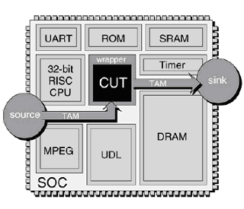
Scan Based Delay Tests
Scan-based delay testing is essential for SOCs
Because of insufficient access to cores for application of at-speed functional tests
Also
Good functional timing tests are difficult to develop
At-speed testers are expensive

Slide 7
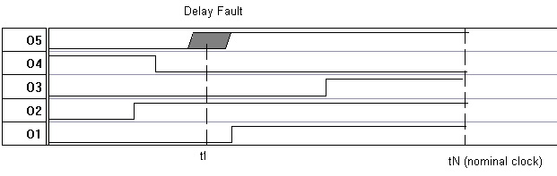
Timing or Delay Tests
V₁ V₂
Two-pattern test vectors <V₁V₂> cause a change at the outputs
Switching delay is the time from the application (launch) of V₂ until change at the output
Worst case switching delay < clock period

Slide 8
Scan Based Delay Testing
Launch
Capture
Restricts the two pattern tests <V1V2> that can be applied
Launch - on - shift (LOS)
  V2 : 1-bit scan shift of V1
Launch - on - capture (LOC)
  V2: functional response to V1
Restriction makes it harder to apply “worst case” delay tests
Comb.
Logic
V1
R[V1]
Scan FFs

Slide 9
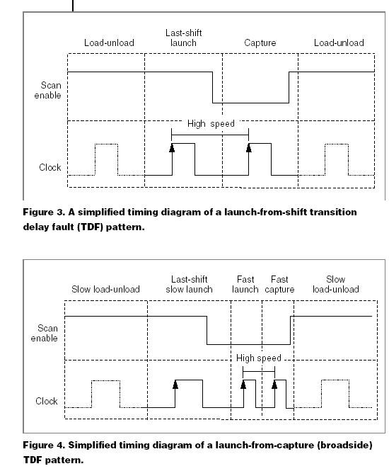
Launch-on-Shift
LOGIC
Data In
Data Out
V1
M
U
X
Flip
Flop
Scan In
V2
Scan
Enable
Clock
Clock Edge 1: Launch V2 (scan = 1)
Then switch scan = 0
Clock Edge 2: Captures response to
change in Flip Flop

Slide 10
Launch
LOGIC
Data In
Data Out
V1
V2
M
U
X
Flip
Flop
Scan In
V2
Scan
Enable
Clock
Clock Edge 1: Launch V2 (scan = 1)
Then switch scan = 0
Clock Edge 2: Captures response to
change in Flip Flop

Slide 11
Capture
LOGIC
Data In
Data Out
V2
M
U
X
Flip
Flop
Scan In
Scan
Enable
Clock
Clock Edge 1: Launch V2 (scan = 1)
Then switch scan = 0
Clock Edge 2: Captures response to
change in Flip Flop

Slide 12
Launch-on-Capture
LOGIC
V2 =
Response[V1]
V1
M
U
X
Flip
Flop
Scan In
Clock Edge 1: Apply V1 (scan = 1)
Then switch scan = 0
Clock Edge 2: Capture response to
V1 to launch V2
Clock Edge 3: Capture response to V2
Scan
Enable
Clock

Slide 13
Transition Delay Fault (TDF) Tests
  Two vector tests that test for rising and falling delays at every circuit node
  Guarantee detection of “gross” delay faults that exceed a clock period
  May not detect smaller delay faults that are absorbed within timing slacks on short paths

Slide 14
TDF Coverage of Scan Based Tests
  Despite the structural restrictions, scan based delay test can achieve
  LOC: 75 -90% TDF coverage
  LOS: 80 -95% TDF coverage
  LOS tests also generally require fewer patterns

Slide 15
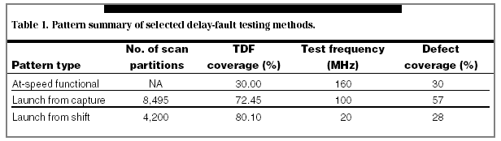
Summary of Delay Tests performed
- LSI Logic IEEE D&T
TDF and at-speed functional effectiveness comparison

Slide 16
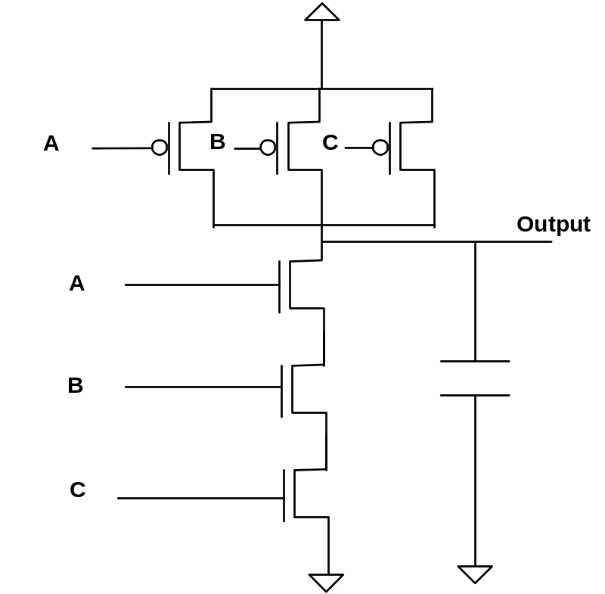
Variations in CMOS Delays
CMOS delays greatly depend on the off path signals and internal circuit state
Hard to find <V₁V₂> to ensure worst case conditions for signal propagation along a path.
Often this worst case test vector pair can be different for the same circuit depending on fabrication parameters
3X variation in rise time

Slide 17
Problems in Delay Test Application
  Finding tests for worst case signal propagation conditions
  “Robust” path delay tests are logic level tests that account for many but not all worst case conditions
  - Robust Path Delay tests often do not
  exist for many (even majority) of the paths
  Many desired delay timing tests may be impossible to apply in a scan environment because of structural restrictions

Slide 18
Input Based Path Delay Variations
average delay
10% T_cr
Timing
Margin
PATH
Delay
T_critical clock
Timing margins to allow for parameter variations, clock skew, etc can make “small” defects undetectable

Slide 19
Input Based Path Delay Variations
average delay
10% T_cr
Timing
Margin
PATH
Delay
T_critical clock
Defects that increase path delay by less than 10-20% of T_critical are virtually undetectable

Slide 20
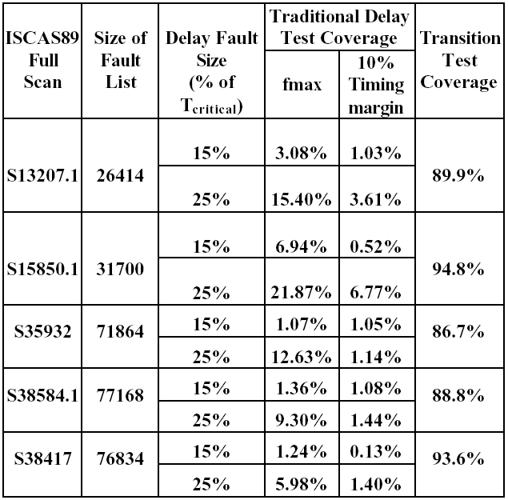
Simulation Results for Launch-on-shift
Yan [ITC 04]

Slide 21
Are these “small” defects worth detecting?
For a 8 level critical path, average gate delay
12.5% of T_critical
25% extra path delay implies a 200% increase in the delay for some gate - significant!
- e.g. Via resistance must grow 1,000-10,000X
from 0.1ohm (typical) to cause such a delay
Simulations [Yan ATS 04] estimate about 50% will cause timing related functional failure for some untested input
- many will also cause early life reliability failure

Slide 22
DDSI: Delay Detection in the Slack Interval
Abnormal delays are observed in the slack interval
A delay defect need only be active to be detected
– no need to set up worst case conditions to exceed the nominal clock period
Slack
V1 V2
Observation
Clock
Operational
Clock

Slide 23

Timing Simulation based Tests
Switching delays for each output obtained through timing simulation
Must add margins for process variations
Test repeated for multiple fast clocks
V1 V2
Fast Observation Clocks
Cadence “True Time” delay tests claim TDF ~ 80%
sufficient for ~ 2X DPM improvement
Accurate timing simulation difficult & expensive!

Slide 24
A Second Major Problem with Scan Based Delay Tests
Delay detection is the slack interval solves the problem of detecting defects on “short” paths
- huge simulation cost
- margins for parameter variations limit
effectiveness
Problem of “out of normal mode testing” still to be solved

Slide 25
Scan Tests “Out of Normal Mode”
Scan based launch and capture delay tests place the circuit out of the normal functional operating mode which can significantly impact circuit performance and change observed delays
  IR drops in power rail due to excess switching activity can slow logic and give false fails
  Unto 20% delay variation from 40º C temperature change
  10-20% “clock stretch”
  Unexpected coupling noise

Slide 26
Proposed Solution: Timing Learned from Silicon
Same idea as simulation based DDSI method
Except timing “learned” from golden die
More accurate and less expensive than simulation
V1 V2
Fast Observation Clocks
Also automatically accounts for test conditions:
      IR drops, temp variations, clock stretch, coupling, etc

Slide 27
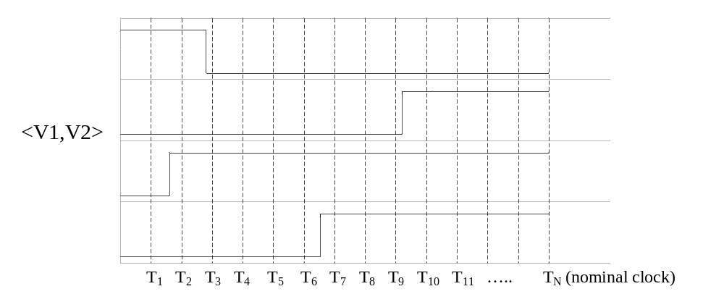
Proposed Solution: Timing Learned from Silicon
For each 2-vector delay test pattern, the switching time is learned from a “golden” die

Slide 28
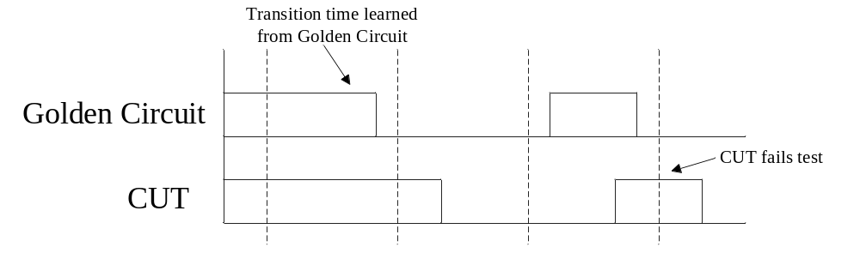
Need Output Hazard Free Tests
How a hazard can cause incorrect timing to be learned

Slide 29
Output Hazard Free Transition Tests
Output hazard free tests are less restrictive than robust tests
Test responses are only observed on outputs known to be hazard free
Philips has shown hazard free tests with ~ 50% TDF coverage with test filtering using fast timing simulation
Expensive to filter large test sets

Slide 30
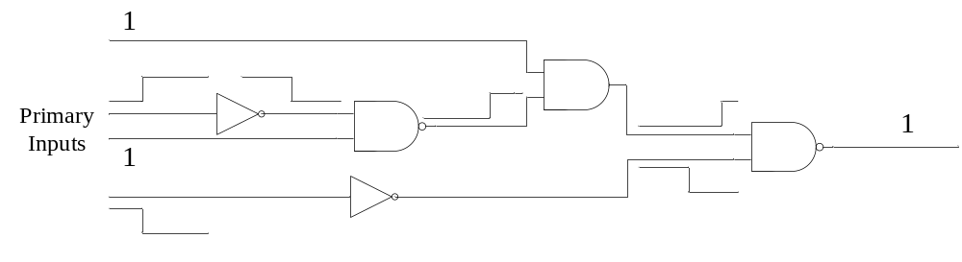
What Coverage is Achievable from Output Hazard Free Transition Tests?
Masking of potential due to paths of differing lengths
Such potentially hazard free outputs are good candidates for test filtering

Slide 31
LOS
Circuit | Hazard-Free TDF (Lower Bound) | Mode 3 | Mode 2 | Mode 1 | Mode 0 | Unrestricted TDF
S208 | 60.10 | 72.84 | 78.37 | 79.33 | 79.33 | 88.94
S298 | 60.74 | 62.92 | 62.92 | 64.60 | 76.51 | 84.23
S344 | 82.70 | 83.43 | 85.76 | 86.63 | 87.50 | 94.04
S349 | 81.66 | 82.38 | 84.67 | 85.53 | 86.39 | 93.41
S382 | 70.94 | 73.56 | 75.79 | 78.01 | 83.38 | 90.71
S386 | 51.17 | 54.79 | 57.51 | 58.16 | 68.26 | 79.40
S400 | 68.62 | 70.88 | 73.62 | 76.38 | 82.13 | 89.50
S420 | 60.00 | 75.83 | 77.98 | 78.57 | 78.81 | 87.74
S444 | 59.57 | 62.39 | 63.40 | 70.72 | 77.70 | 86.60
S510 | 57.84 | 63.14 | 67.06 | 74.41 | 81.37 | 90.39
S526 | 65.78 | 67.11 | 68.25 | 70.53 | 80.13 | 87.45
S526n | 65.87 | 67.21 | 68.35 | 70.63 | 80.04 | 87.64
S641 | 87.52 | 91.13 | 92.23 | 92.54 | 93.80 | 96.70
S713 | 53.09 | 58.49 | 59.75 | 74.96 | 76.72 | 90.81
S820 | 36.83 | 38.41 | 40.30 | 44.09 | 57.99 | 78.17
S832 | 36.06 | 37.44 | 39.30 | 42.85 | 56.97 | 77.04
S953 | 71.09 | 81.11 | 83.16 | 84.42 | 87.51 | 91.03
S1196 | 57.82 | 67.02 | 69.06 | 71.28 | 74.37 | 85.54
S1238 | 57.31 | 65.06 | 66.60 | 68.86 | 71.61 | 81.99
S1423 | 76.88 | 82.64 | 82.78 | 84.50 | 91.22 | 95.99
S1488 | 45.43 | 51.31 | 53.53 | 56.79 | 63.31 | 79.67
S1494 | 44.48 | 50.50 | 52.64 | 55.76 | 62.45 | 79.08
S5378 | 65.45 | 68.75 | 70.98 | 75.27 | 89.59 | 93.05
S9234 | 64.71 | 70.01 | 71.26 | 76.60 | 80.04 | 88.28
S13207 | 78.24 | 80.66 | 81.20 | 84.31 | 87.49 | 94.04
S15850 | 75.66 | 78.45 | 78.79 | 81.17 | 82.15 | 90.66
Ave. | 62.91 | 67.59 | 69.43 | 72.57 | 78.34 | 87.77

Slide 32
LOC
Circuit | Hazard-Free TDF (Lower Bound) | Mode 3 | Mode 2 | Mode 1 | Mode0 | Unrestricted TDF
S208 | 36.78 | 48.08 | 50.24 | 50.72 | 50.72 | 57.45
S298 | 54.19 | 55.03 | 57.55 | 59.90 | 70.30 | 81.21
S344 | 72.97 | 77.47 | 82.27 | 84.59 | 86.19 | 93.75
S349 | 71.92 | 76.36 | 81.09 | 83.38 | 84.96 | 93.12
S382 | 52.49 | 53.27 | 54.45 | 56.81 | 68.85 | 76.83
S386 | 34.97 | 36.92 | 37.82 | 39.90 | 41.71 | 52.72
S400 | 50.88 | 51.63 | 52.88 | 55.25 | 68.37 | 75.63
S420 | 28.21 | 53.81 | 54.88 | 55.48 | 55.48 | 64.76
S444 | 42.12 | 43.47 | 44.03 | 53.49 | 58.11 | 75.11
S510 | 55.00 | 61.18 | 63.92 | 70.10 | 75.49 | 89.41
S526 | 37.26 | 37.74 | 40.02 | 43.54 | 53.23 | 64.35
S526n | 37.26 | 37.74 | 40.02 | 43.54 | 53.33 | 64.35
S641 | 80.46 | 85.48 | 86.34 | 86.50 | 88.07 | 91.60
S713 | 46.91 | 54.63 | 56.73 | 68.09 | 70.48 | 85.13
S820 | 32.87 | 33.84 | 34.94 | 36.95 | 43.48 | 51.83
S832 | 32.27 | 33.23 | 34.38 | 36.36 | 42.91 | 51.08
S953 | 70.46 | 78.70 | 80.90 | 82.06 | 85.94 | 91.55
S1196 | 52.55 | 61.04 | 64.67 | 66.72 | 69.73 | 81.65
S1238 | 50.85 | 60.10 | 63.29 | 65.79 | 68.30 | 79.08
S1423 | 56.01 | 61.35 | 61.74 | 66.02 | 76.88 | 87.10
S1488 | 42.07 | 48.59 | 51.34 | 55.95 | 62.33 | 87.40
S1494 | 41.67 | 47.86 | 50.77 | 55.09 | 61.55 | 86.98
S5378 | 73.64 | 76.61 | 86.65 | 82.35 | 86.65 | 89.61
S9234 | 37.33 | 44.03 | 45.49 | 52.41 | 59.00 | 74.71
S13207 | 53.34 | 56.42 | 57.43 | 63.82 | 70.01 | 82.38
S15850 | 51.91 | 58.60 | 59.17 | 62.12 | 64.23 | 78.82
Ave. | 49.86 | 55.12 | 57.42 | 60.65 | 66.01 | 77.22

Slide 33
Circuit | Hazard-Free TDF (Lower Bound) | Mode 3 | Mode 2 | Mode 1 | Mode 0 | Unrestricted TDF
Circuit | Hazard-Free TDF (Lower Bound) | Mode 3 | Mode 2 | Mode 1 | Mode 0 | Unrestricted TDF
S5378 | 65.45 | 68.75 | 70.98 | 75.27 | 89.59 | 93.05
S9234 | 64.71 | 70.01 | 71.26 | 76.60 | 80.04 | 88.28
S13207 | 78.24 | 80.66 | 81.20 | 84.31 | 87.49 | 94.04
S15850 | 75.66 | 78.45 | 78.79 | 81.17 | 82.15 | 90.66
Ave. | 62.91 | 67.59 | 69.43 | 72.57 | 78.34 | 87.77
S5378 | 73.64 | 76.61 | 86.65 | 82.35 | 86.65 | 89.61
S9234 | 37.33 | 44.03 | 45.49 | 52.41 | 59.00 | 74.71
S13207 | 53.34 | 56.42 | 57.43 | 63.82 | 70.01 | 82.38
S15850 | 51.91 | 58.60 | 59.17 | 62.12 | 64.23 | 78.82
Ave. | 49.86 | 55.12 | 57.42 | 60.65 | 66.01 | 77.22
LOS
LOC

Slide 34
Identifying Golden Die
Timing responses from two matched neighboring die are compared
If delays are with the expected range based on observed parameter variations the die are taken to be golden die
x
x
x
x
x
x
x
x
Note: Response reflects test conditions!

Slide 35
Summary
Learning timing from silicon can allow effective delay testing that automatically accounts for the “non function” test conditions of scan based delay tests
Obtaining such timing requires output hazard free TDF tests which can be obtained with coverage ~10% below unrestricted scan based TDF tests
Learning timing from silicon can be much cheaper and more accurate that timing simulation of short paths and can better account for parameter variations

Slide 36
Questions?

