Slide 1
Galois Fields for Advanced Encryption Standard (AES)
WHY? WHERE? HOW?

Slide 2
Background
Symmetric key cipher.
Significant ‘key’ improvements over DES(64 bit blocks/keys).
Non-Feistal cipher -
Invertible Boolean functions (reversible models).
Example –
Toffoli gate.
XOR (self invertible).

Slide 3
WHY?
Security, cost, and implementation.
Computation efficiency and storage requirement.
Flexible and simple to be implemented across any platform.
Follows –
Avalanche effect – small change in plaintext or key should create significant change in ciphertext.
Completeness effect – each bit of ciphertext need to depend on many bits of plaintext or key.

Slide 4
WHY?
AES preferred over DES due to weak key structure in the latter(brute force method can break DES in 112 hours)
Design criteria for modern block ciphers-
Diffusion - hide relationship between ciphertext and plaintext
Confusion – hide relationship between ciphertext and key
Achieved through combination of S-boxes, P-Boxes and other components.
Multiple rounds – after 6-7 rounds, each output bit in a ciphertext will be function of every plaintext bit and key bit.
Intrabyte(substitution), interbyte(mixing) and byte exchange(permutation) operations.

Slide 5


WHY GF($2^{8}$)?
GF($2^{8}$) perfectly aligns to byte architecture and satisfies 5 axioms over ± and ×/÷.
Scrambles data easily and effectively.
All bytes in AES are interpreted as finite field elements.
Operations –
Substitute Bytes
Mixing columns
XOR operation
Affine transformation

Slide 6
WHERE?
Data/Hard drive encryptions (Seagate, FileVault, BitLocker)
Archive and compression tools (7z, winzip)
File encryption standards (NTFS)
Wireless network security
Web traffic (SSL)
Internet banking

Slide 7
HOW?
128 bit block inputs (128 bit cipher keys for each round)
10 rounds of transformation
SubBytes/InvSubBytes
ShiftRows/InvShiftRows
MixColumns/InvMixColumns
AddRoundKey
KeyExpansion
RotWord
SubWord
Rcon
State – 128 bit (4x4) temporary data matrix between each rounds

Slide 8


SubByte/InvSubByte
Non-linear byte substitution
Find $X^{ive}$ inverse in GF($2^{8}$) mod ($x^{8}+x^{4}+x^{3}+x+$1)
Interpreted as column matrix with LSB at top and MSB at bottom.
Affine transformation over GF(2)
$b_{i}^{′}$ = $b_{i}{\text{⊕ }b}_{(i+4)mod8}$ ${\text{⊕ }b}_{(i+5)mod8}$ ${\text{⊕ }b}_{(i+6)mod8}$ ${\text{⊕ }b}_{(i+7)mod8}$ ${\text{⊕ }c}_{i}$
$b_{i} − i^{th}$ bit of the byte and $c_{i}$ is {63}
Encryption - $multiplication$ first followed by addition
Decryption – subtraction followed by division
$${\text{⊕ }c}_{i}$$

Slide 9
ShiftRows/InvShiftRows
Byte exchange permutation.
Left shift in encryption and right shift in decryption.

Slide 10
MixColumns/InvMixColumns
Interbyte operation with elements interpreted as 8-bit polynomials with coefficients in GF(2).

Slide 11

AddRoundKey
Whitening the data using keys
XORing each column of state with the corresponding key word.
Key expansion – each round has 10 different keys.
Temporary word for each round generated based on -
RotWord – shift each byte to left with wrapping
SubWord – same as SubByte operated on each byte
RCon – use GF($2^{8}$) to calculate the byte dynamically

Slide 12
Key Expansion
Temporary word calculated for every word and updates the next successive word for key generation.

Slide 13
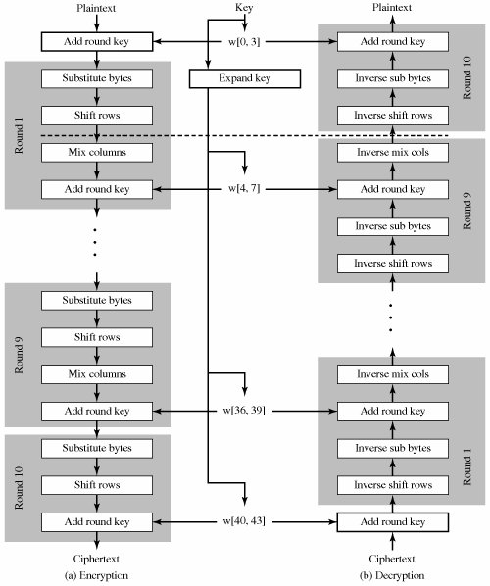
Scheme of operation

Slide 14
Can we formally verify a cipher?
To our knowledge there have been only
Testing the functional output values against the NIST standard suite.
Proving encryption inverts decryption using theorem prover(Duan, Joe, Li, Owens – LPAR’05)
Formal verification of extended Hardware Support for AES (Slobodova – FMCAD’08)
Equivalence checks against different kinds of implementations or a formal spec(automatic formal verification – Eric/David – FMCAD’08) – Java and hand written formal Spec.
Formalization using Mizar proof checking system (Mizar – formalize mathematics with computer aided proving technique)
Formal software verification by specification extraction – echo (low level spec and reverse synthesis) (DSN’07)

