Slide 1


Ruei-Rung Lee, J.-H. Roland Jiang, and Wei-Lun Hung
ALCom Lab
Grad. Inst. of Electronics Engineering
National Taiwan University
115/11/08
DAC
Notes:
Hello, everyone.
My name is Ruei-Rung Lee.
Today I will present this paper.
The topic is “Bi-Decomposing Large Boolean Functions via Interpolation and Satisfiability Soling”.
This is a join work with my advisor professor Roland Jiang and wei-lun hung.

Slide 2
Outline
Introduction
Prior Work and Preliminaries
Main Algorithms
Experimental Results
Conclusions and Future work
Notes:
This is our outline.
At the beginning, I will introduce the background and explain why I want to do this topic.
Next, I will talk about previous work and give some preliminaries.
And then, I will explain our algorithms.
Finally, I will show the experimental results and make some conclusions.
Let’s start to talk about introduction.

Slide 3
Introduction
Bi-decomposition is a special kind of functional decomposition
Functional decomposition
  Break a large function into a network of
  smaller functions
  Reduce circuit and communication complexity
  and thus simplify physical design
Bi-decomposition plays an important role in logic synthesis for restructuring Boolean networks
Notes:
During functional decomposition, we can reduce circuit and communication complexity, and thus simplify physical design.
For these reasons, it motivates us to come up with an efficient algorithm for bi-decomposition

Slide 4
Outline
Introduction
Prior Work and Preliminaries
Main Algorithms
Experimental Results
Conclusions and Future Work
Notes:
Now, I will introduce the related previous work and give some preliminaries.

Slide 5
Closest Prior Work
[Mishchenko et al., 01]
  BDD-based approach
  Two main limitations
    Memory explosion problem
    Decomposability is checked under a fixed variable partition
Notes:
This is the closest prior work.
The algorithm developed by mishchenko is accepted by DAC in 2001.
By the way, the algorithm that I am going to present is also accepted by DAC in June this year.
The previous algorithm is bdd-based approach, so it has 2 main limitations
First of all, it suffers from the memory explosion problem.
Secondly, Decomposability is checked under a fixed variable partition.
It have to try many iterations to find an effective variable partition.
So the bdd-base algorithm consumes a lot of memory and cpu time.
Therefore, we want to design a SAT-based algorithm to bi-decompose boolean functions effectively and efficiently.

Slide 6
Preliminaries: Bi-decomposition
h
f
Bi-decompose
f _{A}
f _{B}
X_{A}
X_{B}
X_{C}
X_{A}
X_{C}
X_{B}
Notes:
What is bi-decomposition?
Given a large function whose primary inputs are variable sets xa,xb,xc,
We bi-decompose f function into 2-input function h based on other functions fa, fb.
Xa is local to fa, Xb is local to fb, and Xc is the common variable of fa and fb.

Slide 7
Preliminaries:Variable Partition
A set X = {X_{A}|X_{B}|X_{C}} is a partition
meaning X_{A} , X_{B} , X_{C} are pair-wise disjoint and X_{A}∪X_{B}∪X_{C} = X
If X_{C} = ψ, we have disjoint
bi-decomposition ;
otherwise, non-disjoint
h
f _{A}
f _{B}
X_{A}
X_{C}
X_{B}
Notes:
A set X equals “this representation” is a partition meaning X_{A} , X_{B} , X_{C} are pair-wise disjoint and X_{A}∪X_{B}∪X_{C} = X
If X_{C} is empty , we have disjoint bi-decomposition ; otherwise, non-disjoint

Slide 8
Preliminaries: Craig Interpolation
Given φ_{A} and φ_{B} are Boolean formulas, if φ_{A} ∧φ_{B}
is unsatisfiable, then there exists another
Boolean formula P with the following properties:
  φ_{A} → P
  P∧ φ_{B} is unsatisfiable
  P refers only to the common variables of φ_{A} and φ_{B}
P
φ_{B}
φ_{A}
Notes:
What is craig interpolation?
Given φ_{A} and φ_{B} are Boolean formulas, if their conjunction is unsatisfiable, then there exists another Boolean formula P with the following properties
First, φ_{A} implies P .
That means the solution space of P contain the solution space of φ_{A}.
Secondly, The conjunction of P and φ_{B} is unsatisfiable.
It means the solution space of P is disjoint from The solution space of φ_{B}.
Finally, P refers only to the common variables of φ_{A} and φ_{B}

Slide 9
Outline
Introduction
Prior Work and Preliminaries
Main Algorithms
Experimental Results
Conclusions and Future Work
Notes:
Now I will present our algorithms for bi-decomposition.

Slide 10
Bi-decomposition Cases
We consider OR, AND, XOR bi-decompositions
  These three cases are enough to generate any other type of bi-decomposition
a | b | a+b | ab | a⊕b | a(¬b)
0 | 0 | 0 | 0 | 0 | 0
0 | 1 | 1 | 0 | 1 | 0
1 | 0 | 1 | 0 | 1 | 1
1 | 1 | 1 | 1 | 0 | 0
Notes:
We have to consider only OR, AND, XOR bi-decompositions
These three cases are enough to generate any other type of bi-decomposition
For example,
(a and not b) decomposition can be achieved by “and bi-decomposition”.
(a xor not b) decomposition can be achieved by “xor bi-decomposition”

Slide 11
Disjoint OR Bi-decomposition
Disjoint: the common variable set X_{c} is empty.
E.g.
f(a,b,c,d) = (¬a)b+cd
X = {a,b,c,d}={X_{A}|X_{B}}
X_{A}= {a,b}, X_{B}= {c,d}
f(X) = (¬a)b+cd
= f_{A}(a,b)+f_{B}(c,d)
OR
X_{B}\X_{A} | 00 | 01 | 11 | 10
00 | 0 | 1 | 0 | 0
01 | 0 | 1 | 0 | 0
11 | 1 | 1 | 1 | 1
10 | 0 | 1 | 0 | 0
f_{B}(X_{B})
0
0
1
0
f _{A}
f _{B}
f_{A}(X_{A}) | 0 | 1 | 0 | 0
X_{A}
X_{B}
Notes:
First , we consider disjoint or bi-decomposition.
Here shows an example f equals (not ab or cd).
Suppose X is partitioned into 2 subsets Xa, Xb.
Xa is ab,Xb is cd.
Here is a truth table of f function.
We rearrange the table in the way that the columns are indexed by Xa variable set, the rows are indexed by Xb variable set.
And there exist fa, fb such that f equals fa or fb

Slide 12
Bi-decomposability
Under what condition can f(X) be written as f_{A}(X_{A})∨f_{B}(X_{B}) ?
The necessary and sufficient condition:
For every 1-entry,
no 0-entries can appear simultaneously in the corresponding row
and column
f(1101) = 0 = f_{A}(11) +f_{B}(01)
f(0010) = 0 = f_{A}(00) +f_{B}(10)
f(1110) = 1 = f_{A}(11) +f_{B}(10)??
X_{B}\X_{A} | 00 | 01 | 11 | 10
00 | 0 | 1 | 0 | 0
01 | 0 | 1 | 0 | 0
11 | 1 | 1 | 1 | 1
10 | 0 | 1 | 0 | 0
f_{B}(X_{B})
0
0
1
0
f_{A}(X_{A}) | 0 | 1 | 0 | 0
X_{B}\X_{A} | 00 | 01 | 11 | 10
00 | 0 | 1 | 0 | 0
01 | 0 | 1 | 0 | 0
11 | 1 | 1 | 1 | 1
10 | 0 | 1 | 1 | 0
f_{B}(X_{B})
0
f_{A}(X_{A}) |  |  | 0
Notes:
If the condition is satisfied, there exist fa,fb such that f equals fa or fb
If there is a 0-entry, we must assign 0 to this corresponding row and column
For example, if this entry (00,01) is 0, fa(00) must be 0, fb (01) must be 0.
If the column or row contains all 1’s, it must be assigned 1.
If the condition is violated, there does not exit fa,fb

Slide 13
SAT-based Bi-decomposability
∃f_{A}, f_{B} such that f(X) = f_{A}(X_{A}) ∨ f_{B}(X_{B})
⇔ For every 1-entry, no 0-entries can appear simultaneously in the corresponding row and column ⇔ f(X_{A},X_{B}) ∧ ¬f(X_{A}’,X_{B}) ∧ ¬f(X_{A},X_{B}’) is unsatisfiable
X_{A}’
X_{A}
X_{B}\X_{A} | 00 | 01 | 11 | 10
00 | 0 | 1 | 0 | 0
01 | 0 | 1 | 0 | 0
11 | 1 | 1 | 1 | 1
10 | 0 | 1 | 1 | 0
f_{B}(X_{B})
?
?
?
?
X_{B}’
X_{B}
f_{A}(X_{A}) | ? | ? | ? | ?
Notes:
We translate the necessary and sufficient condition into Boolean formula.
By doing so, we can use SAT solver to check if the formula is unsatisfiable.

Slide 14
Non-disjoint Bi-decomposition
∃f_{A}, f_{B} such that f(X) = f_{A}(X_{A},X_{C}) ∨ f_{B}(X_{B},X_{C})
⇔ Under every valuation of X_{C}, for every 1-entry, no 0-entries can appear simultaneously in the corresponding row and column
⇔ f(X_{A},X_{B},X_{C}) ∧ ¬f(X_{A}’ ,X_{B},X_{C}) ∧¬f(X_{A},X_{B}’ ,X_{C})is unsatisfiable
X_{C}=00 | X_{A}
X_{B}
X_{C}=01 | X_{A}
X_{B}
X_{C}=10 | X_{A}
X_{B}
X_{C}=11 | X_{A}
X_{B}
Notes:
Now we consider non-disjoint bi-decomposition.
Similar to disjoint bi-decomposition, the necessary and sufficient condition can be generalized to
Non-disjoint bi-decomposition.
f can be written as fa or fb iff this formula is unsatisfiable

Slide 15
OR Bi-decomposition
∃f_{A}, f_{B} such that f(X) = f_{A}(X_{A},X_{C}) ∨ f_{B}(X_{B},X_{C})
⇔ f(X_{A},X_{B},X_{C}) ∧ ¬f(X_{A}’ ,X_{B},X_{C}) ∧¬f(X_{A},X_{B}’ ,X_{C})
is unsatisfiable
Two problems remain to be solved
  How to derive f_{A} and f_{B}?
  How to partition X into X_{A}, X_{B}, X_{C}?
Notes:
Now we have the necessary and sufficient condition.
There are still 2 problems remain to be solved.
First, how to derive fa and fb?
Second, how to partition X into Xa,Xb, Xc?

Slide 16
How to derive f_{A}?
  φ_{A} ∧φ_{B} is UNSAT
  φ_{A} → P
  P∧φ_{B} is UNSAT
  P refers only to the common variables of φ_{A},φ_{B}
f(X_{A},X_{B},X_{C}) ∧ ¬f(X_{A}’ ,X_{B},X_{C}) ∧¬f(X_{A},X_{B}’ ,X_{C}) is UNSAT
φ_{A}
φ_{B}
1
0
0
Offset of f_{A}
Onset of f_{A}
φ_{A}
φ_{B}
f
f
f
X_{A}’
X_{B}’
X_{A}
X_{B}
X_{C}
Notes:
According to the formula, we construct the corresponding network like this.
In order to take advantage of craig interpolation to derive fa, let this part be φA formula, the other part be B formula
If we project the feasible solution of A into the common var ,the image will correspond to the onest of fa
Because their conjunction is empty, there exists an interpolant.
The interpolant refers only to the common variables Xa, Xc
It contains the onset of fa and is disjoint from the offset of fa, so it is a legal implementation of fa
3 conditions

Slide 17
How to derive f_{B}?
Let ¬f_{A} be the care condition of f_{B}
f(X_{A},X_{B},X_{C}) ∧ ¬f_{A}(X_{A},X_{C}) ∧¬f(X_{A}’ ,X_{B},X_{C}) is UNSAT
φ_{B}
φ_{A}
Offset of f_{B}
Onset of f_{B}
1
0
0
f
f_{A}
f
X_{A}
X_{B}
X_{C}
X_{A}’
Notes:
We have derived fa, so Let ¬f_{A} be the care condition of f_{B}
Similar to the previous slide, we can compute an interpolant that corresponds to a legal implementation of fb

Slide 18
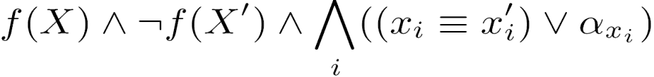
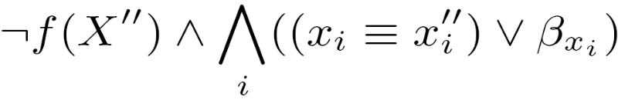
How to partition X into X_{A},X_{B},X_{C}?
φ_{A} =
φ_{B} =
1
0
0
1
0
0
(α_{xi}, β_{xi}) | x_{i} belongs to
(0,0) | X_{C}
(0,1) | X_{B}
(1,0) | X_{A}
(1,1) | either X_{A} or X_{B}
f
f’
f”
f
f
f
X
X’
X”
X_{A}’
X_{B}’
(α_{xi},β_{xi}) =(0,1)
(α_{xi},β_{xi}) =(0,0)
(α_{xi},β_{xi}) =(1,0)
X_{A}
X_{B}
X_{C}
Notes:
We instantiate variable X into X’, X”
Xa connects first and third copy of f
Xc connects all the three copies of f
So for each var x , we use 2 control variables to represent this three conditions.
If (α_{x},β_{x}) is (0,1) , it means x belongs to Xb
If (α_{x},β_{x}) is (0,0) , it means x belongs to Xc
This table summaries the above condition

Slide 19
How to partition X into X_{A},X_{B},X_{C}?
We make unit assumption of MiniSat on the control variables
  Assume all the control variables are 0
  SAT solver will return a conflict clause consisting of only the control variables
  The conflict clause corresponds to a variable partition
E.g.
Conflict clause (α_{x1}+β_{x1}+α_{x2}+β_{x3}) indicates the unit assumption α_{x1}=0,β_{x1}=0,α_{x2}=0,andβ_{x3}=0 causes unsatisfiability. So x₁∈X_{C}, x₂∈X_{B}, and x₃∈X_{A}
Notes:
We make unit assumption of MiniSat on the control variables.
Assume all the control variables are 0.
If the formula is unsatisfiability under this assumption, SAT solver will
return a conflict clause consisting of only the control variables.
The conflict clause corresponds to a variable partition.
For example, if the conflict clause is α_{x1}+β_{x1}+α_{x2}+β_{x3},
It means α_{x1}=0,β_{x1}=0,α_{x2}=0,andβ_{x3}=0 causes unsatisfiability.
So x₁∈X_{C}, x₂∈X_{B}, and x₃∈X_{A}

Slide 20
Avoid Trivial Variable Partition
Bi-decomposition trivially holds if X_{C}, X_{A}∪X_{C}, or X_{B}∪X_{C} equals X
  SAT solver may return a conflict clause that consists of all the control variables ⇒ X_{C} = X
To avoid these trivial partitions, as unit assumption we specify two distinct variables x_{a} and x_{b} to be in X_{A} and X_{B}, respectively, and all other variables in X_{C}
  To check if a function is bi-decomposable, we have to try at most C(n,2) iterations
Notes:
Very likely, SAT solver may return a conflict clause that consists of all the control variables meaning X_{C} is equal to X.
In this case,we can not guarantee that trivial partition is the only partition or there are other partitions but sat solver just return the trivial partition this time.
To avoid trivial partition, we specify one variables x_{a} to be in X_{A} and another variable x_{b} to be in X_{B}.

Slide 21
AND Bi-decomposition
∃f_{A}, f_{B} such that f=f_{A} ∧ f_{B} ⇔ ∃f_{A}, f_{B} such that ¬f=¬f_{A}∨ ¬f_{B}
E.g.
f (a,b,c,d) = (a+¬b+c)(b+¬c+d)
¬f (a,b,c,d) = (¬a)b(¬c) ∨ (¬b)c(¬d)
= ¬f_{A}(a,b,c) ∨ ¬f_{B} (b,c,d)
f_{A} (a,b,c)= (a+¬b+c), f_{B} (b,c,d) = (b+¬c+d)
f (a,b,c,d) = f_{A}(a,b,c) ∧ f_{B} (b,c,d)
Notes:
The and bi-decomposition can be achieved by or bi-decomposition.
Here is an example.

Slide 22
XOR Bi-decomposition
(1)=(5)⊕(7), (2)=(5)⊕(8),(3)=(6)⊕(7), (4)=(6)⊕(8)
⇒(1)⊕(4)=(2)⊕(3)
⇒ (1)⊕(2)=(3)⊕(4)
⇒ [(1)≡(2)]∧[(3)≠(4)] UNSAT
XOR
 |  | X_{A}’ |  | X_{A}
 | X_{B}\X_{A} | 00 | 01 | 11 | 10
 | 00
X_{B}’ | 01 | (1) |  | (3)
 | 11
X_{B} | 10 | (2) |  | (4)
f_{B}(X_{B})
(7)
(8)
f_{A}
f _{B}
X_{A}
X_{C}
X_{B}
 | f_{A}(X_{A}) | (5) |  | (6)
Notes:
This table is similar to previous table.
The columns are indexed by Xa variable set, the rows are indexed by Xb variable set.
Suppose the function can be xor bi-decomposed.
Then the first entry is equal to fifth entry xor seventh entry.
So we can infer that “this formula” is unsat.
In fact, this condition is necessary and sufficient.

Slide 23
XOR Bi-decomposability
[(1)≡(2)]∧[(3)≠(4)] UNSAT
∃f_{A}, f_{B} such that f(X) = f_{A}(X_{A},X_{C})⊕f_{B}(X_{B},X_{C}) ⇔ (f(X_{A},X_{B},X_{C})≡f(X_{A},X_{B}’,X_{C}))∧(f(X_{A}’,X_{B},X_{C})≠f(X_{A}’,X_{B}’,X_{C}) ) UNSAT
For every pair of columns (rows), their patterns are either complementary or identical to each other
 |  | X_{A},X_{c} |  | X_{A}’,X_{c}
 | X_{B}\X_{A} | 00 | 01 | 11 | 10
 | 00
X_{B},X_{c} | 01 | (1) |  | (3)
 | 11
X_{B}’,X_{c} | 10 | (2) |  | (4)
X_{B}\X_{A} | 00
00 | 1
01 | 0
11 | 0
10 | 1
01
0
1
1
0
11
1
0
0
1
10
1
0
0
1
≡
≠
Notes:
We also translate the condition into Boolean formula.
Moreover, the iff condition is equivalent to the statement that
for every pair of columns, their patterns are either complementary or identical to each other
Row

Slide 24
How to derive f_{A} and f_{B}?
f_{A} = f(X_{A},0,X_{C})
f_{B} = f(0,X_{B},X_{C})⊕f(0,0,X_{C})
X_{c}
 | X_{B}\X_{A} | 00 | 01 | 11 | 10 | f_{B}(X_{B},X_{c})
 | 00 | 1 | 0 | 1 | 1 | 1
 | 01 | 0 | 1 | 0 | 0 | 0
 | 11 | 0 | 1 | 0 | 0 | 0
 | 10 | 1 | 0 | 1 | 1 | 1
 | f_{A}(X_{A},X_{c}) | 1 | 0 | 1 | 1
X_{c}
 | X_{B}\X_{A} | 00 | 01 | 11 | 10 | f_{B}(X_{B},X_{c})
 | 00 | 1 | 0 | 1 | 1 | 0
 | 01 | 0 | 1 | 0 | 0 | 1
 | 11 | 0 | 1 | 0 | 0 | 1
 | 10 | 1 | 0 | 1 | 1 | 0
 | f_{A}(X_{A},X_{c}) | 1 | 0 | 1 | 1
Notes:
Since we know the row patterns are either identical or complementary to each other.
We can choose an arbitrary row as our implementation of fa.
After fa is fixed, we must select the right column pattern for fb such that f = fa xor fb

Slide 25
How to partition X into X_{A},X_{B},X_{C}?
Similar to that in OR bi-decomposition
(f(X)≡f(X’))∧(f(X”)≠f(X”’))∧
(((x_{i}≡x_{i}”)∧(x_{i}’≡x_{i}”’))∨α_{xi}) ∧(((x_{i}≡x_{i}’)∧(x_{i}”≡x_{i}”’))∨β_{xi})
(α_{xi}, β_{xi}) | X_{i} belongs to
(0,0) | X_{C}
(0,1) | X_{B}
(1,0) | X_{A}
(1,1) | either X_{A} or X_{B}

Slide 26
Outline
Introduction
Prior Work and Preliminaries
Main Algorithms
Experimental Results
Conclusions and Future Work
Notes:
Now I will show the experimental results

Slide 27
Experimental Results
 |  |  |  | OR2-decomposition |  |  |  | XOR-decomposition
circuit | #in | #max | #out | #dev | #slv | Time (sec) | Mem (Mb) | #dev | #slv | Time (sec) | Mem (Mb)
i2 | 201 | 201 | 1 | 1 | 1 | 1.07 | 18.6 | 1 | 34 | 2.16 | 18.59
s6669c | 322 | 49 | 294 | 101 | 24423 | 198.14 | 29.13 | 176 | 3120 | 279.03 | 22.87
Dalu | 75 | 75 | 16 | 1 | 26848 | 352.87 | 24.14 | 16 | 210 | 26.59 | 19.68
C880 | 60 | 45 | 26 | 16 | 222 | 8.36 | 20.72 | 11 | 4192 | 83.08 | 18.72
Notes:
This table shows some experimental results of or and xor-Bi-decomposition
As can be seen , we. can decompose large circuits with up to 3XX PI

Slide 28
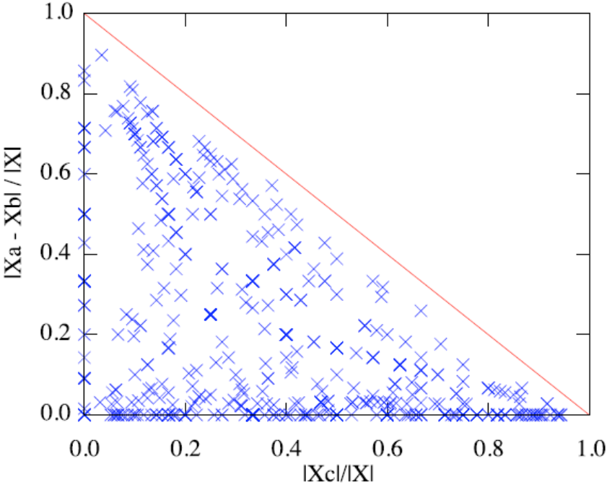
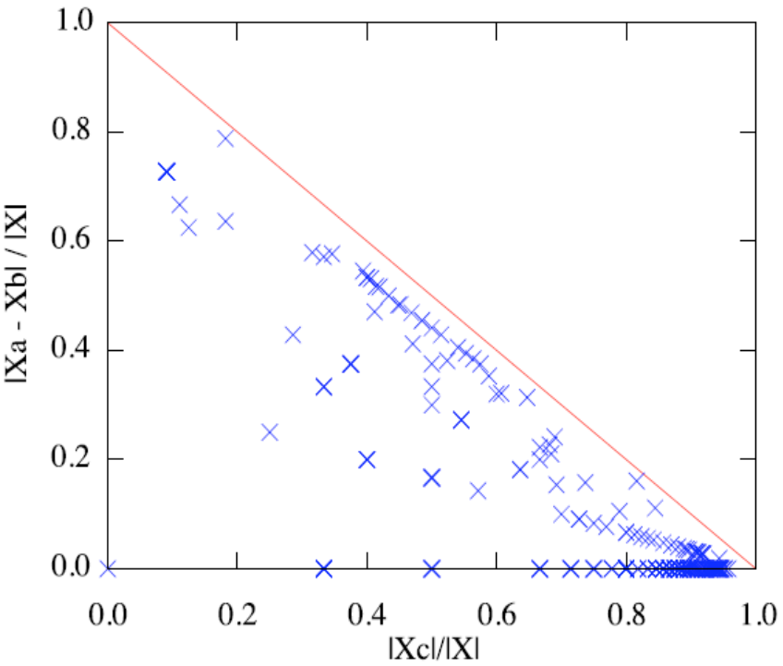
Experimental Results
Variable partition
OR2-decomposition
XOR-decomposition
Notes:
To see the quality of var partition , we perform the following experiments for or and xor bi-decomposition
In decomposing each function, we plot its quality of var partition
X-axis represents disjointness, and y-axis stands for balancedness
The closer the dots to the origin , the better the quality of the var partition
For xor-decomp , there are some structures in the picture.
For a circuit to be xor-decomposable, it usually performs some arithmetic func

Slide 29
Outline
Introduction
Prior Work and Preliminaries
Main Algorithms
Experimental Results
Conclusions and Future Work
Notes:
Now I will summarize the whole algorithm.

Slide 30
Conclusions and Future Work
Conclusions
  We formulated OR, AND, XOR bi-decomposition in terms of SAT solving
  We automated the process of variable partitioning
  Experimental results showed we can bi-decompose
  large Boolean functions
Future Work
  We will study how to effectively enumerate better
  variable partition

Slide 31
Thank You
Notes:
Previous work

