Slide 1
Identifying unknown components of a circuit
Vikas K Rao (University of UTAH)

Slide 2

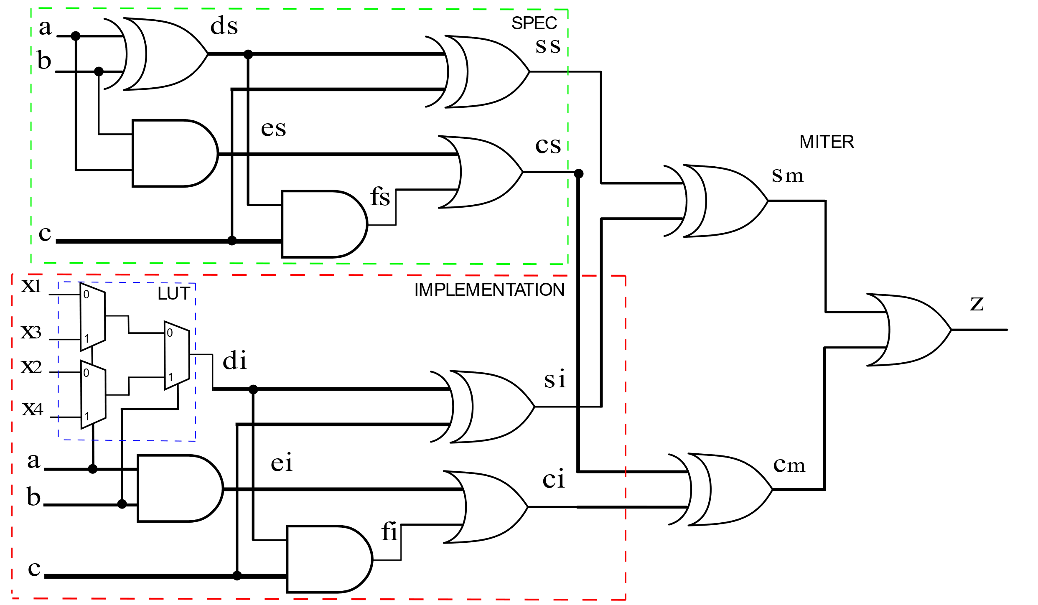



Find the function implemented by the LUT.

Slide 3

Notations
In – Set of all primary input variables – {A,B,C}
X – Set of all parameter variables for each gate transformation – {$X_{1}$, $X_{2}$, $X_{3}$, $X_{4}$ }
Spec(In) – Target specification circuit
Circuit(X, In) – Implementation circuit formula with possible transformations.

Slide 4

Intuition
Given Circuit, Spec and transformations.
Generate complete set of input patterns(${In}_{k}$) which identify all incorrect transformations(X’s).
Generate transformations(X’s) which are correct under complete set of counterexample input values(${In}_{k}$), if exist.

Slide 5
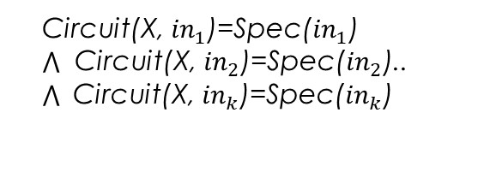
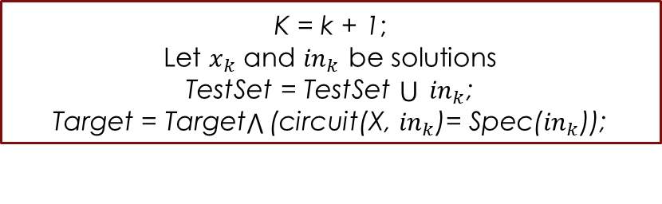
Flowchart
K = 0;
TestSet = {};
Target = (circuit(X, In)≠ Spec(In));
No
Is Target satisfiable?
Yes
K = k + 1;
Let $x_{k}$ and ${in}_{k}$ be solutions
TestSet = TestSet $\bigcup{ }{in}_{k}$;
Target = Target (circuit(X, ${in}_{k}$)= Spec(${in}_{k}$));
Is
Circuit(X, ${in}_{1}$)=Spec(${in}_{1}$)
Circuit(X, ${in}_{2}$)=Spec(${in}_{2}$)..
Circuit(X, ${in}_{k}$)=Spec(${in}_{k}$)
No
Satisfiable?
No correct transformation
Yes
Any solution is a correct transformation

Slide 6
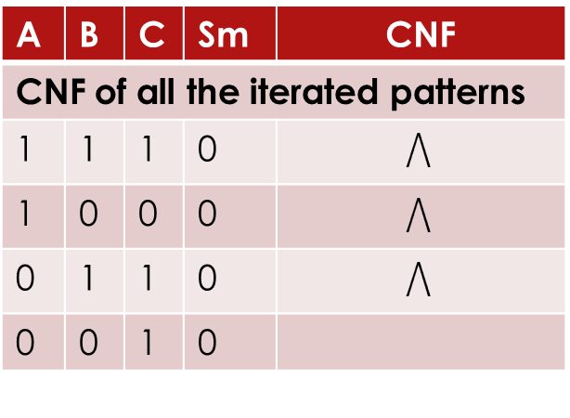
In = {A,B,C} -> primary input counterexamples generated
Sm = constrained output of miter for circuit
Sm = 1 (Circuit(X,In) ≠ Spec(In))
Sm = 0 (Circuit(X,In) = Spec(In))
X = {x1,x2,x3,x4} -> parameter inputs of LUT generating transformations
A | B | C | Sm | x1 | x2 | x3 | x4
Iteration 1
1 | 1 | 1 | 1 | 0 | 0 | 0 | 1
Iteration 2
1 | 1 | 1 | 0 | 1 | 0 | 0 | 0
1 | 0 | 0 | 1 | 1 | 0 | 0 | 0
Iteration 3
1 | 0 | 0 | 0 | 0 | 0 | 1 | 0
0 | 1 | 1 | 1 | 0 | 0 | 1 | 0
Iteration 4
0 | 1 | 1 | 0 | 1 | 1 | 1 | 0
0 | 0 | 1 | 1 | 1 | 1 | 1 | 0
Iteration 5 - UNSAT
A | B | C | Sm | CNF
CNF of all the iterated patterns
1 | 1 | 1 | 0
1 | 0 | 0 | 0
0 | 1 | 1 | 0
0 | 0 | 1 | 0
CNF decision | x1 | x2 | x3 | x4 | Comment
SAT | 0 | 1 | 1 | 0 | Any solution is correct
UNSAT | - | - | - | - | No transformation exists

Slide 7
What does this mean to us?
We have the buggy points in the variety from Standard Monomials.
We have the only correct points in the buggy circuit from remainder evaluation.
The miter formulated under weak nullstellensatz can be solved for a unit Grobner basis(GB).
We will have a lexicographic term order in RTTO with variable order traversed from primary outputs towards inputs and also having the parameter variable X’s in the end.
If the GB is unity, then the Circuit conforms to the Spec.
If it is not unity, then there is one ideal from the GB which is in terms of X’s only.
Given the above pointers, can we find the parameter assignment(gate correction) and bug location?

Slide 8
Example -Backup
Iteration 1
Iteration 2
Iteration 3
A | B | C | Sm | x1 | x2 | x3 | x4
1 | 1 | 1 | 1 | 0 | 0 | 0 | 1
 |  |  | 0 | 0 | 0 | 0 | 0
 |  |  | 0 | 0 | 0 | 1 | 0
 |  |  | 0 | 0 | 1 | 0 | 0
 |  |  | 0 | 1 | 0 | 0 | 0
 |  |  | 0 | 0 | 1 | 1 | 0
 |  |  | 0 | 1 | 0 | 1 | 0
 |  |  | 0 | 1 | 1 | 0 | 0
 |  |  | 0 | 1 | 1 | 1 | 0
Learnt clause – X4 should be 0
A | B | C | Sm | x1 | x2 | x3 | x4
1 | 0 | 0 | 1 | 1 | 0 | 0 | 0
 |  |  | 0 | 0 | 0 | 1 | 0
 |  |  | 0 | 0 | 1 | 1 | 0
 |  |  | 0 | 1 | 0 | 1 | 0
 |  |  | 0 | 1 | 1 | 1 | 0
Learnt clause – X3 should be 1
A | B | C | Sm | x1 | x2 | x3 | x4
0 | 1 | 1 | 1 | 0 | 0 | 1 | 0
 |  |  | 0 | 0 | 1 | 1 | 0
 |  |  | 0 | 1 | 1 | 1 | 0
Learnt clause – X2 should be 1
Iteration 4
A | B | C | Sm | x1 | x2 | x3 | x4
0 | 0 | 1 | 1 | 1 | 1 | 1 | 0
 |  |  | 0 | 0 | 1 | 1 | 0
Final parameter assignment
In = {A,B,C} -> primary input counterexamples generated
Sm = constrained output of miter for circuit
Xi = {x1,x2,x3,x4} -> parameter inputs of LUT generating transformations

Slide 9
Procedure - backup
Find a counterexample with input pattern In such that Circuit and Spec differ for some parameter variable X assignment.
If SAT, a clause is learnt which constraints the parameter variable assignments and reduces the solution space. Find all the solution space for the given In which makes it conform to the Spec.
Find more counterexamples on In with a limitation on the X assignments learnt from 2.
Once 3 is UNSAT, find a common assignment to X for all counterexample In’s which makes the Circuit equal to Spec.

