Slide 1

FRAIGs - A Unifying Representation for Logic Synthesis and Verification
- Alan Mishchenko, Satrajit Chatterjee, Roland Jiang, Robert Brayton
ERL Technical Report, EECS Dept., UC Berkeley, March 2005.
Class presentation by
Santosh Khasanvis

Slide 2
Outline
Introduction
Previous Work
FRAIGs – Definition & Construction
Applications
Basic ABC Commands
Summary

Slide 3
Introduction
AIGs are Boolean networks composed of 2-input AND-gates and Inverters with considerable implementation advantages.
Uniform representation for multi-level logic.
Construction time and size proportional to circuit size (in contrast to canonical BDD).
Enhanced with random simulation and Boolean satisfiability (SAT), they can efficiently solve problems in logic synthesis and verification.

Slide 4
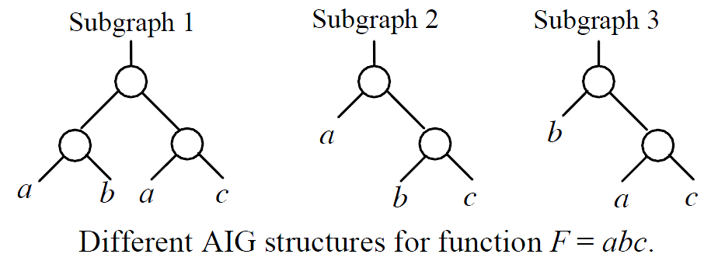
Functional Reduction
AIGs are not canonical – may contain syntactically distinct but functionally equivalent (redundant) internal nodes.
Operations on such AIGs are inefficient and time consuming.
Detecting and merging functionally equivalent nodes is called functional reduction.
“DAG-Aware AIG Rewriting A Fresh Look at Combinational Logic Synthesis” - Alan Mishchenko, Satrajit Chatterjee, Roland Jiang, Robert Brayton, DAC’06 Proceedings of the 43rd annual Design Automation Conference

Slide 5
Previous Work on AIG Functional Reduction
AIGs initially built using structural hashing (strashing) and post-processed optionally to enforce functional reduction.
BDD Sweeping [1]
Constructs BDDs of the AIG nodes in terms of primary inputs (PIs) and intermediate variables.
A pair of AIG nodes with same BDDs are merged.
Resource limits restrict BDD size.
SAT Sweeping [2]
Achieves the same by solving topologically ordered SAT problems designed to prove or disprove equivalence of cut-point pairs.
Candidate pairs are detected using simulation.
[1] A. Kuehlmann, et.al., “Robust boolean reasoning for equivalence checking and functional property verification”, IEEE Trans. CAD, Vol. 21(12), 2002, pp. 1377-1394.
[2] A. Kuehlmann, “Dynamic Transition Relation Simplification for Bounded Property Checking”. Proc. ICCAD ‘04.

Slide 6
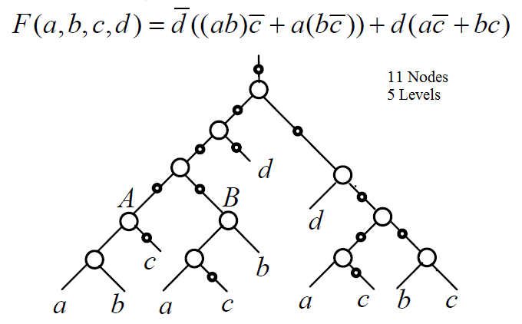
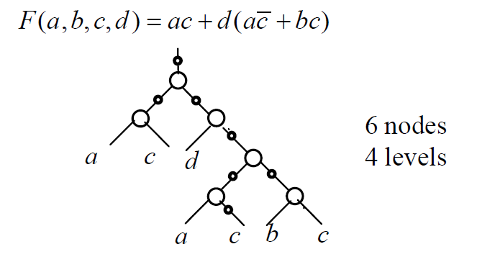
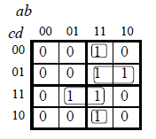
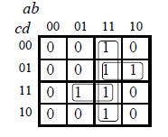
FRAIGs
Definition. A functionally reduced AIG (FRAIG) is an AIG, in which, for any two AIG nodes ‘n1’ and ‘n2’,
f_{n1}(x) ≠ f_{n2}(x) and f _{n1}(x) ≠ f _{n2}(x)
Where f_{n}(x), is a Boolean function of the logic cone rooted in node ‘n’ and expressed in terms of the PI variables x assigned to the leaves of the AIG.
Eg: Functionally Redundant AIG
Eg: FRAIG
ab(c‘)
FRAIGs - A Unifying Representation for Logic Synthesis and Verification

Slide 7
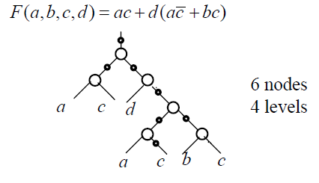
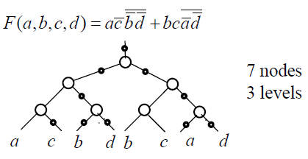
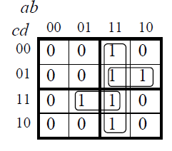
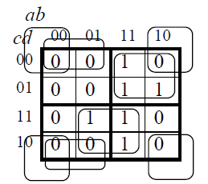
FRAIGs
FRAIGs are semi-canonical.
Different FRAIGs for the same function
FRAIGs - A Unifying Representation for Logic Synthesis and Verification

Slide 8
Main Contributions
Algorithm for on-the-fly Functional Reduction during AIG construction – Functionally Reduced AIGs.
A new lossless logic synthesis methodology.
Unifying logic synthesis and verification with applications to technology mapping.

Slide 9
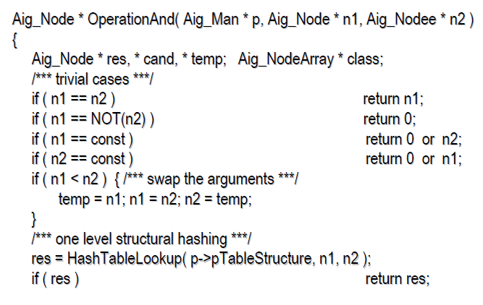
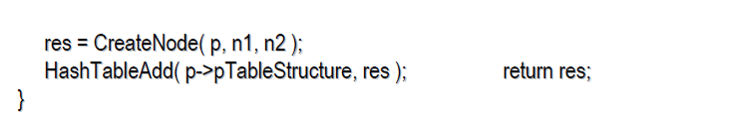
Traditional AIG Construction Algorithm

Slide 10
Traditional AIG Construction Illustrated
Trivial Cases: (n₁ = n₂) ? -> n1
(n₁ = n₂’)? -> 0
(n₁ = const)? -> 0 or n2
(n₂ = const)? -> 0 or n1
p
New Node
n1
n2
Order Inputs: (n₁ < n₂) ? -> swap arguments
Look-up
/****** One-Level Structural Hashing ************/
When a new AND-gate is added, checks are performed for a node with the same fan-in.
Hash Table
p1
p2
n2
Hash Table Lookup: If matched, then return res (representative node)
Else, create new node.
n1
n2
n1
If Match
res
p
Else
p3
p4
n1
n2
n1
n2
n1
n2
n1
n2

Slide 11
FRAIG Construction Algorithm
Enhances traditional algorithm by using random simulation and Boolean Satisfiability (SAT) to achieve functional reduction.
Random Simulation is used to check for potentially equivalent nodes (simulation class).
Also works as a quick method to prove functional uniqueness.
SAT is called for equivalence checking of the candidate nodes derived from simulation (equivalence class).
SAT is the most time consuming operation.

Slide 12
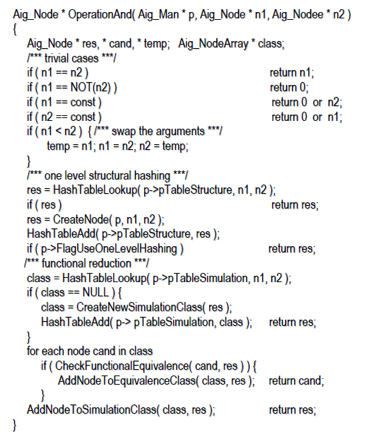
FRAIG Construction

Slide 13
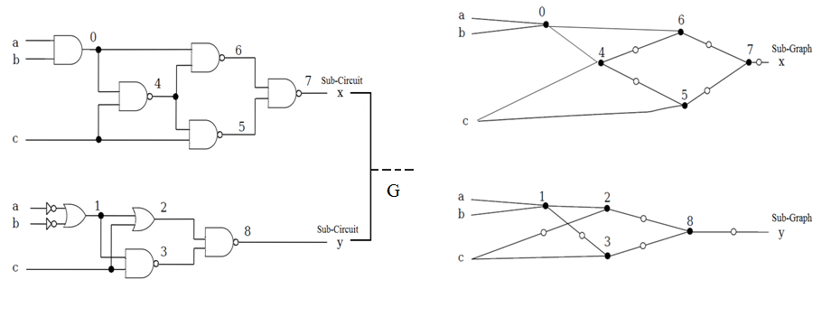
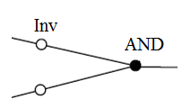
FRAIG Construction Illustrated
Example Circuit
Sub-Graph for x
Sub-Graph for y
Legend:
Adapted From 'Equivalence Checking' - Sean Weaver, - http://gauss.ececs.uc.edu/Courses/c626/lectures/SAT/Equivalence_Checking_11_30_08.pdf

Slide 14
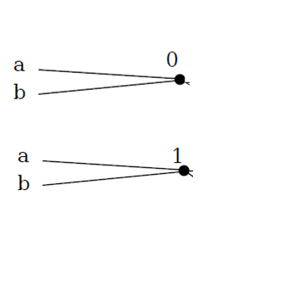
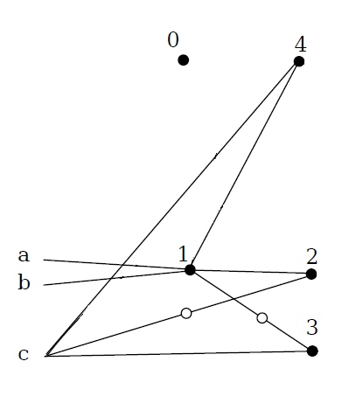
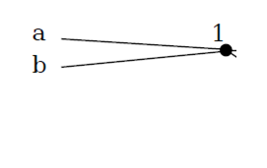
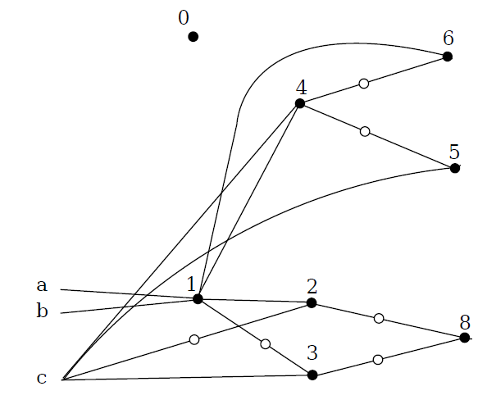
FRAIG Construction Illustrated
No Strashing Possible
Random Simulation to Generate Hash Simulation Table
Sim_Class 1: {2}
Sim_Class 2: {3}
Sim_Class 3: {4}
Sim_Class = set of candidate nodes for equivalence
2
1
1-Level
Strashing
No Strashing Possible
Random Simulation to Generate Hash Simulation Table
Sim_Class 1: {3,5}
Sim_Class 2: {2,6}
Sim_Class 3: {4}
3
Run SAT Solver:
Result 1: 3 = 5
Result 2: 2 = 6
Adapted From 'Equivalence Checking' - Sean Weaver, - http://gauss.ececs.uc.edu/Courses/c626/lectures/SAT/Equivalence_Checking_11_30_08.pdf

Slide 15
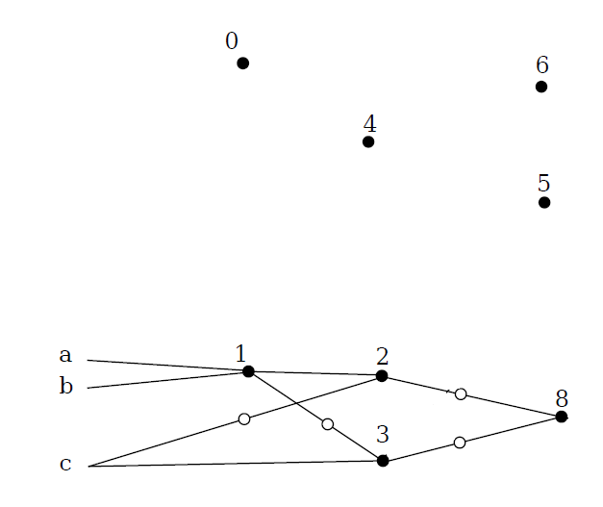
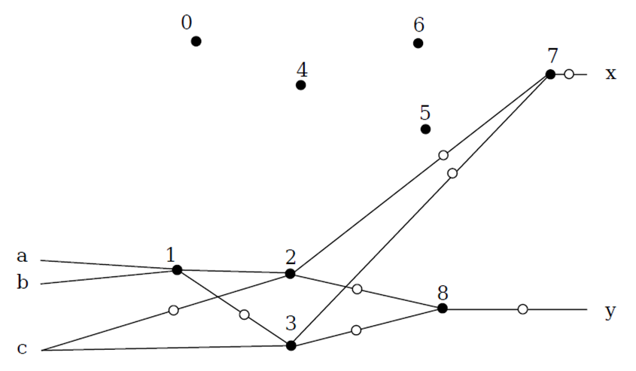
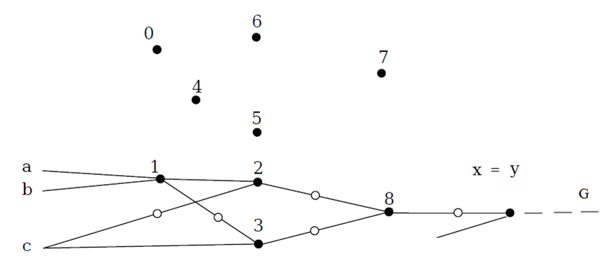
FRAIG Construction Illustrated
Reduce
5 -> 3
6 -> 2
4
5
“Structural Record”
1 Level Strashing
6
Reduce
7 -> 8
Adapted from 'Equivalence Checking' - Sean Weaver, - http://gauss.ececs.uc.edu/Courses/c626/lectures/SAT/Equivalence_Checking_11_30_08.pdf

Slide 16
Applications of FRAIGs
Traditional Logic Synthesis – Compact circuits by detecting and merging functionally equivalent nodes.
Network nodes are constructed in terms of the PI variables.
Nodes, represented by the same FRAIG node, are grouped into classes of equivalent functionality.
One representative of each class is selected and used for equivalent nodes.

Slide 17
Applications of FRAIGs
2. “Lossless” Logic Synthesis & Technology Mapping
Accumulates all intermediate logic representations for final selection later.
Several versions of the network are FRAIGed into one AIG.
Internally records structural alternatives.
Technology mapping works on the cumulative AIG and selects best mapping of available choices.

Slide 18
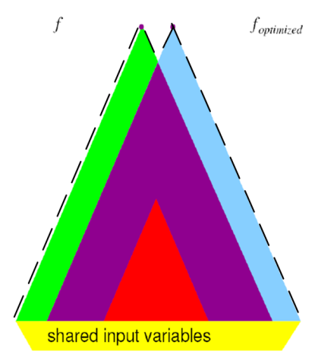
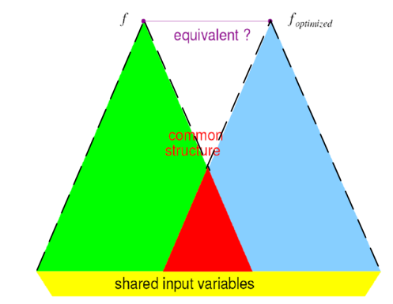
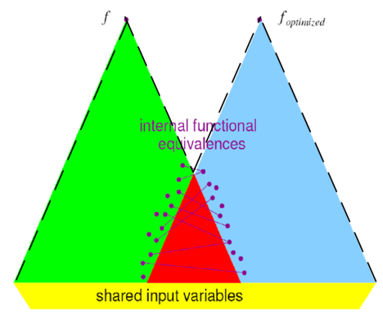
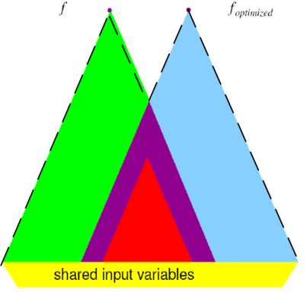
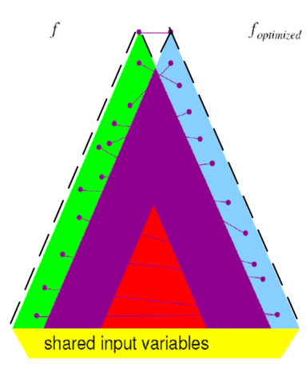
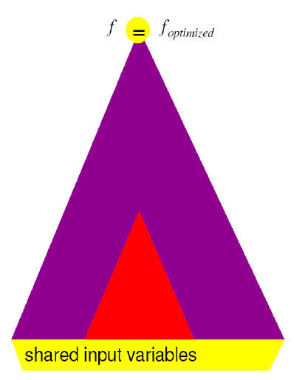
Applications of FRAIGs
3. Formal Verification:
FRAIGs are constructed on-the-fly.
The circuits are equivalent iff the corresponding pairs of outputs are represented by the same FRAIG nodes.
Adapted from 'Equivalence Checking' - Sean Weaver, http://gauss.ececs.uc.edu/Courses/c626/lectures/SAT/Equivalence_Checking_11_30_08.pdf

Slide 19
ABC Commands - FRAIG
fraig – Transforms network into FRAIG.
Options
-n : No strashing
-r : Disable functional reduction (FR)
-c : toggle alternate-structure recording
fraig_store – Stores the current network as one “synthesis snapshot” in the internal AIG database to be restored and used for technology mapping later.
fraig_restore – Converts the currently stored AIG snapshots into a FRAIG and sets it to be the current network, to which technology mapping can now be applied. The AIG database is reset by calling this command
fraig_clean – Resets the AIG database without restoring it.
cec - Performs equivalence check (FRAIGing + SAT approach by default)

Slide 20
Summary
Algorithm for constructing FRAIGs on-the-fly.
FRAIGs are semi-canonical.
Unify Logic Synthesis and Verification.
Default number of simulation vectors is 2¹².
CEC performance using FRAIGs is on par with state-of-the-art academic equivalence checkers.

Slide 21

Questions?

