Slide 1
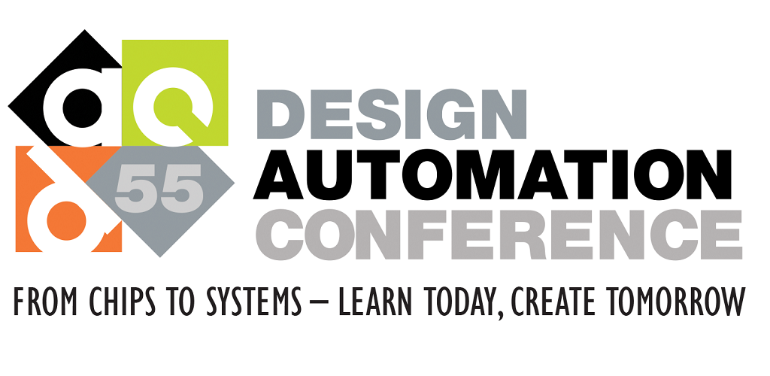

Resolving Unknown Components in Finite Field Arithmetic Circuits using Computer Algebra Methods
Vikas K Rao, Dr. Priyank Kalla
University of Utah

