Slide 1

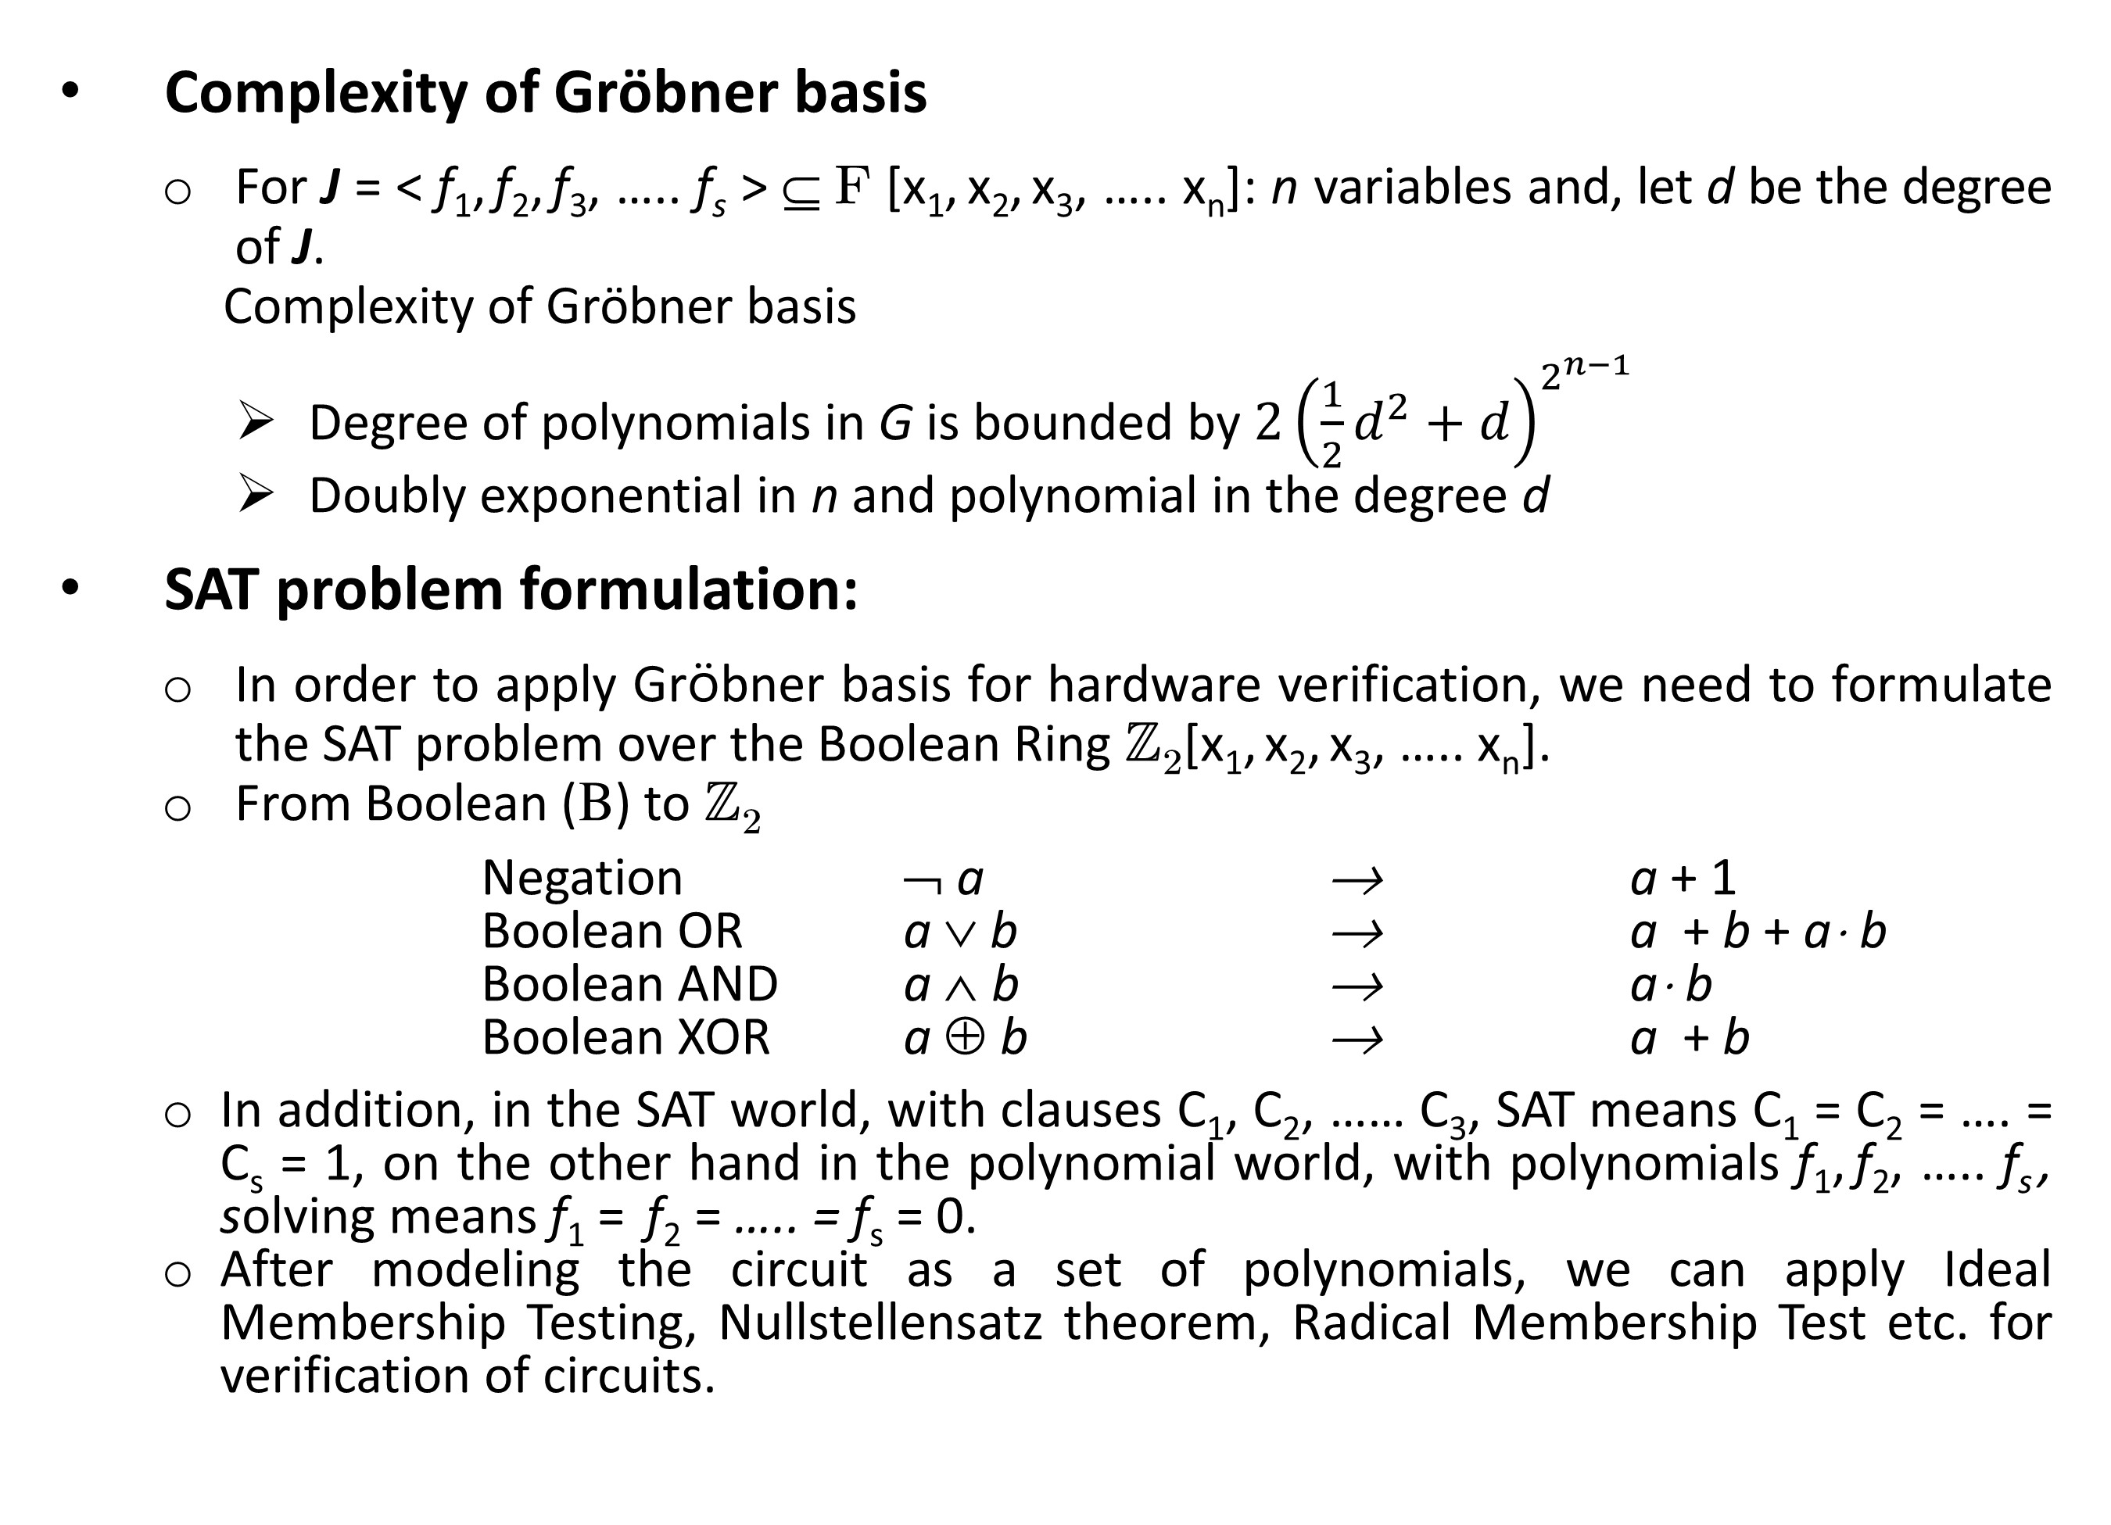
Hardware Verification Using Boolean Gröbner Bases
Utkarsh Gupta
Research Advisor: Dr. Priyank Kalla
University of Utah
1. Introduction
Complexity of Gröbner basis
For J = < f₁, f₂, f₃, ….. f_{s} > Í F [x₁, x₂, x₃, ….. x_{n}]: n variables and, let d be the degree of J.
Complexity of Gröbner basis
Degree of polynomials in G is bounded by $2{\left(\frac{1}{2}d^{2}+d\right)}^{2^{n−1}}$
Doubly exponential in n and polynomial in the degree d
SAT problem formulation:
In order to apply Gröbner basis for hardware verification, we need to formulate the SAT problem over the Boolean Ring ℤ₂[x₁, x₂, x₃, ….. x_{n}].
From Boolean (B) to ℤ₂
Negation Ø a ® a + 1
Boolean OR a Ú b ® a + b + a× b
Boolean AND a Ù b ® a× b
Boolean XOR a Å b ® a + b
In addition, in the SAT world, with clauses C₁, C₂, …… C₃, SAT means C₁ = C₂ = …. = C_{s} = 1, on the other hand in the polynomial world, with polynomials f₁, f₂, ….. f_{s} , solving means f₁ = f₂ = ….. = f_{s} = 0.
After modeling the circuit as a set of polynomials, we can apply Ideal Membership Testing, Nullstellensatz theorem, Radical Membership Test etc. for verification of circuits.
Hardware verification is the process of checking whether a circuit design satisfies some requirements or matches a specification model.
Different approaches are used for this problem, e.g. CNF-SAT (Conjunctive Normal Form - Satisfiability), by using concepts of Gröbner basis etc.
Gröbner basis is a concept from commutative algebra and algebraic geometry, which allows to solve many polynomial decision questions.
A Gröbner basis is a canonical representation of a set of polynomials that generate an ideal in a polynomial ring.
Gröbner basis are computed using the Buchberger's algorithm.
The complexity of Gröbner bases is not very pleasant and is doubly exponential in the number of variables and polynomial in degree of the ideal.
Many approaches presented to overcome this complexity but still there are instances in circuit equivalence checking where these approaches do not work efficiently.
The focus of my research work is on further improving this complexity so that even the circuits with random logic (that encounters an explosion in the number of terms with the previous approaches) can be verified using Gröbner bases.
3. Previous Work
2. Preliminaries
Gröbner bases can solve verification problem independently using the techniques mentioned above, or can aid in the process by analyzing the problem structure [5].
Either of the approaches requires the computation of Gröbner bases, which is computationally very expensive.
An approach to overcome this limitation is by analyzing the circuit topology and deriving a term order (reverse topological order) to represent the polynomials [3].
This term ordering renders the set of polynomials itself a Gröbner basis, thus obviating the need for Buchberger’s algorithm.
This approach is further improved by exploiting the concepts of F4 algorithm for Gröbner basis so that the verification test is formulated as Gaussian elimination on a matrix representation of the problem.
Another approach for equivalence verification of large Galois field arithmetic circuits is by deriving word-level canonical polynomial representation from gate level circuits [4].
The output vector Z is derived in terms of input vector A, i.e. Z = F(A) over F₂^{k}
It is shown that the polynomial F(A) can be derived by computing a Gröbner basis of the polynomials corresponding to the circuit, using a specific elimination term order based on the circuit’s topology.
Polynomial Rings:
Let F be a field (any field: ℝ, ℚ, ℂ, ℤ_{p}), then, R = F[x₁, x₂, x₃, ….. x_{n}] denotes the set (ring) of all polynomials in x₁, x₂, x₃, ….. x_{n} (including constants), with coefficients in F.
Ideals of Polynomials:
Let f₁, f₂, f₃, ….. f_{s} Î R = F[x₁, x₂, x₃, ….. x_{n} ].
Let J = < f₁, f₂, f₃, ….. f_{s} > = { f₁ h₁ + f₂ h₂ + f₃ h₃ …… + f_{s} h_{s} : h₁, h₂,….. hs Î R}
Then, J = < f₁, f₂, f₃, ….. f_{s} > is an ideal generated by f₁, f₂, f₃, ….. f_{s} and the polynomials are called generators(basis) of J.
An ideal may have many different generators. It is possible to have:
J = < f₁, f₂, f₃, ….. f_{s} > = < p₁, p₂, p₃, ….. p_{l} > = ……. = < g₁, g₂, g₃, ….. g_{t} >
Varieties of Ideals:
Given R = F[x₁, x₂, x₃, ….. x_{n}], f₁, f₂, f₃, ….. f_{s} Î R, let J = < f₁, f₂, f₃, ….. fs > Í R. The set of all solutions to:
f₁ = f₂ = f₃ = ….. = f_{s} = 0
is called the variety V(f₁, f₂, f₃, ….. f_{s} )
Variety depends not just on the given set of polynomials f₁, f₂, f₃, ….. f_{s} , but rather on the ideal J = < f₁, f₂, f₃, ….. f_{s} > generated by these polynomials.
Gröbner Basis Computation:
The computation of Gröbner basis can be categorized into two major cases
Univariate Polynomial Rings: polynomial ring R contains polynomials in one variable, i.e. R = F [x].
For ideal J = < f₁, f₂, f₃, ….. f_{s} >, Gröbner basis { f₁, f₂, f₃, ….. f_{s} }
= GCD (f₁, GCD(f₂, f₃, ….. f_{s}) ).
GCD of these polynomials can computed using the Euclidean algorithm.
The division of polynomials required in Euclidean algorithm can be carried out using polynomial long-division method.
Univariate rings are not of much use in hardware verification.
Multivariate Polynomial Rings: polynomial ring R contains polynomials in multiple variables, i.e. , R = F [x₁, x₂, x₃, ….. x_{n}].
For this case, Buchberger’s algorithm is used to compute Gröbner basis for an ideal J = < f₁, f₂, f₃, ….. f_{s} >.
Division (used in Buchberger’s algorithm) is cancellation of leading terms.
For multivariate polynomials, the leading term cannot be identified just on the basis of degree (as there are multiple variables).
A term ordering is imposed on the variables to uniquely identify the leading term.
There are many different term orderings like lexicographic, degree lexicographic, degree reverse lexicographic etc.
4. References
[1] W. W. Adams, and P. Loustaunau, An Introduction to Gröbner bases. American Mathematical Society, 1994.
[2] David Cox, John Little, and Donal O’ Shea, Ideals, Varieties, And Algorithms: An Introduction to Computational Algebraic Geometry and Commutative Algebra. Springer, 2007.
[3] J. Lv, P. Kalla, and F. Enescu, “Efficient Gröbner Basis Reductions for Formal Verification of Galois Field Arithmetic Circuits” in IEEE Trans. on CAD, vol. 32, no. 9, 2013, pp 1409-1420.
[4] T. Pruss, P. Kalla, and F. Enescu, “Equivalence Verification of Large Galois Field Arithmetic Circuits using Word-Level Abstraction via Gröbner Bases”, in Proc. Design Automation Conference (DAC), 2014.
[5] C. Condrat, and P. Kalla, “A Gröbner bases Approach to CNF-formulae Preprocessing”, in International Conference on Tools and Algorithms for the Construction and Analysis of Systems, 2007, pp. 618-631.

