Slide 1

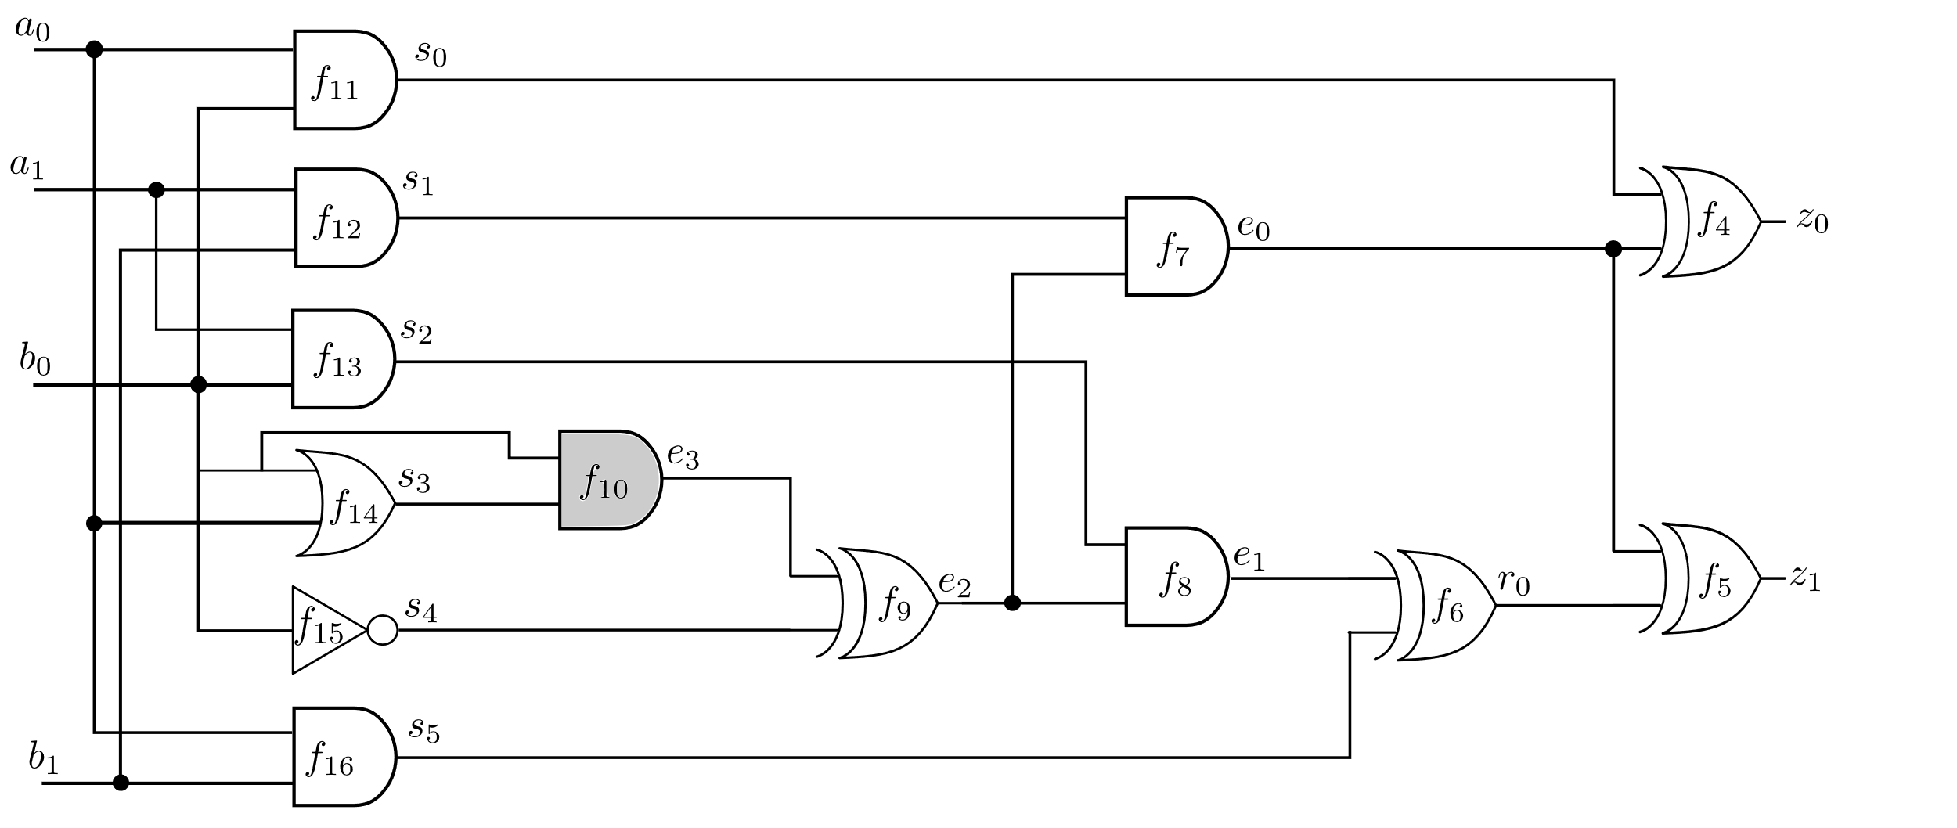
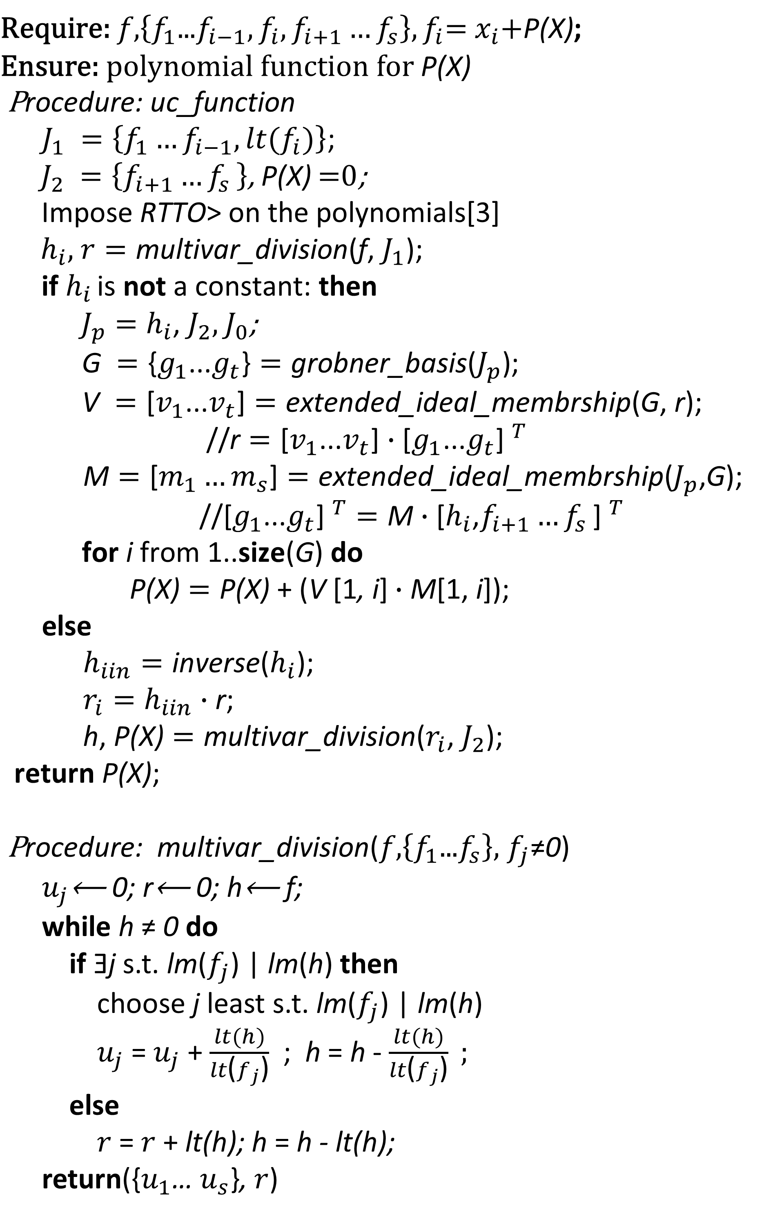
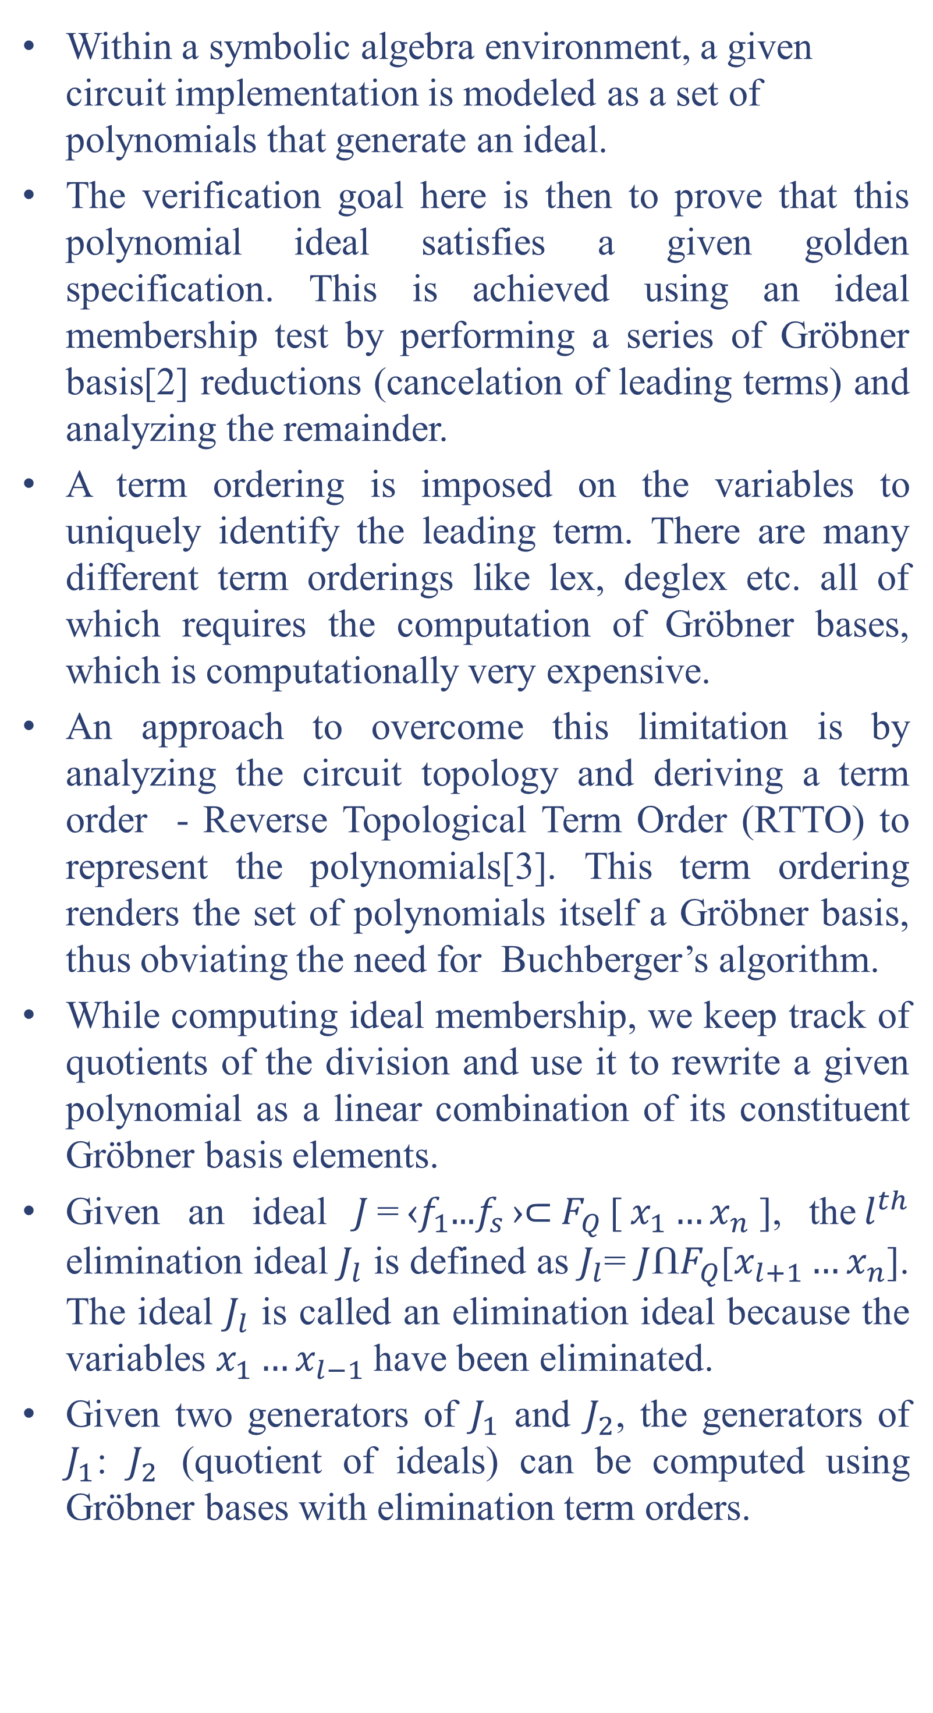
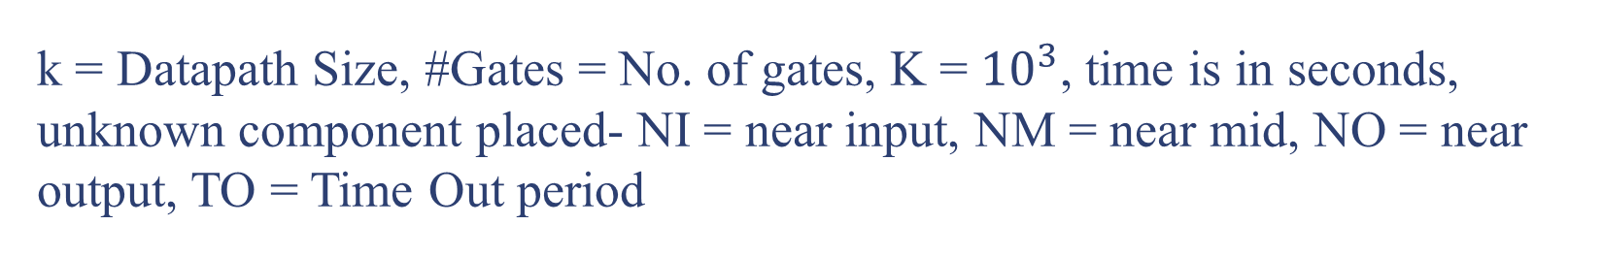

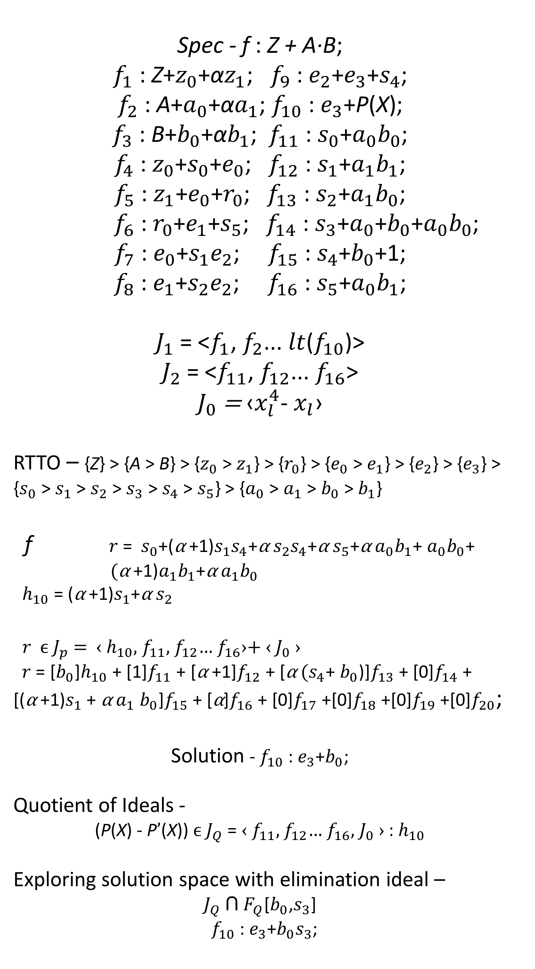
Resolving Unknown Components In Finite Field Arithmetic Circuits Using Computer Algebra Methods
Vikas Rao¹, Utkarsh Gupta¹, Irina Ilioaea², Priyank Kalla¹, and Florian Enescu²
¹Electrical & Computer Engineering, University of Utah
²Mathematics & Statistics, Georgia State University
WHAT IS IT ABOUT
HOW DOES IT WORK
EXPERIMENTS
Addressing post-verification debugging and automatic correction which occurs in logic synthesis during ECO.
Contemporary techniques (SAT/simulation) demand bit-blasting and are considered infeasible for debugging arithmetic circuits[1].
This paper presents an algebraic approach to resolve functionality of an unknown component formulated as polynomial ideal membership test.
The solution space of the unknown component is explored addressed as a synthesis challenge using concepts from the quotient of ideals.
A Grobner basis[2] based algorithm is implemented for a systematic, goal driven search of implementable solutions.
Results are presented on some experiments performed over various finite field arithmetic circuits to compare the efficiency of our approach against recent SAT-based approach[1].
k = Datapath Size, #Gates = No. of gates, K = ${10}^{3}$, time is in seconds, unknown component placed- NI = near input, NM = near mid, NO = near output, TO = Time Out period
Mastrovito v/s Word level Spec
k | #Gates | NO | NM | NI
11 | 0.35K | 0.1 | 0.1 | 0.1
12 | 0.97K | 0.5 | 0.4 | 0.4
13 | 0.82K | 0.2 | 0.2 | 0.3
16 | 1.8K | 1.1 | 1.0 | 1.1
32 | 5.4K | 150.3 | 47.3 | 42.4
64 | 21.8K | 10020 | 2575 | 2432
Mastrovito implementation v/s Montgomery Spec
$\text{Require}\text{: }f\text{,}\left\{f_{1}\text{...}f_{i−1},f_{i},f_{i+1}…f_{s}\right\},f_{i}\text{=}{ x}_{i}\text{+}\text{P}\text{(}\text{X}\text{)}$;
$$\text{En}\text{sure}\text{: }\text{polynomial} \text{function} \text{for} \text{P}\text{(}\text{X}\text{)}$$
$$\text{P}\text{rocedure}\text{:} \text{uc}\text{_}\text{function}$$
$J_{1} =\left\{f_{1}…f_{i−1},lt(f_{i})\right\}$;
${ J}_{2} =\left\{f_{i+1}{…f}_{s}\right\}$, $\text{P}\text{(}\text{X}\text{)}$=0;
$\text{I}\text{mpose} \text{RTTO}\text{> }\text{on} \text{the} \text{polynomials}\text{[3] }$
$h_{i}\text{,}{ r}_{ }=\text{multivar}\text{_}\text{division}\text{(}\text{f}\text{,}{ J}_{1}\text{)}\text{; }$
$\text{if} h_{i }\text{is} \text{not} \text{a} \text{constant}\text{: }\text{then}$
$J_{p}=h_{i}\text{,}{ J}_{2},{ J}_{0}$;
$\text{G} =\text{\{}g_{1}\text{...}g_{t}\text{\}}=\text{g}\text{robner}\text{_}\text{bas}\text{i}\text{s}\text{(}J_{p}\text{)}$;
$\text{V} =\text{[}v_{1}\text{...}v_{t}\text{]}=\text{ext}\text{e}\text{n}\text{ded}\text{_}\text{ideal}\text{_}\text{membrsh}\text{i}\text{p}\text{(}\text{G}\text{,} \text{r}\text{)}\text{;}$
$\text{//}\text{r}=\text{[}v_{1}\text{...}v_{t}\text{]}∙\text{[}g_{1}\text{...}g_{t}\text{]} ^{T}$
$\text{M}=\text{[}m_{1}…m_{s}\text{]}=\text{ext}\text{e}\text{n}\text{ded}\text{_}\text{ideal}\text{_}\text{membrsh}\text{i}\text{p}\text{(}J_{p}\text{,}\text{G}\text{);}$
$\text{//[}g_{1}\text{...}g_{t}\text{]} ^{T}=\text{M}∙\text{[}h_{i}\text{,}f_{i+1}{…f}_{s}\text{]} ^{T}$
$\text{for} \text{i} \text{from}\text{ 1..}\text{size}\text{(}\text{G}\text{) }\text{do}$
$\text{P}\text{(}\text{X}\text{)}=\text{P}\text{(}\text{X}\text{) }\text{+ (}\text{V}\text{ [1}\text{, }\text{i}\text{]}∙\text{M}\text{[1}\text{,} \text{i}\text{]}\text{)}\text{;}$
$\text{else}$
$h_{iin}=\text{inverse}\text{(}h_{i}\text{);}$
$r_{i}=h_{iin}∙\text{r}\text{; }$
$\text{h}\text{,} \text{P}\text{(}\text{X}\text{)}=\text{multivar}\text{_}\text{division}\text{(}r_{i}\text{,}{ J}_{2}\text{);}$
$\text{return} \text{P}\text{(}\text{X}\text{)}\text{;}$
$\text{P}\text{rocedure}\text{: }\text{multivar}\text{_}\text{division}\text{(}f\text{,}\left\{f_{1}\text{...}f_{s}\right\},$ $f_{j}$≠0)
$u_{j}$⟵ 0; r⟵ 0; h⟵ f;
while h ≠ 0 do
if Ǝj s.t. lm($f_{j}$) | lm(h) then
choose j least s.t. lm($f_{j}$) | lm(h)
$u_{j}$ = $u_{j}$ + $\frac{lt(h)}{lt\text{(}f_{j}\text{)}}$ ; h = h - $\frac{lt(h)}{lt\text{(}f_{j}\text{)}} ;$
else
$r$ = $r$+ lt(h); h = h - lt(h);
return({$u_{1}$… $u_{s}$}, $r$)
Spec - f : Z + A·B;
$f_{1}$ : Z+$z_{0}$+α$z_{1}$; $f_{9}$ : $e_{2}$+$e_{3}$+$s_{4}$;
$f_{2}$ : A+$a_{0}$+α$a_{1}$; $f_{10}$ : $e_{3}$+$\text{P}\text{(}\text{X}\text{)}$;
$f_{3}$ : B+$b_{0}$+α$b_{1}$; $f_{11}$ : $s_{0}$+$a_{0}b_{0}$;
$f_{4}$ : $z_{0}$+$s_{0}$+$e_{0}$; $f_{12}$ : $s_{1}$+$a_{1}b_{1}$;
$f_{5}$ : $z_{1}$+$e_{0}$+$r_{0}$; $f_{13}$ : $s_{2}$+$a_{1}b_{0}$;
$f_{6}$ : $r_{0}$+$e_{1}$+$s_{5}$; $f_{14}$ : $s_{3}$+$a_{0}$+$b_{0}$+$a_{0}b_{0}$;
$f_{7}$ : $e_{0}$+$s_{1}e_{2}$; $f_{15}$ : $s_{4}$+$b_{0}$+1;
$f_{8}$ : $e_{1}$+$s_{2}e_{2}$; $f_{16}$ : $s_{5}$+$a_{0}b_{1}$;
$J_{1}$ = <$f_{1}$, $f_{2}$... $lt$($f_{10}$)>
$J_{2}$ = <$f_{11}$, $f_{12}$... $f_{16}$>
$J_{0}$ = ‹$x_{l}^{4}$- $x_{l}$›
RTTO – {Z} > {A > B} > {$z_{0}$ > $z_{1}$} > {$r_{0}$} > {$e_{0}$ > $e_{1}$} > {$e_{2}$} > {$e_{3}$} > {$s_{0}$ > $s_{1}$ > $s_{2}$ > $s_{3}$ > $s_{4}$ > $s_{5}$} > {$a_{0}$ > $a_{1}$ > $b_{0}$ > $b_{1}$}
f $r$ = $s_{0}$+(α +1)$s_{1}s_{4}$+α $s_{2}s_{4}$+α $s_{5}$+α $a_{0}b_{1}$+ $a_{0}b_{0}$+ $(\text{α} \text{+1)}a_{1}b_{1}$+α$a_{1}b_{0}$
$h_{10}$ = (α +1)$s_{1}$+α $s_{2}$
$r$ ϵ $J_{p}$ = ‹ $h_{10},$ $f_{11}$, $f_{12}$… $f_{16}$›+ ‹ $J_{0}$ ›
$r$ = [$b_{0}$]$h_{10}$ + [1]$f_{11}$ + [α +1]$f_{12}$ + [α $(s_{4}$+ $b_{0}$)]$f_{13}$ + [0]$f_{14}$+ [(α +1)$s_{1}$+ α $a_{1}$ $b_{0}$]$f_{15}$+ [α]$f_{16}$+ [0]$f_{17}$+[0]$f_{18}$+[0]$f_{19}$+[0]$f_{20}$;
Solution - $f_{10}$ : $e_{3}$+$b_{0}$;
Quotient of Ideals -
($\text{P}\text{(}\text{X}$) - $\text{P}’\text{(}\text{X}$)) ϵ $J_{Q}$ = ‹ $f_{11}$, $f_{12}$… $f_{16}$, $J_{0}$› : $h_{10}$
Exploring solution space with elimination ideal –
$J_{Q}$Ո $F_{Q}$[$b_{0}$,$s_{3}$]
$f_{10}$ : $e_{3}$+$b_{0}s_{3}$;
k | Gates | Incremental SAT[1] |  |  | Our approach
 |  | NO | NM | NI | NO | NM | NI
10 | 0.7K | 214.3 | 215 | 231 | 0.28 | 0.29 | 0.40
11 | 0.9K | 1999 | 1927 | 2090 | 0.49 | 0.49 | 0.63
12 | 1.6K | 24085 | 23400 | 8676 | 1.49 | 1.68 | 2.26
13 | 1.7K | TO | TO | TO | 2.27 | 2.29 | 2.37
16 | 3K | TO | TO | TO | 13 | 15 | 26
32 | 9.8K | TO | TO | TO | 1204 | 1289 | 1870
PRELIMINARIES
Within a symbolic algebra environment, a given circuit implementation is modeled as a set of polynomials that generate an ideal.
The verification goal here is then to prove that this polynomial ideal satisfies a given golden specification. This is achieved using an ideal membership test by performing a series of Gröbner basis[2] reductions (cancelation of leading terms) and analyzing the remainder.
A term ordering is imposed on the variables to uniquely identify the leading term. There are many different term orderings like lex, deglex etc. all of which requires the computation of Gröbner bases, which is computationally very expensive.
An approach to overcome this limitation is by analyzing the circuit topology and deriving a term order - Reverse Topological Term Order (RTTO) to represent the polynomials[3]. This term ordering renders the set of polynomials itself a Gröbner basis, thus obviating the need for Buchberger’s algorithm.
While computing ideal membership, we keep track of quotients of the division and use it to rewrite a given polynomial as a linear combination of its constituent Gröbner basis elements.
Given an ideal $J$=${\text{‹}f}_{1}\text{...}f_{s}$›⊂$F_{Q}$[$x_{1}…x_{n}$], the$l^{th}$ elimination ideal $J_{l}$ is defined as $J_{l}$= $J$Ո$F_{Q}$[$x_{l+1}…x_{n}$]. The ideal $J_{l}$ is called an elimination ideal because the variables $x_{1}…x_{l−1}$have been eliminated.
Given two generators of $J_{1}$ and $J_{2}$, the generators of $J_{1}$: $J_{2}$ (quotient of ideals) can be computed using Gröbner bases with elimination term orders.
WHAT NEXT?
Employing better data structure and heuristics to compute the unknown component function.
Extending the approach to debug integer arithmetic circuits.
Identify the potential bug locations before marking it as an unknown component.
Verifying if at all a circuit can be rectified at a given location before computing the correction.
Addressing multiple dependent/independent bugs in the design.
$$J_{1}$$
REFERENCES
[1] M. Fujita, “Toward Unification of Synthesis and Verification in Topologically Constrained Logic Design,” Proceedings of the IEEE, 2015
[2] B. Buchberger, “Ein Algorithmus zum Auffinden der Basiselemente des Restklassenringes nach einem nulldimensionalen Polynomideal,” Ph.D. dissertation, University of Innsbruck, 1965.
[3] J. Lv, P. Kalla, and F. Enescu, “Efficient Grobner Basis Reductions for Formal Verification of Galois Field Arithmetic Circuits,” in IEEE Trans. on CAD, vol. 32, no. 9, 2013, pp. 1409–1420.

