Slide 1
How to reason about large integer multipliers (64bits, 128bits, or larger) with BDD
Masahiro Fujita
I have no idea on its connection to algebraic methods

Slide 2
Ways of thinking
BDD (ROBDD) has exponential size for integer multipliers regardless of its ordering
Bryant paper
For formal equivalence checking of multipliers, BDD is still (orders of magnitudes) much better than SAT (BDD is up to 18 bits multipliers whereas SAT is up to 12 bits multiplier)
BMD and its related ones work well for multipliers, if word level design is given
Bryant paper
Hamaguchi paper
Another approach is to allow multiple appearance of variables
Burch paper
Indexed BDD by Jain
Here we would like to utilize the last one for logic verification and optimization
Equivalence checking is up to 104 bits multiplier as of today (April 25)
Can we represent permissible functions (external don’t cares) efficiently by that targeting logic optimization?
Can we formulate the partial logic synthesis problem with BDD with multi-appearance or its related techniques?

Slide 3
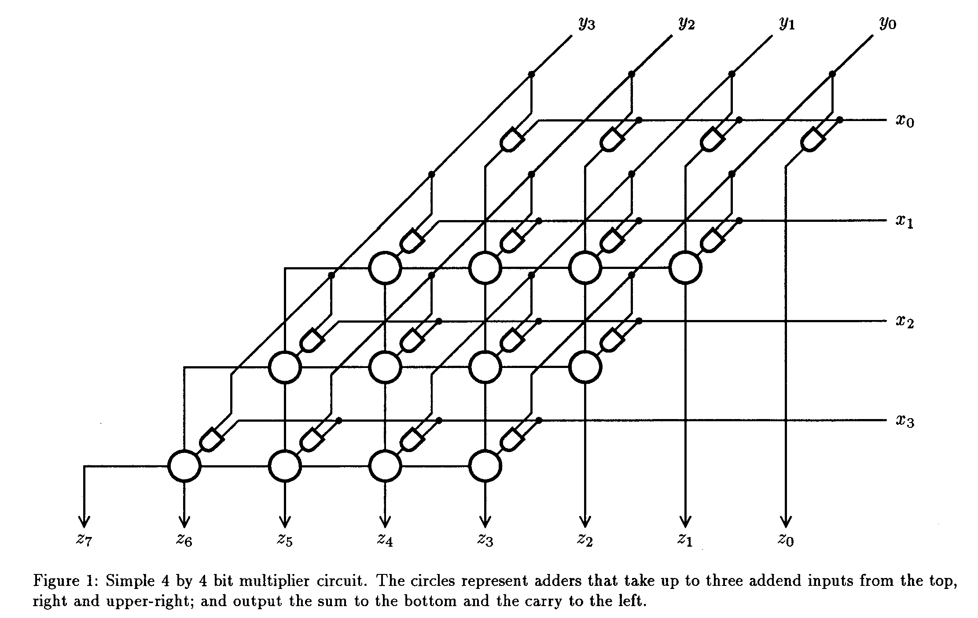
What is Burch method?
Jerry R. Burch: Using BDDs to Verify Multipliers. DAC 1991: 408-412
Works for integer multipliers which are based on partial products
Booth multiplier must be analyzed with extra steps (shown in the paper)
For each partial product, use different variables as shown right
Still canonical representation: EQ checking is easy
Number of input variables becomes 2n² for n bits multiplier

Slide 4
Issues for Booth multiplier
The following is discussed in Burch paper:
As an example, consider a signed, radix 2, Booth encoded multiplier [14].
We apply fanout splitting to each of the inputs, and to the outputs of the recoders.
Fanout splitting on nodes that are not inputs requires replicating the circuitry (the recoders in this case) that drives each node being split.
We have constructed a specification for an n by n bit multiplier of this kind that requires 3n² variables and exactly 10n³ – lln2 + n + 8 BDD nodes, when n >2.
This result has been empirically confirmed for n up to 16.

Slide 5
Web site for multiplier generation
Arithmetic Module Generator at Tohoku University
https://www.ecsis.riec.tohoku.ac.jp/topics/amg/i-amg/
Input word length (4 - 64)
Number representation system: Unsigned binary / 2’s complement
Partial product generator: Simple PPG / PPG with Radix-4 modified Booth
Partial product accumulator: Array, Wallace tree, Balanced delay tree, Overturned-stairs tree, Dadda tree, (4:2) compressor tree, (7:3) counter tree, Redundant binary addition tree
Final stage adder: Ripple carry adder, Carry look-ahead adder, Kogge-stone adder, Brent-Kung adder, Han-Carlson adder, Carry select adder, Conditional sum adder, Ripple-block carry look-ahead adder, Block carry look-ahead adder, Carry-skip adder, Lander-Fischer adder

Slide 6
Size of BDD for multipliers with Burch method
bits |  | L to H order | H to L order | Burch paper L to H (theoretical)
17 | 119,079,286
18 | 343,517,163
19 | NodeOver
24 |  | 547,103 | 51,757 | 640,640
32 |  | 1,793,351 | 124,813 | 1,993,045
40 |  | 4,485,387 | 246,253 | 4,853,547
48 |  | 9,460,947 | 428,365 | 10,080,256
49 |  | 10292769 | 456,007 | 10,950,357
50 |  |  | 484,813 | 11,875,933
56 |  | 17753243 | 683,437 | 18,727,893
64 |  | 30,592,099 | 1,023,757 | 32,047,787
72 |  | 49,403,079 | 1,461,613 | 51,487,872
78 |  |  | 1,861,405 | 71,066,216
80 |  | 75,804,207 | 2,009,293 | 78,692,693
88 |  | 111,608,983 | NodeOver | 115,503,403
96 |  | 158,827,519 |  | 163,957,760
104 |  | 219,666,535 |  | 226,290,133
112 |  |  |  | 304,931,499
120 |  |  |  | 402,509,440
128 |  |  |  | 521,848,149
Numbers of nodes at primary outputs
H to L order need more nodes for internal signals
NodeOver: Number of nodes exceeds 2³²-1 during processing

Slide 7

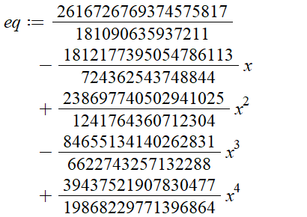
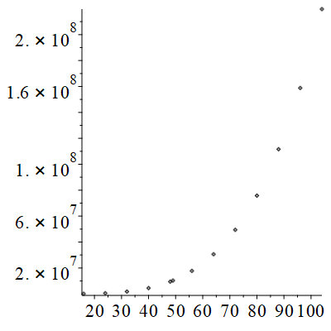
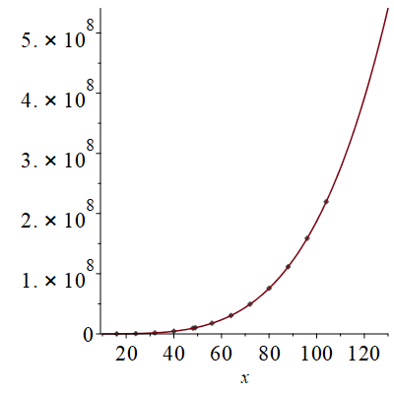
BDD generation using Burch’s method: L to H
Data1 := [[16, 101371], [24, 547103], [32, 1793351], [40, 4485387], [48, 9460947], [49, 10292769], [56, 17753243], [64, 30592099], [72, 49403079], [80, 75804207], [88, 111608983], [96, 158827519], [104, 219666535]]
Eq(256)≒ 8.32*10⁹
This is approximate (under least square)

Slide 8
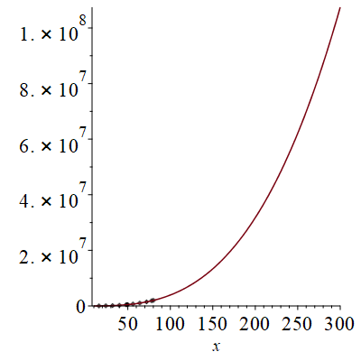
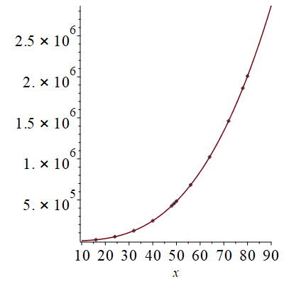
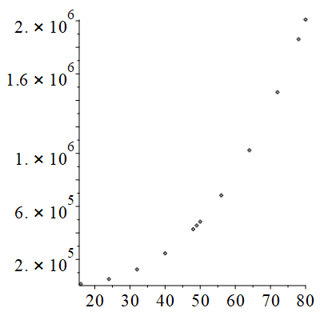
BDD generation using Burch’s method: H to L
This is precise for all results
eq := LeastSquares(Data1, x, curve = a*x^3 + b*x^2 + c*x + d);
eq := 4 x ³ - 6 x ² - 4 x + 13
Data1 := [[16, 14797], [24, 51757], [32, 124813], [40, 246253], [48, 428365], [49, 456007], [50, 484813], [56, 683437], [64, 1023757], [72, 1461613], [78, 1861405], [80, 2009293]]

Slide 9
Summary of BDD generation for multipliers
Burch method with L to H ordering works up to 104 bits multiplier as of today (April 25) with node limit of 2³²-1
Although H to L order gives much smaller BDD at primary outputs, it needs more nodes for internal nodes, and so H to L works up to 80 bits multiplier
Any integer multipliers with simple partial products can be processed up to 104 bits multiplier
Booth multiplier needs special attention (different treatment)
Plan to apply this to:
Permissible function based logic optimization
Partial logic synthesis for large multipliers with BDD
Thoughts: Any way to utilize similar ideas in algebraic method?

