Slide 1
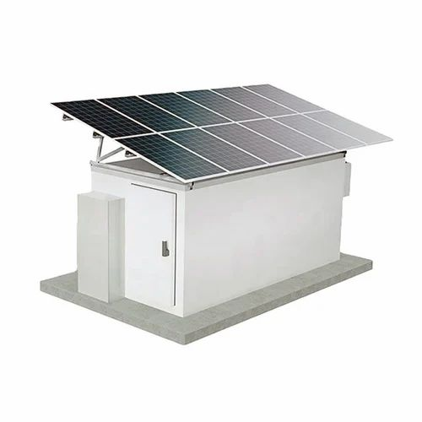
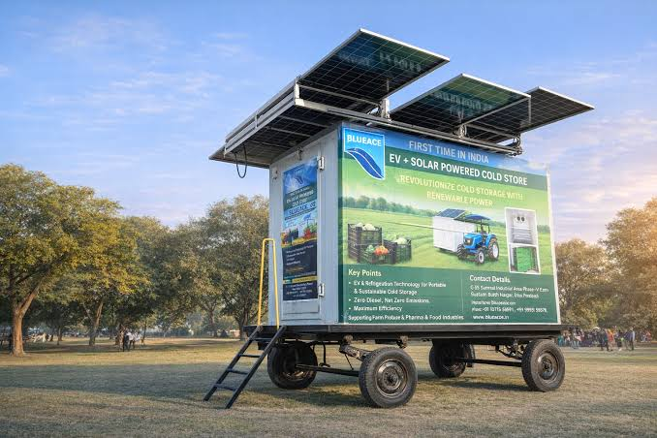

SOLAR-POWERED SMART MINI COLD STORAGE SYSTEM
For Fresh Vegetables in the North Eastern Region (NER)
PROBLEM STATEMENT
THEME
CATEGORY
PS #05 — MDoNER
Agriculture, FoodTech & Rural Dev.
Hardware
Team Name: INNOVITA | Institution: Amrita Vishwa Vidyapeetham, Coimbatore

Slide 2




The Problem
Post-harvest spoilage of vegetables is a major, quantifiable loss driver in India — and NER's terrain and infrastructure gaps make it worse.
4.87–11.61%
₹1.53 L Cr
49.9 MMT
vegetable post-harvest
losses nationally (NABCONS)
estimated annual national
post-harvest loss (~2.35% of GDP)
horticultural produce lost
per year to poor cold chain
Why generic solar cold storage designs fall short in NER
Terrain & Grid
Low Solar Irradiance
Scale Mismatch
Hilly, dispersed farms with unreliable or absent grid power — solar is a necessity, not a preference.
NER receives far less, more variable sunlight than high-irradiance regions most designs assume.
Existing designs target multi-tonne warehouses — unaffordable and oversized for smallholder farmers.
SIH — Solar-Powered Smart Mini Cold Storage System (PS #05)
2

Slide 3


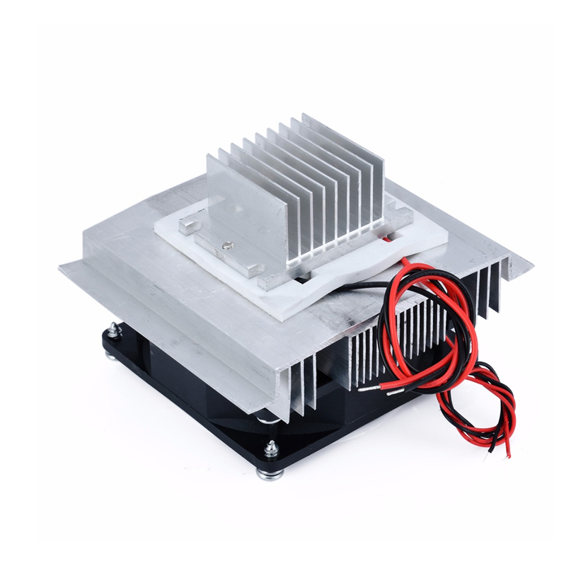
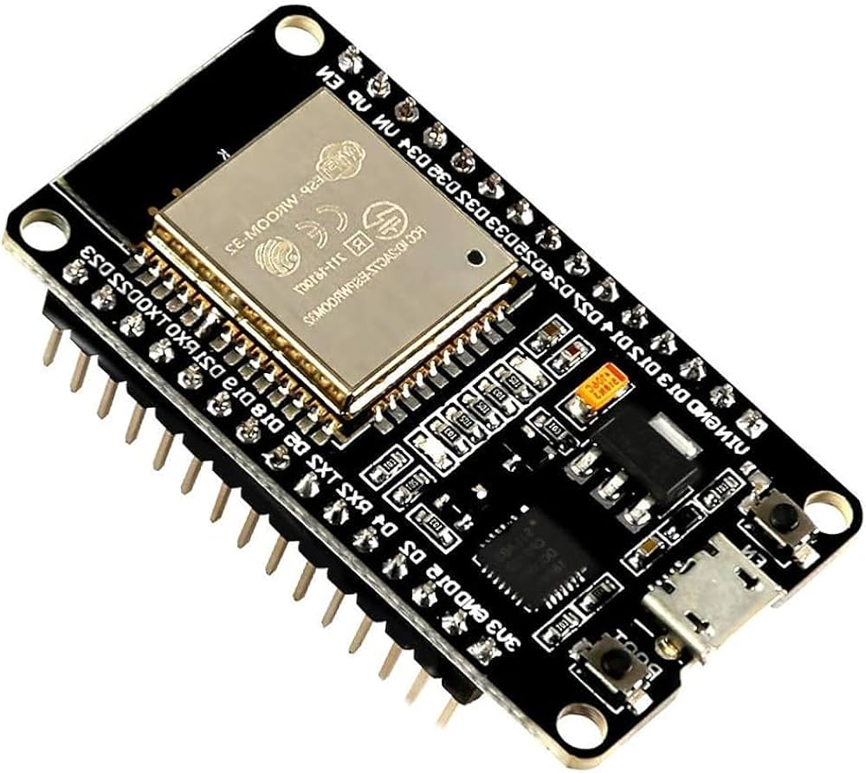



Our Solution
A portable, solar-powered mini cold storage unit that pairs active Peltier cooling with passive PCM thermal buffering and smart IoT monitoring — engineered specifically for NER's terrain, climate and smallholder scale.
Power
Cooling
Smart Monitoring
Solar PV -> MPPT charge controller -> Battery bank, sized for NER's low-irradiance conditions.
Peltier module + PCM thermal buffer inside an insulated chamber — no compressor, no refrigerant.
ESP32 + sensors drive a local display and LoRa alerts — works even with zero connectivity.
Key Differentiators
Sized for NER's actual (low, variable) solar irradiance — not a national-average assumption
PCM thermal buffer smooths out cloudy-day gaps without oversizing the battery
Local display works with zero internet; LoRa alerts work with zero cellular signal
Lightweight, wheeled, portable design suited to hilly, dispersed NER farms
SIH — Solar-Powered Smart Mini Cold Storage System (PS #05)
3

Slide 4

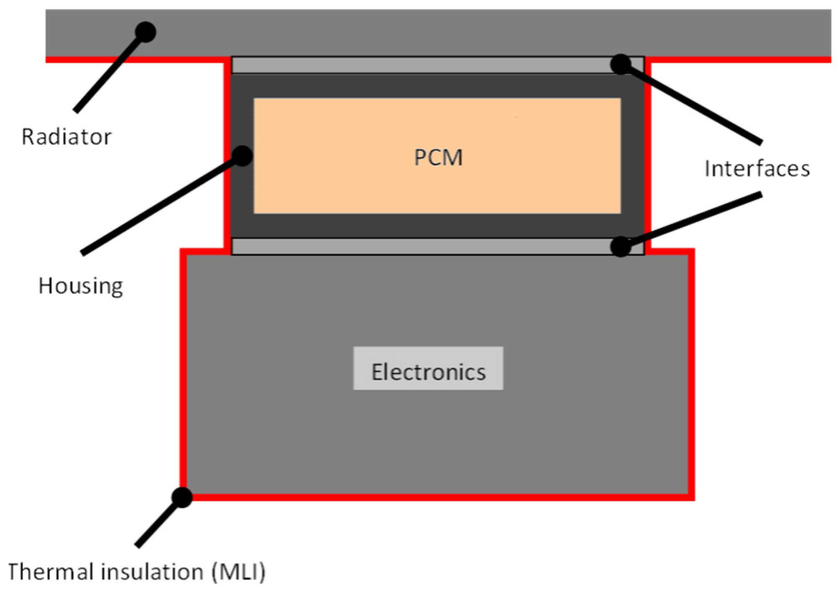
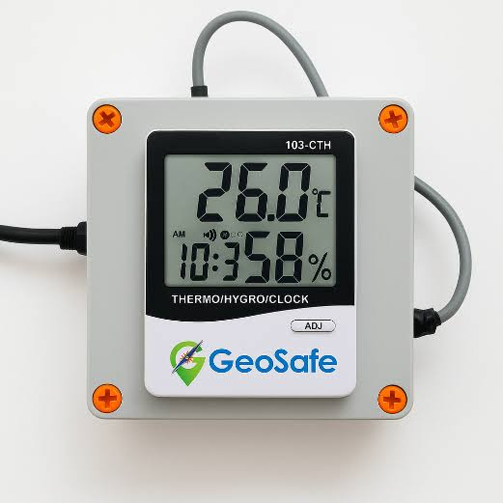
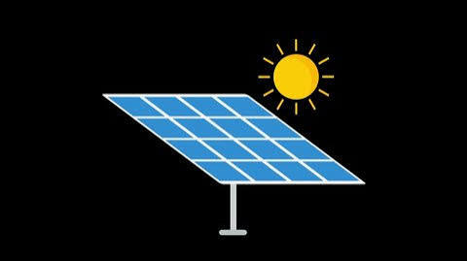
Technical Architecture
Power Subsystem
Cooling Subsystem
Smart Monitoring
Solar PV Panel
Peltier Module
(TEC1-12706)
ESP32 Microcontroller
MPPT Charge Controller
Heatsink + Fan
(hot side)
Temp/Humidity + Current
Sensors
Battery Bank
(LiFePO4 / SLA)
Insulated Chamber
+ PCM Buffer
Local Display + LoRa
Alerts
Solid arrows = power/data flow between subsystems | PCM sits passively inside the cooling chamber as a thermal buffer
SIH — Solar-Powered Smart Mini Cold Storage System (PS #05)
4

Slide 5


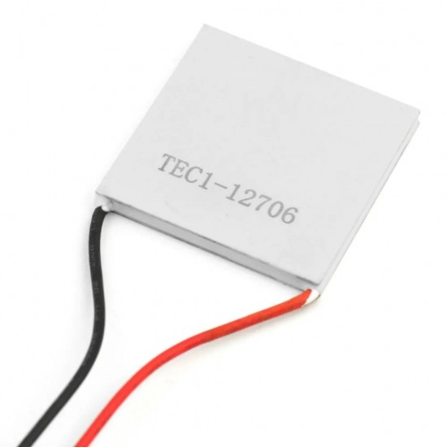
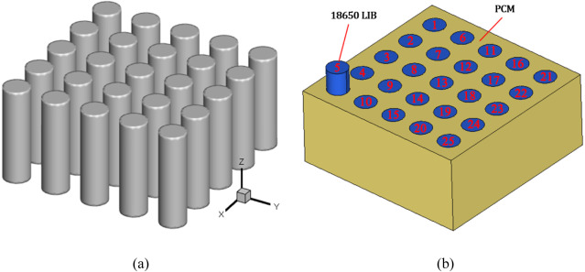
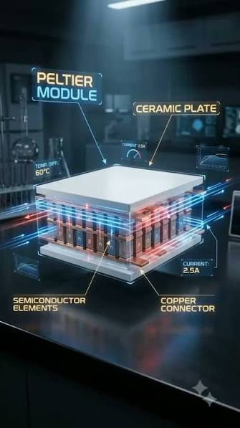
How the Cooling Works
Peltier Module: a Solid-State Heat Pump
PCM: a Reusable Thermal Battery
DC current through P-type/N-type semiconductor junctions pushes heat from one face to the other — no gas, no moving parts. One side gets cold, the other gets hot. Reverse the current, and the sides swap. Real-life analogy: the same tech used in portable car fridges and wine coolers — no compressor needed.
Absorbs heat while melting at a fixed temperature (~8°C) — frozen by surplus solar power during the day, releasing cold slowly overnight or on cloudy days. Lets a small, cheap battery handle only electronics load, while PCM absorbs the bulk thermal swings. Real-life analogy: an ice pack in a picnic cooler — keeps things cold for hours with zero power draw.
SIH — Solar-Powered Smart Mini Cold Storage System (PS #05)
5

Slide 6
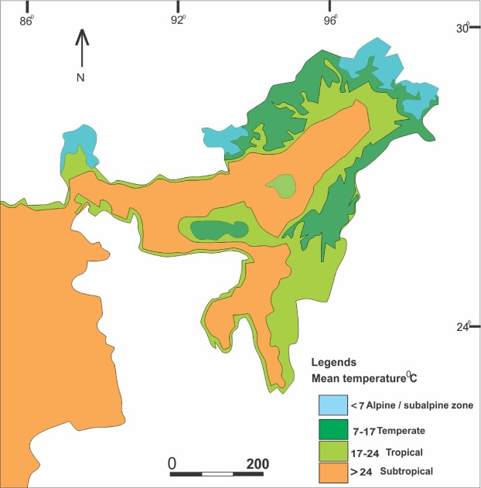
Engineering for NER's Low Solar Irradiance
Over-Insulation + Duty Cycling
Thicker PUF/EPS panels + thermostat logic so the Peltier module runs only when needed.
Bifacial Panels + Optimal Tilt
Captures reflected/diffused light and matches panel angle to NER's latitude.
PCM Thermal Buffering
Stores 'cold' during peak sun, releasing it through cloudy stretches — reduces battery size needed.
Illustrative figures based on MNRE solar radiation resource data — NER falls in the country's lowest solar-irradiance tier.
Weather-Aware Pre-Cooling
Software logic pre-cools and pre-freezes PCM ahead of a forecast cloudy spell — zero extra hardware cost.
SIH — Solar-Powered Smart Mini Cold Storage System (PS #05)
6

Slide 7

Feasibility & Estimated Cost
Component | Approx. Cost (INR)
Solar PV Panel (100-150W) | 4,000 - 6,000
MPPT Charge Controller | 1,500 - 2,500
Battery Bank (LiFePO4 / SLA) | 6,000 - 12,000
Peltier Modules (TEC1-12706) x2-4 | 1,200 - 2,400
Heatsinks + Cooling Fans | 800 - 1,500
Insulated Chamber (PUF/EPS + frame) | 3,000 - 5,000
PCM Packs (~5 kg) | 1,000 - 2,000
ESP32 Microcontroller | 400 - 600
Sensors (Temp/Humidity + Current) | 300 - 700
LoRa Module | 600 - 1,200
OLED Display | 300 - 500
Wheels, Frame & Misc. Hardware | 1,000 - 2,000
ESTIMATED TOTAL
Rs. 20,000 - 35,000
Feasibility Notes
All components are off-the-shelf and widely available — no custom fabrication or import dependency.
Peltier-based cooling avoids refrigerant handling, keeping build and maintenance simple for a student team.
Costs are idea-stage estimates for a single mini unit; cluster-sharing models reduce per-farmer cost further.
SIH — Solar-Powered Smart Mini Cold Storage System (PS #05)
7

Slide 8

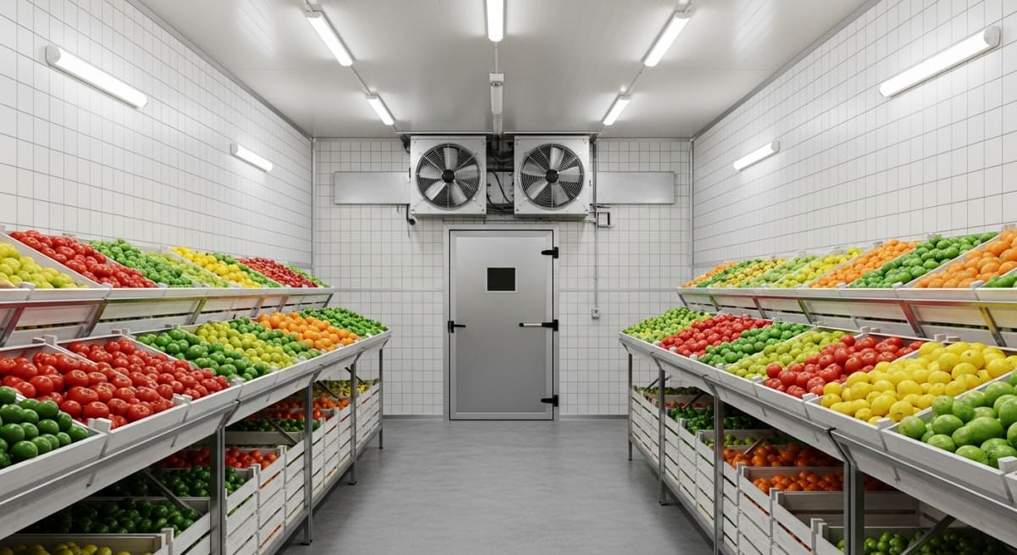
Impact & Benefits
Extended Shelf Life
Stable 8-12C storage extends usable shelf life of leafy greens and local NER produce well beyond ambient conditions.
Off-Grid Resilience
PCM + battery combination targets 1-2 days of cooling autonomy with zero sunlight.
Farmer Income Protection
Reduced distress-selling and spoilage losses directly protect smallholder farmer income.
Illustrative target range, based on national post-harvest loss baselines (NABCONS) for stored vegetables.
Zero-Connectivity Safe
Local display + LoRa alerts work without internet or cellular signal — built for remote NER blocks.
SIH — Solar-Powered Smart Mini Cold Storage System (PS #05)
8

Slide 9





Scalability & Future Scope
Cluster-Level Shared Units
Portable & Mobile Version
A slightly larger shared unit for 4-5 nearby farmers spreads solar/battery cost per household.
Wheeled base now; vehicle-mounted version for transport cooling as a future scaling direction.
Predictive Cooling Software
Micro-Hydro Hybrid Charging
Weather-aware pre-cooling logic layered onto the same hardware — a zero-cost future upgrade.
NER's streams offer a complementary charging source during monsoon when solar is weakest.
Government Scheme Alignment
Produce-Specific Tuning
Positioned to plug into MDoNER cold-chain and NABARD rural infrastructure support schemes.
PCM melting point and humidity control tuned per crop (leafy greens vs. root vegetables).
SIH — Solar-Powered Smart Mini Cold Storage System (PS #05)
9

Slide 10

References
NABCONS (2022), Report on Assessment of Harvest and Post-Harvest Losses of Crops in India — Ministry of Food Processing Industries, Govt. of India.
ICAR-CIPHET studies on post-harvest losses in fruits and vegetables.
Ministry of New and Renewable Energy (MNRE) — National Solar Radiation Resource Assessment / Solar Atlas.
Ministry of Development of North Eastern Region (MDoNER) — Problem Statement brief, SIH PS #05.
Published research on solar-hybrid cold storage systems using Phase Change Material (PCM) for decentralized perishable storage.
Thank You

