Slide 1
Day1
Introduction to Programming

Slide 2
Software
System Software
OS
Application Software
Desktop
Web Applications
Mobile Applications
Distributed Applications
Microservices

Slide 3
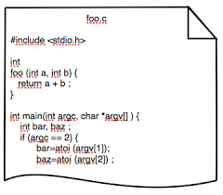
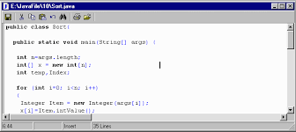
Computer program
A Program File is an electronic file containing a series of instructions telling a computer to do a particular tasks
eg: a class in java, c#, c++

Slide 4

Computer program
A computer requires programs to function
The computer executes the program's instructions in a central processing unit (CPU).
A computer program is written in a programming language like c, c++, java, cSharp, etc..

Slide 5
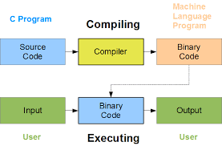

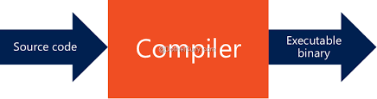
Computer program
A computer program file is also called as a code file or source code
The instructions in a code file is written in human readable form and can not be executed by the computer
A compiler can derive machine code — a form consisting of instructions that the computer can directly execute.
Alternatively, a computer program may be executed with the aid of an interpreter

Slide 6
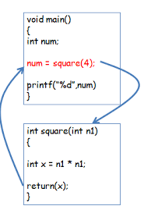
Functions / Methods
A function is a group of statements that together perform a task
A program file (Code file) contains one or many functions
Functions are "self contained" modules of code that accomplish a specific task
Functions usually "take in" data, process it, and "return" a result
Once a function is written, it can be used over and over and over again (code reuse)
Functions can be "called" from the inside of other functions.

Slide 7
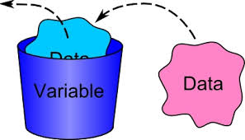
Variables
Variables are the names given to computer memory locations which are used to store values in a computer program
The variable name is the usual way to reference the stored value which can be used independently of the exact information it represents
The variable can be bound to a value during run time, and the value of the variable may thus change during the course of program execution

Slide 8
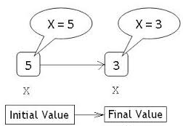
Working with Variables
public static void MethodA()
{
int x=5;
Console.WriteLine(x);
x=3;
Console.WriteLine(x);
x+=10;
Console.WriteLine(x);
}

Slide 9
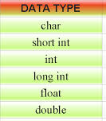
Data Type
A data type is a classification of data which tells the compiler or interpreter how the programmer intends to use the data
A Data type provides a set of values from which an expression (i.e. variable, function ...) may take its values
The type defines the operations that can be done on the data, the meaning of the data, and the way values of that type can be stored

Slide 10
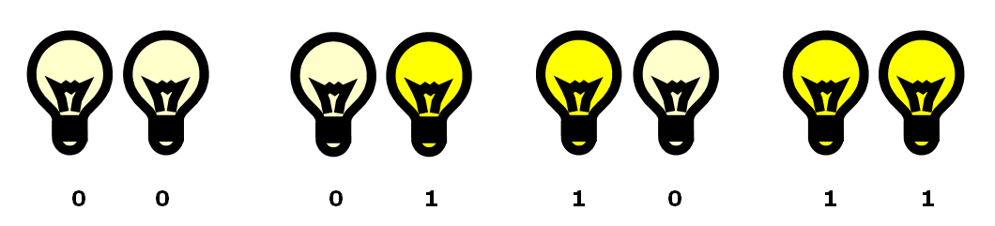
Data Type
Data is represented, transmitted, or stored in discrete pieces with numerical values
Computers use a binary system with the numerals of 0 and 1 like counting with just 2 fingers instead of 10
Think of a computer as a huge collection of millions of switches that are either on or off. Each of these switches is called a bit. It’s the combination of “on” or “off” switches called bits that creates the magic

Slide 11
Working with Data Types
public static void MethodB()
{
int x=10; int y=20; Console.WriteLine(x+y);// 30
String s1=“10”; String s2=“20”; Console.WriteLine(s1+s2); // 1020
String s3=“Hello “ ; String s4=“ Have a Nice Day”;
Console.WriteLine(s3+s4);
}

Slide 12
Method Parameter
A parameter is a special kind of variable, used in a function to refer to one of the pieces of data provided as input to the function
A parameter is the variable which is part of the function’s signature (function declaration)
An argument is an expression used when calling the function
void Foo(int i, float f)
{
// Do things
}
void Bar()
{
int anInt = 1;
Foo(anInt, 2.0);
}
Here i and f are the parameters
anInt and 2.0 are the arguments.

Slide 13
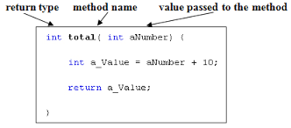
Return type of a function

Slide 14
Return type of a function
Methods can return a value to the caller, the type listed before the method name
If the return type is not void, then the method must return the value by using the return keyword in its method declaration
The data type of the return value must match the method's declared return type and will return that value to the method caller
The method can't return an integer value from a method declared to return a boolean
The return keyword also stops the execution of the method. If the return type is void, a return statement without a value is still useful to stop the execution of the method
Notes:
;

Slide 15
Void Methods
Void doesn't return anything; it tells the compiler the method doesn't have a return value

