Slide 1
How Browsers Work
Notes:
https://www.html5rocks.com/en/tutorials/internals/howbrowserswork/
By Tali Garsiel and Paul Irish
Published: August 5th, 2011
<number>

Slide 2
Desktop Browser
There are five major browsers used on desktop today:
Chrome,
Internet Explorer / EDGE
Firefox,
Safari and
Opera.

Slide 3
Mobile browsers
On mobile, the main browsers are
Android Browser,
iPhone,
Opera Mini and Opera Mobile,
UC Browser,
the Nokia S40/S60 browsers and Chrome
Notes:
all Browsers, except for the Opera browsers, are based on WebKit
<number>

Slide 4
The browser's main functionality
The main function of a browser is to present the web resource
The resource is usually an HTML document,
Or may also be a PDF,
image, or
some other type of content.
The location of the resource is specified by the user using a URI
The way the browser interprets and displays HTML files is specified in the HTML and CSS specifications
These specifications are maintained by the W3C (World Wide Web Consortium) organization

Slide 5
Browser UI
Browser user interfaces have a lot in common with each other.
Among the common user interface elements are:
Address bar for inserting a URI
Back and forward buttons
Bookmarking options
Refresh and stop buttons for refreshing or stopping the loading of current documents
Home button that takes you to your home page

Slide 6
common elements
The HTML5 specification doesn't define UI elements a browser must have, but lists some common elements.
Among those are the address bar, status bar and tool bar.

Slide 7
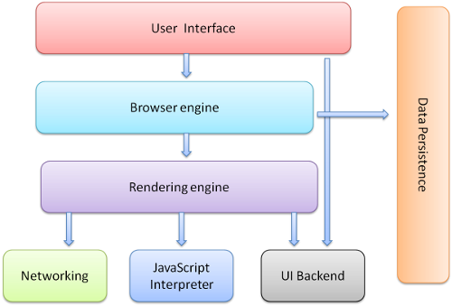
The browser's high level structure
Notes:
The user interface: this includes the address bar, back/forward button, bookmarking menu, etc. Every part of the browser display except the window where you see the requested page.
The browser engine: marshals actions between the UI and the rendering engine.
The rendering engine : responsible for displaying requested content. For example if the requested content is HTML, the rendering engine parses HTML and CSS, and displays the parsed content on the screen.
Networking: for network calls such as HTTP requests, using different implementations for different platform behind a platform-independent interface.
UI backend: used for drawing basic widgets like combo boxes and windows. This backend exposes a generic interface that is not platform specific. Underneath it uses operating system user interface methods.
JavaScript interpreter. Used to parse and execute JavaScript code.
Data storage. This is a persistence layer. The browser may need to save all sorts of data locally, such as cookies. Browsers also support storage mechanisms such as localStorage, IndexedDB, WebSQL and FileSystem.
<number>

Slide 8
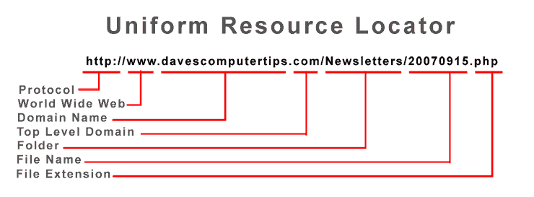

Slide 9
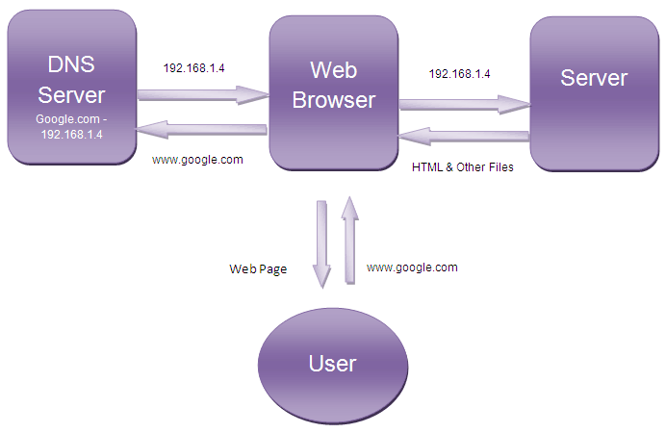
Steps in Web Browsing

Slide 10
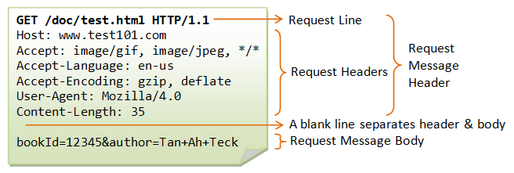
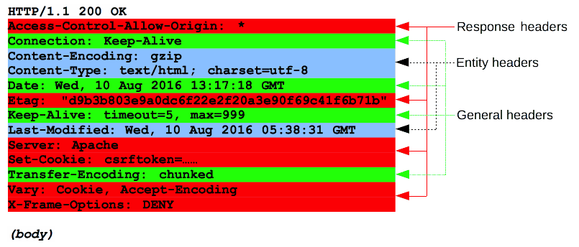
HTTP Request & HTTP Response

Slide 11
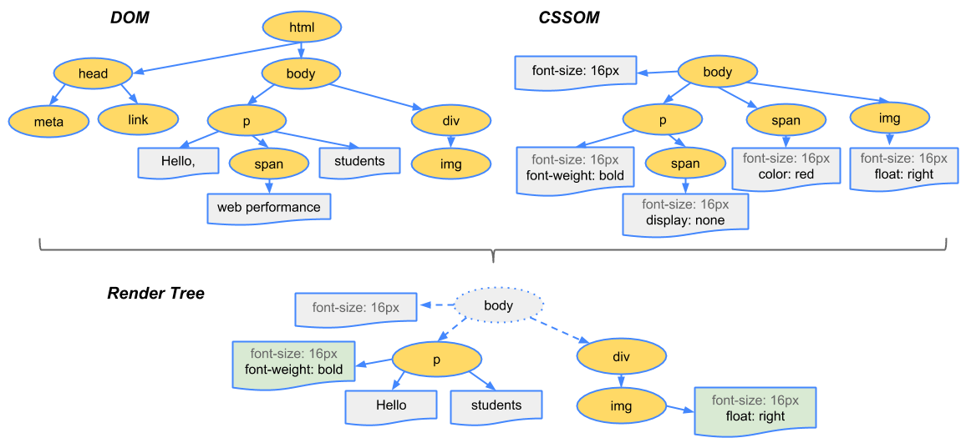
Render Tree

Slide 12
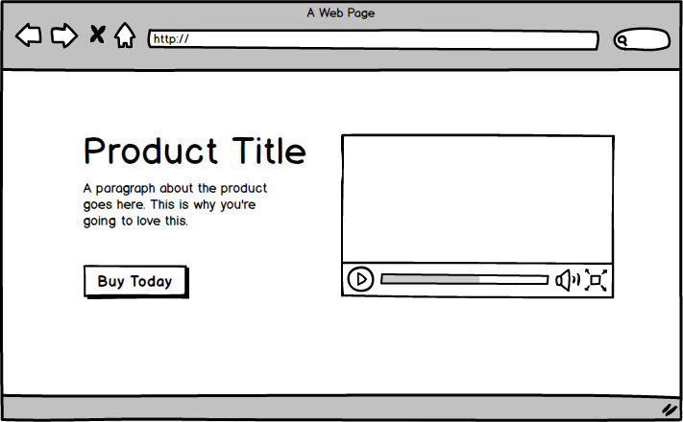
Rendering Engine - Layout

Slide 13
The rendering engine
By default the rendering engine can display HTML and XML documents and images.
It can display other types of data via plug-ins or extension; for example, displaying PDF documents using a PDF viewer plug-in

Slide 14

Chrome
Chrome runs multiple instances of the rendering engine:
one for each tab.
Each tab runs in a separate process.
14000 context can be created in the chrome stack

Slide 15
Process

Slide 16
Process
Process
Process
Runtime
Runtime
Application
Application
OS

