Slide 1

Angular 4
Part 1 - Venkat

Slide 2
Agenda
What is Angular
Prerequisite
Setting up the environment
Creating an Angular Project
Running the new Angular Application
A walk around the project. Understanding the Scaffolding
Introduction to Trans piling
6 Key Artifacts of Angular
Architecture Overview

Slide 3
What is Angular?
Empowers developers to build web / mobile / desktop apps
Integrated best practices to solve development challenges
A Platform to build web applications

Slide 4
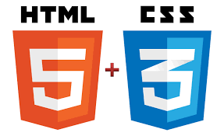


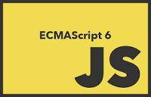

Pre request
HTML 5
Bootstrap
Java script , ES5 , and ES6
Type Script

Slide 5

Assumptions
We assume that you are already familiar with JavaScript, and some of the tools from the latest standards such as classes and modules

Slide 6
Quick Start
Setting up the environment

Slide 7
Installing Node js and Angular CLI
Install nodejs (6.x or higher) , and npm if not already installed in your computer from https://nodejs.org/en/
Open a command prompt
Install Angular CLI : npm install @angular/cli -g
Notes:
Installing npm
1. https://www.npmjs.com/get-npm
2. npm is installed with Node.js
3. https://nodejs.org/en/
-- Node js version 6.11.0 / npm version 3.10.10

Slide 8
Creating an Angular Project
Create a new folder for the project: md NGLabs
Create a new Angular project called <myproject> :
ng new myproject --skip-install
Change directory to the new project : cd myproject
Install all dependent angular bundles : npm i

Slide 9
Running the new Angular Application
Build the dev version of this app: ng serve
Now open your browser at http://localhost:4200,
and you’ll see the page rendered by the top-level component app.component.ts

Slide 10
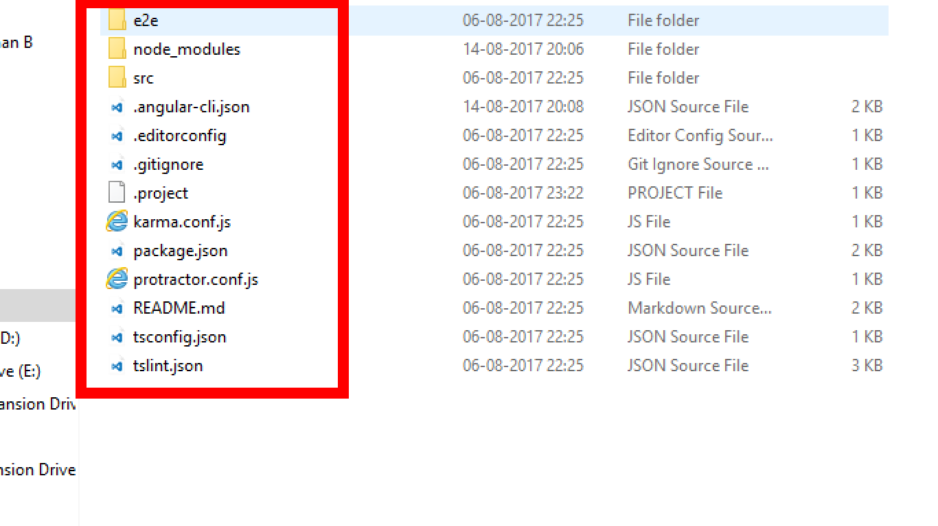
Project scaffolding
Package.json – dependencies
Dev dependencies
TypeScript
Jasmine : Unit testing
Karma : Test runner
Protractor : End to end Testing ( like selenium)
Lint : Code Quality check tool
<e2e> : end to end test

Slide 11

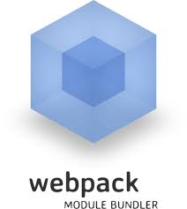
Transpiling
Type Script
Write Code in ts (VS Code / Eclipse)
Build type script into java script using typescript compiler
Babel
Downgrading ES6 to ES5 or ES3.
Webpack
Do Minification and create bundles
Notes:
Angular 4 applications can be written in 4 different languages
1. ES5, 2 ES6 , 3. Type Script, 4. Dart (a Google internal lang)

Slide 12
Architecture Overview

Slide 13
Angular is a framework for building client applications in HTML and JavaScript. Languages like TypeScript can be used to create JavaScript on compilation.
The framework consists of core and optional libraries

Slide 14
6
Key Artifacts
Angular
Modules
Structural
Directives
Components
Services
Data Binding
Dependency
Injection

Slide 15
Angular Artifacts
Component from '@angular/core'
NgModule from '@angular/core‘
platformBrowserDynamic from '@angular/platform-browser-dynamic‘
Structural Built-In Directives - Indicated by the * prefix
Data Binding, Interpolation, 1 Way Binding, Event Binding,
Dependency Injection

Slide 16
Architecture Overview
HTML templates with Angularized markup are used to create the application
Component classes are used to manage those templates
Services are used for application logic
The components and services are boxed in modules
The app is launched by bootstrapping the root module

Slide 17
<<module>>
<< Components >>
Index.html
App module
App component
HTML
<< HTML Template>>

Slide 18

Over to Part 2
Understanding an Angular Project.
Building a Full website step by step.

Slide 19
ES Modules
Angular Modules
Components
Templates
Metadata

