Slide 1

Angular 4
Part 2 Building a Web Application

Slide 2
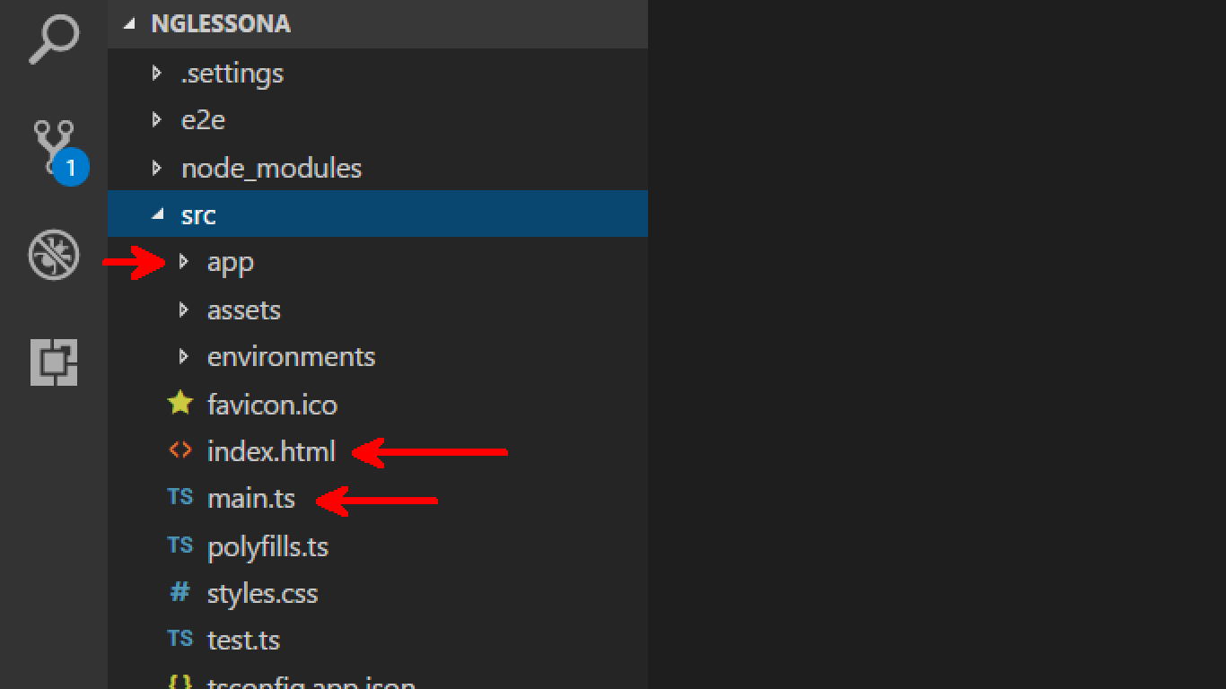
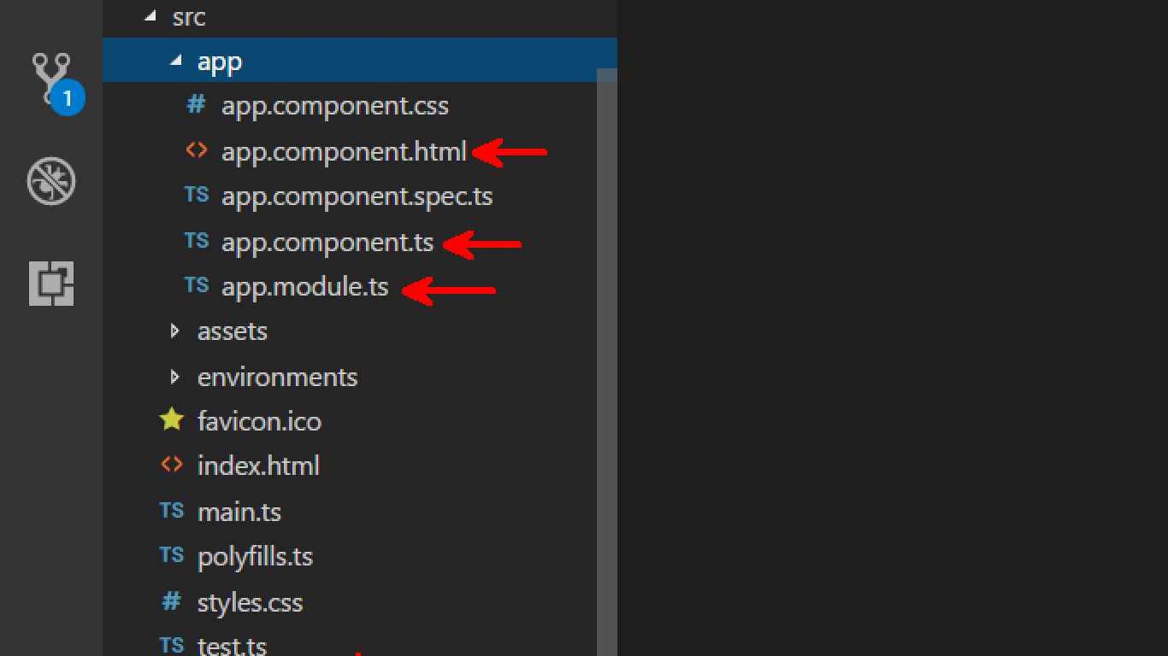
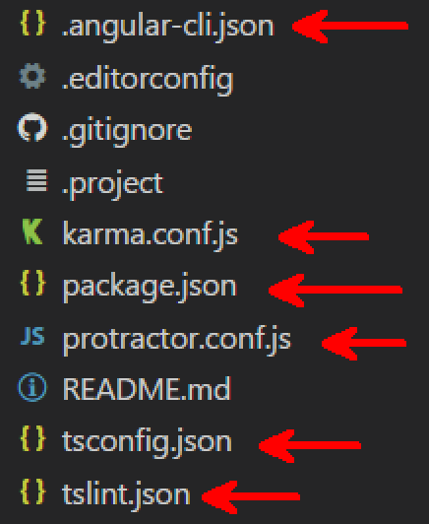
Angular Project Structure

Slide 3


Transpiling
Type Script
Write Code in ts
Webpack
Build ts into js
Babel
Downgrading ES6 to ES5 or ES3.
Do Minification and create bundles

Slide 4
<< Components >>
<<module>>
App component
App module
Comp2
Index.html
M2
Comp3
Comp4

Slide 5
<app-news [type]=‘corp’>
</app-news>
<app-about> </app-about>
<app-contact> </app-contact>
<app-news [type]=‘chennai’>
</app-news>
Comp1
HTML
Comp2
HTML
HTML
Comp3
HTML
app-component
Comp4
HTML

Slide 6
The Page Execution Path
Main.ts
Load ngmodule
Load Components, and Bootstrap
Select HTMLElement from index.html
Add HTML template to the selected element
Bind data to HTML output
Add js functions to the component
Generate Output

Slide 7
First look
An Angular application must have at least one Ng Module
A Module consist of one or more components
Each component has a HTML template , functions, data properties
The HTML Template in a component is mapped to an element in index.html
Properties defined in the component can be accessed from the HTML templates

Slide 8
Hello World Demo
Open app.component.ts from src\app
import { Component } from '@angular/core';
Define a class for the component and export the component
Then decorator the class with @Component({ … }) directive
Inside the component decorator add a reference to the html element <app-root>
Then add the html template to be added to the <app-root>
Step 1 :

Slide 9
app.component.ts
import { Component } from '@angular/core';
@Component({
selector: 'app-root', // should follow kebab style
template:`<div>HelloWorld</div>`,
styleUrls: ['./app.component.css']
})
export class AppComponent {
title = 'app';
}
Step 1

Slide 10
App.module.ts
Step 2
import { BrowserModule } from '@angular/platform-browser';
import { NgModule } from '@angular/core';
import { AppComponent } from './app.component';
@NgModule({
declarations: [ AppComponent ],
imports: [ BrowserModule ],
providers: [],
bootstrap: [AppComponent]
})
export class AppModule { }

Slide 11
App.module.ts
Step 2
@NgModule({
declarations: [ AppComponent ],
imports: [ BrowserModule ],
providers: [],
bootstrap: [AppComponent]
})
export class AppModule { }
Components, directives, pipes
Import other dependent modules.
i.e. other modules used in the current module
Provide services to app root injector

Slide 12
Main.ts
import { enableProdMode } from '@angular/core';
import { platformBrowserDynamic } from '@angular/platform-browser-dynamic';
import { AppModule } from './app/app.module';
import { environment } from './environments/environment';
if (environment.production) {enableProdMode();}
platformBrowserDynamic().bootstrapModule(AppModule);

Slide 13
Executing the application
Open the Integrated terminal from the View menu
Launch the serve : ng serve
Wait for webpack: Compiled successfully.
Open a browser and check : localhost:4200

Slide 14
Using HTML Template files
templateURL, and properties DEMO

Slide 15
Building the Home

Slide 16

Over to Part 3
Directives, Pipes , and Data-binding

