Slide 1
Angular 4 Directives, Databinding, Pipes
Part 3

Slide 2
Component based Framework
Directives
Component
Structural
Data-binding
Interpolation
Property Binding
Attribute
Event-Binding
2 Way Binding
Pipes
Currency
String
Date
Notes:
Angular --> component based F.W
---------------------------------------
Directives - is a js function that can be dynamically used as html elements
a. Component ==> UI
b. Structural ==> to modify existing DOM
c. Attribute ==> will change element's attributes
2. Pipes
3. Data-binding
a. interpolation ==> {{}}
b. property/attribute binding ==> <element [prop]="expr" />
c. event-binding ==> <element (event)="handler()"/>
d. 2-way binding

Slide 3
bootstrap
npm i bootstrap --save
css – can be imported at global level / at component level
To put bootstrap in global css in “style.css”
@import url("../node_modules/bootstrap/dist/css/bootstrap.css");

Slide 4

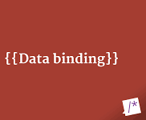
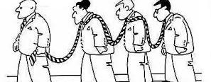
Interpolation binding
demo

Slide 5
Structural Directives
Structural Directives are used to manage / change DOM Elements conditionally
All structural directives are prefixed with *
*ngIf → *ngIf=“condition”
*ngFor → *ngFor="let x of nos“ | *ngFor="let x of nos; let idx=index” |
Notes:
*ngFor="let x of nos; let idx=index”
Index base is zero

Slide 6
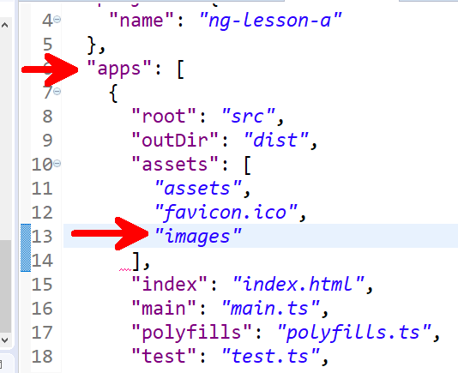
Adding Images
Add images folder to src
Copy the images to this folder
Open “.angular-cli.json” file
Add images to apps/assets list
Then add image to the component
images:[
{tumb:'images/WorldofThreeZeros.png', full:''}
]
<img alt="" [src]="item.images[0].thumb" >

Slide 7
Property Binding
Following DOM standards -- w3d standards
<img alt="" [src]="item.images[0].thumb" >
<span class="badge" [innerText]=idx+1></span>

Slide 8
Event Binding
Add an Event handler in the ts file
onbuy() { console.log("book Added to Cart.."); }
Assign the Event handler to a control Event
<button (click)="onbuy()" …..>
$event : the event object

Slide 9
Property binding (class binding)
Adding tabs to the Page
Class turbuling : changing css class between elements
<li [class.active]="isTabSelected(1)"><a href (click)="onTabChangeA($event,1)">Description</a> </li>

Slide 10
Attribute Directive
Multiple classbinding to an element
[ngClass]={active:true, anotherClass:true}

Slide 11
Using Pipes
currency:’INR’:true
Uppercase
Slice ➔ pagination
|slice:0:5 (slice:start index no : end index no)
Date
date:'MMM yyyy‘ / date:’yMd’ / date:’yyyy’ / date:’fullDate’
Json
{{item|json}}
Notes:
INR – Unicode - &#8377;

Slide 12
Creating Custom Pipes
ng g pipe <pipename>
Notes:
ng g pipe PriceDiscount

Slide 13
Multi Components
Nested components and data flow between the components

Slide 14
Component creation
Cli command
$ ng g component <componentName>
Creates 4 files :
<componentName>.html template
<componentName>. spec.ts
<componentName>. ts
<componentName>.css
Updates the app.module.ts

Slide 15
BoxA
BoxB

Slide 16

Over to Part 5
<< next Slide >>

