Slide 1
Routing
Part 9

Slide 2
What is Routing
Routing allows us to navigate between different Components in an application

Slide 3
App Module
imports: [
BrowserModule, RouterModule.forRoot(routes)
],

Slide 4
App.component.html
<div class="container">
<div class="panel panel-default">
<div class="panel-heading">Using Router</div>
<router-outlet></router-outlet>
</div>
</div>

Slide 5
App.component.html
<div class="container">
<div class="panel panel-default">
<div class="panel-heading"> <h1>Using Router</h1>
<div><a href="n">News</a> | <a href="">Home</a> </div>
</div>
<router-outlet></router-outlet>
</div>
</div>

Slide 6
Menu - routerLink
To prevent reloading the entire Page
<ul class="nav nav-pills">
<li> <a [routerLink]="['']">Home</a> </li>
<li> <a [routerLink]="['news']">Company News</a> </li>
</ul>

Slide 7
routerLinkActive
Css active class will be applied based on selected link

Slide 8
Router Navigate / History API
this.router.navigate(['/books']);

Slide 9
Routing Resolvers
Get data prior to traversing the route
Any class that implements Resolve interface is called as Resolvers
Resolvers are also services
import { Injectable } from '@angular/core';
import { Resolve } from '@angular/router';
@Injectable()
export class BooksresolverService implements Resolve<any>
{
constructor() { }
resolve() { …. }
}

Slide 10
Adding the resolver to the route
In app.module.ts
{
path: 'books',
component: BookCatlogComponent,
resolve: { books: BooksresolverService}
},

Slide 11
ActivatedRoute
import { ActivatedRoute } from '@angular/router';
constructor( private activeroute: ActivatedRoute ) { }
ngOnInit() {
this.activeroute.data.subscribe((data) => this.Books = data.books );
}

Slide 12
Booksresolver Service
BookByid
resolver Service
Menu Component
Router
App Component
Books-Catlog Component
Home Component
News Component
Book Component
Book-Tab Component
BookForm Component
CustomerForm Component

Slide 13
Book Catlog
Book Component
BookTab Component
Book Component
BookTab Component
Book Component
BookTab Component
Book Component
BookTab Component
onEdit
Add a Customer
Comment
CustomerForm Component
BookForm Component

Slide 14
Third Party Angular Components
Jboss
Primeface
Kendo UI
Notes:
https://www.primefaces.org/primeng/#/

Slide 15
PrimeNG - DataTable
https://www.primefaces.org/primeng/#/
Npm install priming 4 –save
Dependencies:
<link rel="stylesheet" type="text/css" href="YOUR_PATH/font-awesome.min.css" />
<link rel="stylesheet" type="text/css" href="/node_modules/primeng/resources/themes/omega/theme.css" />
<link rel="stylesheet" type="text/css" href="/node_modules/primeng/resources/primeng.min.css" />

Slide 16
font-awesome
https://cdnjs.com/libraries/font-awesome
https://cdnjs.cloudflare.com/ajax/libs/font-awesome/4.7.0/css/font-awesome.css
<link
href="https://cdnjs.cloudflare.com/ajax/libs/font-awesome/4.7.0/css/font-awesome.css"
rel="stylesheet"
>

Slide 17
Import Modules from priming to app.module
import {DataTableModule, SharedModule} from 'primeng/primeng';
<p-dataTable [value]="Books">
<p-column field="id" header="Id"></p-column>
<p-column field="Name" header="Name"></p-column>
<p-column field="Publishdate" header="Publish Date"></p-column>
<p-column field="Price" header="Price"></p-column>
<p-column field="AuthorName" header="Author"></p-column>
</p-dataTable>

Slide 18
Modules

Slide 19
Creating Modules
Ng g module < newModuleName>

Slide 20
Routes - LoadChildren
Lazy loading Modules
{
path: 'about' ,
loadChildren: 'app/about/about.module#AboutModule'
}

Slide 21
Guards
Guards allow us to either
continue,
abort or
take a new direction
at key points in the routing lifecycle
Notes:
If CanActivate returns true then the route will navigate to the next component
Else
It can be navigated to Login or any other component

Slide 22
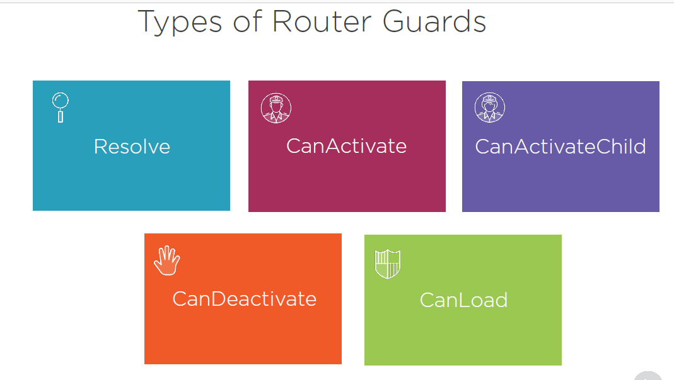
CanLoad

Slide 23
Guards - CanActivate
CanActivate:
Implement the CanActivate interface, This interface requires CanActivate()
Check if the user is Authenticated / Authorized for the route to be activated
Else re-navigate elsewhere ( Login ) this.route.navigate( ‘login’ ) ;
canActivate(route: ActivatedRouteSnapshot,
state: RouterStateSnapshot) {
if( this.token ) return true;
else {
this.route.navigate(['login']);
return false; }
}
Notes:
If CanActivate returns true then the route will navigate to the next component
Else
It can be navigated to Login or any other component

Slide 24
CanDeactivate

