Slide 1
Java
INTRODUCTION

Slide 2
  Java was conceived by
  James Gosling,
  Patrick Naughton,
  Chris Warth, Ed Frank, and
  Mike Sheridon at Sun Microsystems in 1991.
  Primary Motivation for developing java was the need for Platform Independent (Architecture neutral) Language.
  Platform Independence - To produce code that could run on a variety of CPU’s under differing environments.

Slide 3
Security
- Fear of viral infection
- Fear of malicious program
Java answers both of these concerns by providing a firewall between a networked application and your computer.
Java achieves this protection by confining a java program to the Java execution environment and not allowing it access to other parts of the computer.

Slide 4
Portability
Portability is a characteristic of a computer program if it can be used in an operating systems other than the one in which it was created without requiring major rework.
For programs to be dynamically downloaded to all the various types of platforms connected to the Internet, some means of generating portable executable code is needed.
** The same mechanisms that helps security also helps create portability.

Slide 5
BYTECODE
The output of a java compiler is not executable code rather it is Bytecode.
-Bytecode is a highly optimized set of instructions designed to be executed by the Java run-time system, which is called the Java Virtual Machine (JVM).
- Only the JVM needs to be implemented for each platform.
*The details of JVM will differ from Platform to Platform

Slide 6
C code file
java code file
javac
High level Code
compile
ByteCode
JVM
Native Code
Low level Code
OS

Slide 7
Java Development framework
Byte Code
JSR
Base Class Libraries
JVM

Slide 8
JVM
Runtime Execution Support
Security
Provider
Thread Manager
Exception Manager
GC
JITC
Stack Walker
Class Loader

Slide 9
Java Runtime Execution Model
Byte Code
JITC
JVM
Native Code
OS

Slide 10
1.Load
Class
2. Load
Method
Java Runtime
Execution Model
Next Class
3. Check for Native Code
Not Available
Call Next Method
JITC
Available
Execute Native Code
Generate Native Code

Slide 11
Int x=100; int y=200;
Box b1=new Box(); b1.x=100;
Box b2=new Box(); b2.x=200;
Working Set
Stack
Heap
Meta data
Byte code
Type description
X=100;
Y=200;
b2
Box
X=200
b1
Box
X=100

Slide 12
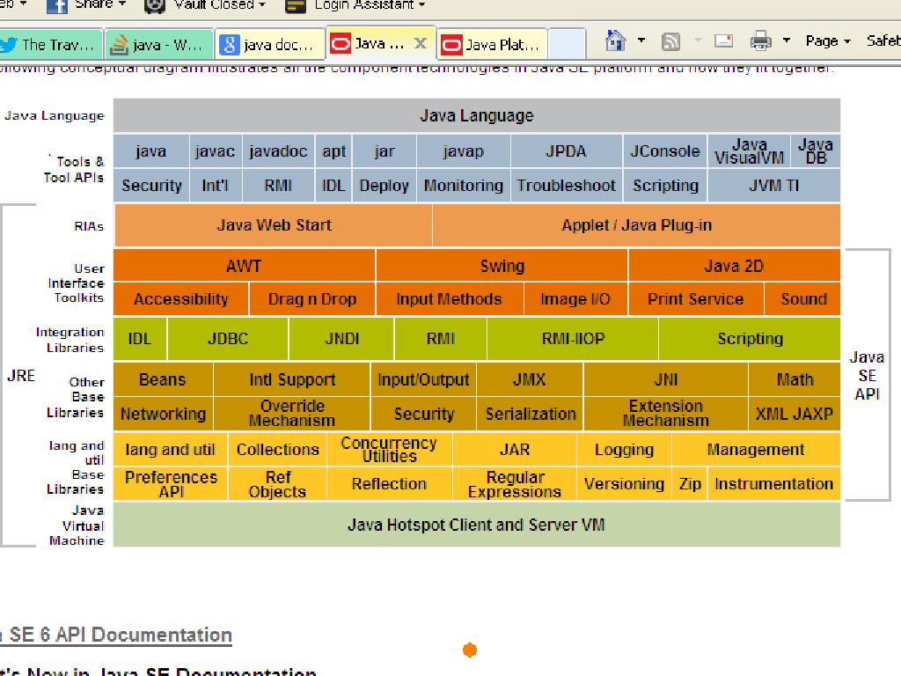

Slide 13
Process
Java Host
JRE
Class Loader
bytecode
bytecode
bytecode

Slide 14


