Slide 1
Threads

Slide 2
Threads
A thread is a program's path of execution
Threads are the basic unit to which an operating system allocates processor time.
More than one thread can be executing code inside a process.
App
Core
Core

Slide 3
Threads
Each thread maintains
1. Exception handlers,
2. a Scheduling priority, and
3. a set of structures the system uses to save the thread context until it is scheduled

Slide 4
Threads
The thread context includes all the information the thread needs to seamlessly resume execution, including
1. the thread's set of CPU registers and
2. stack, in the address space of the thread's host process.

Slide 5
Processes and Components
Scope of a thread is limited to the process in which it is created.
t1
t2
class loader
class loader
C4
C1
t1
t1
X
t2
C3
C6
C2
C5
t2
Process 1
Process 2

Slide 6
Current Thread Code Demo

Slide 7
Thread States
New
Time_Waited
start()
Sleep( long )
Runnable
Blocked
lock()
join()
unlock()
Waiting
stop()
Terminated

Slide 8
Multithreading
When multiple threads (2 or more threads) execute byte-code instruction sequences in the same program at the same time, then that action is known as multithreading.
Multithreaded applications are faster and efficient when they are running on a multiprocessor machine, or multi core machine than on a single core or single processor.

Slide 9
java.lang.Thread
Java accomplishes multithreading through its java.lang.Thread class.
Each Thread object describes a single thread of execution.
That execution occurs in Thread's run() method.
Because the default run() method does nothing, the Thread class must be subclassed and override run() to accomplish useful work.
Thread class implements java.lang.Runnable

Slide 10
Creating A New Thread
There are two ways to create a new thread of execution.
  One: is to declare a class to be a subclass of Thread. This subclass should override the run() method. An instance of the subclass can then be allocated and started.
  Or declare a class that implements the Runnable interface. That class then implements the run() method. An instance of the class can then be allocated, passed as an argument when creating Thread, and started.

Slide 11

Code Demo

Slide 12





Slide 13
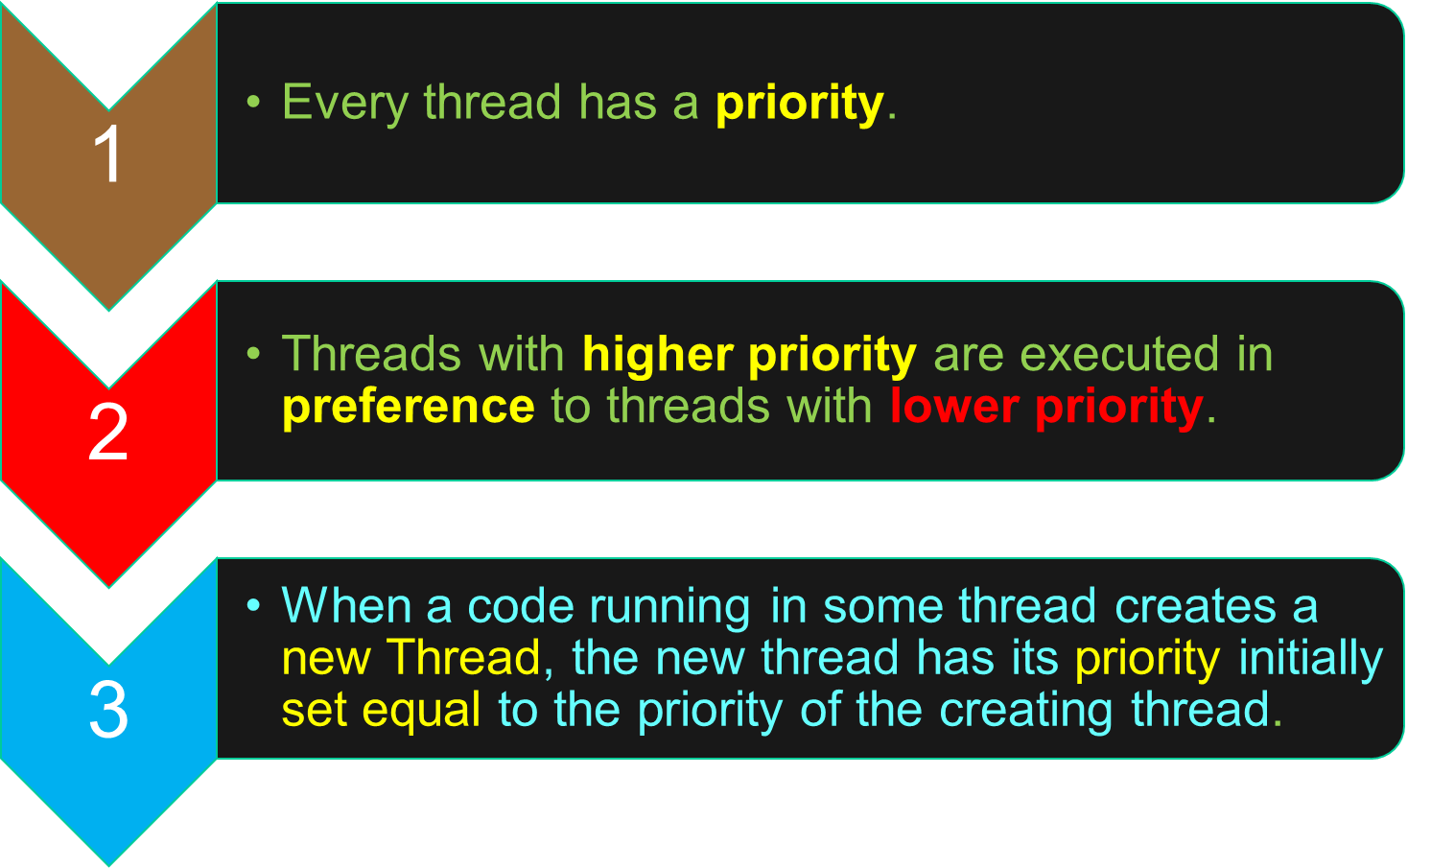
Thread Priority

Slide 14
Threads - Exit
When a JVM starts up, there is usually a single thread which typically calls the main method . The JVM continues to execute threads until either of the following occurs:
  The exit method of class Runtime has been called and the security manager has permitted the exit operation to take place.
  All threads have died, either by returning from the call to the run() method or by throwing an Exception that propagates beyond the run() method.

Slide 15
Method-call stack
The JVM gives each thread its own method-call stack.
The method-call stack tracks the current byte code instruction, local variables, method parameters, and the method's return value.
A Call stack is a stack data structure that stores information about the active subroutines of a computer program.
The main role of a Call stack is to keep track of the point to which each active subroutine should return control when it finishes executing.

Slide 16
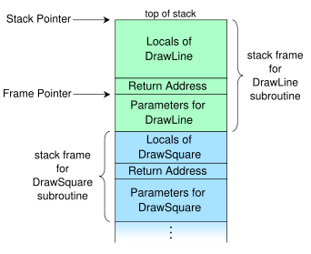

Slide 17
Synchronization
When two or more threads need access to a shared resource, they need some way to ensure that the resource will be used by only one thread at a time.
The process by which this is achieved is called synchronization.

Slide 18
A monitor is an object that is used as a mutually exclusive lock, or mutex.
Only one thread can own a monitor at a given time.
When a thread acquires a lock, it is said to have entered the monitor.
All other threads attempting to enter the locked monitor will be made to wait until the first thread exits the monitor.
These other threads are said to be waiting for the monitor.

