Slide 1
JDBC

Slide 2
Database Connectivity is a specific term, which is very widely
used to access different databases via a network..
"The job of a client is to request for a service and the job of the
server is to serve the request."

Slide 3
RDBMS
Java
Application
J
D
B
C
IO
Documents

Slide 4
Client
Database Server
Application GUI
JDBC API
Network Interface
SQL Results
SQL Requests
SQL Results
SQL Requests
Network Connection
JDBC API defines a set of interfaces and classes to be used
for communicating with a database.

Slide 5
Client
Application
Database Server
JDBC Driver
Database Libraries
Network Interface
SQL Results
SQL Requests
SQL Results
SQL Requests
Network Connection
JDBC Driver: translates java into SQL.
JDBC drivers are implemented by database vendors.
JDBC supports the ANSI SQL92 Entry Level standard.

Slide 6
Using JDBC it is possible to do three major activities.
- Establish a connection with a database
- Send SQL statements (query)
- Process the results. ( rows and columns)

Slide 7
JDBC Driver Types:
Driver Type | Description
1. ODBC-JDBC Bridge | Map JDBC calls to ODBC driver calls on the client.
2. Native API-Part Java | Maps JDBC calls to native calls on the client.
3. JDBC Network-All Java | Maps JDBC calls to network protocol, which calls native methods on server.
4. Native Protocol-All Java | Directly calls RDBMS from the client machine.

Slide 8
Database Drivers
Think of a database as just another device connected to your computer
like other devices it has a driver program with a high level api to work with the database

Slide 9
ODBC
Open Data Base Connectivity
Developed by Microsoft for the Windows platform as the way for Windows applications to access Microsoft databases (SQL Server, FoxPro, Access)
Has become an industry standard
Most data base vendors supply native, odbc, and jdbc drivers for their data base products

Slide 10
Type 4 Driver-Native-Protocol Driver (Pure Java Driver)
Also known as the Direct to Database Pure Java Driver, is a database driver implementation that converts JDBC calls directly into a vendor-specific database protocol.
Written completely in Java, type 4 drivers are thus platform independent. They install inside the Java Virtual Machine of the client.
This provides better performance than the type 1 and type 2 drivers as it does not have the overhead of conversion of calls into ODBC or database API calls.

Slide 11
Type 4 Driver - Advantages
Native-Protocol Driver (Pure Java Driver)
Unlike the type 3 drivers, it does not need associated software to work.
As the database protocol is vendor specific, the JDBC client requires separate drivers, usually vendor supplied, to connect to different types of databases.

Slide 12
Type 4 Driver – Advantages (cont)
These drivers don't translate the requests into an intermediary format (such as ODBC).
The client application connects directly to the database server.
No translation or middleware layers are used, improving performance.
The JVM can manage all aspects of the application-to-database connection; this can facilitate debugging.

Slide 13
Disadvantages of Type 4
Drivers are database dependent, as different database vendors use wildly different network protocols (and usually proprietary).

Slide 14
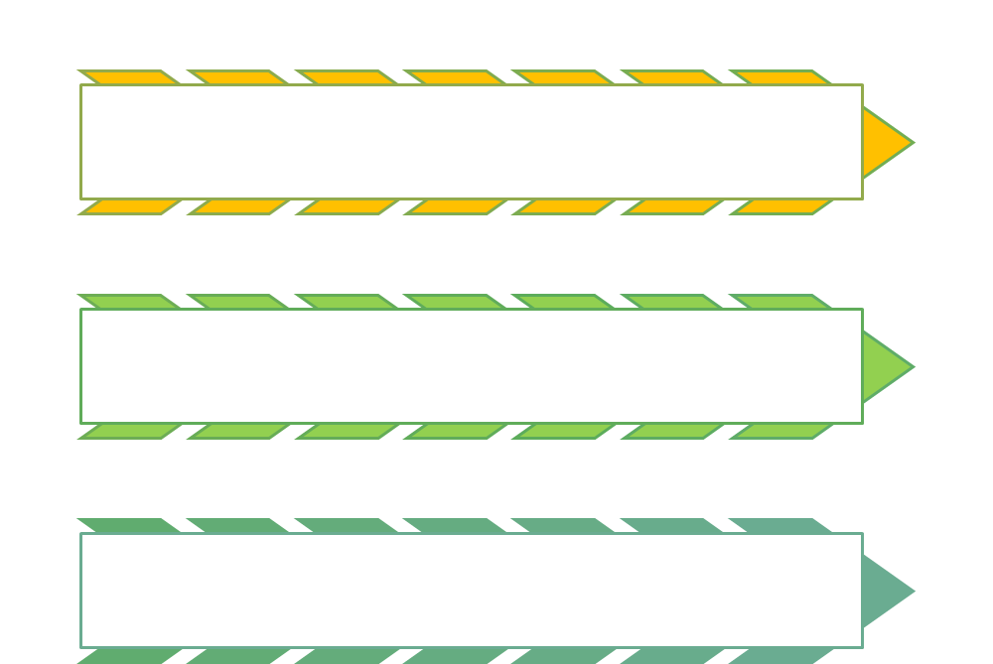

Slide 15
JDBC classes and interfaces are available in the java.sql package.
- DriverManager Class -
- Connection Interface
- Statement Interface
- PreparedStatement Interface
- CallableStatement Interface
- ResultSet Interface
- ResultSetMetaData Interface
- Types Class
- Date Class

Slide 16
The Driver Manager class.
The DriverManager class works as an interface between the user and database drivers.
The DriverManager.getConnection(), is a public static method that establishes a connection to a database.
The DriverManager is a Factory for the Connection

Slide 17
Driver Manager
The DriverManager class is responsible for establishing connections to the data sources, accessed through the JDBC drivers
JDBC database drivers are defined by classes that implement the “Driver” interface
The “Properties” class defined in java.util package defines/stores the property (key) and the corresponding value (object)
You can use the “setProperty” method to set the value of any of the properties
  E.g: System.setProperty(“jdbc.drivers”,
  “sun.jdbc.odbc.JdbcOdbcDriver”)
  The first is the key (or name) for the property to be set and the second argument is the value to be set

Slide 18
Driver Manager (contd)
If a security manager is in effect, may not be able to set the System property – then setProperty() will throw an exception of type “Security Exception”
If not able to set System property, the driver can be loaded explicitly by calling the static method “forName” in the “Class” class and pass the driver argument
  Eg: Class.forName(“sun.jdbc.odbc.JdbcOdbcDriver”);
The “forName()” method can throw a “ClassNotFoundException” if the driver class is not found. Hence, this function call should be in a try-catch block
The above statement loads the JDBC driver and takes care of any initialization that needs to be done

Slide 19
The Connection Interface.
A Connection object represents a bridge with a database.
A connected session includes the SQL statements that are executed
and the results that are returned over that connection.

Slide 20
Connection Object
Connection object represents an established connection to a particular data source
A connection object can also be used to query the data source (data and meta data)
Different versions of getConnection() method contained in the DriverManager class that returns a connection object:
  Connection myconn = DriverManager.getConnection(source);
  Connection myconn = DriverManager.getConnection(source, username, password);
Example
System DSN name – ODBC data source
String mysource = “jdbc:odbc:technical_library”;
Connection myconn = DriverManager.getConnection(mysource);

Slide 21
Steps during JDBC execution
The following steps are executed when running a JDBC application
  Import the necessary classes
  Load the JDBC driver
  Identify the database source
  Create a “connection” object
  Create a “Statement” object
  Execute a query using the “Statement” object
  Retrieve data from the returned “ResultSet” object
  Close the “ResultSet” object
  Close the “Statement” object
  Close the “Connection” object

Slide 22
JDBC Component Interaction
Driver
Manager
Creates
Creates
Connection
Statement
Creates
ResultSet
SQL
Driver
Establish
Link to DB
Result
(tuples)
Database

Slide 23
Statement Interface
Jdbc provides three Statement Interface for sending SQL statements to the database.
There are three methods in the Connection interface to create
instances of Statement interfaces.
Interface Description Factory method
Statement Simple SQL without parameters createStatement()
PreparedStatement Sql with one or more In parameters prepareStatement()
CallableStatement Used to call stored procedures prepareCall()

Slide 24
Methods of Statement for executing a SQL Query :
executeQuery() - is designed for normal select statements
executeUpdate() - is used to execute Insert, Update, Delete,
        Create Table, Drop Table.
execute() - is used to execute multiple statements that
        return more than one result set.
        It returns a boolean value,

Slide 25
Statement Object
Provides workspace for creating an SQL query, execute it, and retrieve the results that are returned
Statement objects are created by calling the createStatement() method of a valid connection object
Used to execute an SQL query by calling the executeQuery() method of Statement object
The SQL query string is passed as argument to the executeQuery() method
The result of executing the query is returned as on object of type “ResultSet”
JDBC Provides two other kinds of objects to execute SQL statement:
  PreparedStatement -> extends Statement class
  CallableStatement -> extends PreparedStatement class
Statement mystatement = myconn.createStatement();
ResultSet myresults = mystatement.executeQuery(“select * from authors”);

Slide 26
ResultSet Object
The results of executing an SQL query are returned in the form of an object that implements the ResultSet interface
ResultSet object contains a “cursor” that points to a particular record (called the current record)
When the ResultSet object is created, the cursor points to the position immediately preceeding the first record
Several methods available to navigate the ResultSet by moving the cursor
  first(), last(), beforeFirst(), afterLast(), next(), previous(), etc. //returns true if the move is successful
  isFirst() //whether you reached the beginning of the ResultSet
  isLast() // whether you reached the end of the ResultSet

Slide 27
Method Description
first() Points the cursor position to the first record.
next() point the cursor position to the next record
previous() points the cursor position to the previous record.
last() Points the cursor position to the last record.
getString() Takes either column index number or column name
        and returns a string, which is nothing but the data from the column.
        Also other functions like getInt(), getDate(), getFloat() etc are available.

Slide 28
beforeFirst() Moves the cursor to the front of the result set,
just before the first row.
afterLast() Moves the cursor to the end of the result set,
just after the last row.
wasNull() Returns a boolean value to denote whether the
last column read had a value of SQL null.
absolute() Points the cursor position to the given row number.
relative(int) Points the cursor position to a relative number of rows.
isFirst() Whether reached the beginning of the ResultSet
isLast() Whether reached the end of the ResultSet

Slide 29
Accessing Data in a ResultSet
We can retrieve the value of any column for the current row (specified by the cursor) by name or position
  Using Name: authorNames.getString(“lastname”);
  Using Position: authorNames.getString(2);
  Using the column position is a little bit faster
Methods for Retrieving Column Data
  getString(), getInt(), getShort(), getFloat(), getDouble(), getTime() etc.
We can always use getString() method for numerical values if we are not going to do some computations
Column names are NOT case sensitive
ResultSetMetaData object has metadata information about records, I.e., column names, data types etc.
Name of the
ResultSet
Method that returns
the value of String
Name of the
column or attribute
Second column in the row or tuple

Slide 30
JDBC 2.0 Navigation Methods for Scrollable Result Sets
boolean next ( ) Advances the cursor to the next row.
boolean previous ( ) Moves the cursor back one row.
boolean first ( ) Moves the cursor to the first row.
boolean last ( ) Moves the cursor to the last row.
void beforeFirst ( ) Moves the cursor before the first
row, usually in anticipation of
calling next ( )
void afterLast ( ) Moves the cursor after the last row,
usually in anticipation of
calling previous ( )
boolean Moves the cursor to the specified
absolute (int row) row. Specifying a negative number
moves the cursor relative to the
end of the result set;

Slide 31
JDBC 2.0 Navigation Methods for Scrollable Result Sets (contd.)
boolean Moves the cursor forward or
relative (int row) backward the number of rows
specified.
boolean True if the cursor is before the
isBeforeFirst ( ) first row.
boolean True if the cursor is after the
isAfterLast ( ) last row.
boolean isFirst ( ) True if the cursor is positioned on
the first row.
boolean isLast ( ) True if the cursor is positioned on
the last row.

Slide 32
Scrollable Result Sets
In JDBC1.0, result sets could be navigated in only one direction (forward) and starting at only one point (first row)
Since JDBC 2.0, the cursor can be manipulated as if it were a array index
Methods exist for reading both forward and backward, for starting from any row, and for testing the current cursor location.

Slide 33
Creating Scrollable Result Sets
Statement object created with parameters to indicate specific capabilities
Connection.createStatement() method can have up to three parameters:
  resultSetType – type of scrolling to be used
  resultSetConcurrency – indicates whether the result set can be updated
  resultSetHoldability – specifies whether to close cursors when a commit is done
Example
  stmt = con.createStatement(
  ResultSet.TYPE_SCROLL_INSENSITIVE,
  ResultSet.CONCUR_READ_ONLY);

Slide 34
Constants in Result Sets
Cursor Related Constants
  TYPE_FORWARD_ONLY
    JDBC 1.0-style navigation in which the cursor starts at the first row and can only move forward.
  TYPE_SCROLL_INSENSITIVE
    All cursor positioning methods are enabled; the result set doesn’t reflect changes made by others in the underlying table.
  TYPE_SCROLL_SENSITIVE
    All cursor positioning methods are enabled the result set reflects changes made by others in the underlying table.

Slide 35
Constants in Result Sets (contd.)
Updating Record Sets
  CONCUR_READ_ONLY
    The results set won’t be updatable
  CONCUR_UPDATABLE
    Rows can be added and deleted, and columns can be updated.
Closing Cursors
  HOLD_CURSORS_OVER_COMMIT
    Do not close cursors after a commit is done.
  CLOSE_COURSORS_AT_COMMIT
    Close cursors when a commit is done.

Slide 36
Getting MetaData for a ResultSet
The ResultSetMetaData object encapsulates the metadata for a ResultSet object
Use getMetaData() method of ResultSet object to get the metadata
Some of the methods of ResultSetMetaData object:
  getColumnName() // returns column name
  getColumnType() // returns column data type
  getColumnCount() // # of columns in the row
  getTableName() //returns the name of the table
  getColumnLabel() //suggested label for a column for use in printouts
The Types class in java.sql package contains the field types used in SQL
  Eg: CHAR, VARCHAR, DOUBLE, INT, TIME etc.
Once we know the SQL data type, then we can call the appropriate getXXX() function for getting the value of that column

Slide 37
public void getMetaData()
{
ResultSetMetaData meta=null;
ResultSet rs1=null;
rs1=stmt.executeQuery("Select empno, ename, sal from emp");
meta=rs1.getMetaData();
for(int i=1;i<=meta.getColumnCount();i++)
{
System.out.println( “column name:” + meta.getColumnName(i));
System.out.println( “Data type:”+ meta.getColumnTypeName(i));
}
}

Slide 38
Connection Pooling

Slide 39
Connection Pooling
Database
Java Code
Connection
datasource
Database
Java Code
con
Java Code
con
con
Java Code
con
con
Java Code
con
con

