Slide 1


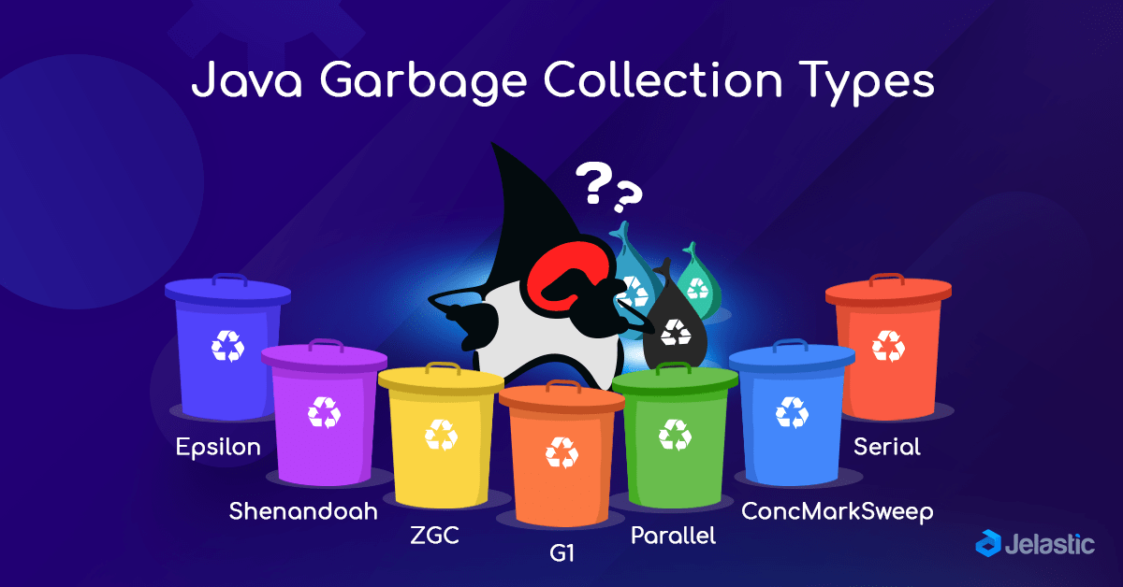

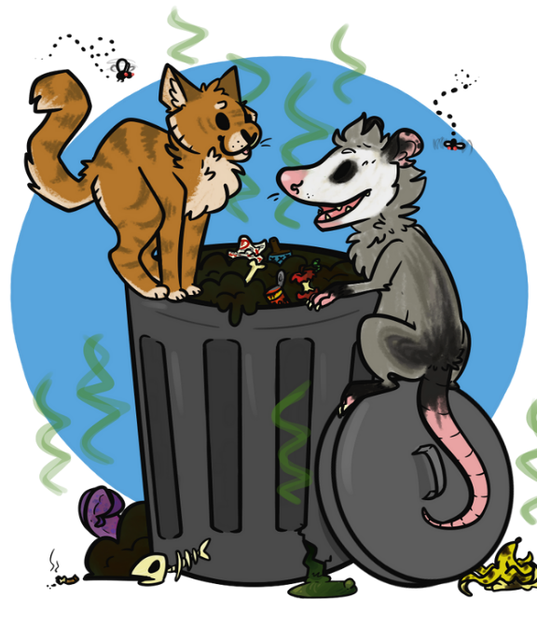


Slide 2
Step 1
Heap
Next Object pointer

Slide 3
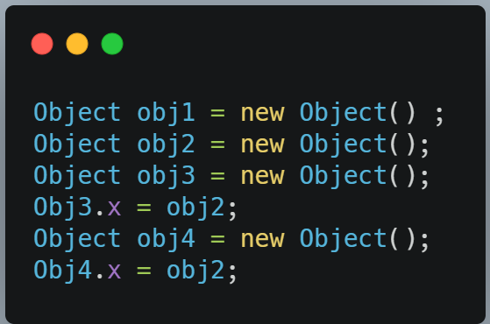

Slide 4
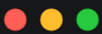
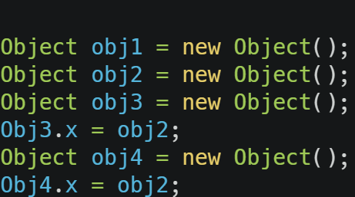
Step 2
stack
Heap
Next Object
pointer
obj1
New Object

Slide 5
Step 2
stack
Next Object
pointer
obj3
New Object
obj2
New Object
obj1
New Object

Slide 6
Step 2
stack
Next Object
pointer
obj3
New Object
obj2
New Object
obj1
New Object

Slide 7
Step 2
stack
Next Object
pointer
obj4
New Object
obj3
New Object
obj2
New Object
obj1
New Object

Slide 8
Step 2
Object obj1=new Object() ;
Object obj2=new Object();
Object obj3=new Object();
Obj3.x=obj2;
Object obj4=new Object();
Obj4.x=obj2;
Obj2 = null;
Next Object
pointer
obj4
New Object
obj3
New Object
Obj2 null
New Object
obj1
New Object

Slide 9
Step 2
Object obj1=new Object() ;
Object obj2=new Object();
Object obj3=new Object();
Obj3.x=obj2;
Object obj4=new Object();
Obj4.x=obj2;
Obj2 = null;
Obj3.x = null;
Obj4.x = null;
stack
Heap
Next Object
pointer
obj4
New Object
X=null
obj3
New Object
X=null
Obj2 null
New Object2
obj1
New Object

Slide 10
Step 3
heap
obj9
obj8
obj7
obj6
obj5
obj4
obj3
obj2
obj1

Slide 11

Step 3
heap
obj9
obj8
obj7
obj6
obj5
obj4
obj3
obj2
obj1

Slide 12

Step 4
obj10
heap
obj9
obj8
obj7
obj6
obj5
obj4
obj3
obj2
obj1

Slide 13

GC algorithm
Map the reachable Objects
Mark the Unreachable Objects
Sweep Marked Objects
Compress and re-reference
Create the New Object
heap
obj9
obj8
obj7
obj6
obj5
obj4
obj3
obj2
obj1

Slide 14
GC Steps
heap
Map the reachable Objects
obj9
root
obj8
obj8
obj7
obj7
obj9
obj6
obj1
obj6
obj3
obj5
obj5
obj2
obj4
obj4
obj3
obj2
obj1

Slide 15
GC Steps
Map the reachable Objects
Mark the Unreachable Objects
obj9
root
obj8
obj7
obj9
obj6
obj1
obj3
obj5
obj5
obj2
obj4
obj3
obj2
obj1

Slide 16


GC Steps
Map the reachable Objects
Mark the Unreachable Objects
Sweep Marked Objects
obj9
obj5
Now can I load
A new Object
obj3
obj2
obj1

Slide 17
GC Steps
Map the reachable Objects
Mark the Unreachable Objects
Sweep Marked Objects
Compress
obj9
obj5
obj3
obj2
obj1

Slide 18


GC Steps
Map the reachable Objects
Mark the Unreachable Objects
Sweep Marked Objects
Compress and re-reference
obj9
obj5
Now can I load
A new Object
obj3
obj2
obj1

Slide 19
GC Steps
Map the reachable Objects
Mark the Unreachable Objects
Sweep Marked Objects
Compress and re-reference
Create the New Object
obj10
obj9
obj5
obj3
Old Objects
obj2
obj1

Slide 20

Object Spaces

Slide 21
GC Steps
obj16
obj13
obj15
obj12
obj14
obj11
obj10
obj10
obj9
obj9
obj5
obj5
obj3
Old Objects
obj3
Old Objects
obj2
obj2
obj1
obj1

Slide 22
GC Steps
obj21
obj15
obj13
obj10
obj9
Old Objects S1
obj5
obj3
obj13
obj2
obj9
Old Objects S2
obj1
obj1

Slide 23
GC Steps
obj47
obj46
obj40
obj31
S1
obj22
obj13
obj9
S2
obj1

Slide 24


