Slide 1

HTML5.0

Slide 2
HTML5.0 Overview
HTML is a markup language used to design and layout web pages. HTML5 is a new version of that language that has more tags and hence more design options.
HTML5 will be the new standard for HTML, XHTML.
HTML5 is still a work in progress. However, most modern browsers have some HTML5 support.

Slide 3
How do we help our clients transition from older HTML/CSS to HTML 5/ CSS3
  Start traversing through your document and replace the endless DIVs with the appropriate structural elements.
  More specific with our fields and have our forms ready for APIs and future web applications.
  Video, audio and images are all easily written right into the code, eliminating the need for any third party software
  With the help of CSS3, the functionality and aesthetic appeal can be increased exponentially.

Slide 4
About the benefits of HTML 5
  HTML5 will load much quicker than its earlier version because it implements WebSockets.
  Mobile phone applications will be much more accessible if written in HTML5 because we don’t have to write applications for a specific brand of phone but rather can create universal applications for all phones.
  HTML5 brings a whole new dimension to web world. It can embed videos and audios on web-pages without using any plug-in like Flash.
  HTML5 will allow search engines to easily crawl the website, Search engine indexing will thus be more efficient, meaningful and possibly more advanced.
Contd.

Slide 5
About the benefits of HTML 5
    Using Cookies recently searched filter are stored and displayed through footer.
    The Client-side database are stored in session and can be accessed when the client is disconnected for a short period of time.
    Video’s are directly embedded using HTML 5 tag without using flash plugin
    HTML5 new structure of tags are applied, which will allow search engines to easily crawl the website, Search engine indexing will thus be more efficient, meaningful and possibly more advanced.
Contd.

Slide 6
About the benefits of HTML 5
    Smarter forms - HTML 5 offers enhanced forms with improvements to text inputs, search boxes and other fields and provides better controls for validating data, focusing, interaction with other page elements on the page and various other improvements
    Canvas 2D -The new canvas element provides developers with a very powerful and very simple way to using pure Javascript to draw diagrams, graphics and dynamic animations on a web page.
Contd.

Slide 7
Which Browsers Support HTML5?
Currently only Apples Safari is fully HTML 5 ready,
Firefox 3.5 “supports” the new coding but is not 100% compatible.
Internet explorer still does not reconize HTML 5 reference as of yet.
http://www.html5test.com/

Slide 8
Websites Created using HTML 5
http://paperkilledrock.com/
http://www.rubious.co.uk/
http://www.pelletized.com/
http://wasitup.com/

Slide 9

DOCTYPE Declaration
The doctype in HTML 4.01 required a reference to a DTD, HTML5 and does not require a reference to a DTD, but need the doctype for browsers to behave as they should.
Syntax:
<! DOCTYPE HTML>
Note:
The <! DOCTYPE> tag does not have an end tag.
The <! DOCTYPE> declaration is NOT case sensitive.

Slide 10
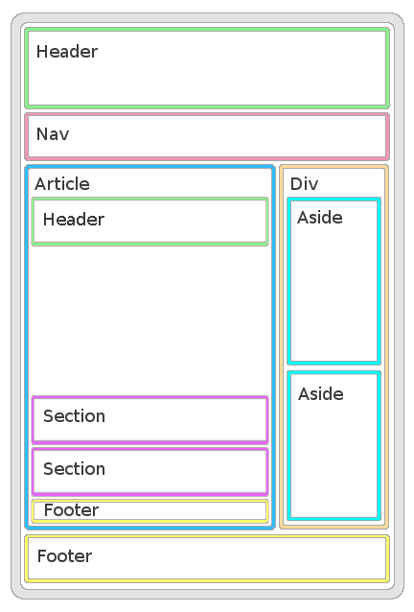
Page Structure
Header
Section
Article
Aside
Footer
Nav

Slide 11
Audio and Video
HTML5 introduces built-in media support via the <audio> and <video> elements, offering the ability to easily embed media into HTML documents.

Slide 12
Audio formats
Audio Formats
Currently, there are 3 main formats for the audio element:
Format | IE 9 | Firefox 3.5 | Opera 10.5 | Chrome 3.0 | Safari 3.0
Ogg Vorbis | No | Yes | Yes | Yes | No
MP3 | Yes | No | No | Yes | Yes
Wav | No | Yes | Yes | Yes | Yes

Slide 13
Audio formats
Example for HTML 5 Audio Element :
<audio controls="controls">
<source src="song.ogg" type="audio/ogg" />
<source src="song.mp3" type="audio/mpeg" />
Your browser does not support the audio element.
</audio>

Slide 14

Video on the Web
Until now, there has never been a standard for showing video on a web page.
Today, most videos are shown through a plug-in (like flash). However, not all browsers have the same plug-ins.
HTML5 specifies a standard way to include video, with the video element.
Video Formats
Currently, there are 3 supported video formats for the video element:
Format | IE | Firefox | Opera | Chrome | Safari
Ogg | No | 3.5+ | 10.5+ | 5.0+ | No
MPEG 4 | 9.0+ | No | No | 5.0+ | 3.0+
WebM | No | 4.0+ | 10.6+ | 6.0+ | No
Ogg = Ogg files with Theora video codec and Vorbis audio codec
MPEG4 = MPEG 4 files with H.264 video codec and AAC audio codec
WebM = WebM files with VP8 video codec and Vorbis audio codec

Slide 15
Video on the Web
Example for HTML 5 Video Element :
<video width="320" height="240" controls="controls">
<source src="movie.mp4" type="video/mp4" />
<source src="movie.ogg" type="video/ogg" />
Your browser does not support the video tag.
</video>

Slide 16
Other New Tags in HTML 5
<canvas> tag
<command> tag
<datagrid> tag
<datalist> tag
<datatemplate> tag
<details> tag
<dialog> tag
<embed> tag
<figcaption> tag
<figure> tag
<keygen> tag
<mark> tag
<meter> tag
<nest> tag
<output> tag
<progress> tag
<ruby>, <rt> and <rb> tags
<rule> tag
<summary> tag
<time> tag
<wbr> tag

