Slide 1
Klasifikacija zdravlja fetusa na temelju kardiotokografije
Valentina Križ, Jelena Kurilić, Lucija Valentić
Strojno učenje
PMF-MO

Slide 2
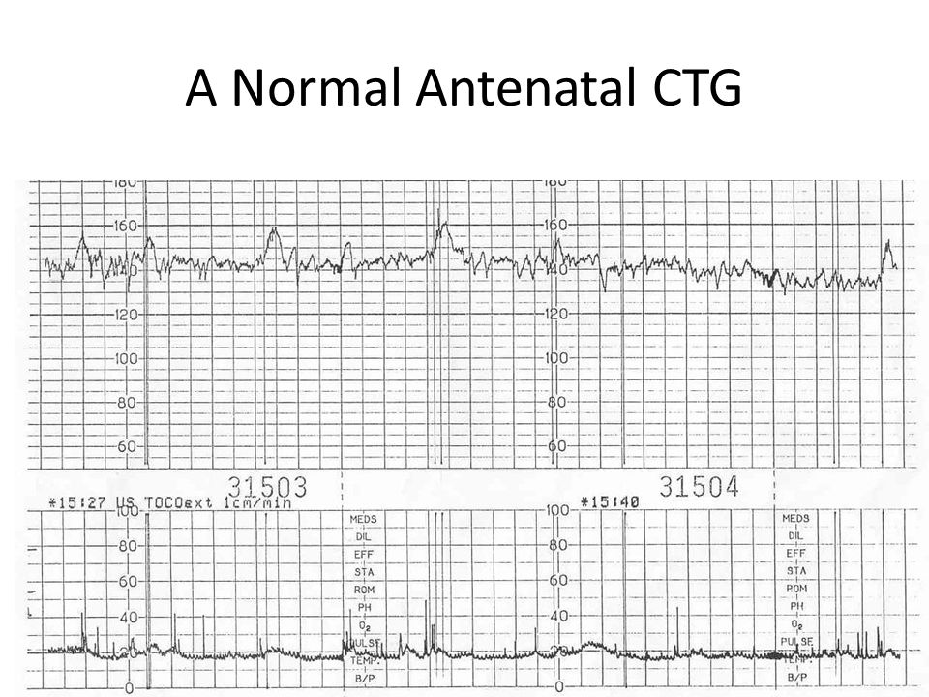
Uvod
fetalna patnja
zdravstveni problemi nerođenog djeteta u trećem tromjesečju trudnoće
kardiotokografija
dijagnostička metoda praćenja stanja fetusa
grafički prikaz aktivnosti srca ploda i aktivnosti
mišića zida maternice

Slide 3
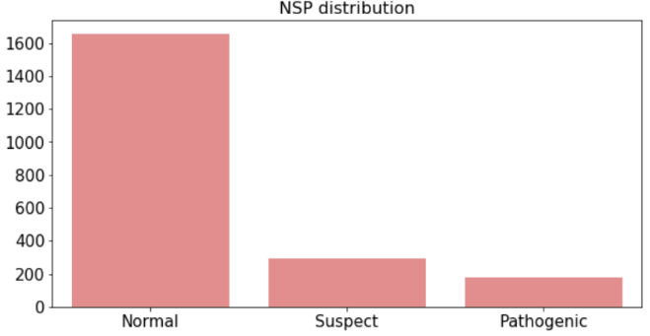
Podaci
UCI „Cardiotocography“ skup podataka (2126 primjeraka automatski obrađenih CTG snimki)
21 varijabla, 3 klase (normalna, sumnjiva, patološka)
Nebalansirani klasifikacijski problem → oversampling

Slide 4
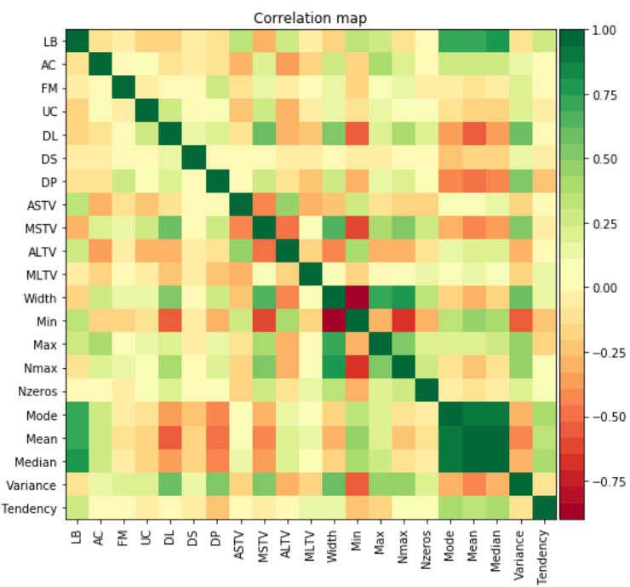
Varijable
Symbol | Description
LB | baseline value
AC | accelerations
FM | fetal movement
UC | uterine contractions
ASTV | percentage of time with abnormal short term variability
mSTV | mean value of short term variability
ALTV | percentage of time with abnormal long term variability
mLTV | mean value of long term variability
DL | light decelerations
DS | severe decelerations
DP | prolongued decelerations
DR | repetitive decelerations
Width | histogram width
Min | low freq. of the histogram
Max | high freq. of the histogram
Nmax | number of histogram peaks
Nzeros | number of histogram zeros
Mode | histogram mode
Mean | histogram mean
Median | histogram median
Variance | histogram variance
Tendency | histogram tendency: -1=left asymmetric; 0=symmetric; 1=right asymmetric

Slide 5
Podjela primjera i odabir modela
train i test skup u omjeru 80:20 (stratificirana podjela)
XGBoost, SVC, Random Forest
GridSearchCV (5-fold unakrsna validacija) + imbalanced-learn Pipeline na train skupu
SMOTE, BorderlineSMOTE, ADASYN
parametri:
SVC - c ϵ {1, 10, 100, 1000}
- gamma ϵ {0.001, 0.0001} (RBF kernel)
XGBoost - min_child_weight ϵ {1, 5, 10}
- gamma ϵ {0.5, 1, 1.5, 2, 5}
- subsample ϵ {0.6, 0.8, 1.0}
- max_depth ϵ {3, 4, 5}
Random Forest - n_estimators ϵ {16, 32, 64, 128}
- max_features ϵ {1, 2, 3, …, 19}
testiranje na test skupu

Slide 6
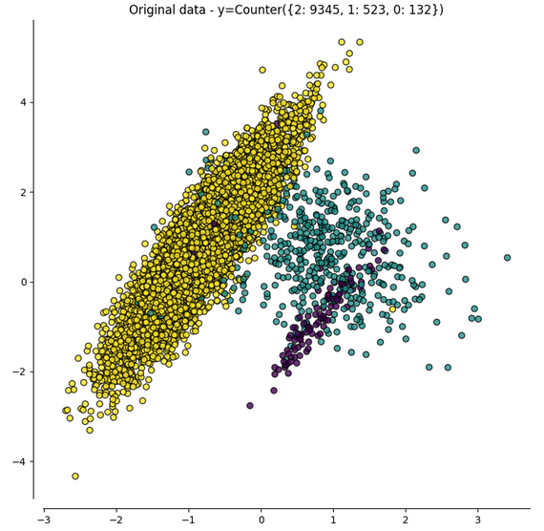
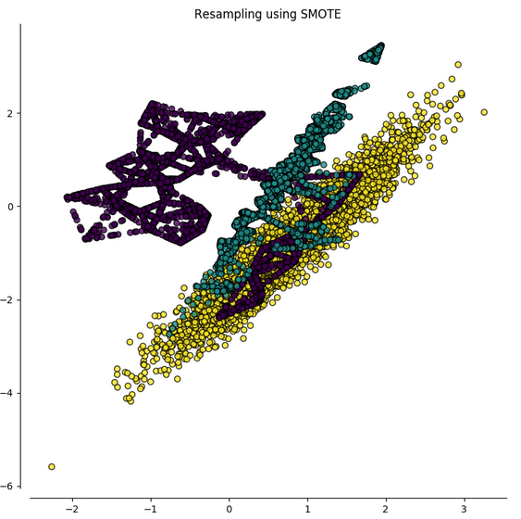
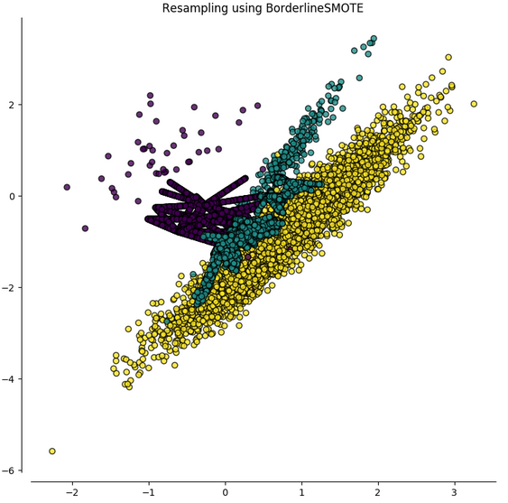
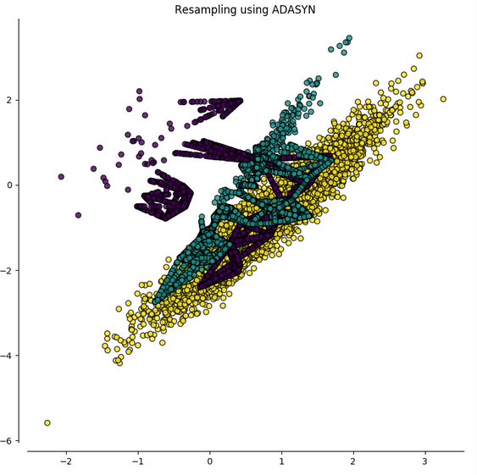
originalni podaci
SMOTE
BorderlineSMOTE
ADASYN

Slide 7
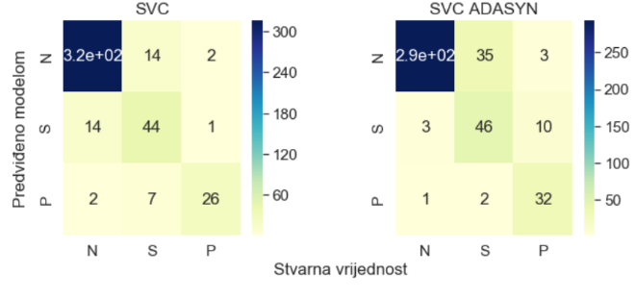
Rezultati - SVC
najlošiji od svih isprobanih modela
bez oversamplinga:
Točnost 90.61%
Osjetljivost 74.29%
ADASYN oversampling:
Točnost 87.32%
Osjetljivost 91.43%

Slide 8
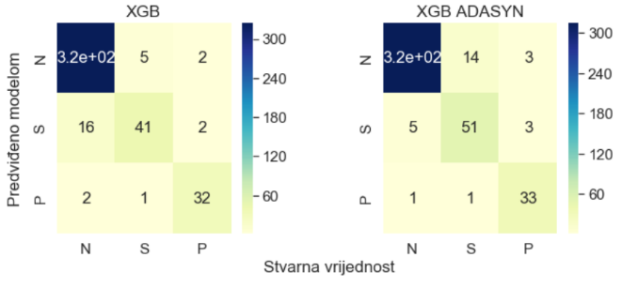
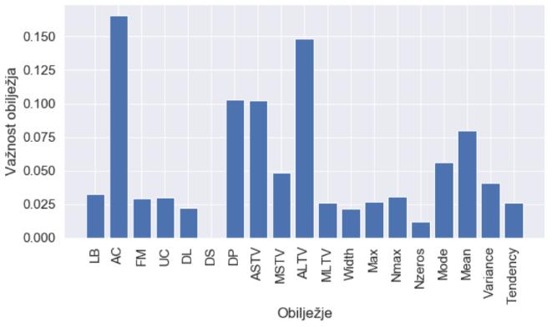
Rezultati - XGBoost
najbolji od svih isprobanih modela
bez oversamplinga:
Točnost 93.43%
Osjetljivost 91.43%
ADASYN oversampling:
Točnost 93.66%
Osjetljivost 94.29%
Najvažnije značajke:
AC (accelerations)
ALTV (percentage of time with abnormal
long term variability)

Slide 9
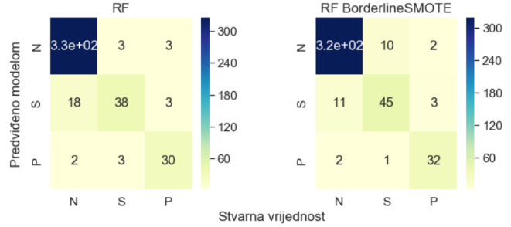
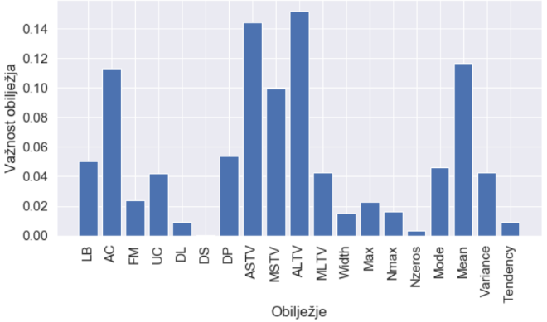
Rezultati – Random Forest
bez oversamplinga:
Točnost 92.49%
Osjetljivost 85.71%
BorderlineSMOTE oversampling:
Točnost 93.19%
Osjetljivost 91.43%
Najvažnije značajke:
ALTV (percentage of time with abnormal
long term variability)
ASTV (percentage of time with abnormal
short term variability)

Slide 10
Usporedba modela
 | - | SMOTE | BorderlineSMOTE | ADASYN
SVC | 90.61 | 89.20 | 85.92 | 87.32
XGB | 93.43 | 93.13 | 94.13 | 93.66
RF | 92.49 | 92.25 | 93.19 | 92.25
Točnost modela u postocima
 | - | SMOTE | BorderlineSMOTE | ADASYN
SVC | 74.29 | 88.57 | 85.71 | 91.43
XGB | 91.43 | 91.43 | 91.43 | 94.29
RF | 85.71 | 85.71 | 91.43 | 91.43
Osjetljivost modela u postocima

Slide 11
Zaključak
XGBoost
uz ADASYN najbolji rezultati
dobri rezultati i bez oversamplinga
SVC i Random Forest
uz oversampling značajan porast osjetljivost (i do 17.14%)
u prosjeku najbolji ADASYN oversampling
bez oversamplinga najčešće klasificirano kao Normal
uz oversampling češće klasificiranje kao Pathologic (i Suspect)

Slide 12
Daljnji rad
korištenje 10-fold unakrsne validacije
veći raspon parametara pri određivanju optimalnih parametara
prikupljanje većeg broja primjeraka

Slide 13
Literatura
[1] https://archive.ics.uci.edu/ml/datasets/cardiotocography
[2] M.-L. Huang and Y.-Y. Hsu, "Fetal distress prediction using discriminant analysis, decision tree, and artificial neural network," Journal of Biomedical Science and Engineering, vol. 5, p. 526, 2012.
[3] C. Sundar, et al., "Classification of cardiotocogram data using neural network based machine learning technique," International Journal of Computer Applications, vol. 47, 2012.
[4] E. Yılmaz and Ç. Kılıkçıer, "Determination of fetal state from cardiotocogram using LS-SVM with particle swarm optimization and binary decision tree," Computational and mathematical methods in medicine, vol. 2013, 2013.
[5] H. Ocak and H. M. Ertunc, "Prediction of fetal state from the cardiotocogram recordings using adaptive neuro-fuzzy inference systems," Neural Computing and Applications, vol. 23, pp. 1583-1589, 2013.
[6] E. M. Karabulut and T. Ibrikci, "Analysis of cardiotocogram data for fetal distress determination by decision tree based adaptive boosting approach," Journal of Computer and Communications, vol. 2, p. 32, 2014.

Slide 14
Literatura
[7] H. Sahin and A. Subasi, "Classification of the cardiotocogram data for anticipation of fetal risks using machine learning techniques," Applied Soft Computing, vol. 33, pp. 231-238, 2015.
[8] Z. Cömert, et al., "Cardiotocography signals with artificial neural network and extreme learning machine," in Signal Processing and Communication Application Conference (SIU), 2016 24th, 2016, pp. 1493-1496.
[9] M. Arif, "Classification of cardiotocograms using random forest classifier and selection of important features from cardiotocogram signal," Biomaterials and Biomechanics in Bioengineering, vol. 2, pp. 173-183, 2015.
[10] R. Kamath and R. Kamat, "Modeling fetal morphologic patterns through cardiotocography data: Decision tree-based approach," Journal of Pharmacy Research| Vol, vol. 12, p. 10, 2018.
[11] https://imbalanced-learn.readthedocs.io/en/stable/
[12] https://towardsdatascience.com/feature-selection-correlation-and-p-value-da8921bfb3cf

