Slide 1
ENGINEERING BRIEFING · 25 MIN
Towards Reliable
AI Agents
A capable agent can still be an unsafe system.
From task success to a science of behavior — τ-bench (arXiv:2406.12045) · Towards a Science of AI Agent Reliability (arXiv:2602.16666)

Slide 2
THE PROBLEM
Four failures, one gap
Replit coding agent
July 2025
Air Canada chatbot
Feb 2024
Deleted a live production database during a code freeze — despite instructions forbidding changes.
Invented a bereavement-refund policy. A tribunal ordered the airline to pay; the “separate entity” defense failed.
OpenAI Operator
2025
NYC business chatbot
2024
Bought eggs for $31.43 without asking for confirmation of the purchase.
Gave ten journalists ten different wrong answers to the same questions.
One evaluation gap underneath all four: benchmarks test whether an agent can succeed once — not whether it behaves reliably every time.
Towards Reliable AI Agents
2

Slide 3
THE PROBLEM
Benchmarks ask the wrong question
BENCHMARKS ASK
DEPLOYMENT ASKS
“Can it succeed once?”
“Will it behave — every time?”
A single green run — one task, one attempt, one pass.
Correctly, consistently, robustly, predictably, and safely — across millions of repeated real interactions.
Agents are not pure functions. They are stochastic systems assembled from model · prompt · memory · tools · policies · permissions · orchestration · external state. One green run tells us little about the behavior distribution.
Towards Reliable AI Agents
3

Slide 4
THE MAP
Two papers set the direction
τ-bench
Towards a Science of
AI Agent Reliability
Sierra · 2024
Rabanser et al. · 2025
Proved agent success rates hide inconsistency.
Gave us pass^k — the probability of getting it right every time, not just once.
A reproducible customer-service environment: real tools, policies, simulated users, goal-state grading.
Proved reliability lags capability: 0.03/yr vs 0.21/yr over 18 months.
Four dimensions to measure it: consistency, robustness, predictability, safety.
12 metrics · 15 agentic models · GAIA + τ-bench.
arXiv:2406.12045
arXiv:2602.16666
Capability climbed 7× faster than reliability. Scaling alone does not close the gap.
Towards Reliable AI Agents
4

Slide 5
01
τ-bench — task success is not enough
A reproducible environment that measures behavior, not a single green run.
Towards Reliable AI Agents
5

Slide 6
Τ-BENCH
Why one-shot benchmarks miss
1
Users reveal intent incrementally and imprecisely
Benchmarks are the feedback loop of agent engineering.
2
Tools expose partial and changing state
Without a reproducible environment, failures stay anecdotes, prompt changes can’t be compared, and upgrades hide silent regressions.
3
Policy documents constrain permitted actions
4
Some actions modify persistent records
The missing question: not “Can it succeed?” but “Will it behave reliably in production?”
5
Millions of similar requests must get similar treatment
Towards Reliable AI Agents
6

Slide 7
Τ-BENCH
Two domains, one structure
τ-retail
τ-airline
115
tasks
50
tasks
500
users
500
users
50
products
300
flights
1,000
orders
2,000
reservations
15
API tools
13
tools
Rules are mostly common sense.
Harder: rules depend on fare class, cabin, membership, timing, payment.
Each environment: database · API tools · natural-language policy · LLM-simulated users · annotated goal states. Sierra extended it — τ²-bench added telecom + dual-control; τ³-bench added banking, a voice modality, and task corrections.
Towards Reliable AI Agents
7

Slide 8

Τ-BENCH
Outcome-based, trajectory-invariant grading
How it works
What it can’t see
An LLM plays the customer from a hidden brief — sampling makes repeated trials cheap.
Grade compares end states, not paths: any tool sequence reaching the goal scores 1.
Both terms deterministic — no LLM judge in the loop; cheap to re-run many times.
It checks the endpoint, not the process — an agent can reach the right state while skipping a mandated step (refund without confirmation).
Cost moves to annotation: every valid ending must be enumerated (40+ trials per retail task).
Towards Reliable AI Agents
8

Slide 9
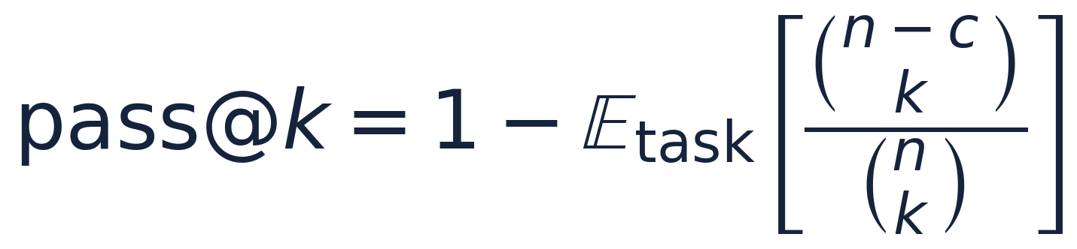
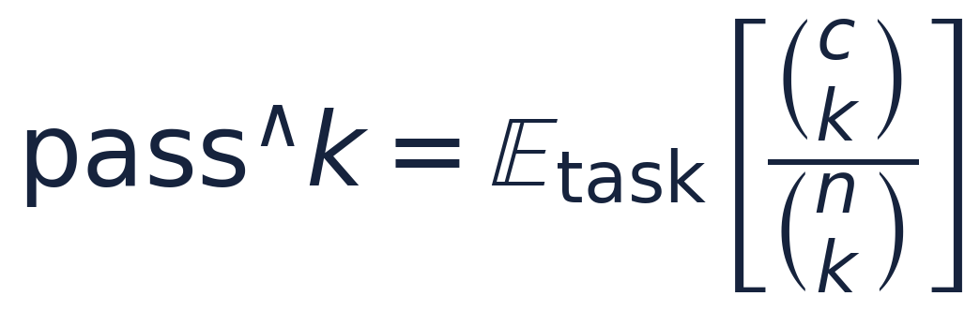
Τ-BENCH
Two metrics, two questions
pass@k
pass^k
Probability that AT LEAST ONE of k attempts succeeds.
Probability that ALL k attempts succeed.
Fits code generation: sample many candidates, a test suite picks a winner.
More attempts improve the odds.
Fits customer-facing, business-critical deployment.
A customer receives one execution — repeating the task must keep producing the right result.
Towards Reliable AI Agents
9

Slide 10
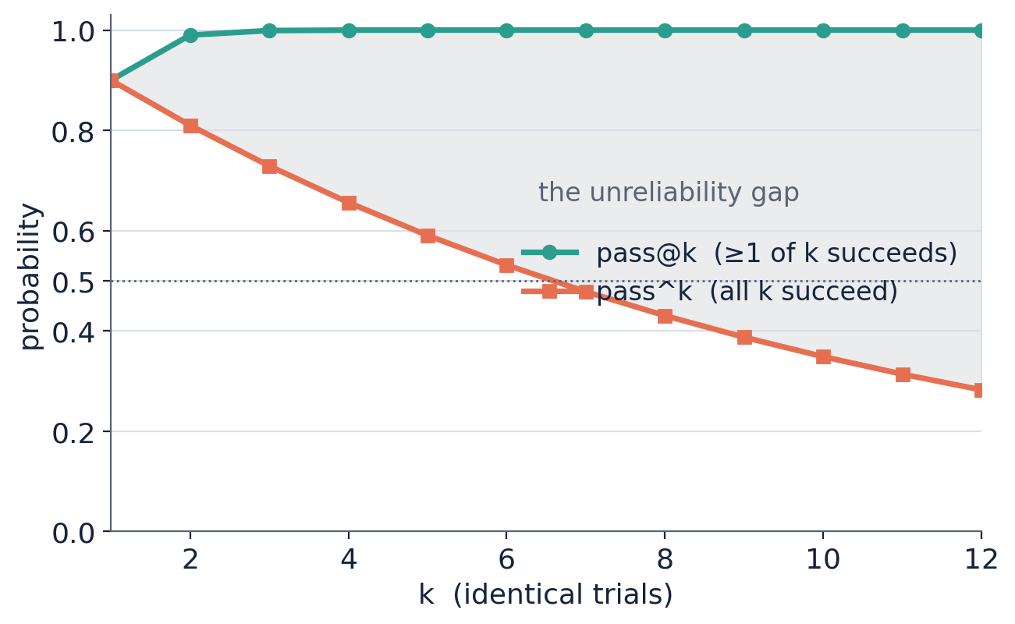

Τ-BENCH
90% once is not reliable
Strong by single-run accuracy — yet under a 50% chance of completing the same task correctly eight times in a row.
Assuming independent runs at p = 0.9. Runnable reference implementations ship in the companion notebook.
Towards Reliable AI Agents
10

Slide 11
Τ-BENCH · 2024
The best config was still shaky
Best configuration: GPT-4o with native function calling.
61.2%
35.2%
48.2%
<25%
pass^1 · retail
pass^1 · airline
pass^1 · averaged
pass^8 · retail
Run the same retail task eight times, and it succeeds every time less than a quarter of the time. A task the agent could solve once, it often could not solve every time.
Towards Reliable AI Agents
11

Slide 12
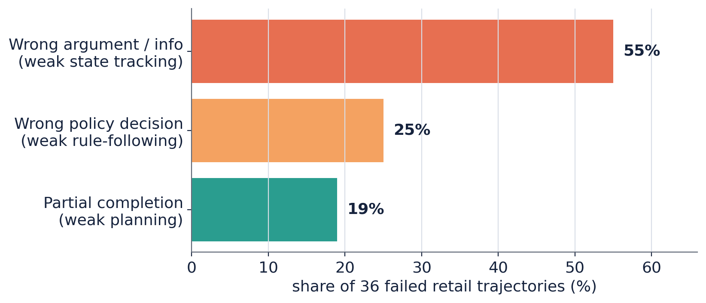
Τ-BENCH · 2024
36 failed retail runs → three fixes
55%
Wrong argument / info
Weak state tracking
→ add input validation
25%
Wrong policy decision
Weak rule-following
→ add policy boundary tests
19%
Partial completion
Weak planning
→ add completion checks
Towards Reliable AI Agents
12

Slide 13
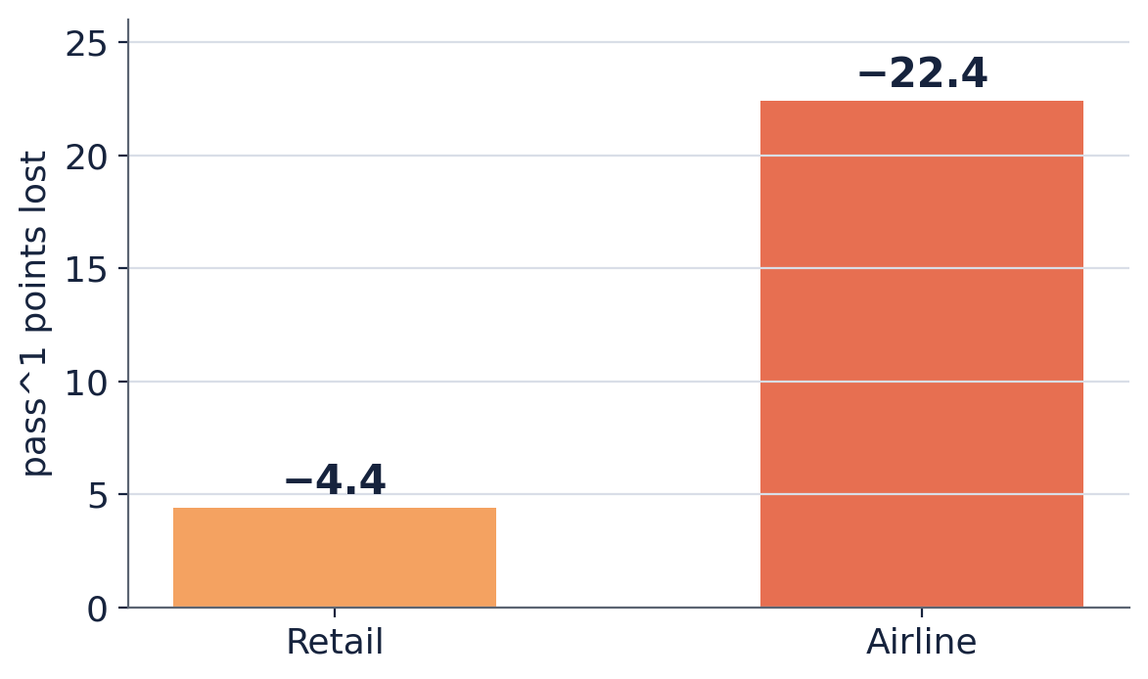
Τ-BENCH · 2024
Delete the policy, re-score
Retail −4.4 pts. Tasks are common sense — the rules barely mattered.
Airline −22.4 pts. It needs the fine print — fare class, cabin, timing.
Always test against the client’s real policies.
Towards Reliable AI Agents
13

Slide 14
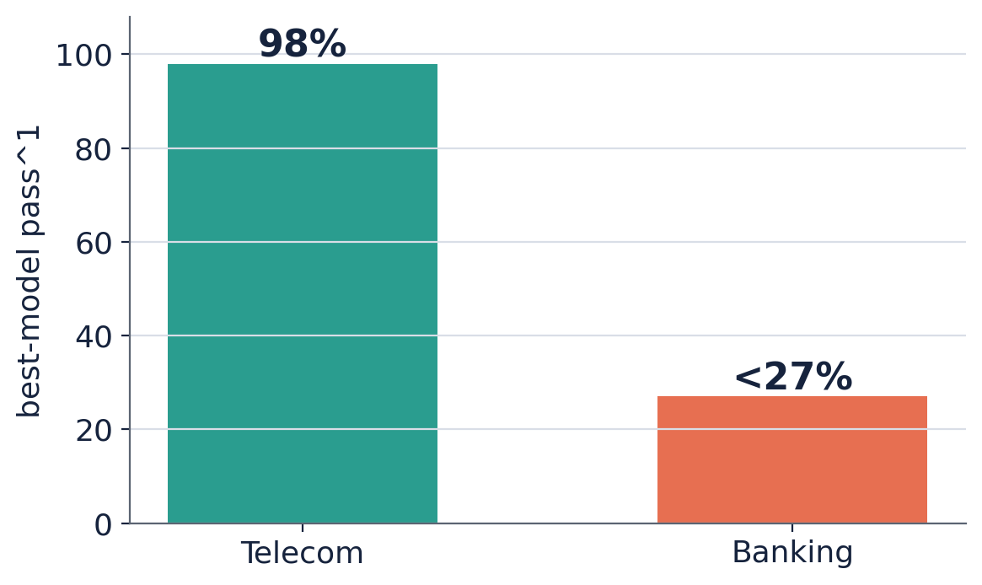
Τ³-BENCH · TODAY
Capability rose — unevenly
Telecom > 98%. Top agents nearly solve it.
Banking < 27%. No model breaks 27% on the hardest domain.
Capability rose. It did not become uniform — and it did not bring reliability with it.
Towards Reliable AI Agents
14

Slide 15
02
Towards a Science of AI Agent Reliability
15 models · GAIA + τ-bench · 12 metrics · four dimensions borrowed from aviation, nuclear, rail.
Towards Reliable AI Agents
15

Slide 16
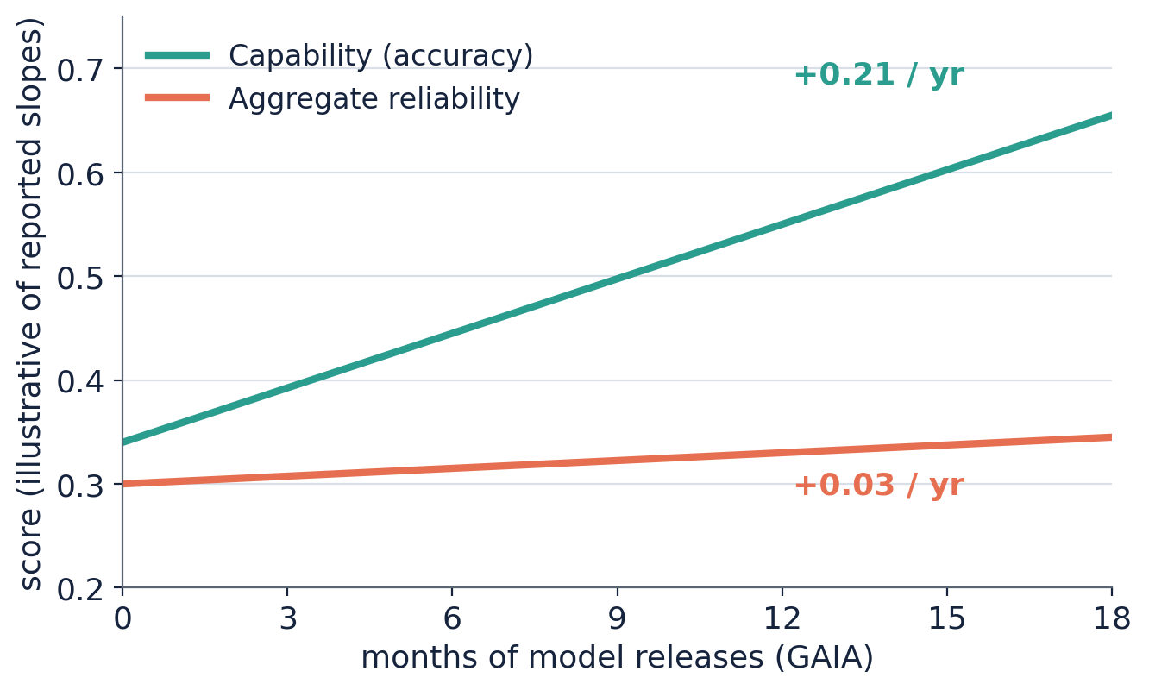
RELIABILITY
Capability outran reliability — a 7× gap
Over 18 months on GAIA: accuracy +0.21/yr, aggregate reliability +0.03/yr — a factor of seven.
Why accuracy alone hides it
Agent A fails the same identifiable 10% every time → route those to humans.
Agent B fails randomly on 10% of every task class.
Both score 90%. Only Agent A supports predictable automation.
Towards Reliable AI Agents
16

Slide 17
RELIABILITY
Four dimensions of reliability
Borrowed from domains where reliability is non-negotiable: aviation · nuclear · automotive · rail.
1
Consistency
2
Robustness
Same task, same conditions — same result?
Does performance survive changed conditions?
3
Predictability
4
Safety
Does the agent know when it will fail?
How bad does it get when a failure happens?
Towards Reliable AI Agents
17

Slide 18
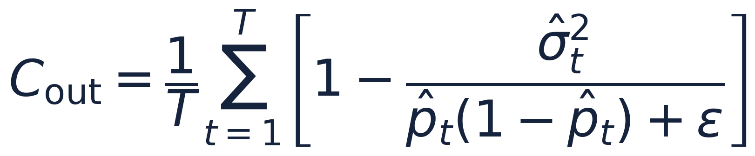
DIMENSION 1 · CONSISTENCY
Consistent in what, not when
K=5 runs at temperature 0 still diverge — float non-associativity, batching, implementation. Temp 0 ≠ deterministic.
The metric separates consistency from capability: an always-failing agent has pass^k = 0 yet is perfectly consistent.
Trajectory consistency: Jensen–Shannon on which actions; Levenshtein on their order. Agents are consistent in what they do, inconsistent in when.
Why order matters
Check inventory then charge — or charge first? Both may pass, but an interruption leaves different states: one recoverable, one an incorrect charge.
Smaller models are often more consistent — fewer valid paths, less run-to-run variation.
Towards Reliable AI Agents
18

Slide 19
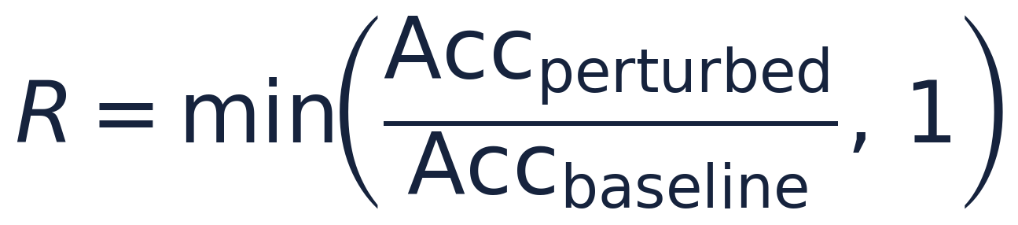
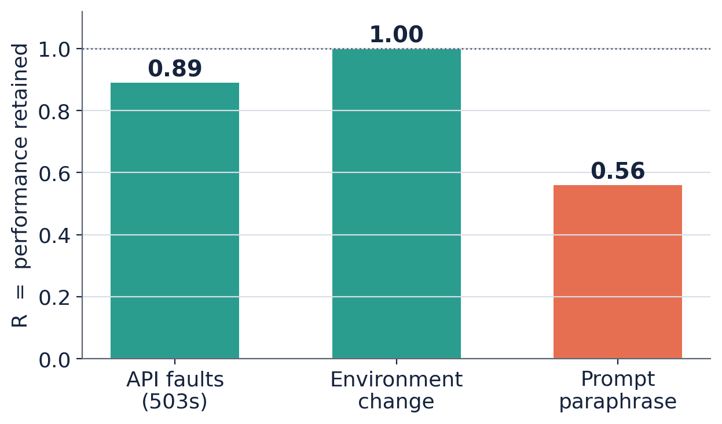
DIMENSION 2 · ROBUSTNESS
Paraphrase is the axis that breaks
Perturbations: API timeouts + HTTP 503s (p = 0.2); environment changes (reordered JSON, renamed params); five paraphrases per task.
Faults and environment changes barely dent accuracy.
Prompt paraphrase is the main differentiator — users never match benchmark wording.
Recovers from a 503 — then fails when “cancel my subscription” becomes “please end my plan.”
Towards Reliable AI Agents
19

Slide 20
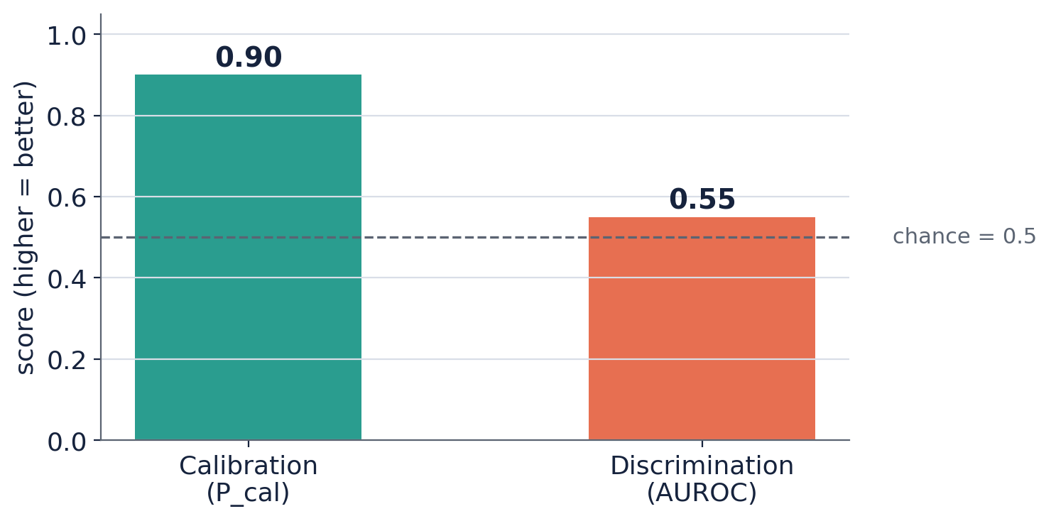
DIMENSION 3 · PREDICTABILITY
Calibrated is not discriminating
Three metrics: calibration (P_cal = 1 − ECE), discrimination (AUROC), Brier score.
Calibration improved — frontier models’ confidence is numerically accurate on average (Claude strongest across both benchmarks).
Discrimination did not — AUROC near 0.5 means confidence ranks a success above a failure barely better than chance.
Selective automation — auto-approve high-confidence, route the rest to humans — needs discrimination, not aggregate calibration.
Towards Reliable AI Agents
20

Slide 21
DIMENSION 4 · SAFETY
Reported separately, deliberately
Compliance S_comp: fraction of runs without violations (skipped ID checks, unauthorized actions).
Harm severity S_harm: buckets violations low (0.25) · medium (0.5) · high (1.0).
Combined via the Kaplan–Garrick (1981) risk model — probability × consequence.
Why it’s excluded from the aggregate
Tail events dominate. Safe in 99% of runs but catastrophic in 1% should not average to a good score.
Aviation targets < 1 catastrophe per 10⁹ flight hours. Top τ-bench violation: financial inaccuracy.
Towards Reliable AI Agents
21

Slide 22
PAYOFF
The same four failures — now labeled
Replit
Air Canada
High harm severity + weak prompt robustness. Irreversible action; “don’t touch the DB” did not survive rephrasing.
Policy-compliance failure. Invented a rule the policy never contained — exactly what the ablation exposes.
Operator
NYC chatbot
Compliance failure, visible in the action sequence: spent $31.43 without the mandated confirmation.
Outcome inconsistency + poor calibration. Ten runs, ten wrong answers, none flagged low-confidence.
A common objection — “bigger models will just be reliable” — holds only at perfect accuracy. Scaling alone did not close the gap.
Towards Reliable AI Agents
22

Slide 23
PRACTICE
Building reliability into the lifecycle (ADLC)
1
Define the operating envelope
2
Build a representative eval environment
Supported intents, languages, tools, failure modes. Reliability is always relative to this.
Real APIs, policies, simulated users, goal-state grading. One task → one outcome.
3
Run repeated + perturbed tests
4
Create a reliability profile
Report pass^k, not pass^1. Test paraphrases, faults, env changes. CI needs repeated runs.
Report the four dimensions separately; weight them by application. Weighting is an engineering choice.
5
Enforce release gates + containment
6
Turn failures into regression tests
Thresholds before production. Replit was a reliability AND a containment failure.
Add every incident; map to a dimension; re-run. Qualification in January ≠ June.
Towards Reliable AI Agents
23

Slide 24
WHAT’S NEXT
Three problems still open
1
2
3
Benchmarks decay
Multi-agent attribution
The LLM-judge problem
Fixed test sets get memorized. Benchmarks must become generative and parameterized — sampling fresh environments, not replaying a fixed set.
No strong metrics for multi-agent reliability. Errors propagate across agent boundaries, making the source of failure hard to pin down.
Safety evaluation leans on LLM judges — which share the same inconsistency, prompt sensitivity, and calibration errors as the systems they grade.
Towards Reliable AI Agents
24

Slide 25
THE QUESTION CHANGED
Not “How often does it succeed?”
but
“How consistently, robustly, predictably, and safely does it behave?”
τ-bench made it measurable. The reliability framework split it into dimensions. The ADLC connects it to testing, release, monitoring, and containment.
Closing the gap is an engineering discipline — not another model release.
Towards Reliable AI Agents
25

