Slide 1
Piezoelectric Transducers for Ultrasonic Flowmeters
Understanding Principles, Types, and Applications

Slide 2
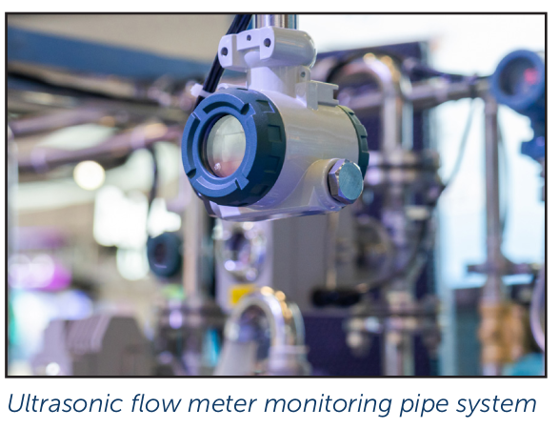
Introduction to Ultrasonic Flowmeters
Devices that use ultrasonic waves to measure fluid flow.
Applications: Water distribution, industrial measurement, leak detection

Slide 3
Working Principle of Ultrasonic Flowmeters
Piezoelectric transducers emit and detect ultrasonic waves.
Flow changes affect wave frequency or propagation time.

Slide 4
Types of Ultrasonic Flowmeters
1. Doppler Flow Meters: Measure frequency shift due to moving particles.
2. Transit Time Flow Meters: Compare upstream and downstream travel time.

Slide 5
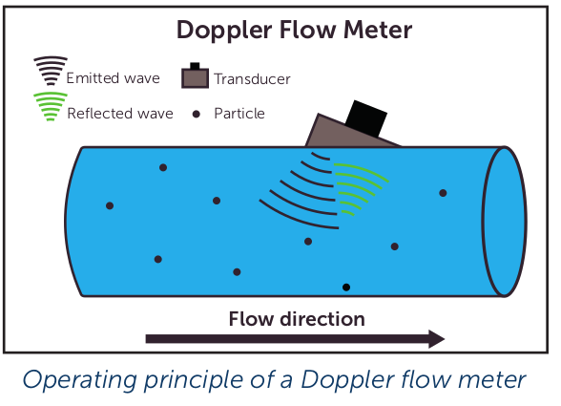
Doppler Flow Meters
Uses one or two piezoelectric transducers.
Measures frequency shifts from reflected ultrasonic waves.
Best for fluids with suspended particles or bubbles.

Slide 6
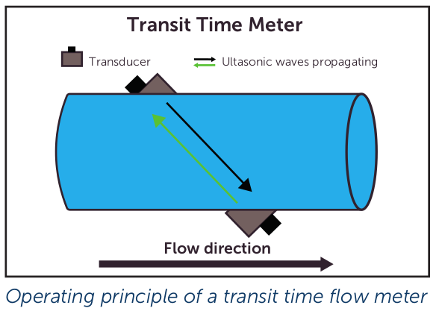
Transit Time Flow Meters
Uses paired transducers placed diagonally across the flow path.
Compares upstream and downstream transit times.
Best suited for clean fluids.

Slide 7
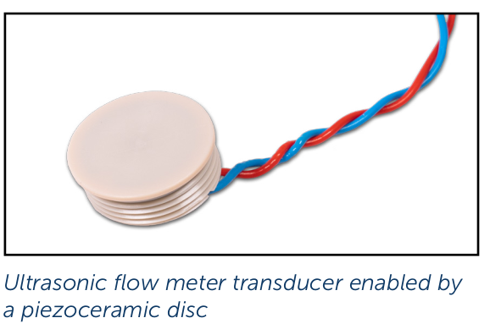
Piezoelectric Transducers in Flowmeters
Convert electrical signals into ultrasonic waves.
Material choice influences performance and efficiency.

Slide 8
Piezoelectric Material Properties
NCE51: Stable acoustic properties, best for transit time meters.
NCE56: High sensitivity, best for Doppler meters.

Slide 9
Customization of Piezoelectric Transducers
Electrode shaping: Wrap-around electrodes for better connectivity.
Assembly & Testing: Custom wiring, potting, and validation.
Transducer Design: FEM optimization.

Slide 10
Advantages of Piezoelectric Transducers
High accuracy and sensitivity.
Non-invasive measurement options.
Low maintenance and long-term stability.

Slide 11
Conclusion
Piezoelectric transducers are essential for ultrasonic flowmeters.
Material advancements improve efficiency and reliability.
Widely used across industries for precise flow monitoring.

