Slide 1

F.E. A
(Computer Engineering)
Welcome to
Thakur Shree DPS College of Engineering & Management

Slide 2
Institute Vision
To be a leader in technical education, producing globally competent and socially responsible professionals, who will contribute to technological and societal advancements through innovation and ethical practices.

Slide 3
Institute Mission
1. Deliver Comprehensive Technical Education
To provide a well-rounded education that integrates technical expertise, practical skills, and creativity, empowering students to solve complex problems.
2. Promote Research and Innovation
To foster a culture of research, creativity, and innovation to generate new knowledge and develop sustainable technologies that address local and global challenges.
3. Develop Ethical and Responsible Engineers
To instill ethical values and social responsibility in students, emphasizing sustainability, diversity, and the positive impact of technology on society.
4. Encourage Lifelong Learning and Professional Growth
To encourage continuous learning, leadership development, and effective communication to adapt to the changing technological landscape and foster holistic personal growth.

Slide 4
Department Vision
To provide an impetus in the field of Computer Engineering producing innovative, ethical and socially responsible professionals to build technologically empowered society.

Slide 5
Department Mission
1. Develop Strong Theoretical Foundation and Practical Proficiency
To deliver a comprehensive computing education that integrates theoretical and practical knowledge with hands-on skills, helping students develop efficient computing solutions.
2. Fostering Innovation, Research and Industry Collaboration
To cultivate a spirit of innovation and critical thinking - by promoting research and strengthening industry collaboration to develop creative and sustainable solutions.
3. Ethical Responsibility and Sustainable Computing
To instill ethical values, social responsibility and environmental consciousness among students to develop inclusive technologies that positively influence society.
4. Lifelong Learning and Collaborative Leadership
To nurture a mindset of continuous learning, teamwork and leadership qualities - preparing graduates adapt to multidisciplinary and evolving technological environment.

Slide 6
Program Educational Objectives (PEOs)
PEO-1: Core Technical Competence
To apply core knowledge and technical skills across various domains to design, develop and implement effective solutions that meet industry and societal needs.
PEO-2: Innovation and Research Orientation
To engage in research and innovation to solve complex engineering problems using modern tools and technologies.
PEO-3: Ethical Practice and Social Responsibility
To practice with integrity, uphold ethics and develop sustainable, inclusive technological solutions for societal and environmental well-being.
PEO-4: Continuous Learning and Adaptability
To embrace lifelong learning and adapt to rapidly evolving global, multidisciplinary and collaborative technological environment.

Slide 7
Program OUTCOMES (POs)
PO1: Engineering Knowledge
Apply knowledge of mathematics, natural science, computing, engineering fundamentals and an engineering specialization as specified in WK1 to WK4 respectively to develop the solutions of complex engineering problems.
PO2: Problem Analysis
Identify, formulate, review research literature and analyze complex engineering problems reaching substantiated conclusions with consideration for sustainable development. (WK1 to WK4)
PO3: Design/Development of Solutions
Design creative solutions for complex engineering problems and design/develop systems/components/processes to meet identified needs with consideration for the public health and safety, whole-life cost, net zero carbon, culture, society and environment as required. (WK5)
PO4: Conduct Investigations of Complex Problems
Conduct investigations of complex engineering problems using research-based knowledge including design of experiments, modelling, analysis & interpretation of data to provide valid conclusions. (WK8)

Slide 8
Program OUTCOMES (POs)
PO5: Engineering Tool Usage
Create, select and apply appropriate techniques, resources and modern engineering & IT tools, including prediction and modelling recognizing their limitations to solve complex engineering problems. (WK2 and WK6)
PO6: The Engineer and The World
Analyze and evaluate societal and environmental aspects while solving complex engineering problems for its impact on sustainability with reference to economy, health, safety, legal framework, culture and environment. (WK1, WK5, & WK7)
PO7: Ethics
Apply ethical principles and commit to professional ethics, human values, diversity and inclusion; adhere to national & international laws. (WK9)
PO8: Individual and Collaborative Team work
Function effectively as an individual, and as a member or leader in diverse/multi-disciplinary teams. (WK9)

Slide 9
Program OUTCOMES (POs)
PO9: Communication
Communicate effectively and inclusively within the engineering community and society at large, such as being able to comprehend and write effective reports and design documentation, make effective presentations considering cultural, language, and learning differences.
PO10: Project Management and Finance
Apply knowledge and understanding of engineering management principles and economic decision-making and apply these to one’s own work, as a member and leader in a team, and to manage projects and in multidisciplinary environments.
PO11: Life-long Learning
Recognize the need for, and have the preparation and ability for i) independent and life-long learning ii) adaptability to new and emerging technologies and iii) critical thinking in the broadest context of technological change. (WK8)

Slide 10
Program Specific Outcomes (PSOs) On successful completion, graduates of B.E. (Computer Engineering) degree program will be able to:
PSO-1: Demonstrate technical skills to provide computing solutions using basic hardware components and applying standard software engineering practices.
PSO-2 Use modern tools and platforms for developing, testing and deploying computing solutions across different domains.
PSO-3: Exhibit professional ethics, effective communication, leadership qualities and collaborative skills necessary to work in multicultural teams.

Slide 11
Semester Pattern
SEMESTER I
SEMESTER II

Slide 12
Semester-I Subjects
Applied Mathematics – I
Applied Physics
Applied Chemistry
Engineering Mechanics
Basic Electrical &Electronics Engineering
Professional Communication & Ethics
C Programming
Workshop Practice

Slide 13
Semester-II Subjects
Applied Mathematics – II
Elective Physics
Elective Chemistry
Engineering Graphics
Python Programming
Core Course Subjects
Indian Knowledge Systems
Workshop Practice

Slide 14
Attendance Norms
Minimum 75% attendance in each subject
Defaulter List prepared monthly → Shared with all
Poor attendance → May lose exam eligibility

Slide 15
Rules for Passing & Promotion to S.E.
Minimum 40% marks in each subject (Theory, Practical)
Must clear set of Theory (Internal & University) &/or Practical (Termwork & Oral/ Practical) exams
Minimum 32 credit (Maximum 45 (23+22)) to be earned.

Slide 16
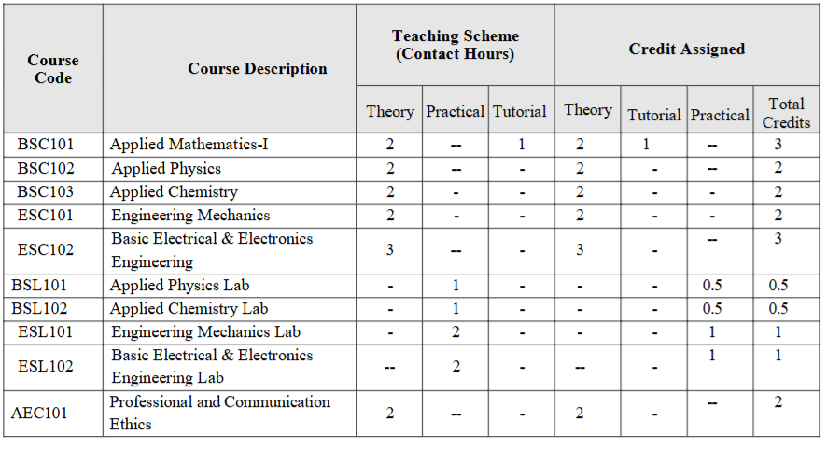
NEP 2020 With Effect from Academic Year (2024-2025) Semester-I

Slide 17
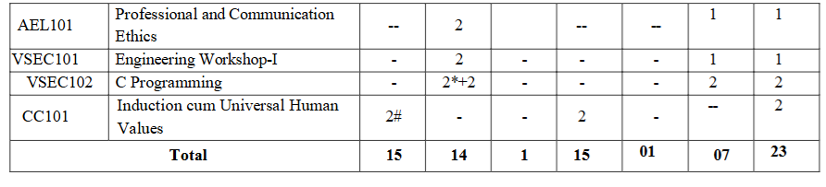
NEP 2020 With Effect from Academic Year (2024-2025) Semester-I
* Two hours of practical class to be conducted for full class as demo/discussion.
# Course evaluation is activity-based which may be an individual or group of four students.
Theory / Tutorial 1 credit for 1 hour and Practical 1 credit for 2 hours

Slide 18
Credit Assignment: Sample Calculation I
THEORY CREDITS
TUTORIAL CREDITS
CREDITS
AM-I
IAT
ESE
2 Credits
TW
1 Credit
3 Credits
IAT
ESE
0 Credits
TW
1 Credit
1 Credit
IAT
ESE
0 Credits
TW
1 Credit
1 Credit
IAT
ESE
2 Credits
TW
0 Credits
2 Credits
IAT
ESE
0 Credits
TW
0 Credits
0 Credits

Slide 19
Credit Assignment: Sample Calculation II
THEORY CREDITS
TUTORIAL CREDITS
CREDITS
IAT
ESE
2 Credits
TW
OR
1 Credit
3 Credits
EM
&
BEEE
IAT
ESE
0 Credits
TW
OR
1 Credit
1 Credit
IAT
ESE
0 Credits
TW
OR
1 Credit
1 Credit
IAT
ESE
2 Credits
TW
OR
0 Credits
2 Credits
IAT
ESE
0 Credits
TW
OR
0 Credits
0 Credits

Slide 20
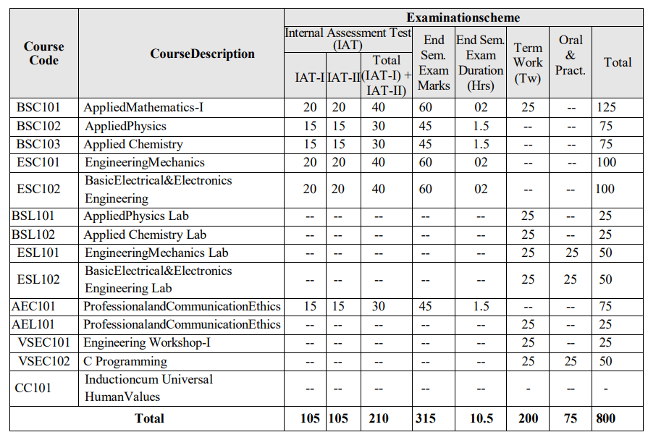
Examination Scheme: Semester-I

Slide 21
Examinations (Continuous Assessments)
TOTAL: 23 | 22
Internal Assessments: I & II
Term Work & Practical/Oral:
End-Semester Exams:
Grading system: CGPI [10]

Slide 22
Academic Arrangements
Semester I: 31 Aug. – Dec. | Semester II: 4 Jan. – May
Internal tests: Oct. & Nov. 26 | Feb. & April 27
End Semester Exams: Dec. ‘26 | May ‘27
Results declared ~45 days after exams

Slide 23
Parent Communication
Defaulter lists & Exam results shared on WhatsApp groups
PTM
Via Class Advisors &/ or HOD

Slide 24
Library Services
Book Bank facility for textbooks
Access to Central Library & Reference Books
Digital Library: IEEE, NPTEL, E-Magazines, etc.
Study areas & reading halls available

Slide 25
Some Useful information
FE classrooms: 301 to 307
FE Laboratories: I, II & III floor
Library: 209
FE Staffroom: 207
College hours: 8 pm to 4 pm or 9 am to 5 pm
Canteen: Ground floor
Main Events: Freshers, Naad, Personality Development, DLLE & NSS.

Slide 26
Summary
Well-structured semester-based curriculum
Balanced mix of theory, practical & projects
Focus on attendance, discipline & continuous assessment
Parents & faculty work together for student success
Co & Extra Curricular activities

Slide 27
Thank You!
“Engineering is not only study of 45 subjects but it is moral studies of intellectual life & the art of balancing!”

