Slide 1

F.E. , Div. E
(Artificial Intelligence & Data Science)
Welcome to
Thakur Shree DPS College of Engineering & Management

Slide 2
Institute Vision
“To be a leader in technical education, producing globally competent and socially responsible professionals, who will contribute to technological and societal advancements through innovation and ethical practices.”

Slide 3
Institute Mission
1. Deliver Comprehensive Technical Education
To provide a well-rounded education that integrates technical expertise, practical skills, and creativity, empowering students to solve complex problems.
2. Promote Research and Innovation
To foster a culture of research, creativity, and innovation to generate new knowledge and develop sustainable technologies that address local and global challenges.
3. Develop Ethical and Responsible Engineers
To instill ethical values and social responsibility in students, emphasizing sustainability, diversity, and the positive impact of technology on society.
4. Encourage Lifelong Learning and Professional Growth
To encourage continuous learning, leadership development, and effective communication to adapt to the changing technological landscape and foster holistic personal growth.

Slide 4
Department Vision
“To nurture an outcome-based and innovative ecosystem that shapes globally competent, ethical, skilled, and visionary professionals in AI and Data Science to serve society, drive innovation, and advance technology.”

Slide 5
Department Mission
Mission 1: Deliver Industry-Focused and Interdisciplinary Education
To provide practical, outcome-driven learning that blends AI, Data Science, and multidisciplinary knowledge to solve real-world challenges.
Mission 2: Inspire Research and Innovation
To apply modern tools and engage individuals in research activities for the technological advancements to nurture the culture of research and startups.
Mission 3: Nurture Ethical and Global Professionals
To imbibe ethical values, social responsibility, and cultural awareness to prepare professionals for a diverse, global AI platform.
Mission 4: Support Lifelong Learning and Holistic Development
To encourage lifelong learning, leadership, teamwork, and communication for sustained holistic and professional growth.

Slide 6
Program Educational Objectives (PEOs)
PEO-1: Professional Excellence
To apply analytical, problem-solving, and programming skills to solve complex challenges in Artificial Intelligence and related fields as skilled professionals.
PEO-2: Research, Higher Studies, and Innovation
To contribute to advancements in AI through research, innovation and higher studies while engaging in lifelong learning.
PEO-3: Innovative and Multidisciplinary Engagement
To demonstrate innovation, teamwork, communication, and an entrepreneurial mindset to contribute across multidisciplinary domains as competent professionals.
PEO-4: Ethical and Social Responsibility
To practice the profession ethically and responsibly to promote sustainable development and societal well-being.

Slide 7
Program OUTCOMES (POs)
PO1: Engineering Knowledge
Apply knowledge of mathematics, natural science, computing, engineering fundamentals and an engineering specialization as specified in WK1 to WK4 respectively to develop the solutions of complex engineering problems.
PO2: Problem Analysis
Identify, formulate, review research literature and analyze complex engineering problems reaching substantiated conclusions with consideration for sustainable development. (WK1 to WK4)
PO3: Design/Development of Solutions
Design creative solutions for complex engineering problems and design/develop systems/components/processes to meet identified needs with consideration for the public health and safety, whole-life cost, net zero carbon, culture, society and environment as required. (WK5)
PO4: Conduct Investigations of Complex Problems
Conduct investigations of complex engineering problems using research-based knowledge including design of experiments, modelling, analysis & interpretation of data to provide valid conclusions. (WK8)

Slide 8
Program OUTCOMES (POs)
PO5: Engineering Tool Usage
Create, select and apply appropriate techniques, resources and modern engineering & IT tools, including prediction and modelling recognizing their limitations to solve complex engineering problems. (WK2 and WK6)
PO6: The Engineer and The World
Analyze and evaluate societal and environmental aspects while solving complex engineering problems for its impact on sustainability with reference to economy, health, safety, legal framework, culture and environment. (WK1, WK5, & WK7)
PO7: Ethics
Apply ethical principles and commit to professional ethics, human values, diversity and inclusion; adhere to national & international laws. (WK9)
PO8: Individual and Collaborative Team work
Function effectively as an individual, and as a member or leader in diverse/multi-disciplinary teams. (WK9)

Slide 9
Program OUTCOMES (POs)
PO9: Communication
Communicate effectively and inclusively within the engineering community and society at large, such as being able to comprehend and write effective reports and design documentation, make effective presentations considering cultural, language, and learning differences.
PO10: Project Management and Finance
Apply knowledge and understanding of engineering management principles and economic decision-making and apply these to one’s own work, as a member and leader in a team, and to manage projects and in multidisciplinary environments.
PO11: Life-long Learning
Recognize the need for, and have the preparation and ability for i) independent and life-long learning ii) adaptability to new and emerging technologies and iii) critical thinking in the broadest context of technological change. (WK8)

Slide 10
Program Specific Outcomes (PSOs) On successful completion, graduates of B.E. (artificial intelligence & data science) degree program will be able to:
PSO-1: Design and implement intelligent models using AI, Data Analytics, and statistical techniques to solve domain-specific problems using structured and unstructured data.
PSO-2: Apply data engineering tools, programming languages, cloud platforms and deployment strategies to build scalable, efficient, and real-time AI/ML implementations.
PSO-3: Apply engineering, science, and mathematical principles to design, develop, and implement effective solutions for complex problems, addressing environmental and societal needs.

Slide 11
Semester Pattern
SEMESTER I
SEMESTER II

Slide 12
Semester- I Subjects
Applied Mathematics – I
Applied Physics
Applied Chemistry
Engineering Mechanics
Basic Electrical &Electronics Engineering
Professional Communication & Ethics
C Programming
Workshop Practice

Slide 13
Semester- II Subjects
Applied Mathematics – II
Elective Physics
Elective Chemistry
Engineering Graphics
Python Programming
Core Course Subjects
Indian Knowledge Systems
Workshop Practice

Slide 14
Attendance Norms
Minimum 75% attendance in each subject in each subject (in each term)
Defaulter List prepared monthly → Shared with all (Students & Parents)
Poor attendance → May lose exam eligibility (as per University of Mumbai guidelines)

Slide 15
Rules for Passing & Promotion to S.E.
Minimum 40% marks in each subject (Theory, Practical)
Must clear set of Theory (Internal & University) &/or Practical (Termwork & Oral/ Practical) exams
Minimum 32 credit (Maximum 45 (23+22)) to be earned
Result of Previous Academic Year ≈ 80%
(SEM-I + SEM-II)

Slide 16
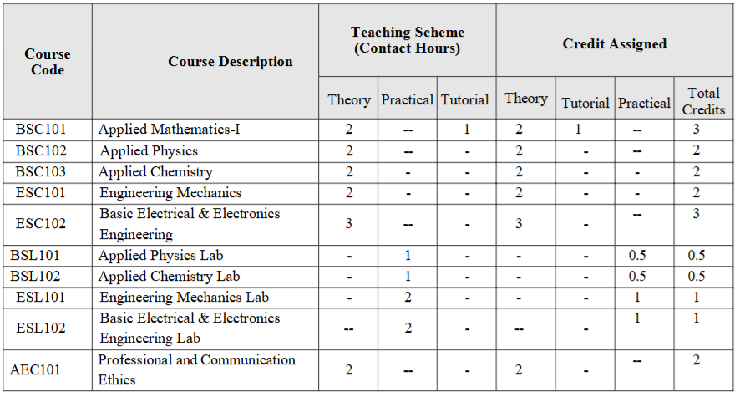
NEP 2020 With Effect from Academic Year (2024 - 2025) Semester- I

Slide 17
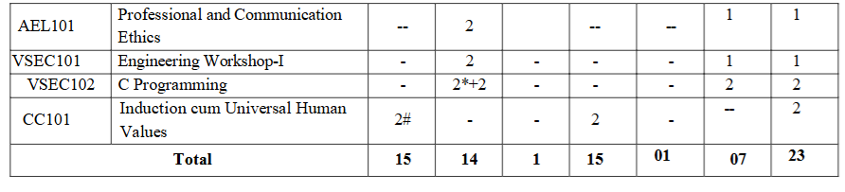
NEP 2020 With Effect from Academic Year (2024 - 2025) Semester- I
* Two hours of practical class to be conducted for full class as demo/discussion.
# Course evaluation is activity-based which may be an individual or group of four students.
Theory / Tutorial 1 credit for 1 hour and Practical 1 credit for 2 hours

Slide 18
Credit Assignment: Sample Calculation I
THEORY CREDITS
TUTORIAL CREDITS
CREDITS
AM-I
IAT
ESE
2 Credits
TW
1 Credit
3 Credits
IAT
ESE
0 Credits
TW
1 Credit
1 Credit
IAT
ESE
0 Credits
TW
1 Credit
1 Credit
IAT
ESE
2 Credits
TW
0 Credits
2 Credits
IAT
ESE
0 Credits
TW
0 Credits
0 Credits

Slide 19
Credit Assignment: Sample Calculation II
THEORY CREDITS
TUTORIAL CREDITS
CREDITS
IAT
ESE
2 Credits
TW
OR
1 Credit
3 Credits
EM
&
BEEE
IAT
ESE
0 Credits
TW
OR
1 Credit
1 Credit
IAT
ESE
0 Credits
TW
OR
1 Credit
1 Credit
IAT
ESE
2 Credits
TW
OR
0 Credits
2 Credits
IAT
ESE
0 Credits
TW
OR
0 Credits
0 Credits

Slide 20
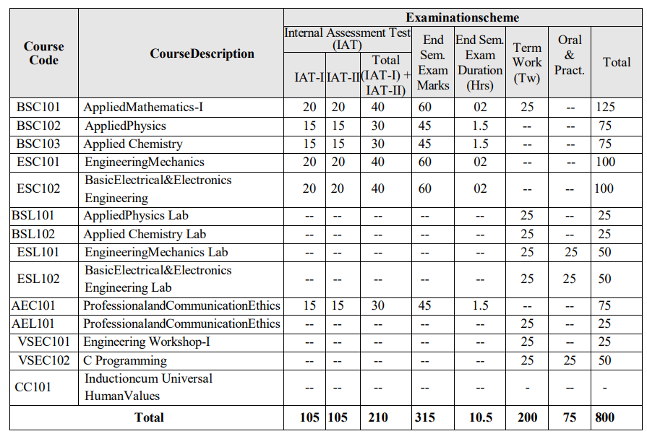
Examination Scheme: Semester- I

Slide 21
Examinations (Continuous Assessments)
TOTAL: 23 | 22
Internal Assessments: I & II
Term Work & Practical/Oral
End-Semester Exams
Grading system: CGPI [10]

Slide 22
Academic Arrangements
Semester I: 31 Aug. – Dec. 2026 | Semester II: 4 Jan. – May 2027
Internal tests: Oct. & Nov. 2026 | Feb. & April 2027
End Semester Exams: Dec. 2026 | May 2027
Results declared ≈ 45 days after exams

Slide 23
Parent / GUARDIAN Communication
Defaulter lists & Exam results will be shared on WhatsApp groups
Parent Teacher Meeting
Via. Class-In-Charge and/or HOD

Slide 24
Library Services
Book Bank facility for textbooks
Access to Central Library & Reference Books
Digital Library: IEEE, NPTEL, E-Magazines, etc.
Study areas & reading halls available

Slide 25
Some Useful information
F.E. classrooms: 301 to 307
F.E. Laboratories: I, II & III floor
Library: 209
F.E. Staffroom: 207
College hours: 8 pm to 4 pm or 9 am to 5 pm
Canteen: Ground floor
Main Events: Freshers, Naad, Personality Development etc.

Slide 26
Beyond the Classroom
💻 Technical Festivals
🧑‍💻 Hackathons & Innovation Activities
🎭 Cultural Events
🏆 Sports & Competitions
🤝 NSS – National Service Scheme
🌱 DLLE – Development of Learners and Learning Environment
Why participate?
Build confidence • teamwork • leadership • creativity • communication skills

Slide 27
Mentoring & Student Support
Students will be assigned faculty mentors in groups
Mentors will help students with:
Academic guidance
General concerns and difficulties
Personal and professional development
Your mentor is your first point of contact whenever you need guidance or support
Student leadership & responsibilities
Class and lab. representatives

Slide 28
Transport & Hostel Services
🚌 College Bus Facility
🛺 Share Auto-Rickshaw connectivity
🏠 Hostel facilities are available for students
For detailed information regarding transport, hostel and other administrative matters, please contact the college administration.

Slide 29
Summary
Well-structured semester-based curriculum
Balanced mix of theory, practical & projects
Focus on attendance, discipline & continuous assessment
Parents & faculty work together for student success
Co & Extra Curricular activities

Slide 30
Thank You!
“Engineering is not only study of 45 credits / subjects but it is moral studies of intellectual life & the art of balancing!”

