Slide 1



Uber
Case Study
By - Vikas Kumar Singh

Slide 2
Data Exploration
Data set Contains 6 columns
Request id
Pickup point
Driver id
Status
Request timestamp
Drop timestamp
Business Objectives
The aim of analysis is to identify the root cause of the problem (i.e. cancellation and non-availability of cars) and recommend ways to improve the situation.

Slide 3
Data Cleaning and Munging
Possible data cleaning and munging
NA values in the columns of interest
Request timestamp is in object format. Converted it to datetime format
Date are separated by “/” and “-”. Corrected this inconsistency

Slide 4
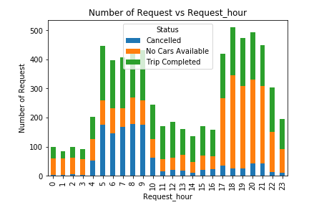
Requests Analysis – Cancellation and Unavailability
The pattern of requests are different for status of request for different hours of the day.
Cancellation in morning, unavailable in evening

Slide 5
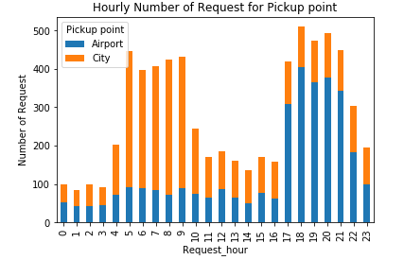
Requests Analysis- City and Airport
The pattern of request is different for pickup point for different hours of the day.
High number of request in morning are from city
High number of request in evening are from airport

Slide 6
Binning Time into 5 Categories
Request generated are divided into 5 homogenous categories based on request time
Time | Category
12 am – 5 am | Pre_Morning
5 am – 10 am | Morning_Rush
10 am – 5 pm | Day_Time
5 pm – 10 pm | Evening_Rush
10 pm – 12 am | Late_Night

Slide 7
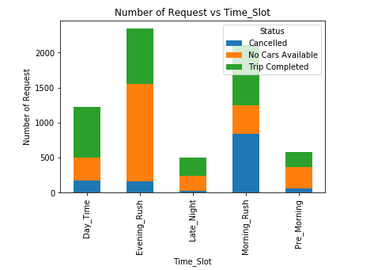
Problem Identification – Morning and Evening
Graph shows that the major problem are
Cancelled request during the morning rush
Unavailability of cars during evening rush

Slide 8
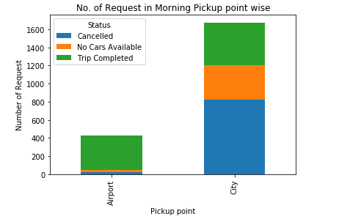
Cancelled Request are approx. 50% from city
Approximately 50% of request are cancelled from city in morning

Slide 9
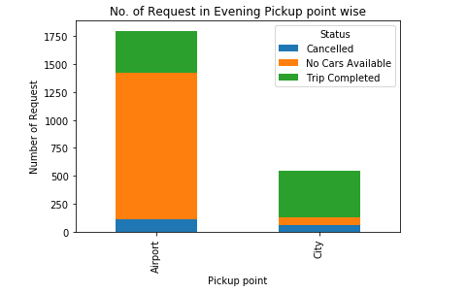
Unavailable Request are approx. 70% from Airport
Approximately 70% of request are unavailable from Airport in evening

Slide 10
Recommendations
For the request in the morning, drivers can be incentivized to make those trips to airport
They could be given a bonus for each trip from city to airport in the morning rush.
Uber can pay for petrol bill of drivers to come back to city without ride.
For the Evening unavailability recommendation can be
Drivers can again be given bonus to complete a trip from airport to city in evening.
Uber can pay driver for come without passenger to airport.

