Slide 1
Digital Image Processing
Introduction to MATLAB

Slide 2
Background on MATLAB
(Definition)
MATLAB is a high-performance language for technical computing.
The name MATLAB stands for matrix laboratory. So, it is an interactive system whose basic data element is an array (matrix)
The Image Processing Toolbox (ITP) is a collection of MATLAB functions (called M-functions or M-files) that extend the capability of the MATLAB environment for the solution of digital image processing problems.

Slide 3
The MATLAB Working Environment
The MATLAB Desktop
  It is the main MATLAB application window.
  It contains five subwindows:
    The Command Window
    The Workspace Browser
    The Current Directory Window
    The Command History Window
    And one or more Figure Windows, which are shown only when the user displays a graphic

Slide 4
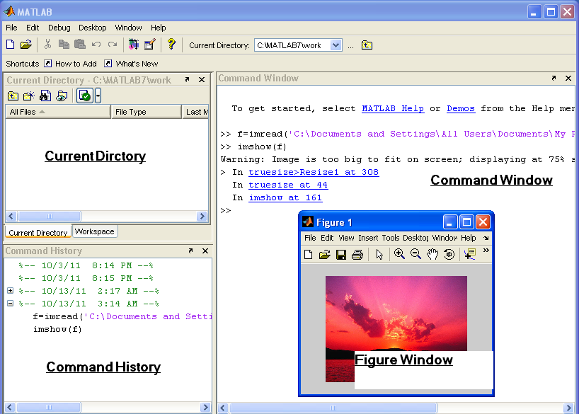
The MATLAB Working Environment – Desktop

Slide 5
The MATLAB Working Environment – Desktop
The Command Window is where the user types MATLAB commands and expressions at the prompt (>>) and where the outputs of those commands are displayed.
MATLAB defines the workspace as the set of variables that the user creates in a work session. The Workspace Browser shows these variables and some information about them.

Slide 6
The MATLAB Working Environment – Desktop
Double-clicking on a variable in the Workspace Browser launches the Array Editor, which can be used to obtain information and in some instances edit certain properties of the variable.
The Current Directory tab shows the content of the current directory, whose path is shown in the Current Directory Window.

Slide 7
The MATLAB Working Environment – Desktop
Clicking on the arrow in the Current Directory Window shows a list of recently used paths. Clicking to the button (…) allows the user to change the current directory.
MATLAB uses a search path to find M-files ad other MATLAB-related files, which are organized in directories in the computer file system. Any file run in MATLAB must reside in the current directory or in a directory that is on the search path.

Slide 8
The MATLAB Working Environment – Desktop
The Command History Window contains a record of the commands a user has entered in the Command Window, including current and previous MATLAB sessions.
Previously entered MATLAB commands can be selected and re-executed from the Command History Window by right-clicking on a command or a sequence of commands. This action launches a menu from which to select various options in addition to executing the commands.

Slide 9
The MATLAB Working Environment – Desktop
A Figure window can be opened when you open a certain .fig file, or read a new image, by writing the following in the prompt in Command window:
  >> f = imread (‘filename.jpg’);
  >> imshow(f)
  Tip: Use the filename directly, if the file resides on the current directory, otherwise use the whole path.

Slide 10
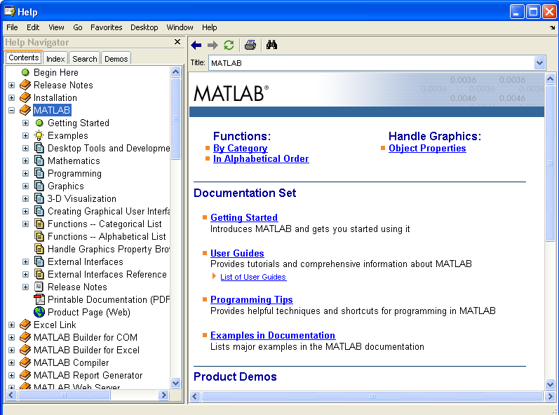
Getting Help
-- Help Browser --

Slide 11
Getting Help
-- Help Browser --
To open MATLAB Help Browser, you either:
  Press the question mark symbol (?) on the desktop toolbar.
  From Menu: Help ➔ MATLAB Help
  Pressing F1 button
  Typing “helpbrowser” at the prompt in the Command Window

Slide 12
Getting Help
-- Help Browser --
You can either search through the contents, or search for a certain function name. You can display some demos from Demos tab.
Another way to obtain help for a specific function, is by typing “doc functionname” in the prompt in Command Window. (Example: >> doc format)
Typing “Help functionname” in the prompt, will display information about the function directly on the Command window.

Slide 13
Saving and Retrieving a Work Session
To save your work:
  Click on any place in the Workspace Browser
  From File Menu, select “Save Workspace as”
  Give a name to your MAT-file, and click Save
To Retrieve your work:
  From File menu, select “Open”
  Browse for your file, select it, and press Open

Slide 14
Digital Image Representation
Images as Matrices
Important notations:
  f(p,q) denotes the element located in row p and column q.
    Ex: f(2,5) resides in the second row and fifth column
  We use the letters M and N, respectively to denote the number of rows and columns in a matrix.
  1 x N matrix, is called a row vector, whereas as M x 1 matrix is called a column vector.
  1 x 1 matrix is a scalar.
Matrices in MATLAB are stored in variables with names such as A, a, RGB, real_array and so on. Variables must begin with a letter and contain only letters, numerals and underscores.

Slide 15
Reading Images
Images are read into MATLAB environment using function imread, whose syntax is:
  imread (‘filename’)
  filename: is a string containing the complete name of the image file (including and applicable extension)
  Ex: >> f = imread (‘xray.jpg’)
  Read and store the image in an array named f

Slide 16
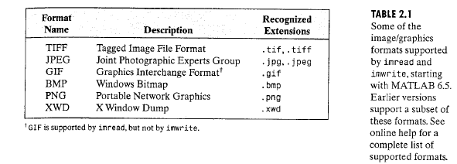
Reading Images
Supported Image Extensions

Slide 17
Reading Images
Tip - Semicolon
The use of Semicolon:
  When using a Semicolon at the end of a command it will stop the output from appearing, and creates directly another prompt symbol (>>)
  While, when not using a semicolon, the output will be displayed directly in the Command window (Hint: the output of imread function, is the matrix of the read image)

Slide 18
Reading Images
Tip – filename path
When writing the command in this way:
  >> f = imread (‘sunset.jpg’);
  MATLAB will expect to find the image in the current directory already defined by the user.
But, if the image does not exist on the current directory use the full path in the string:
>> f = imread (‘C:\documents and settings\user\desktop\sunset.jpg’);

Slide 19
Reading Images
Tip – filename path
Another case might happen; sometimes you may create a folder (ex: myimages) on the current directory and place the image that you want to read in it, in this case, there is no need to write the whole path, you can start from the new folder:
>> f = imread (‘.\myimages\sunset.jpg’);

Slide 20
Reading Images
Other functions
Function size gives the row and column dimensions of an image:
  >> size (f)
  ans =
  1024
This function can be more useful when using it in programming in this manner:
  >> [M, N] = size (f);
  In this case, instead of displaying the size, number of rows will be stored in M, and number of columns will be stored in N

Slide 21
Reading Images
Other functions
The whos function displays additional information about an array, for instance the statement:
  >> whos f
  Gives:
  Name Size Bytes Class
  f 1024x1024 1048576 uint8 array
  Grand total is 1048576 elements using 1048576 bytes

Slide 22
Displaying Images
Images are displayed on MATLAB desktop using function imshow, which has the basic syntax:
imshow (f , G)
where f is an image array, and G is the number of grey levels used to display it. If G is omitted, it defaults to 256 grey levels.

Slide 23
Displaying Images
Using the syntax
imshow (f , [low high])
Displays as black all values less than or equal to low, and as white all values greater than or equal to high.
The values in between are displayed using the default number of levels.
Ex: imshow (f, [20 25])

Slide 24
Displaying Images
Finally, the syntax
  imshow (f, [ ])
  Sets variable low to the minimum value of array f, and high to the maximum value.

Slide 25
Displaying Images
If another image, g, is displayed using imshow, MATLAB replaces the image in the screen with the new image. To keep the first image and output a second image, we use function figure as follows:
  >> figure, imshow (g)
Using the statement:
>> imshow(f), figure, imshow(g)
displays both images. Note that more than one command can be written on a line, as long as different commands are properly delimited by commas or semicolons.

Slide 26
Writing Images
Images are written to disk using function imwrite, which has the following basic syntax:
  imwrite (f, ‘filename’)
With this syntax, the string contained in filename must include a recognized format extension (mentioned earlier). Alternatively, the desired format can be specified explicitly with a third input argument. For example, the following two commands are the same:
  >> imwrite (f, ‘file1.tif’)
  >> imwrite(f, ‘file1’, ‘tif’)
If filename contains no path information, then imwrite saves the file in the current working directory.

Slide 27
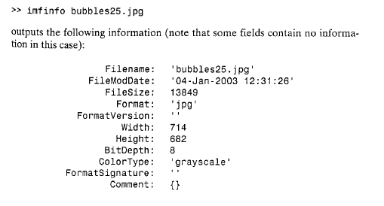
Writing Images
In order to get an idea of the compression achieved and to obtain another image file details, we can use function imfinfo, which has the syntax:
  imfinfo filename
  Where filename is the complete file name of the image stored in disk.
  Ex: >> imfinfo sunset2.jpg

Slide 28
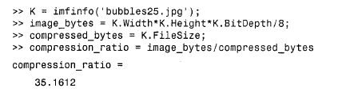
Writing Images
You can store the the information in one variable, k for example:
>> k = imfinfo (‘bubbles25.jpg’);
And to refer to any information within k, you can start with k, then ‘.’ and the information needed:

Slide 29
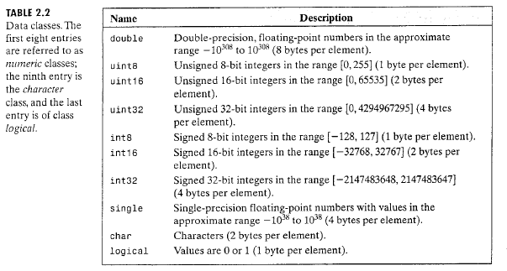
Data Classes
Although we work with integer coordinates, the values of pixels themselves are not restricted to be integers in MATLAB.

Slide 30
Data Classes
- The frequently used data classes that encountered in image processing are double, uint8 and logical.
- Logical arrays are created by using function logical or by using relational operators

Slide 31
Image Types
The toolbox supports four types of images:
  Intensity Images
  Binary Images
  RGB Images

Slide 32
Intensity Images
(Grayscale Images)
An intensity image is a data matrix whose values have been scaled to represent intensities.
Allowed Class | Range
Uint8 | 0-255
Uint16 | 0-65535
Double | [0-1]

Slide 33
Binary Images
Logical array containing only 0s and 1s, interpreted as black and white, respectively.
If the array contains 0s and 1s whose values are of data class different from logical (for example uint8), it is not considered a binary image in MATLAB.

Slide 34
Binary Images
To convert a numeric array to binary, we use function logical:
  >> A = [0 1 0 1 1 1];
  >> B = logical (A);
If A contains other than 0s and 1s, the logical function converts all nonzero values to logical 1s.
>> A = [0 3 1 0 4 0];
>> B = logical (B);
>> B
0 1 1 0 1 0

Slide 35
Binary Images
By using relational and logical operations, we can also create a logical array
To test if an array is logical, we use islogical function:
>> islogical (A);
Returns 1, if A is logical, and 0, otherwise
Logical arrays can be converted into numerical arrays using the data class conversion functions.

Slide 36
RGB Images
Also called, true color images, require a three –dimensional array, (M x N x 3)of class uint8, uint16, single or double, whose pixel values specify intensity values.
M and N are the numbers of rows and columns of pixels in the image, and the third dimension consists of three planes, containing red, green and blue intensity values.

Slide 37
Converting between Data Classes
The general syntax is
  B = data_class_name (A)
  Where data_class_name is one of the names defined in the previous lecture for Data Classes
  Ex: B = double (A)
  D = uint8(C)
  Note: Take into consideration the data range for each of the data classes before conversion

Slide 38
Array Indexing - Vector
Vector Indexing
  As discussed before, an array of dimension 1xN is called a row vector, while an array of dimension Mx1 is called a column vector.
  To refer to any element in a vector v, we use the notation v(1) for the first element, v(2) for the second and so on.

Slide 39
Array Indexing - Vector
Example of Vector Indexing
  >> v = [1 3 5 7 9]
  v =
  1 3 5 7 9
  >> v(2)
  ans =
  3

Slide 40
Array Indexing - Vector
To transpose a row vector into a column vector:
>> w = v.’ // use the operand (.’)
w =
1
3
5
7
9

Slide 41
Array Indexing - Vector
To access blocks of elements, use (:)
>> v(1:3)
ans =
1 3 5
>> v(3:end)
ans =
5 7 9

Slide 42
Array Indexing - Vector
If v is a vector, writing
>> v(:)
produces a column vector, whereas writing
>> v(1:end)
produces a row vector

Slide 43
Array Indexing - Vector
Indexing is not restricted to contiguous elements, for example:
  >> v(1:2:end)
  ans =
  5 9
  >> v(end:-2:1)
  ans =
  9 5 1

Slide 44
Array Indexing - Vector
Indexing a vector by another vector
  >> v([1 4 5])
  ans =
  1 7 9

Slide 45
Array Indexing – Matrix
Matrix Indexing
Matrices can be represented in MATLAB as a sequence of row vectors enclosed by square brackets and separated by semicolons.
>> A = [1 2 3; 4 5 6; 7 8 9] // 3x3 matrix
A =
1 2 3
4 5 6
7 8 9

Slide 46
Array Indexing – Matrix
We select elements in a matrix just as we did for vectors, but now we need two indices; one for the row location, and the other for the column location
>> A (2,3)
ans =
6

Slide 47
Array Indexing – Matrix
To select a whole column:
  >> C3 = A(:, 3)
  C3 =
  3
  6
  9
To select a whole row:
>> R3 = A(2,:)
R3 =
4 5 6

Slide 48
Array Indexing – Matrix
To indicate the top two rows:
  >> T2 = A(1:2, 1:3)
  T2 =
  1 2 3
  4 5 6
To indicate the left two columns
>> L2 = A(1:3, 1:2)
1 2
4 5
7 8

Slide 49
Array Indexing – Matrix
To create a matrix B equal to A but with its last column set to 0s, we write:
>> B = A;
>> B(:,3) = 0
B =
1 2 0
4 5 0
7 8 0

Slide 50
Array Indexing – Matrix
Using “end” operand in Matrices
>> A (end, end)
ans =
9
>> A (end, end -2) //(3,1)
ans =
7
>> A (2:end, end:-2:1)
ans =
6 4
9 7

Slide 51
Array Indexing – Matrix
Using vectors to index into a matrix
>> E = A ([1 3], [2 3])
E =
2 3
8 9

Slide 52
Array Indexing – Matrix
Indexing a matrix using a logical matrix
>> D = logical ([1 0 0; 0 0 1; 0 0 0])
D =
1 0 0
0 0 1
0 0 0
>> A (D)
ans =
1
6

Slide 53
Array Indexing – Matrix
To display all matrix elements in one column, we use (:) to index the matrix
  >> V = T2 (:)
  V =
  1
  4
  2
  5
  3
  6
This can be helpful when, for example, we want to find the sum of all the elements of a matrix
>> s = sum (A(:))
s=
45

Slide 54
Some Important Standard Arrays
zeros (M,N), generates an MxN matrix of 0s of class double.
ones(M,N), generates an MxN matrix of 1s of class double.
true(M,N), generates an MxN logical matrix of 1s.
false(M,N), generates an MxN logical matrix of 0s.
magic(M), generates an MxM “magic square”. This is a square array in which the sum along any row, column or main diagonal, is the same. The generated numbers are integers.
rand(M,N), generates an MxN matrix whose entries are uniformly distributed random numbers in the interval [0,1].
randn(M,N), generates an MxN matrix whose numbers are normally distributed random numbers with mean 0 and varience 1.
length(A), return the size of the longest dimension of an array A
numel(A), return the number of elements in an array directly.
ndims(A), return the dimensions of array A.

Slide 55
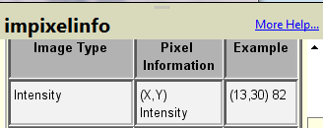

Pixel information:
>>imshow(image)
>>impixelinfo
This function is used to display the intensity values of individual pixel interactively.
Moving the cursor, the coordinates of the cursor position and the corresponding intensity vales are shown.

Slide 56
Introduction to M-function Programming

Slide 57
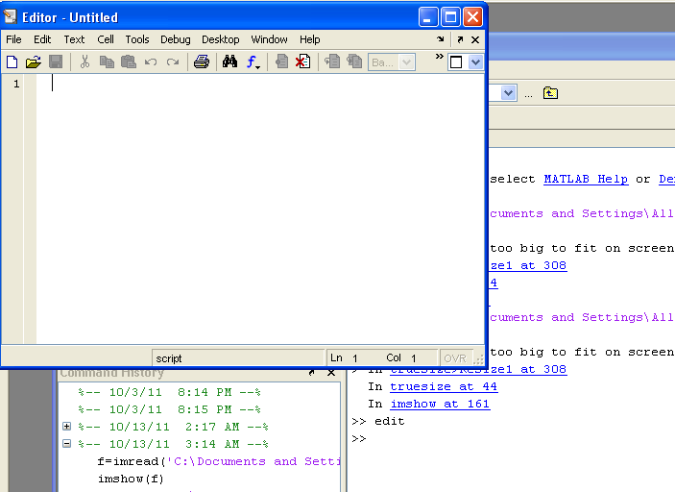
Using the MATLAB Editor to Create M-Files

Slide 58
Using the MATLAB Editor to Create M-Files
To open the editor, type “edit” at the prompt in the Command Window. Similarly, typing “Edit filename” at the prompt opens the M-file “filename.m” in an editor window, ready for editing.
As noted earlier, the file opened in the editor should be within a folder in the search path.

Slide 59
M-Files
M-Files in MATLAB, can be:
  Scripts that simply execute a series of MATLAB statements, or
  Functions that can accept arguments and can produce one or more outputs.
M-Files are created using a text editor and are stored with a name of the form filename.m.

Slide 60
M-Files
The components of a function M-file are:
  The function definition line
  The H1 line
  Help text
  The function body
  Comments

Slide 61
M-Files
The function definition line
  It has the form:
  function [outputs] = name (inputs)
  For example, a function that computes the sum and the product of two images, has the following definition:
  function [s, p] = sumprod (f, g)
  Where f and g are the input images.

Slide 62
M-Files
The function definition line
  Notes:
    The output arguments are enclosed by brackets and the input by parentheses.
    If the function has a single output argument, it is acceptable to list the argument without brackets.
    If the function has no output, only the word function is used, without brackets or equal sign
      function sum(f,g)
    Function names must begin with a letter, and followed by any combination of letters, numbers or underscores. No spaces are allowed

Slide 63
M-Files
The function definition line
  Notes:
    Functions can be called at the command prompt, for example:
    >> [s, p] = sumprod (f, g)
    >> y = sum (x)

Slide 64
M-Files
The H1 line
  Is the first text line.
  It is a single comment line that follows the function definition line.
  There can be no blank lines or leading spaces between the H1 line and the function definition line
  Ex:
  % SUMPROD computes the sum and product of two images
  H1 line is the first text that appears when a user types:
    >> help function_name

Slide 65
M-Files
Help Text
  Is a text block that follows the H1 line, without any blank lines in between the two.
  Help text is used to provide comments and online help for the function.
  When a user types help function_name at the prompt, MATLAB displays all comment lines that appear between the function definition line and the first noncomment line (executable or blank).
  The help system ignores any comment lines that appear after the Help text block.

Slide 66
M-Files
The function body
  Contains all the MATLAB code that performs computations and assigns values to output arguments.
Comments
  All lines preceded by the symbol “%” that are not the H1 line or help text are considered function comment lines and are not considered part of the Help text block.

Slide 67
Operators
MATLAB operators are grouped into three main categories:
  Arithmetic operators that perform numeric computations
  Relational operators that compare operands quantitatively
  Logical operators that perform the functions AND, OR and NOT.

Slide 68
Arithmetic Operations
For example, A*B indicates matrix multiplication in the traditional sense, whereas A.*B indicates array multiplication, in the sense that the result is an array, with the same size as A and B, in which each element is the product of corresponding elements of A and B.
i.e. if C = A.*B, then C(I,J) = A(I,J) * B(I,J)
C= A+B, then C(I,J) = A(I,J) + B(I,J)
C= A-B, then C(I,J) = A(I,J) - B(I,J)

Slide 69
MAX and MIN
Ex1:
>> A = [1 2 3 4]
>> max(A)
ans =
4
Ex2:
>> A = [1 2 3; 4 5 6]
>> max(A)
ans =
4 5 6

Slide 70
MAX and MIN
Ex3:
>> A = [1 2 3]
>> B = [4 5 6]
>> max(A,B)
ans =
4 5 6
Ex4:
>> A = [1 2 3; 4 5 6]
>> B = [7 8 9; 1 2 3]
>> max(A,B)
ans =
7 8 9
4 5 6

Slide 71
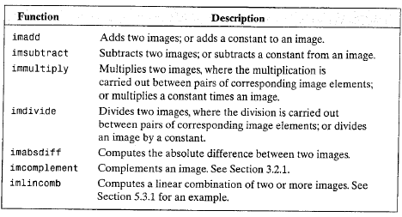
The Image Arithmetic Functions Supported by IPT

Slide 72
Relational Operation
operation | name
< <= > >= == ~= | Less than Less than or equal Grater than Grater than or equal Equal to Not equal to
Both image must be the same size

Slide 73
Relational Operation
Ex: A==B produce a logical array of the same dimension as A and B with 1s in locations where the corresponding elements of A and B match, and 0s else where
>> A = [1 2 3 4])
>> B = [1 5 6 4])
A==B
ans =
1 0 0 1

Slide 74
Logical Operators and Functions
Operators: | Name
& | ~ | logical AND logical OR logical NOT
  Logical operator can operate on both logical and numeric data.
  Matlab treats a logical 1or non zero numeric quantity as true, and logical 0 or numeric 0 as false

Slide 75
Logical Operators and Functions
Ex1:
>> A = logical ([1 0 1 0])
>> B = logical ([1 1 1 1])
>> A & B
ans =
1 0 1 0

Slide 76
Logical Operators and Functions
Ex2:
>> A = logical ([1 0 1 0])
>> B = logical ([1 1 1 1])
>> A | B
ans =
1 1 1 1

Slide 77
Logical Operators and Functions
Ex3:
>> A = logical ([1 0 1 0])
>> ~ A
ans =
0 1 0 1

Slide 78
Logical Operators and Functions
Ex8:
>> A = [1 2 0 ; 0 4 5])
>> B = [1 -2 3; 0 1 1])
>>A & B
ans =
1 1 0
0 1 1

Slide 79
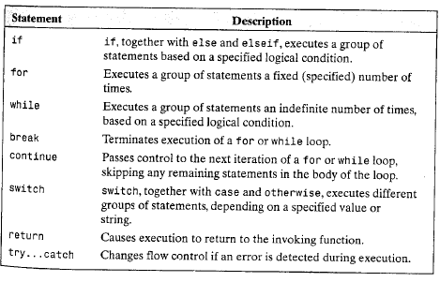
Flow Control

Slide 80
Flow Control if, else and elseif
Conditional statement if has the syntax:
if expression
statements
end
General syntax:
  If expression1
  statements1
  else if expression2
  statements2
  else
  statements3
  end
  end

Slide 81
Flow Control if, else and elseif
Ex: Write a function that compute the average intensity of an image. The program should produce an error if the input is not a one or two dimensional array

Slide 82
Solition:
function av = Average (f)
if (ndims(f)>2)
error(‘the dimensions of the input cannot exceed 2');
end
av = sum(f(:))/length(f(:));
Notes:
Error: returns the error enclosed in “”, and stops the program.
Length: returns no of elements in a matrix

Slide 83
Flow Control for
Syntax:
  for index = start:increment:end
  statements
  End
Nested for:
for index1 = start1:increment1:end
statements1
for index2 = start2:increment2:end
statements2
end
additional loop1 statements
end

Slide 84
Flow Control for
Ex:
count = 0;
for k=0:0.1:1
count = count + 1;
end
Notes:
If increment was omitted it is taken to be 1.
The increment can be negative value, in this case start should be greater than end.

Slide 85
Flow Control while
Syntax:
while expression
statements
end
Nested while:
while expression1
statements1
while expression2
statements2
end
additional loop1 statements
end

Slide 86
Flow Control while
Ex:
a = 10;
b = 5;
while a
a = a – 1;
while b
b = b - 1;
end
end
Note: MATLAB treatment for a numeric value in a logical context:
nonzero value ➔ True
zero value ➔ False

Slide 87
Q:Write an M-function to extract a rectangular sub image from an image
Input: original image f
Output: sub image s of size m-by-n
Note: convert image into double for calculation then after compute the new image return it to the original class.

Slide 88
Solution:
function s= subim(f, m, n, rx ,cy)
% the coordinates of its top, left corner are (rx,cy).
s=zeros(m, n);
row=rx +m -1;
col=cy +n -1;
x=1;
for r=rx :row
y=1;
for c=cy: col
s(x,y)=f(r,c);
y=y+1;
end
x=x+1
end
end

Slide 89
Flow Control break and continue
break
  Using break terminates the execution of a for or while loop.
Continue
  The continue statement passes control to the next iteration of the for or while loop in which it appears, skipping any remaining statements in the body of the loop.

Slide 90
Flow Control switch
The syntax:
switch switch_expression
case case_expression
statements1
case {case_expression1, case_expression_2,…}
statements2
otherwise
statements3
end

Slide 91
Flow Control switch
Ex
switch newclass
case ‘uint8’
g = uint8(f);
case ‘uint16’
g = uint16(f);
case ‘double’
g = double(f);
otherwise
error(‘unknown’);
end

Slide 92
Color planes
In RGB image we can create a separate image for each color planes (red, green and blue) of the image.
RGB = imread(‘D.jpg');
red = RGB(:,:,1);
green = RGB(:,:,2);
blue = RGB(:,:,3);
imshow(red),figure,imshow(green),figure,imshow(blue)

Slide 93
Color planes
We can swap any color plane of rgbimage.
EX: swap the green and red color plane
f=imread('A.jpg');
g(:,:,1)=f(:,:,2);
g(:,:,2)=f(:,:,1);
g(:,:,3)=f(:,:,3);
imshow(g);

Slide 94
Factorizing loop high-level processing
Matlab is a programming language specially designed for array operations, we can whenever possible to increase the computation speed using vectorzing loops
Vectorizing simply means converting for and while loop to equivalent vector
The vecrotized code runs on the order at 30 times faster than the implementation based on for loop.

Slide 95
Example: divide the intensity of the red color channel of RGB_image by 2 (using low level processing and high level processing)
Low level processing:
f=imread (‘D.jpg’);
[m n d]=size(f);
g=uint8(zeros(m,n,3));
for x=1:m
for y=1:n
g(x,y,1)=f(x,y,1)/2;
g(x,y,2)=f(x,y,2);
g(x,y,3)=f(x,y,3);
end;
end;
imshow(g);

Slide 96
High level processing:
f=imread(‘D.jpg’);
g=f;
g(:,:,1)=g(:,:,1)/2;
imshow(g);

Slide 97
Example: Vectorization of programs for extracting regions(s) from image (f)
function s=subimage(f,m,n,rx,cy)
row=rx+m-1;
col=cy+n-1;
s=f(rx:row,cy:col)
end

Slide 98
Interactive I/O
To write interactive M-Function that display information and instructions to users and accept inputs from the keyboard.
Function disp is used to display information on the screen.
Syntax: disp(argument)
Argument maybe :
1. Array: >>a=[1 2; 3 4];
>>disp(a);
2. Variable contains string:
>>sc=‘Digital Image processing’;
>>disp(sc);
3. String:
>>disp(‘This is another way to display text’);

Slide 99
Function Input: is used for inputting data into an M-Function
Syntax:
1. t=input(‘message’)
This function outputs the words contained in message and waits for an input from the user followed by a return, and stores the input in t. the input can be
Single number
Character
Vector(enclosed by square bracketes)
Matrix
Example:
function AA
t=input('enter vector');
s=sum(t);
disp(s);
end

