Slide 1
Motion
(Chapter 8)
CS485/685 Computer Vision
Prof. Bebis

Slide 2
Visual Motion Analysis
Motion information can be used to infer properties of the 3D world with little a-priori knowledge of it (biologically inspired).
In particular, motion information provides a visual cue for :
  Object detection
  Scene segmentation
  3D motion
  3D object reconstruction

Slide 3
Visual Motion Analysis (cont’d)
The main goal is to “characterize the relative motion between camera and scene”.
Assuming that the illumination conditions do not vary, image changes are caused by a relative motion between camera and scene:
  Moving camera, fixed scene
  Fixed camera, moving scene
  Moving camera, moving scene

Slide 4
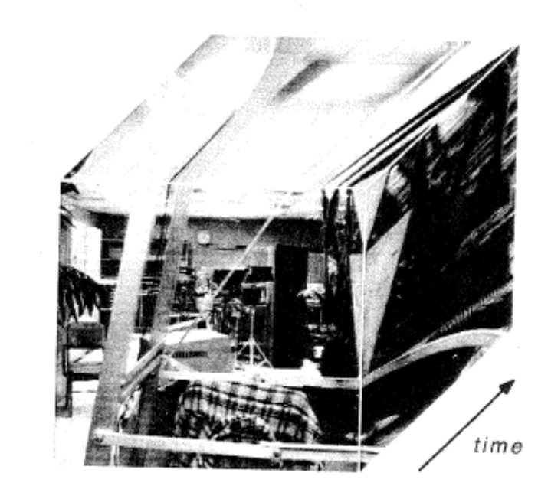
Visual Motion Analysis (cont’d)
Understanding a dynamic world requires extracting visual information both from spatial and temporal changes occurring in an image sequence.
Spatial dimensions: x, y
Temporal dimension: t

Slide 5
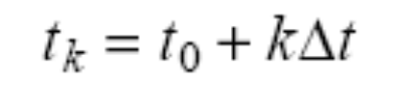
Image Sequence
Image sequence
  A series of N images (frames) acquired at discrete time instants:
Frame rate
  A typical frame rate is 1/30 sec
  Fast frame rates imply few pixel displacements from frame to frame.

Slide 6
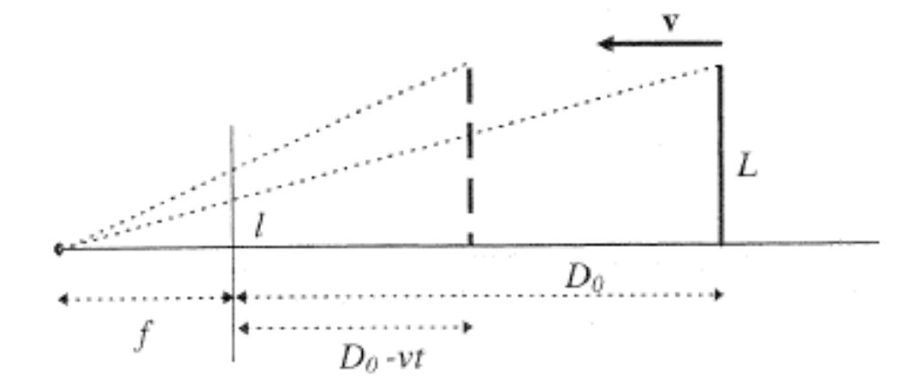
Example: time-to-impact
Consider a vertical bar perpendicular to the optical axis, traveling towards the camera with constant velocity.
constant
velocity
L,V,D_{o},f
are unknown!
at t=0
D(t)=D₀-Vt

Slide 7
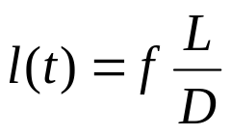
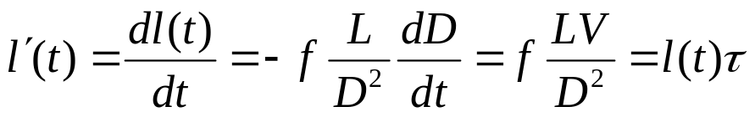
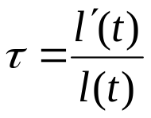
Example: time-to-impact (cont’d)
Question: can we compute the time τ taken by the bar to reach the camera only from image information?
  i.e., without knowing L or its velocity in 3D?
and
τ=V/D
Both l(t) and l’(t)
can be computed from
the image sequence!

Slide 8
Two Subproblems of Motion
Correspondence
  Which elements of a frame correspond to which elements of the next frame.
Reconstruction
  Given a number of corresponding elements and possibly knowledge of the camera’s intrinsic parameters, what can we say about the 3D motion and structure of the observed world?

Slide 9
Motion vs Stereo
Correspondence
  Spatial differences (i.e., disparities) between consecutive frames are very small than those of typical stereo pairs.
  Feature-based approaches can be made more effective by tracking techniques (i.e., exploit motion history to predict disparities in the next frame).

Slide 10
Motion vs Stereo (cont’d)
Reconstruction
  More difficult (i.e., noise sensitive) in motion than in stereo due to small baseline between consecutive frames.
  3D displacement between the camera and the scene is not necessarily created by a single 3D rigid transformation.
  Scene might contain multiple objects with different motion characteristics.

Slide 11
Assumptions
(1) Only one, rigid, relative motion between the camera and the observed scene.
  Objects cannot have different motions.
  No deformable objects.
(2) Illumination conditions do not change.
  Illumination changes are due to motion.

Slide 12
The Third Subproblem of Motion
Segmentation
  What are the regions of the image plane which correspond to different moving objects?
Chicken and egg problem!
  Solve matching problem, then determine regions corresponding to different moving objects?
  OR, find the regions first, then look for corresponding points?

Slide 13
Definition of Motion Field
2D motion field v – vector field corresponding to the velocities of the image points, induced by the relative motion between the camera and the observed scene.
Can be thought as the projection of the 3D motion field V on the image plane.
V
P
C
p

Slide 14
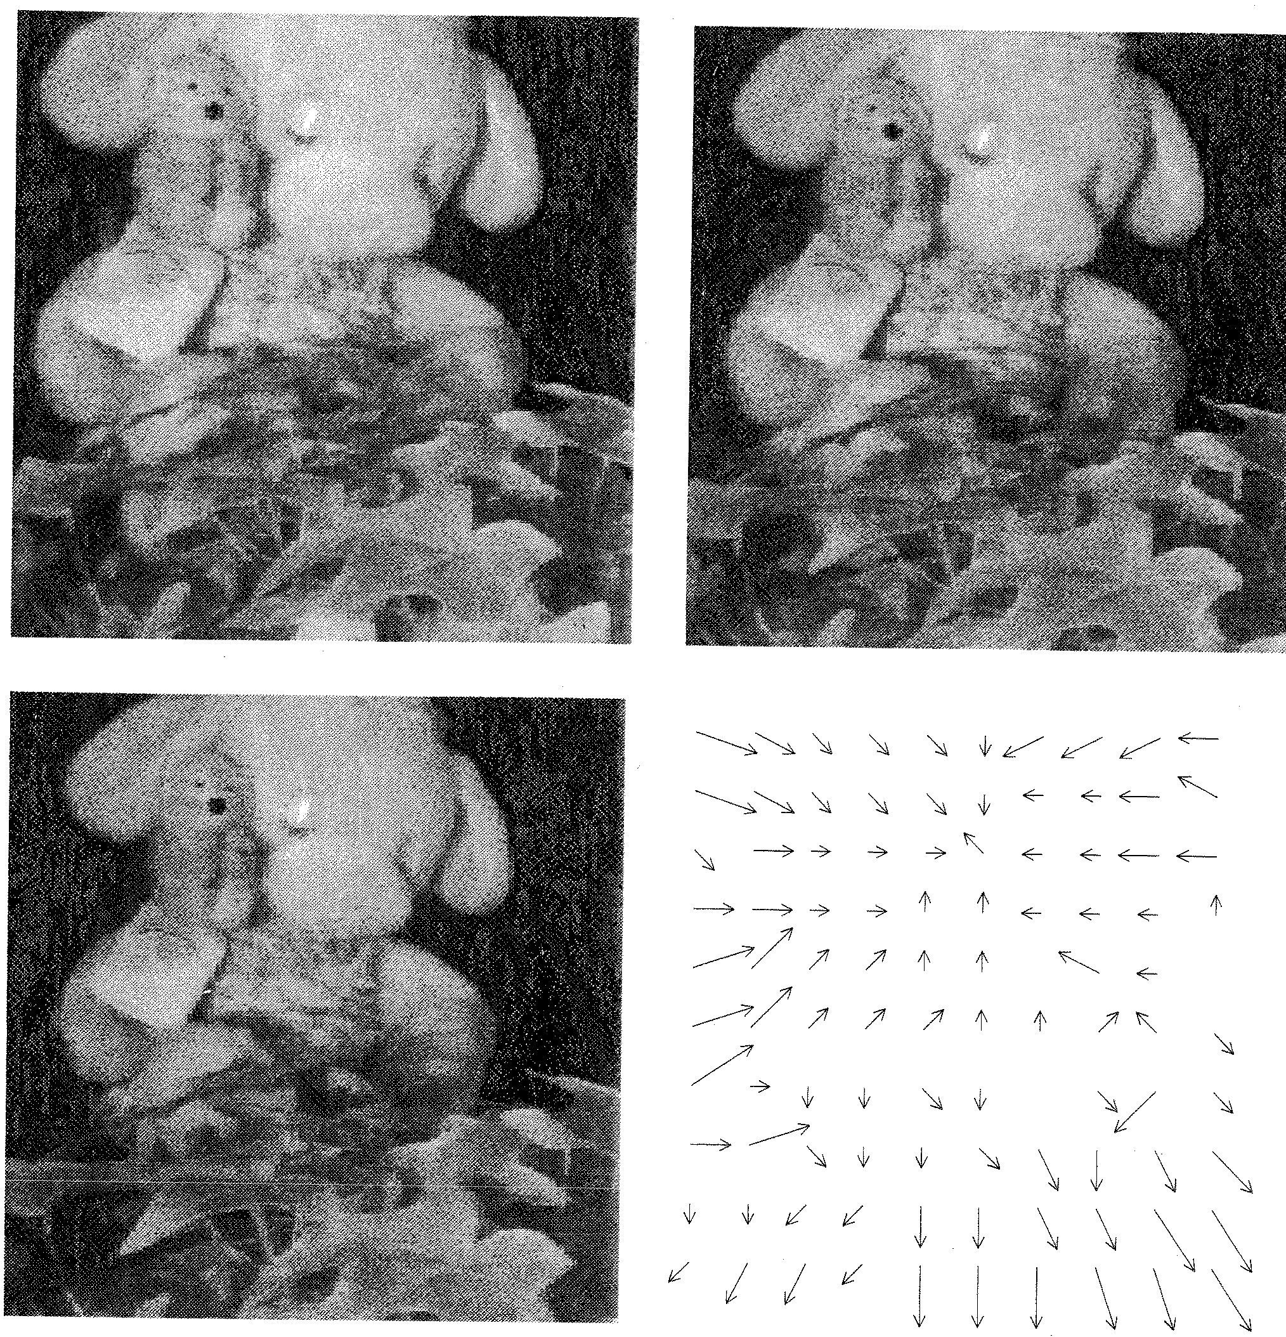
Key Tasks
Motion geometry
  Define the relationship
  between 3D motion/structure
  and 2D projected motion field.
Apparent motion vs true motion
  Define the relationship
  between 2D projected motion field
  and variation of intensity between
  frames (optical flow).
optical flow:
apparent motion of brightness pattern

Slide 15
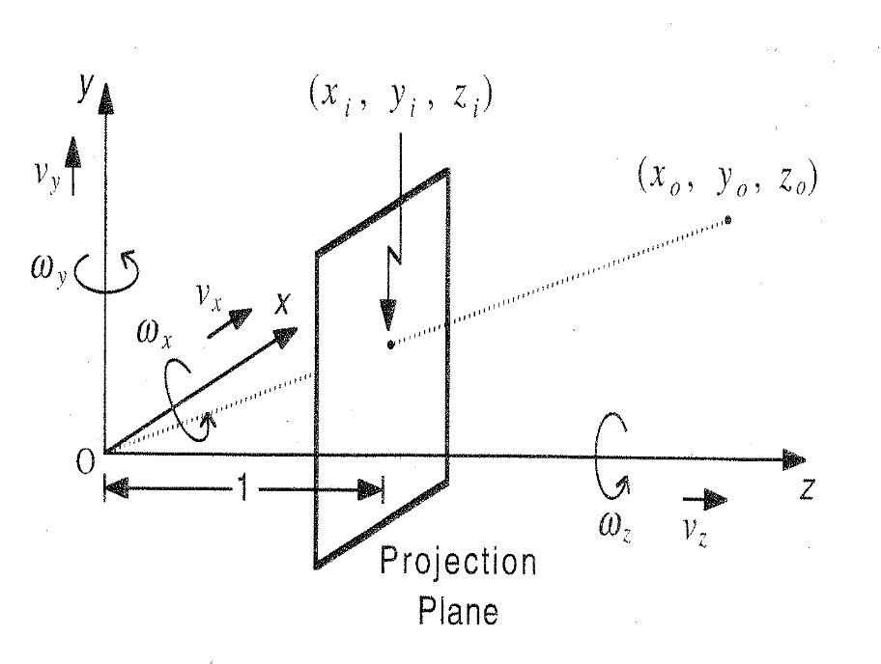
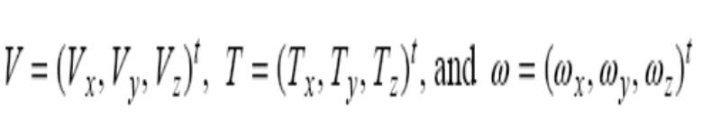
3D Motion Field (cont’d)
Assuming that the camera moves with some translational component T and rotational component ω (angular velocity), the relative motion V between the camera and P is given by the Coriolis equation:
V = -T – ω x P
T_{y}
P
T_{x}
T_{z}

Slide 16
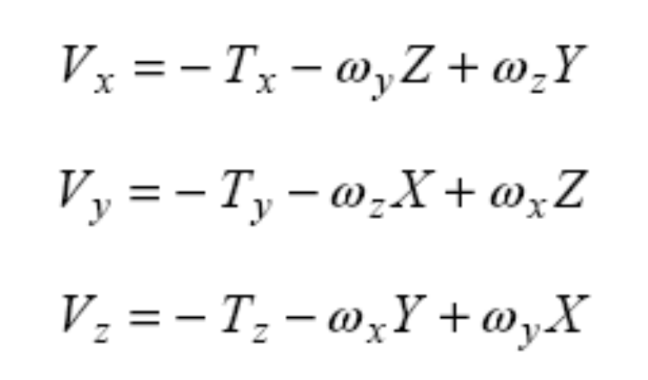
3D Motion Field (cont’d)
Expressing V in terms of its components:
(1)

Slide 17
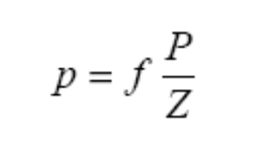
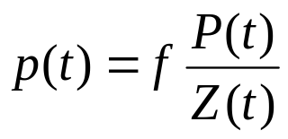
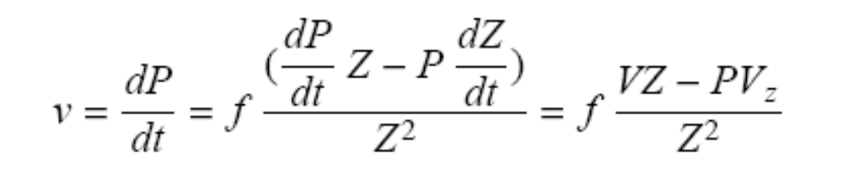
2D Motion Field
To relate the velocity of P in space with the velocity of p on the image plane, take the time derivative of p:
or
dp
(2)

Slide 18
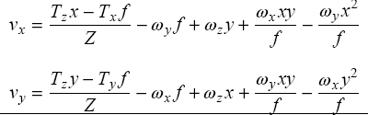
2D Motion Field (cont’d)
Substituting (1) in (2), we have:

Slide 19

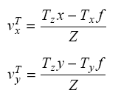
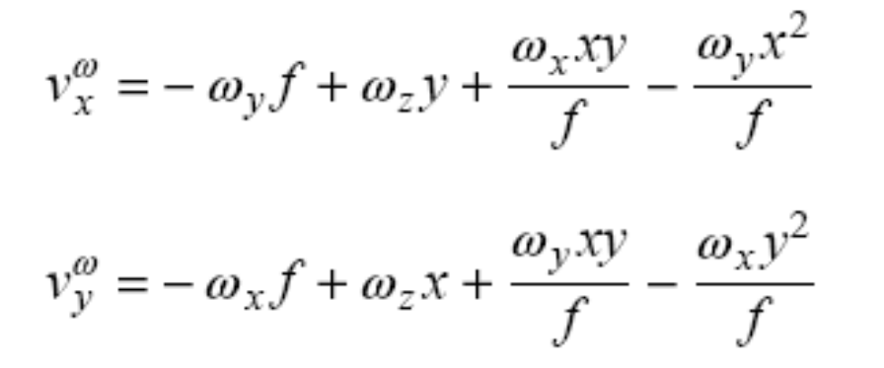
Decomposition of 2D Motion Field
The motion field is the sum of two components:
translational component
rotational component
Note: the rotational component of motion does not carry any
“depth” information (i.e., independent of Z)

Slide 20
Stereo vs Motion - revisited
Stereo
  Point displacements are represented by disparity maps.
  In principle, there are no constraints on disparity values.
Motion
  Point displacements are represented by motion fields.
  Motion fields are estimated using time derivatives.
  Consecutive frames must be as close as possible to guarantee good discrete approximations of the continuous time derivatives.

Slide 21
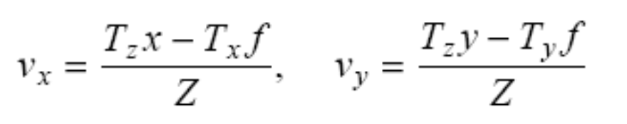
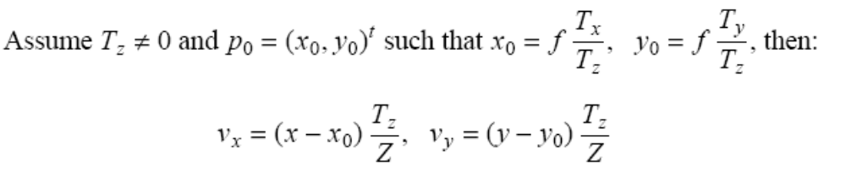
2D Motion Field Analysis:
Case of Pure Translation
Assuming ω = 0 we have:
Motion field is radial - all vectors
radiate from p₀ (vanishing point of
translation)

Slide 22
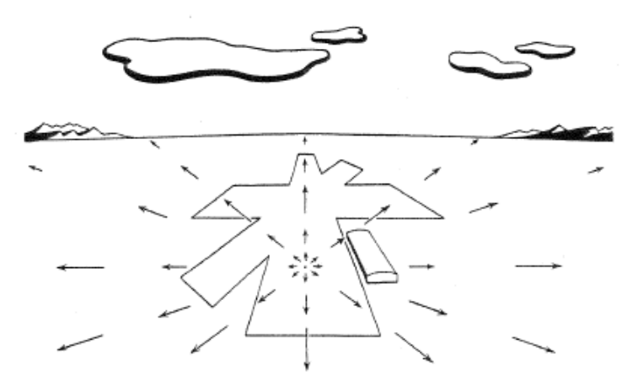
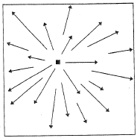
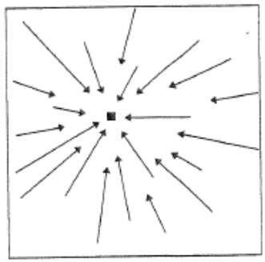
2D Motion Field Analysis:
Case of Pure Translation (cont’d)
If T_{z} < 0, the vectors point away from p₀ ( p₀ is called "focus of expansion").
If T_{z} > 0, the vectors point towards p₀ ( p₀ is called "focus of contraction").
T_{z} < 0
T_{z} < 0
T_{z} > 0
e.g., pilot looking straight ahead while
approaching a fixed point on a landing strip

Slide 23
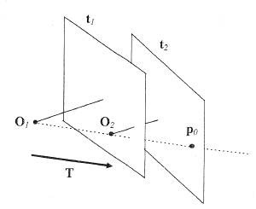
2D Motion Field Analysis:
Case of Pure Translation (cont’d)
p₀ is the intersection with the image plane of the line passing from the center of projection and parallel with the translation vector.
v is proportional to the distance of p from p₀ and inversely proportional to the depth of P.

Slide 24
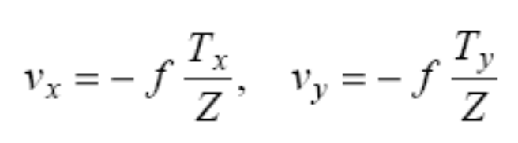
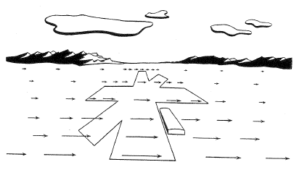
2D Motion Field Analysis:
Case of Pure Translation (cont’d)
If T_{z} = 0, then
  Motion field vectors are parallel.
  Their lengths are inversely proportional to the depth of the corresponding 3D points.
e.g., pilot is looking to the
right in level flight.

Slide 25
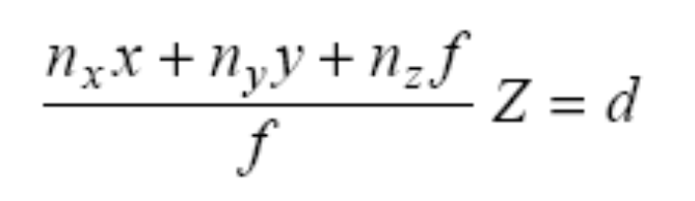
2D Motion Field Analysis:
Case of Moving Plane
Assume that the camera is observing a planar surface π
If n = (n_{x}, n_{y}, n_{z})^{T} is the normal to π , and d is the distance of π from the center of projection, then
Assume P lies on the plane; using p = f P/Z we have
n^{T}P=d

Slide 26
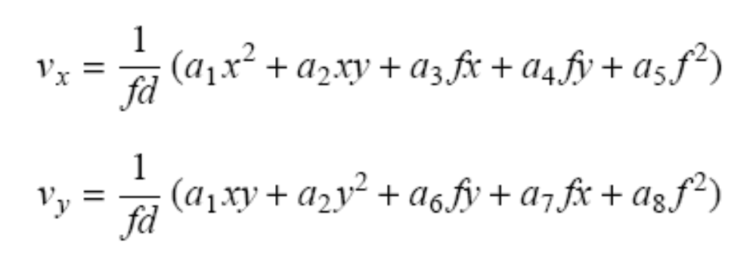
2D Motion Field Analysis:
Case of Moving Plane (cont’d)
Solving for Z and substituting in the basic equations of the motion field, we have:
The terms α₁,α₂, …, α₈ contain elements of T, Ω, n, and d

Slide 27
2D Motion Field Analysis:
Case of Moving Plane (cont’d)
Show the alphas …
Discuss why need non-coplanar points …

Slide 28
2D Motion Field Analysis:
Case of Moving Plane (cont’d)
Comments
  The motion field of a moving planar surface is a quadratic polynomial of x, y, and f.
  Important result since 3D surfaces can be piecewise approximated by planar surfaces.

Slide 29
2D Motion Field Analysis:
Case of Moving Plane (cont’d)
Can we recover 3D motion and structure from coplanar points?
  It can be shown that the same motion field can be produced by two different planar surfaces undergoing different 3D motions.
  This implies that 3D motion and structure recovery (i.e., n and d) cannot be based on coplanar points.

Slide 30
Estimating 2D motion field
How can we estimate the 2D motion field from image sequences?
(1) Differential techniques
  Based on spatial and temporal variations of the image brightness at all pixels (optical flow methods)
  Image sequences should be sampled closely.
  Lead to dense correspondences.
(2) Matching techniques
  Match and track image features over time (e.g., Kalman filter).
  Lead to sparse correspondences.

Slide 31
Optical Flow Methods
Estimate 2D motion field from spatial and temporal variations of the image brightness.
Need to model the relation between brightness variations and motion field!
This will lead us to the image brightness constancy equation.

Slide 32
Image Brightness Constancy Equation
Assumptions
  The apparent brightness of moving objects remains constant.
  The image brightness is continuous and differentiable both in the spatial and the temporal domain.
Denoting the image brightness as E(x, y, t), the constancy constraint implies that:
dE/dt =0
  E is a function of x, y, and t
  x and y are also a function of t
…
(x(t),y(t))
(x(1),y(1))
(x(2),y(2))
E(x(t), y(t), t)

Slide 33
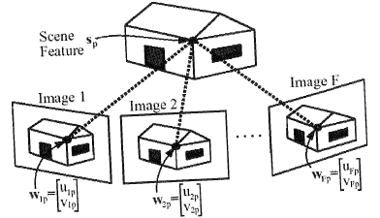
Example

Slide 34
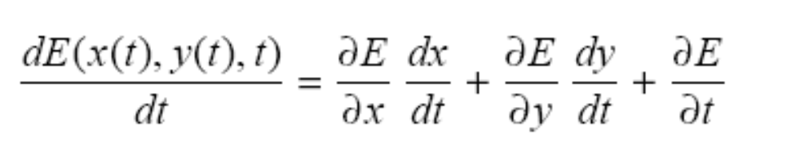
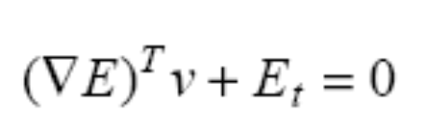
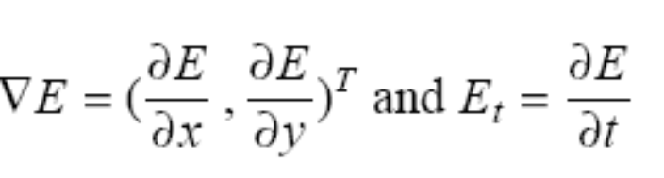
Image Brightness Constancy Equation (cont’d)
Using the chain rule we have
Since v = (dx/dt, dy/dt)^{T} , we can rewrite the above equation as
(optical flow equation)
where
gradient - spatial derivatives
temporal derivative

Slide 35
Spatial and Temporal Derivatives
(see Appendix A.2)
The gradient can be computed from one image.
The temporal derivate requires more than one frames.
(x,y)
(x+1,y)
=E(x+1,y) – E(x,y)
e.g.,
(x,y+1)
(x+1,y+1)
=E(x,y+1) – E(x,y)
…
(x(t),y(t))
e.g., E(x(t),y(t)) - E(x(t+1),y(t+1))
(x(1),y(1))
(x(2),y(2))

Slide 36
Spatial and Temporal Derivatives (cont’d)
is non-zero in areas where the intensity varies.
It a vector pointing to the direction of maximum intensity change.
Therefore, it is always perpendicular to the direction of an edge.

Slide 37
The Aperture Problem
We cannot completely recover v since we have one equations with two unknowns!
v_{n}
v
v_{p}

Slide 38
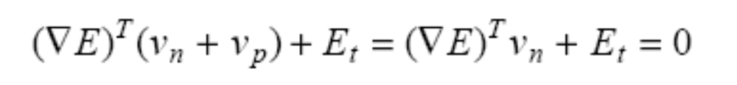
The Aperture Problem (cont’d)
The brightness constancy equation then becomes:
We can only estimate the motion components v_{n} which is parallel to the spatial gradient vector
v_{n} is known as normal flow

Slide 39
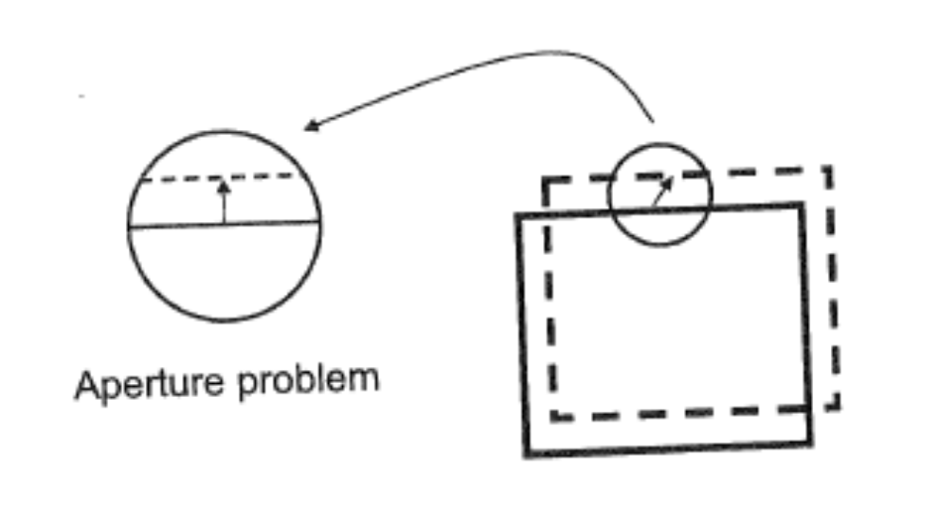
The Aperture Problem (cont’d)
Consider the top edge of a moving rectangle.
Imagine to observe it through a small aperture (i.e., simulates the narrow support of a differential method).
There are many motions of the rectangle compatible with what we see through the aperture.
The component of the motion field in the direction orthogonal to the spatial image gradient is not constrained by the image brightness constancy equation.

Slide 40
The Aperture Problem (cont’d)

Slide 41
Optical Flow
An approximation of the 2D
motion field based on variations
in image intensity between frames.
Cannot be computed for motion
fields orthogonal to the spatial
image gradients.

Slide 42
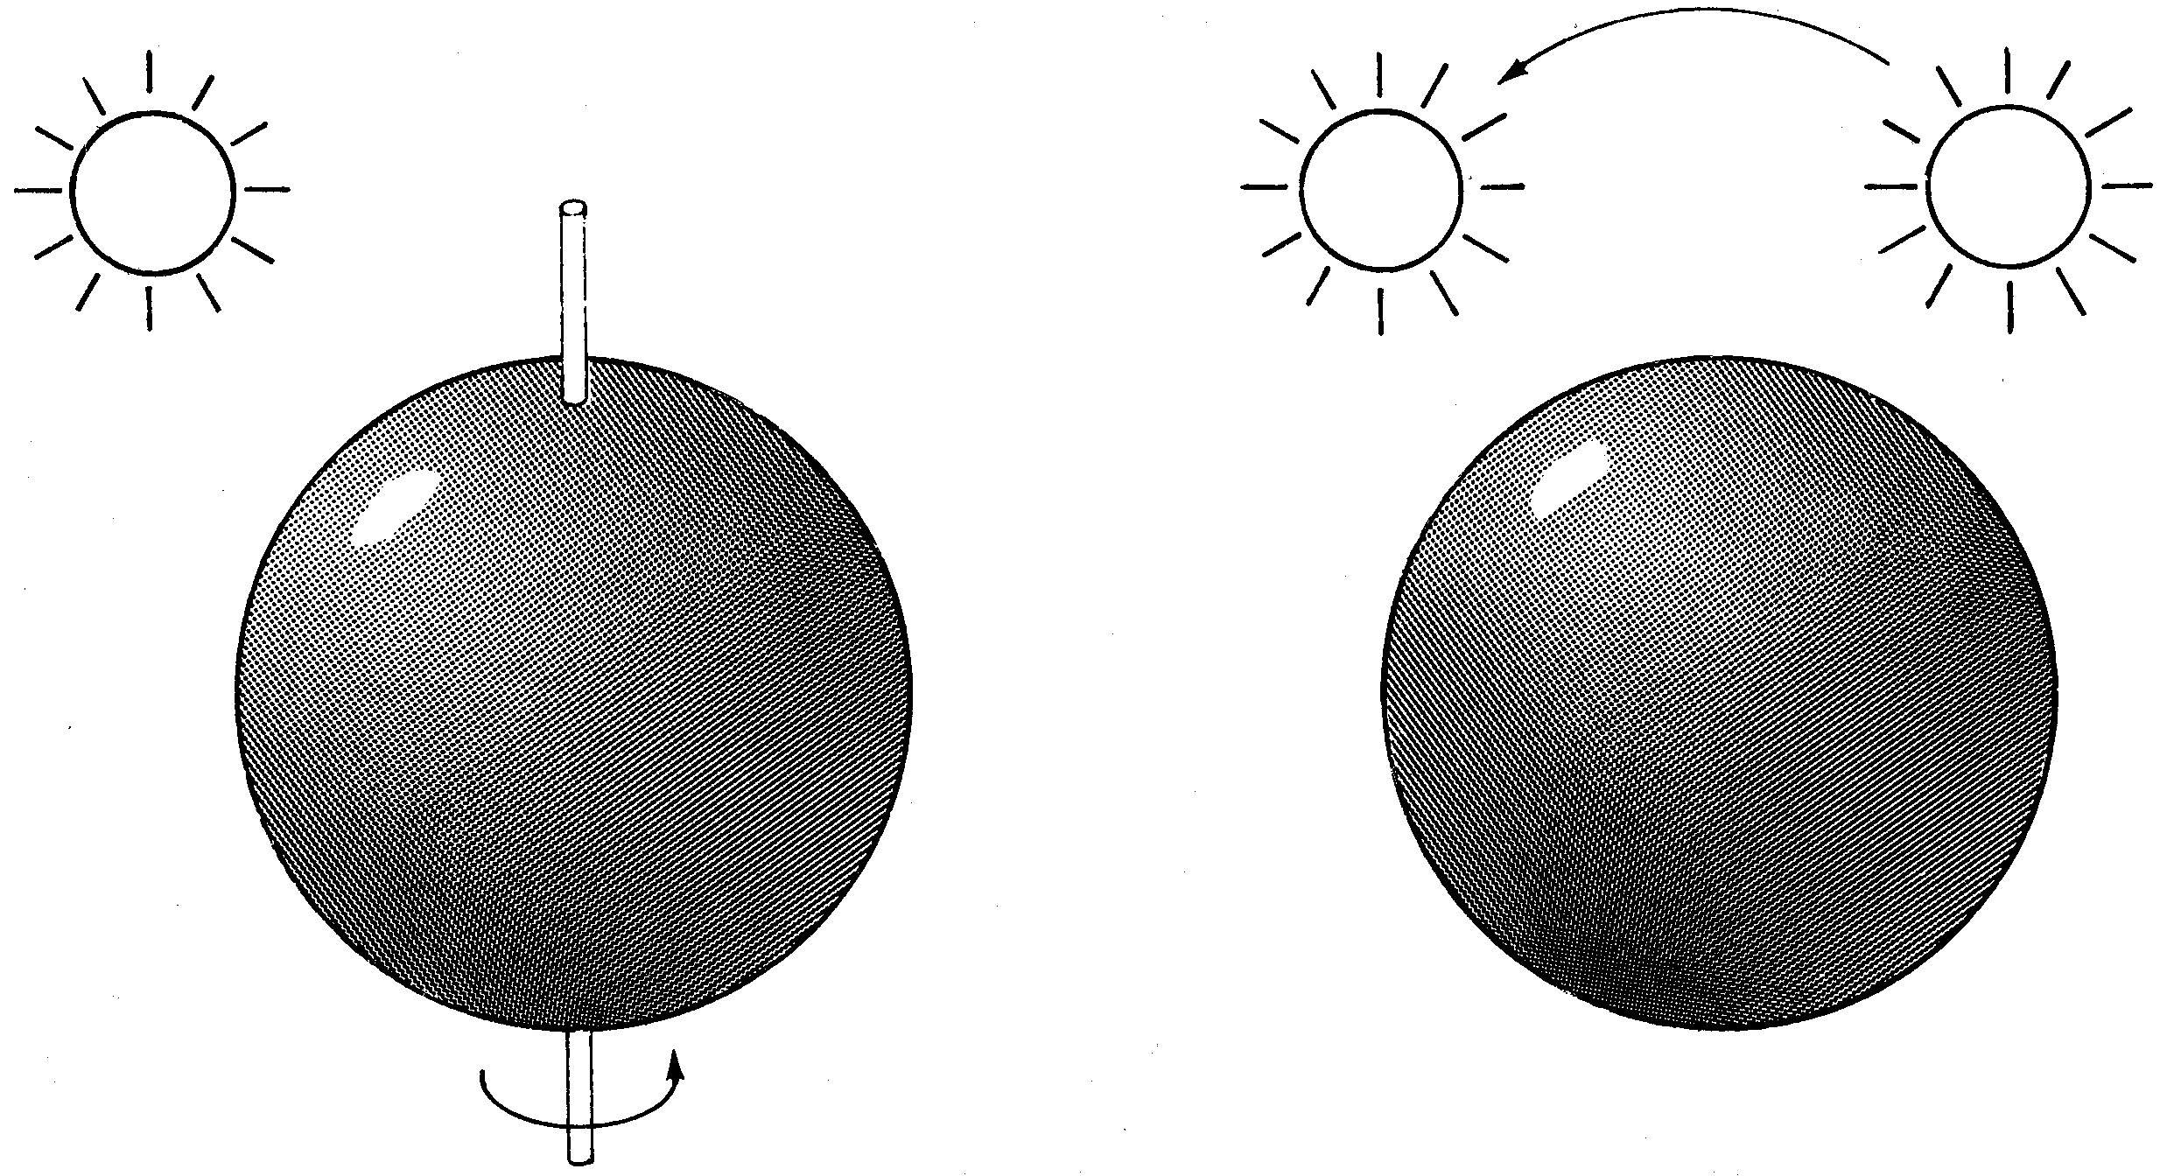
Optical Flow (cont’d)
The relationship between motion field and optical flow is not straightforward!
We could have zero apparent motion (or optical flow) for a non-zero motion field!
  e.g., sphere with constant color surface rotating in diffuse lighting.
We could also have non-zero apparent motion for a zero motion field!
  e.g., static scene and moving light sources.

Slide 43
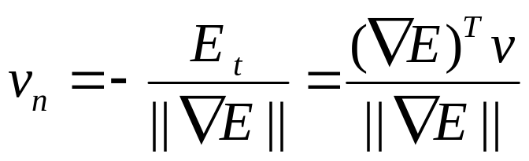
Validity of the Constancy Equation
How well does the brightness constancy equation estimate the normal component v_{n} of the motion field?
Need to introduce a model of image formation, to model the brightness E using the reflectance of the surfaces and the illumination of the scene.

Slide 44
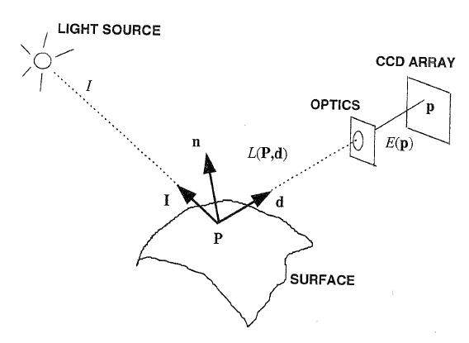
Basic Radiometry
(Section 2.2.3)
Radiometry is concerned with the relation among the amounts of light energy emitted from light sources, reflected from surfaces, and registered by sensors.
Image radiance: The power of light, ideally emitted by each point P of a surface in 3D space in a given direction d.
Image irradiance: The power of the light, per unit area and at each point p of the image plane.

Slide 45
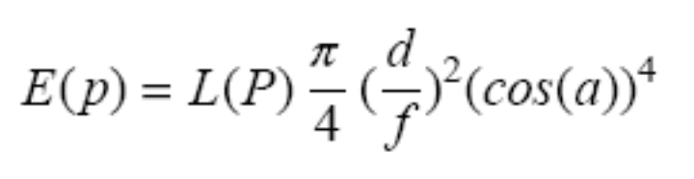
Linking Surface Radiance with Image Irradiance
The fundamental equation of radiometric image formation is given by:
The illumination of the image at p decreases as the fourth power of the cosine of the angle formed by the principal ray through p with the optical axis.
(d: lens diameter)

Slide 46
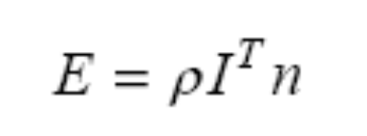
Lambertian Model
Assumes that each surface point appears equally bright from all viewing directions (e.g., rough, non-specular surfaces).
I : a vector representing the direction and amount of incident light
n : the surface normal at point P
ρ : the albedo (typical of surface’s material).
(e.g., rough, non-specular surfaces)
(i.e., independent of α)

Slide 47
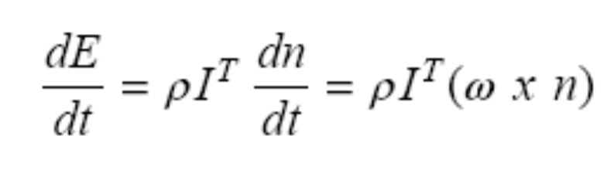
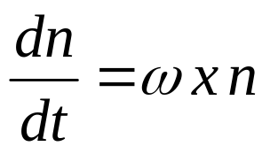
Validity of the Constancy Equation (cont’d)
The total temporal derivative of E is:
since
(only n depends on t)

Slide 48

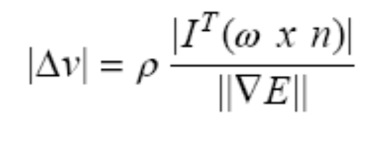
Validity of the Constancy Equation (cont’d)
Using the constancy equation, we have:
The difference Δv between the true value of v_{n} and the one estimated by the constancy equation is:

Slide 49
Validity of the Constancy Equation (cont’d)
Δv = 0 when:
  The motion is purely translational (i.e., ω =0)
  For any rigid motion where the illumination direction is parallel to the angular velocity (i.e., ω x n = 0)
Δv is small when:
  || || is large.
  This implies that the motion field can be best estimated at points with high spatial image gradient (i.e., edges).
In general, Δv ≠ 0
  The apparent motion of the image brightness is almost always different from the motion field.

Slide 50
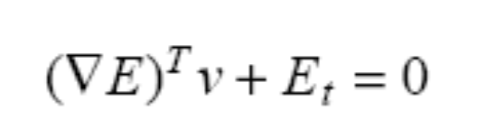
Optical Flow Estimation
Under-constrained problem
  To estimate optical flow, we need additional constraints.
Examples of constraints
  (1) Locally constant velocity
  (2) Local parametric model
  (3) Smoothness constraint (i.e., regularization)

Slide 51
Optical Flow Estimation: (1) Locally Constant Velocity (Lucas and Kanade algorithm)
Constant velocity assumption
  Constant optical flow for each image point p_{i} in a small N x N neighborhood Q.
  Reasonable assumption assuming small windows (e.g., 5x5), not near edges.
Q
p_{i}

Slide 52

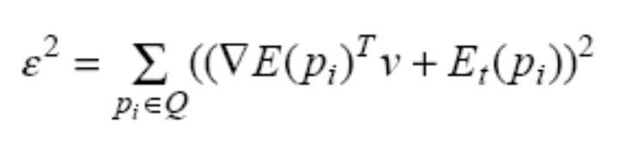
Optical Flow Estimation:
(1) Locally Constant Velocity (cont’d)
Every point p_{i} in Q needs to satisfy the constancy equation:
Obtain v by minimizing:

Slide 53
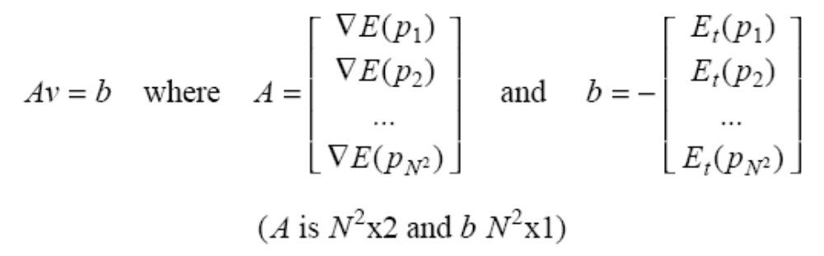
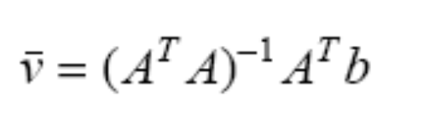
Optical Flow Estimation:
(1) Locally Constant Velocity (cont’d)
Minimizing ε² is equivalent to solving:
The solution is given by the pseudo-inverse matrix:
Assign to the center pixel of Q
A dense optical flow can be computed by repeating this procedure for all image points.
Q
p_{i}

Slide 54
Comments
Smoothing (i.e., averaging) should be applied prior to the optical flow computation to reduce noise.
  Both spatial and temporal smoothing using, e.g., a Gaussian (σ =1.5)
  Temporal smoothing is implemented by stacking the images on top of each other and filtering sequences of pixels having the same coordinates.
…

Slide 55

Comments (cont’d)
It can be shown that:
When the matrix becomes singular, the aperture problem cannot be solved.
  Q has close to constant intensity (e.g., both eigenvalues very close to zero) .
  Intensity changes in one direction only (e.g., one of the eigenvalues very close to zero).
  SVD can be used in this case to obtain the smallest norm solution (i.e., v_{n}).

Slide 56
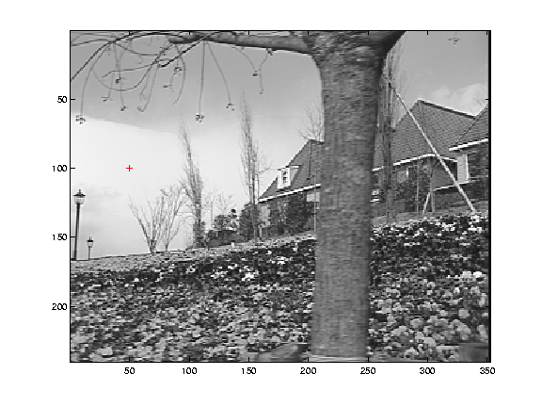
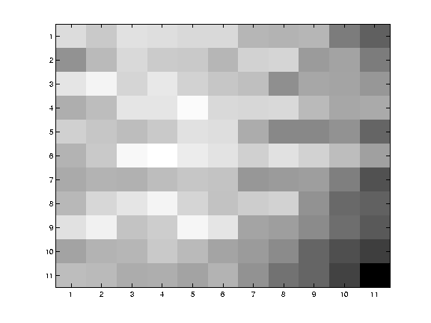
Example: Low texture region
small λ₁, small λ₂

Slide 57
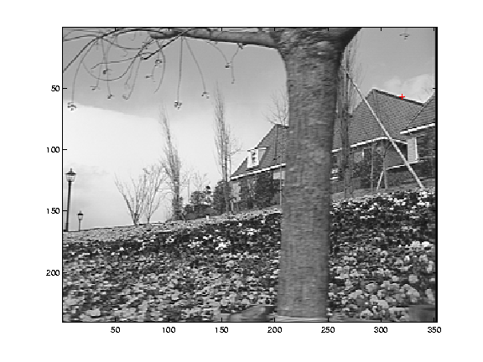
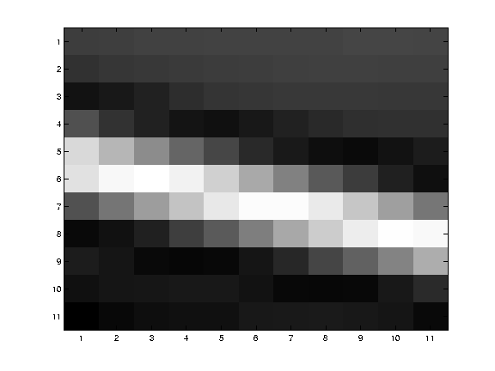
Example: Edge
large λ₁, small λ₂

Slide 58
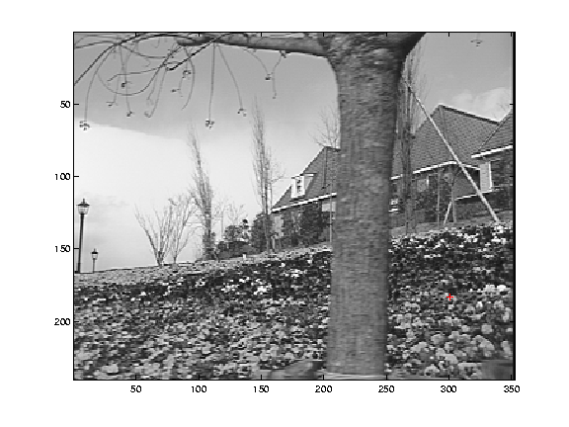
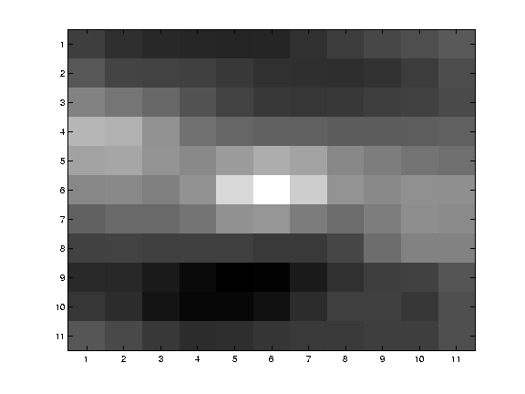
Example: High textured region
large λ₁, large λ₂

Slide 59

Example
Measurement window must contain sufficient gradient variation in order to determine motion.
  e.g., corners and edges

Slide 60


Example: Optical flow result

Slide 61
Improving estimates using weights
The assumption of constant velocity is more likely to be wrong as we move away from the point of interest (i.e., the center point of Q)
Use weights to control the influence of the points: the farther from p, the less weight

Slide 62
Solving for v with weights
Let W be a diagonal matrix with weights
Multiply both sides of Av = b by W:
  W A v = W b
Multiply both sides by (WA)^{T}:
  A^{T} WWA v = A^{T} WWb
A^{T} W²A is square (2x2):
    (A^{T}W²A)⁻¹ exists if det(A^{T}W²A) ≠ 0
Assuming that (A^{T}W²A)⁻¹ exists:
  (A^{T} W²A)⁻¹ (A^{T} W²A) v = (A^{T} W²A)⁻¹ A^{T} W²b
  v = (A^{T} W²A)⁻¹ A^{T} W²b

Slide 63
Optical Flow Estimation: (2) Local Parametric Models (First Order Approximation)
The previous algorithm assumes constant velocity within region (only valid for small regions).
Improved performance can be achieved by integrating optical flow estimates over larger regions using parametric models.

Slide 64


Optical Flow Estimation:
(2) First Order Approximation (cont’d)
First order (affine) model:
Assuming N optical flow estimates (v_{x1},v_{y1}), (v_{x2},v_{y2}), …, (v_{xN}, v_{yN}) at N positions, we have:
w=Ha
a=(H^{T}H)⁻¹H^{T}w
vy₁
or
α₆

Slide 65


Optical Flow Estimation:
(3a) Smoothness Constraints
Enforcing local smoothness by constraining intensity variations.
  We have 1+3=4 equations now:

Slide 66


Optical Flow Estimation:
(3a) Smoothness Constraints (cont’d)
We can estimate (v_{x} , v_{y}) by solving the following system of equations:
where

Slide 67


Optical Flow Estimation:
(3b) Smoothness Constraints
Impose global smoothness constraint on v (i.e., v should vary smoothly over the image)
Using techniques from the calculus of variations, we get a pair of PDEs:
regularization
(1)
where λ controls the strength of the smoothness term.

Slide 68
Example: Optical flow result

Slide 69
Optical Flow Estimation:
(3b) Smoothness Constraints (cont’d)
Using iterative methods leads to the following scheme:
v_{x} = u_{x_avg} – E_{x} P/D
v_{y} = v_{y_avg} – E_{y} P/D
where P = E_{x} v_{x_avg} + E_{y} v_{y_avg} + E_{t}
and D = λ² + E²_{x} + E² _{y}
stop when (1) becomes
less than a threshold
(Horn and Schunk algorithm)

Slide 70
Enforcing motion smoothness (cont’d)
Comments
  The smoothness constraint is not satisfied at the boundaries of objects because the surfaces of objects may be at different depths.
  When overlapping objects are moving in different directions, the constraint is also violated.

Slide 71
Estimating Motion Field Using
Feature Matching
Estimate the motion field at feature points only (e.g., corners) -- this yield a sparse motion field!
Assuming two frames only, the idea is finding corresponding features between the frames
(e.g., using block matching).
Assuming multiple frames, frame-to-frame matching can be improved using tracking (i.e., methods that track the motion of features across a long sequence).

Slide 72
Estimating Motion Field Using
Feature Matching in Two Frames
Consider matching feature points (e.g., corners)
  Given a set of corresponding points p₁ and p₂, estimate displacement d between p₁ and p₂ using optical flow algorithms (e.g., Lucas and Kanade algorithm) iteratively.
Input: I₁, I₂ and a set of corresponding points
Output: An estimate of d for all feature points.

Slide 73
Estimating Motion Field Using
Feature Matching in Two Frames (cont’d)
Q’
For each feature point p do
Set d = 0
(1) Estimate displacement d₀ in a small region Q₁ using the assumption of constant velocity: d = d + d₀
(2) Warp Q₁ to Q′ according to the estimated displacement d₀
(resampling is required e.g., using bilinear approximation)
(3) Compute the correlation SSD between Q′ and Q₂ (i.e., corresponding patch in I₂)
(4) If SSD > t, then Q₁ = Q′, go to step (1), else stop.
Q₁
Q₂
p’
p
I₁
I₂

Slide 74
Estimating Motion Field Using
Feature Tracking in Multiple Frames
Two-frame feature matching can be improved assuming long image sequences.
Idea: make predictions on the motion of the feature points on the basis of their trajectory.
  Assume that the motion of observed scene is continuous.
t+1
t
t-1

Slide 75

Tracking feature points Using Kalman Filter
Kalman filtering is a popular technique for feature tracking (see Appendix A.8)
Recursive algorithm which estimates the position and uncertainty of a moving feature point in the next frame.

Slide 76
Tracking feature points Using Kalman Filter (cont’d)
Consider tracking point p=(x_{t},y_{t})^{T} where t represents the time step.
Let’s the velocity be v_{t}=(v_{x,t}, v_{y,t})
Let’s represent the state of p at time t by s_{t}
s_{t}=[x_{t}, y_{t}, v_{x,t}, v_{y,t}]^{T}
The goal is to estimate s_{t+1} from s_{t}

Slide 77
Tracking feature points Using Kalman Filter (cont’d)
According to the theory of Kalman filtering, s_{t+1} relates to s_{t} in a linear way as follows:
where Φ is the state transition matrix and w_{t} represents state uncertainty.
w_{t} follows a Gaussian distribution, i.e., w_{t} ~ N(0,Q)
s_{t+1}=Φs_{t} + w_{t}

Slide 78

Tracking feature points Using Kalman Filter (cont’d)
Example: assuming that the feature movement between consecutive frames is small, then the transition matrix Φ can be expressed as follows:
x_{t+1} = x_{t}+v_{x,t}+w_{x,t}
y_{t+1} = y_{t}+v_{y,t}+w_{y,t}
v_{x,t+1} = v_{x,t}+w_{vx,t}
v_{y,t+1} = v_{y,t}+w_{vy,t}

Slide 79
Tracking feature points Using Kalman Filter (cont’d)
Kalman filtering also involves a measurement model given by
z_{t} = Hs_{t} + v_{t}
where H relates current state s_{t} to current measurement z_{t} and v_{t} represents measurement uncertainty
v_{t} follows a Gaussian distribution, i.e., v_{t} ~ N(0,R)
z_{t} is the estimate for p_{t} provided through feature detection
(e.g., corner detection)

Slide 80

Tracking feature points Using Kalman Filter (cont’d)
Example: assuming that the feature detector estimates the position of a feature point p, then H can be expressed as follows:
z_{x,t} = x_{t} + v_{x,y}
z_{y,t} = y_{t} + v_{y,t}

Slide 81

Tracking feature points Using Kalman Filter (cont’d)
Kalman filtering involves two main steps:
  State prediction
    Based on state model
  State updating
    Based on measurement model

Slide 82
Tracking feature points Using Kalman Filter (cont’d)
(1) State prediction
Σ⁻_{t+1}
(x⁻_{t+1},y⁻_{t+1})
position
uncertainty
(x_{t},y_{t})
predicted feature
at time t+1
detected feature
at time t

Slide 83

Tracking feature points Using Kalman Filter (cont’d)
State prediction
  (1.1) State projection
  (1.2) Error covariance estimation
a-priori
estimates
Σ_{t} is the
covariance of s_{t}

Slide 84
Tracking feature points Using Kalman Filter (cont’d)
(x⁻_{t+1},y⁻_{t+1})
(2) State updating
predicted estimate
Σ_{t+1}
position
uncertainty
(x_{t},y_{t})
final estimate
(x_{t+1},y_{t+1})
detected z_{t+1}
final feature
at time t+1
detected feature
at time t

Slide 85

Tracking feature points Using Kalman Filter (cont’d)
(2) State updating
(2.1) Obtain z_{t+1} by applying the feature detector
within the search region defined by Σ⁻_{t+1}
(2.2) Compute Kalman gain K_{t+1}

Slide 86


Tracking feature points Using Kalman Filter (cont’d)
  (2.3) Combine s⁻_{t+1} with z_{t+1}
  (2.4) Update uncertainty for s_{t+1}
posterior
estimate
posterior
estimate

Slide 87


Filter Initialization
To initialize the state, we need to process at least two frames first:
Σ⁻₀ is usually initialized to some very large values but they should decrease and reach a steady state rapidly.
Σ⁻₀=

Slide 88


Filter Initialization (cont’d)
To initialize Q, for example, we can assume that the standard deviation for positional error to be 4 pixels and for velocity to be 2 pixels/frame.
To initialize R, we can assume that the measurement error is 2 pixels.
Q
R

Slide 89
Filter Limitations
Assumes that the state model is linear and that the state vector follows a Gaussian distribution.
Multiple filters are required for tracking multiple points in this case.
Improved filters (e.g., Extended Kalman Filter) have been proposed to overcome these problems.
Another method, called Particle Filtering, has been proposed for tracking objects whose state follows a multimodal, non-Gaussian distribution.

Slide 90
3D Motion and Structure from Sparse Motion Field
Goal
  Estimate 3D motion and structure from a sparse set of matched image features.
Assumptions
  The camera model is orthographic.
  The position of n image points p_{i} have been tracked in N frames (N ≥ 3)
  The image points p_{i} correspond to n, not all co-planar, scene points P₁, P₂, ..., P_{n}.

Slide 91
Factorization Method
Main characteristics
  Used when the disparity between frames is small.
  Gives very good and numerically stable results for objects viewed from rather large distances.
  Easy to implement.
Assumes that the sequence of frames has been acquired prior to starting any processing.

Slide 92

Notation
j-th point, j=1,2,…,n
i-th frame, i=1,2,…,N

Slide 93



Notation (cont’d)
Measurement matrix
Normalized points
Normalized points

Slide 94


Rank theorem
The normalized measurement matrix
(without noise) has at most rank 3
The proof is based on the decomposition (factorization) of
R describes the frame to frame rotation of the camera with respect to the points P_{j} .
S describes the structure of the points (i.e., coordinates).

Slide 95


Proof of the rank theorem
Let’s assume that the word reference frame has its origin at the centroid of P₁, P₂, ..., P_{n}
Let us denote with i_{i} and j_{i} the unit vectors of the i-th image plane, expressed in world coordinates.
The direction of the orthographic projection would then be
i.e.,

Slide 96

Proof of the rank theorem (cont’d)

Slide 97


Proof of the rank theorem (cont’d)
The camera coordinates of P_{j} would be:
Assuming orthographic projection, the image plane coordinates of P_{j} in frame i would be:

Slide 98



Proof of the rank theorem (cont’d)
The above equations can be rewritten as:
Since we have

Slide 99




Proof of the rank theorem (cont’d)
The above expressions are equivalent to
where
and
(2N x 3)
(3 x n)
The rank of is 3 since the rank of R is 3 (i.e., N>=3)
and the rank of S is 3 (i.e., non-coplanar points).

Slide 100

Non-uniqueness
If R and S factorize , then RQ and Q⁻¹S also factorize where Q is any invertible 3x3 matrix.

Slide 101
Constraints
The rows of R must have unit norm.
i^{T}_{i} must be orthogonal to the j^{T}_{i}

Slide 102



Compute Factorization using SVD
Enforce rank 3 constraint by setting to zero all but the three largest singular values of D
Rewrite the above expression as follows:

Slide 103


Compute Factorization using SVD (cont’d)
Compute R and S as:
Enforce constraints for matrix R

Slide 104
Uniqueness of Solution
Initial orientation of the world frame with respect to the camera frame is unknown.
The above constraints allow computing a factorization of which is unique up to an unknown initial orientation.
One way to determine this unknown is by assuming that the world and camera reference frames coincide at t = 0 (x-y axes only)

Slide 105
Determine translation
Component of translation parallel to the image plane is proportional to the frame-to-frame motion of the centroid of P_{j} ’s
Component of translation along the optical axis cannot be computed due to the orthographic projection assumption.

Slide 106
3D Motion and Structure from
Dense Motion Field
Given an optical flow field and intrinsic parameters of the viewing camera, recover the 3D motion and structure of the observed scene with respect to the camera reference frame.

Slide 107
3D Motion and Structure from
Dense Motion Field
Differences with previous method
  Optical flow provides a dense but often inaccurate estimate of the motion field.
  The analysis is instantaneous, not integrated over many frames.
  3D motion and structure can not be recovered as accurate as using the previous method.
  Depends on local approximation of motion, assumptions about large variation in depth in the observed scene, and camera calibration.

Slide 108
3D Motion and Structure from
Dense Motion Field (cont’d)
Steps
  Determine the direction of translation through approximate motion parallax.
  Determine the rotational component of motion.
  Compute depth information.

Slide 109

Motion Parallax
The relative motion field of two instantaneously coincident points (i.e., points at different depths along a common line of sight) does not depend on the rotational component of motion in 3D space.

Slide 110


Justification of Motion Parallax
Consider two points P=[X,Y,Z]^{T} and
Suppose that the their projections p and p_bar coincide at
some instant t, then the relative motion can be expressed as:

Slide 111


Properties of the relative motion field
The relative motion field does not depend on the rotational component of the motion.
For all possible rotational motions, the vector (Δv_{x} , Δv_{y}) points in the direction of p₀ =(T_{x}/T_{z}, T_{y}/T_{z})

Slide 112

Properties of the relative motion field (cont’d)
Δv_{x} and Δv_{y} increase with the separation in depth between P and P_bar
The dot product between v and [y − y₀, −(x − x₀)]^{T}= [Δv_{y}, −Δv_{x} ]^{T} does not depend on the 3D structure of the scene or the translational component
T

