Slide 1
Lecture 6:
Finding Features (part 1/2)
Professor Fei-­‐Fei Li Stanford Vision Lab
Lecture 6 -

Slide 2

What we will learn today?
Local invariant features
Motivation
Requirements, invariances
Keypoint localization
Harris corner detector
Scale invariant region selection
Automatic scale selection
Diﬀerence-­‐of-­‐Gaussian (DoG) detector
SIFT: an image region descriptor
Next lecture (#7)
Lecture 6 -

Slide 3
What we will learn today?
Local invariant features
Motivation
Requirements, invariances
Keypoint localization
Harris corner detector
Some background reading:
Rick Szeliski, Chapter 14.1.1; David Lowe, IJCV 2004
Lecture 6 -

Slide 4
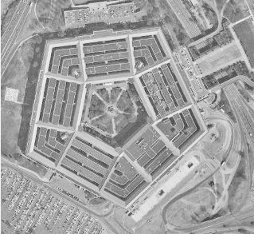
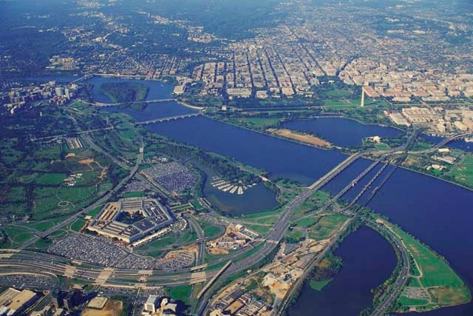
Image matching:
a challenging problem
Lecture 6 -

Slide 5
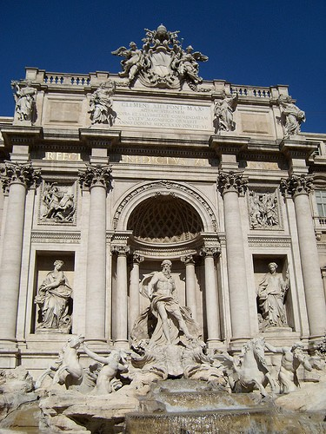
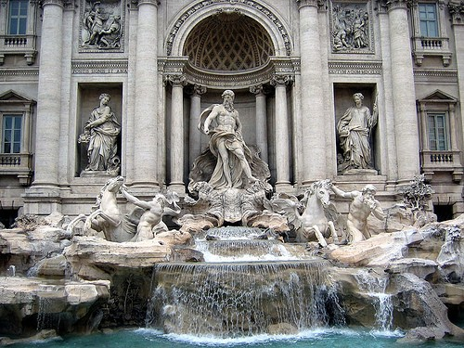
Image matching:
a challenging problem
Slide credit: Steve Seitz
by Diva Sian
by swashford
Lecture 6 -

Slide 6
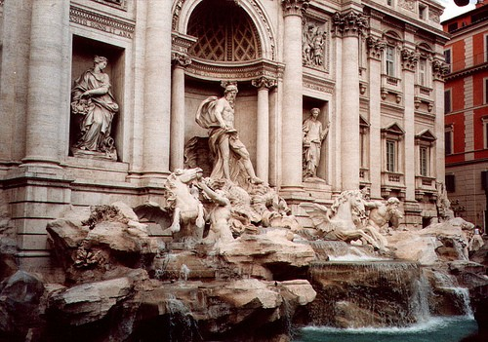
Harder Case
Slide credit: Steve Seitz
by Diva Sian
by scgbt
Lecture 6 -

Slide 7
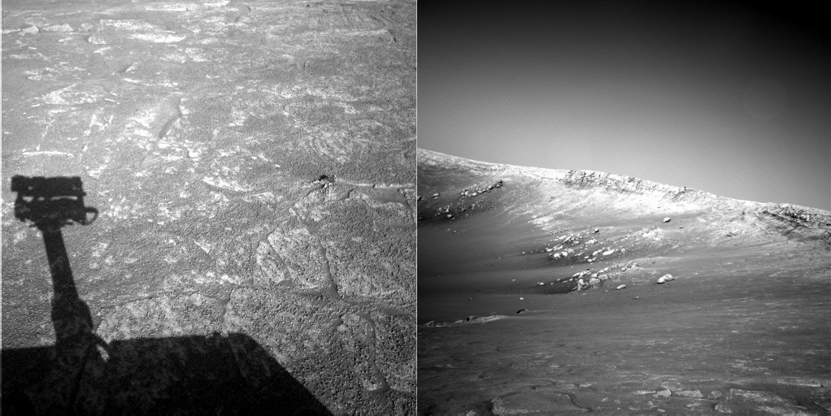
Harder Still?
Slide credit: Steve Seitz
NASA Mars Rover images
Lecture 6 -

Slide 8
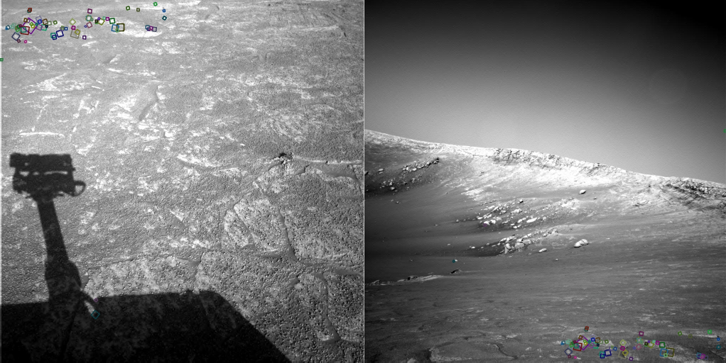
Answer Below (Look for tiny colored squares)
Slide credit: Steve Seitz
NASA Mars Rover images with SIFT feature matches (Figure by Noah Snavely)
Lecture 6 -

Slide 9




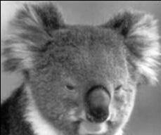
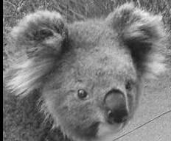
Motivation for using local features
Global representations have major limitations
Instead, describe and match only local regions
Increased robustness to
– Occlusions
– Articulation
d
d_{q}
φ
φ
θ
– Intra-­‐category variations
θ_{q}
Lecture 6 -

Slide 10




General Approach
Find a set of distinctive key- points
Define a region around each keypoint
A₃
Extract and normalize the region content
A₁
B
3
A₂
B
2
B
1
f _{A}
Similarity measure
f_{B}
Slide credit: Bastian Leibe
4. Compute a local descriptor from the normalized region
N pixels
e.g. color
e.g. color
N pixels
d( f_{A} , f_{B} ) < T
5. Match local descriptors
Lecture 6 -

Slide 11


Common Requirements
Problem 1:
– Detect the same point independently in both images
Slide credit: Darya Frolova, Denis Simakov
No chance to match!
We need a repeatable detector!
Lecture 6 -

Slide 12
Common Requirements
Problem 1:
Detect the same point independently in both images
Problem 2:
For each point correctly recognize the corresponding one
?
Slide credit: Darya Frolova, Denis Simakov
We need a reliable and distinctive descriptor!
Lecture 6 -

Slide 13




Invariance: Geometric Transformations
Slide credit: Steve Seitz
Lecture 6 -

Slide 14
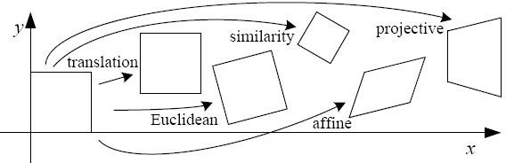


Levels of Geometric Invariance
Slide credit: Bastian Leibe
CS131
CS231a
Lecture 6 -

Slide 15
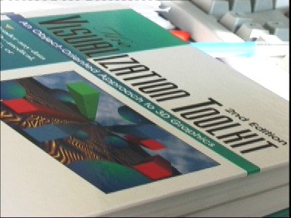
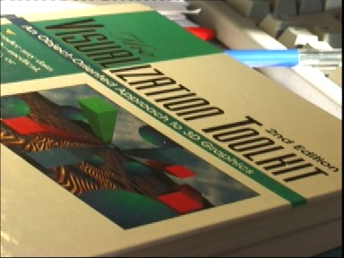
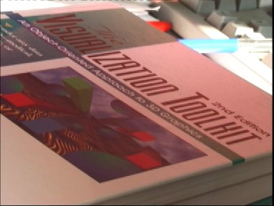
Invariance: Photometric Transformations
Slide credit: Tinne Tuytelaars
Ofen modeled as a linear transformation:
– Scaling + Oﬀset
Lecture 6 -

Slide 16
Requirements
Region extraction needs to be repeatable and accurate
Invariant to translation, rotation, scale changes
Robust or covariant to out-­‐of-­‐plane (≈aﬃne) transformations
Robust to lighting variations, noise, blur, quantization
Locality: Features are local, therefore robust to occlusion and clutter.
Quantity: We need a suﬃcient number of regions to cover the object.
Distinctivenes : The regions should contain “interesting” structure.
Eﬃciency: Close to real-­‐time performance.
Slide credit: Bastian Leibe
Lecture 6 -

Slide 17
Many Existing Detectors Available
Hessian & Harris
Laplacian, DoG
Harris-­‐/Hessian-­‐Laplace
Harris-­‐/Hessian-­‐Aﬃne
[Beaudet ‘78], [Harris ‘88]
[Lindeberg ‘98], [Lowe ‘99] [Mikolajczyk & Schmid ‘01]
[Mikolajczyk & Schmid ‘04]
EBR and IBR
MSER
Salient Regions
Others…
[Tuytelaars & Van Gool ‘04] [Matas ‘02]
[Kadir & Brady ‘01]
Slide credit: Bastian Leibe
Those detectors have become a basic building block for many recent applications in Computer Vision.
Lecture 6 -

Slide 18
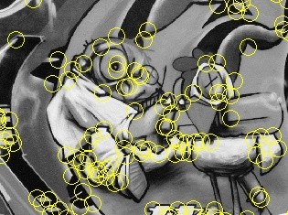
Keypoint Localization
Goals:
Repeatable detection
Precise localization
Interesting content
⇒ Look for two-­‐dimensional signal changes
Slide credit: Bastian Leibe
Lecture 6 -

Slide 19
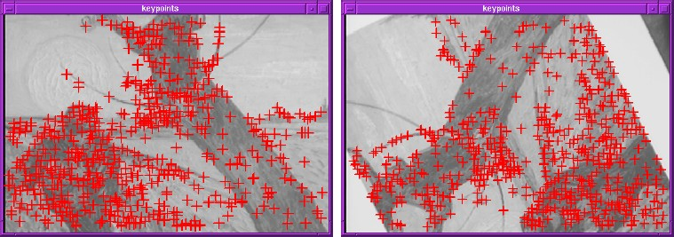
Finding Corners
Key property:
– In the region around a corner, image gradient has two or more dominant directions
Corners are repeatable and distinctive
Slide credit: Svetlana Lazebnik
C.Harris and M.Stephens. "A Combined Corner and Edge Detector.“
Proceedings of the 4th Alvey Vision Conference, 1988.
Lecture 6 -

Slide 20

Corners as Distinctive Interest Points
Design criteria
We should easily recognize the point by looking through a small window (locality)
Shifing the window in any direction should give a large change in intensity (good localization)
Slide credit: Alyosha Efros
“flat” region: no change in all directions
“edge”:
no change along the edge direction
“corner”: significant change in all directions
Lecture 6 -

Slide 21
Harris Detector Formulation
Change of intensity for the shif [u,v]:
E(u, v) = ∑w(x, y)[I (x + u, y + v) − I (x, y)]²
x, y
Window function
Shifted intensity
Intensity
Slide credit: Rick Szeliski
Window function w(x,y) =
or
1 in window, 0 outside
Gaussian
Lecture 6 -

Slide 22
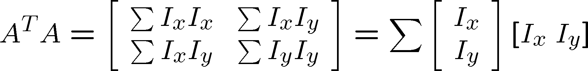
Harris Detector Formulation
This measure of change can be approximated by:
⎡⎡u⎤⎤
E(u, v) ≈ [u v] M
⎢⎢_{v}⎥⎥
⎣⎣ ⎦⎦
where M is a 2×2 matrix computed from image derivatives:
_{⎡⎡ I} 2
M = ∑w(x, y) ⎢⎢
I I ⎤⎤
x
x y
⎥⎥
Gradient with respect to x, times gradient with respect to y
_{I} 2
⎢⎢⎣⎣
I I
⎥⎥⎦⎦
x, y
x y
y
Slide credit: Rick Szeliski
Sum over image region – the area we are checking for corner
M
Lecture 6 -

Slide 23
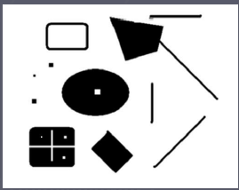
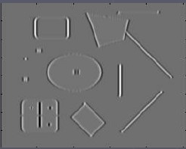
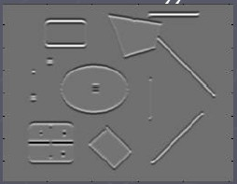
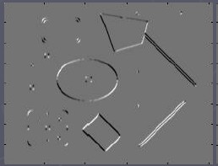
Harris Detector Formulation
Image I I_{x} I_{y} I_{x}I_{y}
where M is a 2×2 matrix computed from image derivatives:
_{⎡⎡ I} 2
M = ∑w(x, y) ⎢⎢
I I ⎤⎤
x
x y
⎥⎥
Gradient with respect to x, times gradient with respect to y
_{I} 2
⎢⎢⎣⎣
I I
⎥⎥⎦⎦
x, y
x y
y
Slide credit: Rick Szeliski
Sum over image region – the area we are checking for corner
M
Lecture 6 -

Slide 24
What Does This Matrix Reveal?
First, let’s consider an axis-­‐aligned corner:
∑ x
I ∑I I ⎤⎤ ⎡⎡λ 0 ⎤⎤
⎥⎥
⎡⎡
2
M = ⎢⎢
⎢⎢∑I I
x y 1
⎥⎥ = ⎢⎢
∑ ⎥⎥
⎣⎣ 0 λ ⎦⎦
I
2
⎣⎣
x y
y
⎦⎦
2
Slide credit: David Jacobs
Lecture 6 -

Slide 25
What Does This Matrix Reveal?
First, let’s consider an axis-­‐aligned corner:
∑ x
I ∑I I ⎤⎤ ⎡⎡λ 0 ⎤⎤
⎥⎥
⎡⎡
2
M = ⎢⎢
⎢⎢∑I I
x y 1
⎥⎥ = ⎢⎢
∑ ⎥⎥
⎣⎣ 0 λ ⎦⎦
I
2
⎣⎣ ⎦⎦
x y
y
2
This means:
Dominant gradient directions align with x or y axis
If either λ is close to 0, then this is not a corner, so look for locations where both are large.
What if we have a corner that is not aligned with the image axes?
Slide credit: David Jacobs
Lecture 6 -

Slide 26
General Case
0 ⎤⎤_{R}
Since M is symmetric, we have
M = R^{−1 ⎡⎡λ1}
⎢⎢ ₀
⎥⎥
λ
⎣⎣ 2 ⎦⎦
(Eigenvalue decomposition)
We can visualize M as an ellipse with axis lengths determined by the eigenvalues and orientation determined by R
Direction of the fastest change
Direction of the slowest change
_{(λmax)}-1/2
_{(λmin)}-1/2
adapted from Darya Frolova, Denis Simakov
Lecture 6 -

Slide 27

Interpreting the Eigenvalues
Classiﬁcation of image points using eigenvalues of M:
λ₂
“Edge”
λ₂ >> λ₁
“Corner”
λ₁ and λ₂ are large, λ₁ ~ λ₂;
E increases in all directions
Slide credit: Kristen Grauman
λ₁ and λ₂ are small;
E is almost constant in all directions
“Flat” region
“Edge”
λ₁ >> λ₂
λ₁
Lecture 6 -

Slide 28
Corner Response Function
θ = det(M ) − α trace(M ) = λ λ − α(λ + λ
2
)
2
1 2
1
2
λ₂
“Edge”
θ < 0
“Corner”
θ > 0
Slide credit: Kristen Grauman
Fast approximation
Avoid computing the eigenvalues
α: constant (0.04 to 0.06)
“Flat” region
“Edge”
θ < 0
λ₁
Lecture 6 -

Slide 29
Window Function w(x,y)
_{⎡⎡ I} 2
M = ∑w(x, y) ⎢⎢
I I ⎤⎤
x
x y
⎥⎥
_{I} 2
⎢⎢⎣⎣
I I
⎥⎥⎦⎦
x, y
Option 1: uniform window
– Sum over square window
x y
y
M = ∑⎢⎢
⎡⎡ I ² I I ⎤⎤
x
x y
⎥⎥
I I
_{I} 2
x, y ⎢⎢⎣⎣ x y y ⎥⎥⎦⎦
– Problem: not rotation invariant
1 in window, 0 outside
Option 2: Smooth with Gaussian
– Gaussian already performs weighted sum
Slide credit: Bastian Leibe
⎡⎡ I ² I I ⎤⎤
M = g(σ ) ∗ ⎢⎢
x
x y
⎥⎥
⎢⎢I I
_{I} 2
⎣⎣
⎥⎥
x y
y
⎦⎦
Gaussian
– Result is rotation invariant
Lecture 6 -

Slide 30
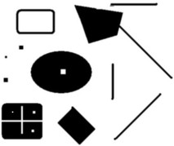
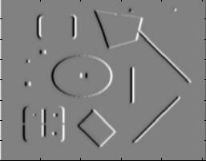
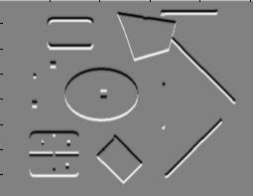
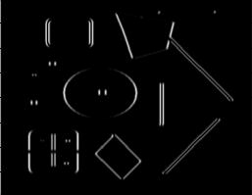
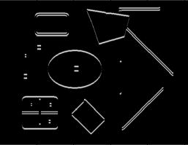
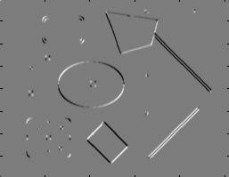
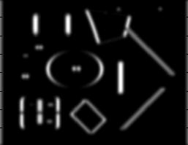
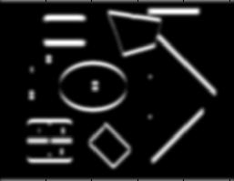
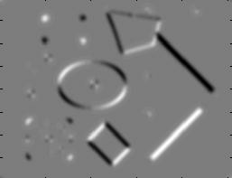
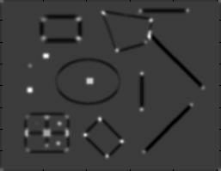
Summary: Harris Detector [Harris88]
Compute second moment matrix (autocorrelation matrix)
I_{x}
I_{y}
⎡⎡ I ² (σ ) I I (σ )⎤⎤
1. Image
derivatives
M (σ _{I} ,σ _{D} ) = g(σ _{I} ) ∗ ⎢⎢
x D
x y D
2
⎥⎥
⎢⎢⎣⎣I_{x} I _{y} (σ _{D} ) I _{y} (σ _{D} ) ⎥⎥⎦⎦
_{I} 2
_{I} 2
I I
2. Square of derivatives
x
y
x y
Slide credit: Krystian Mikolajczyk
3. Gaussian filter g(σ_{I})
g(I_{x} )
2
g(I_{y} )
2
g(I_{x}I_{y})
4. Cornerness function – two strong eigenvalues
2
θ = det[M (σ _{I} ,σ _{D} )] − α[trace(M (σ _{I} ,σ _{D} ))]
= g(I ² )g(I ² ) −[g(I I )]² −α[g(I ² ) + g(I ² )]²
x y x y x y
5. Perform non-maximum suppression
R
Lecture 6 -

Slide 31
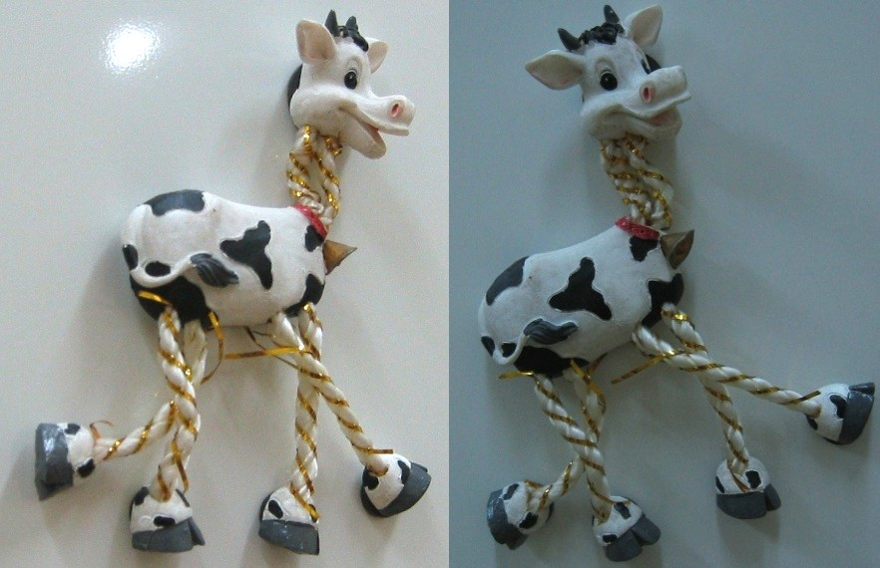
Harris Detector: Workﬂow
Slide adapted from Darya Frolova, Denis Simakov
Lecture 6 -

Slide 32
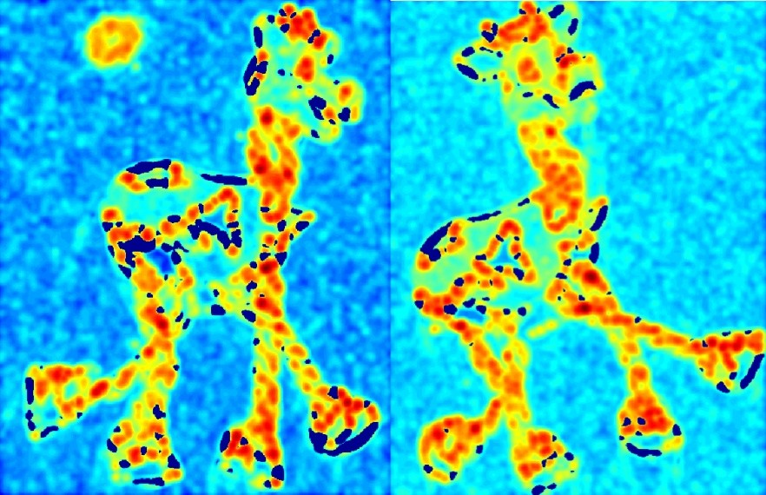
Harris Detector: Workﬂow
-­‐ computer corner responses θ
Slide adapted from Darya Frolova, Denis Simakov
Lecture 6 -

Slide 33
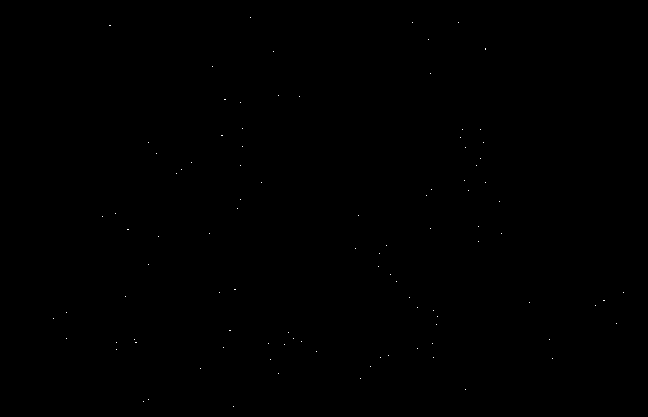
Harris Detector: Workﬂow
-­‐ Take only the local maxima of θ, where θ>threshold
Slide adapted from Darya Frolova, Denis Simakov
Lecture 6 -

Slide 34

Harris Detector: Workﬂow
-­‐ Resulting Harris points
Slide adapted from Darya Frolova, Denis Simakov
Lecture 6 -

Slide 35
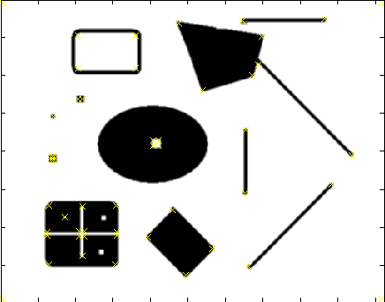
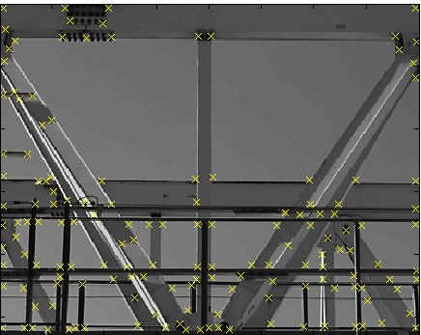
Harris Detector – Responses [Harris88]
Slide credit: Krystian Mikolajczyk
Effect: A very precise corner detector.
Lecture 6 -

Slide 36
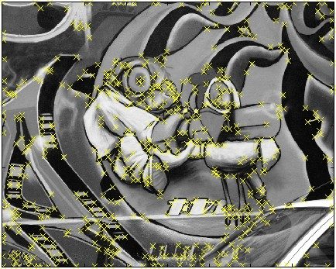
Harris Detector – Responses [Harris88]
Slide credit: Krystian Mikolajczyk
Lecture 6 -

Slide 37
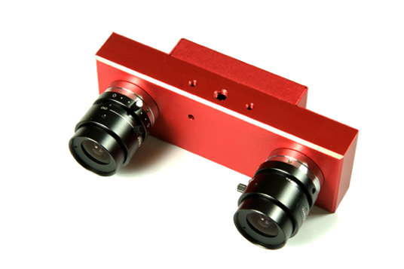
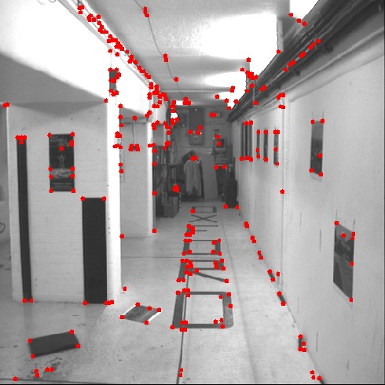
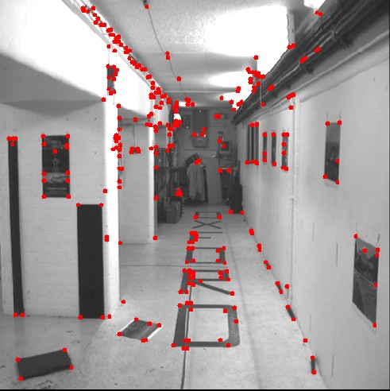
Harris Detector – Responses [Harris88]
Slide credit: Kristen Grauman
Results are well suited for ﬁnding stereo correspondences
Lecture 6 -

Slide 38
Harris Detector: Properties
Translation invariance?
Slide credit: Kristen Grauman
Lecture 6 -

Slide 39
Harris Detector: Properties
Translation invariance
Rotation invariance?
Slide credit: Kristen Grauman
Ellipse rotates but its shape (i.e. eigenvalues) remains the same
Corner response θ is invariant to image rotation
Lecture 6 -

Slide 40
Harris Detector: Properties
Translation invariance
Rotation invariance
Scale invariance?
Slide credit: Kristen Grauman
Corner
All points will be classified as edges!
Not invariant to image scale!
Lecture 6 -

Slide 41
What we have learned today?
Local invariant features
Motivation
Requirements, invariances
Keypoint localization
Harris corner detector
Scale invariant region selection
Automatic scale selection
Diﬀerence-­‐of-­‐Gaussian (DoG) detector
SIFT: an image region descriptor
Some background reading:
Rick Szeliski, Chapter 14.1.1; David Lowe, IJCV 2004
Next lecture (#7)
Lecture 6 -

