Slide 1
Image Enhancement in the Spatial Domain II
Jen-Chang Liu, 2006

Slide 2
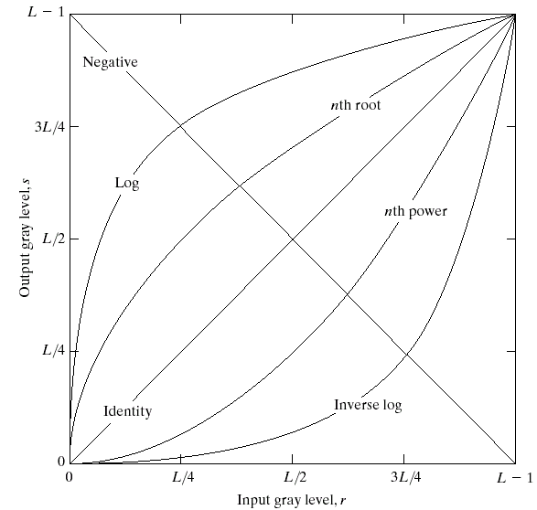
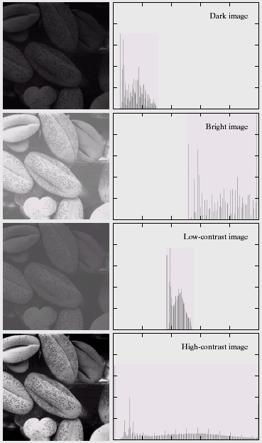
Review: gray level transformations
For this image,
what transform
should we apply?

Slide 3
Histogram Processing
Histogram equalization
Histogram matching
Local enhancement
Use of histogram statistics

Slide 4
Histogram 直方圖
Statistics of the pixel gray-levels of an image
h(r_{k})=n_{k} : histogram
no. of
occurrence
gray level

Slide 5
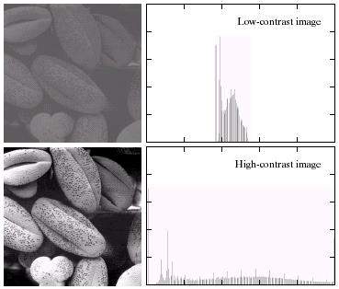
Obtain contrast information from histogram

Slide 6
Histogram: implementation issue
Divide the range of gray levels (ex. 0~255)
  Number of bins
  Position of bins specified in a vector
10 bins
5 bins

Slide 7
Histogram: normalization
no. of
occurrence
no. of occurrence
=prob.
total pixels
gray level
gray level

Slide 8
Histogram equalization 均化
Goal: produce an uniform histogram
  Find a transformation: s=T(r)
uniform
0
1
0
1

Slide 9
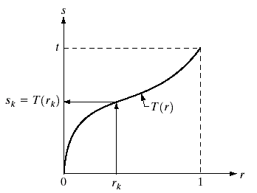
Histogram equalization(cont.)
Cumulative function of
histogram
1
Ideal cumulative func.
0.5
Prob.
0.5
0.5
0
1
0
0.5
1
Ideal uniform histogram

Slide 10
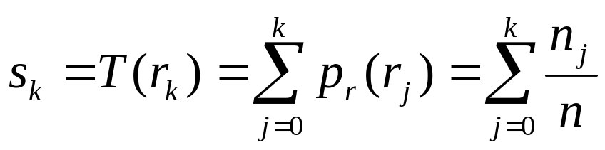
Histogram equalization: discrete solution
Probability (normalized histogram) of gray level r_{k}
  p(r_{k})=n_{k}/n, k=0,1,2,…, L-1
Discrete version of CDF (cumulative distribution function)
<1

Slide 11
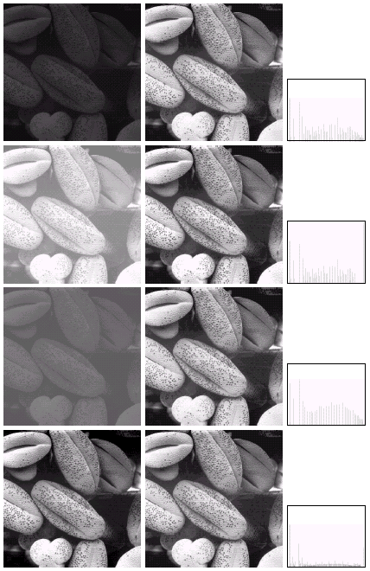
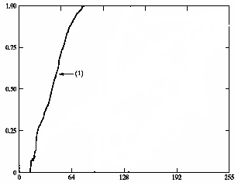
Example: histogram equalization

Slide 12
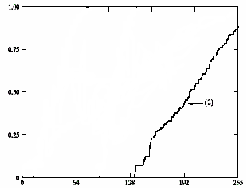

Slide 13
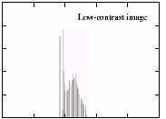
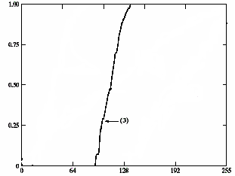

Slide 14
Histogram Processing
Histogram equalization
Histogram matching
Local enhancement
Use of histogram statistics

Slide 15
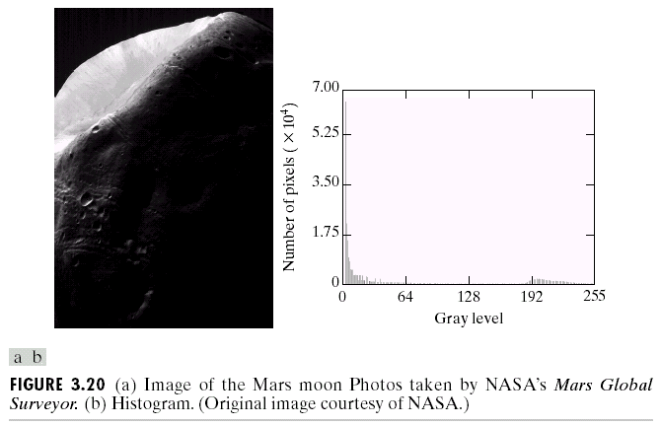
Histogram matching: original image

Slide 16
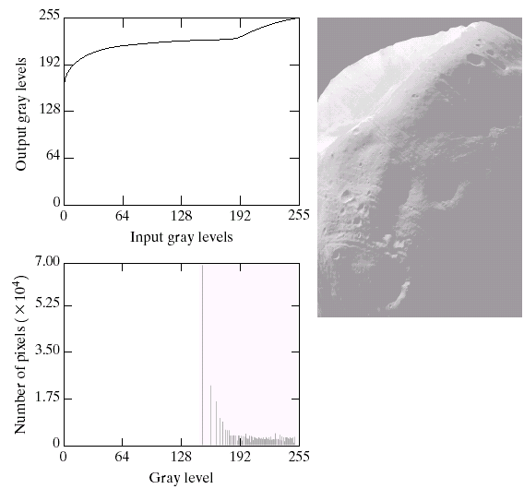
Histogram equalization result
Histogram
Equalization
function
Equalized
histogram
After equalization

Slide 17
Histogram matching
The desired shape of histogram is specified (not necessarily uniform)
Derivation of histogram matching function:
z=G⁻¹(T(r))
z
desired
s
uniform
r
input
z=G⁻¹(s)
s=T(r)
histogram
equalization
histogram
equalization
s=G(z)

Slide 18
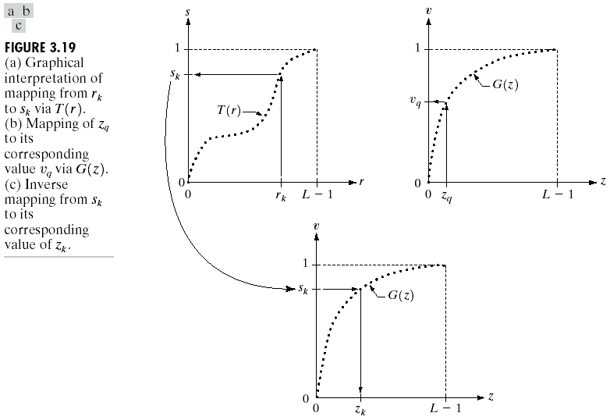
Original -> uniform
(equalization)
desire -> uniform
(equalization)
Inverse
function
of G

Slide 19
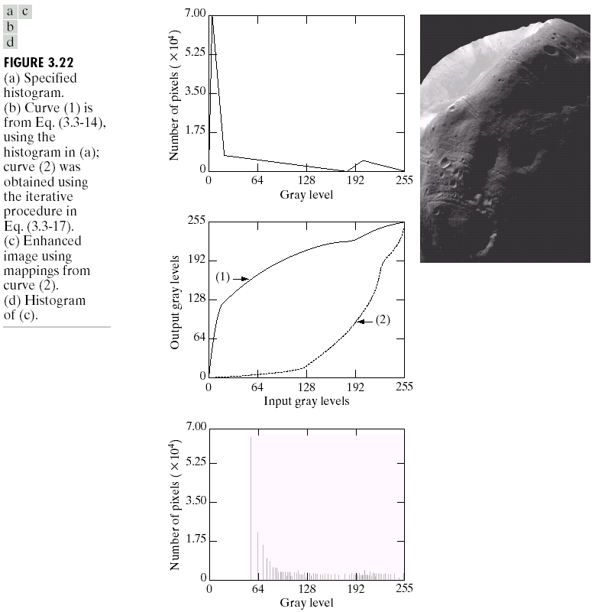
Histogram matching result
Desired histogram
After histogram
matching
G
G⁻¹

Slide 20
Histogram Processing
Histogram equalization
Histogram matching
Local enhancement
Use of histogram statistics

Slide 21
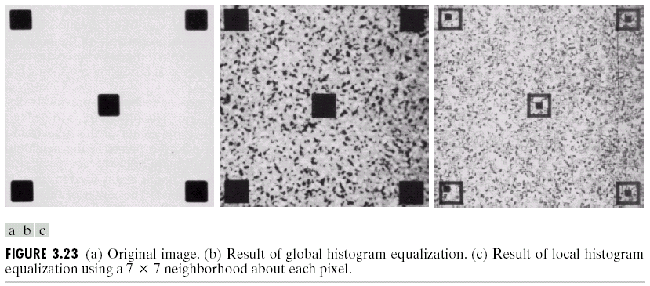
Local enhancement
Global: entire image
Local: neighborhood of each pixel
Original image
Global equalization
7x7 neighborhood
local equalization

Slide 22
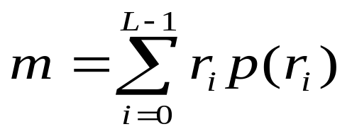
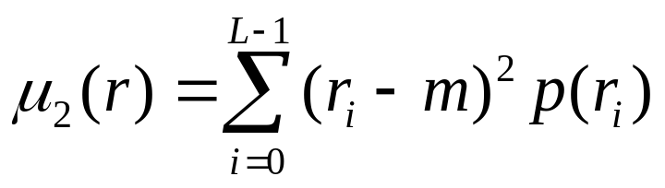
Histogram statistics
Take pixel value r as a random variable
Some measure about pdf
Normalized histogram of an image
=> probability distribution function of r
mean
variance
mean => average gray level
variance => average contrast

Slide 23
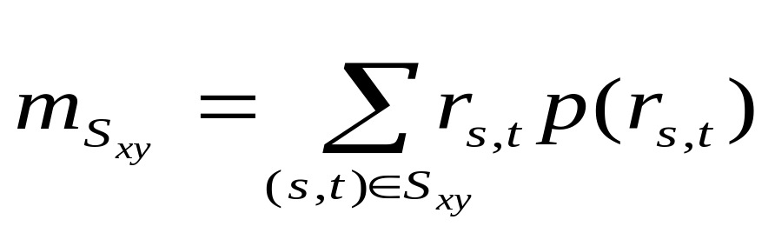
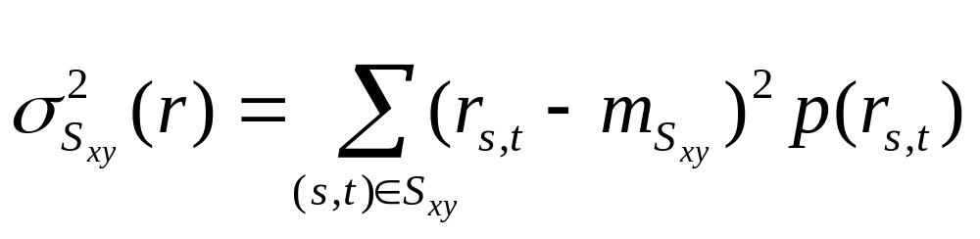
Histogram statistics (cont.)
Local measurement: S_{xy} neighborhood
mean in S_{xy}
variance in S_{xy}

Slide 24
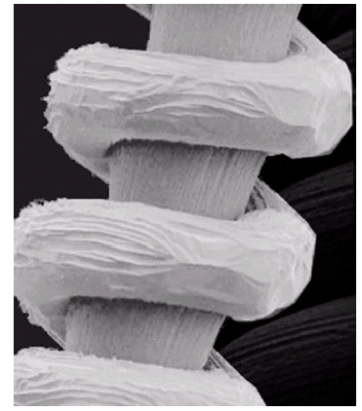
Application of histogram statistics: example
Globally, this image is light
However, some dark
background object is
unseen
鎢絲及其支柱的放大影像

Slide 25
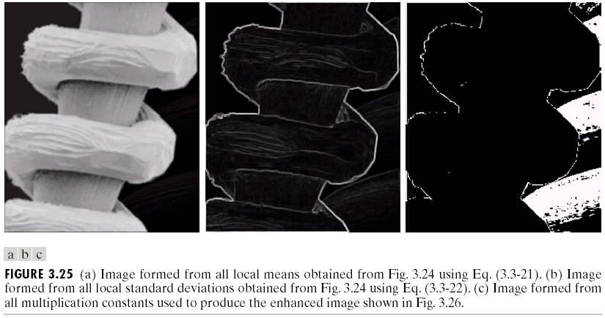
Histogram statistics: example
Calculate local statistics in 3x3 region
local mean
local standard deviation

Slide 26
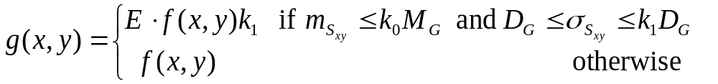
Histogram statistics: example
Local enhancement
像素平均值小
但是標準差大
enhanced
pixels

Slide 27
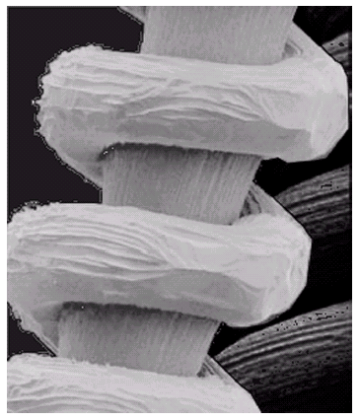
Histogram statistics: example
original
enhanced

Slide 28
Outline: spatial domain
Histogram processing
Spatial filtering 空間濾波
  Smoothing filter
  Ordered statistics filter
  Sharpening filter

Slide 29
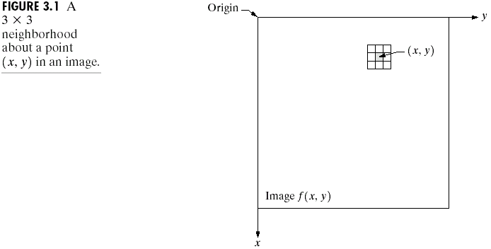
Basics of spatial filtering
g(x,y)=T[ f(x,y) ]
T operates on a neighborhood

Slide 30
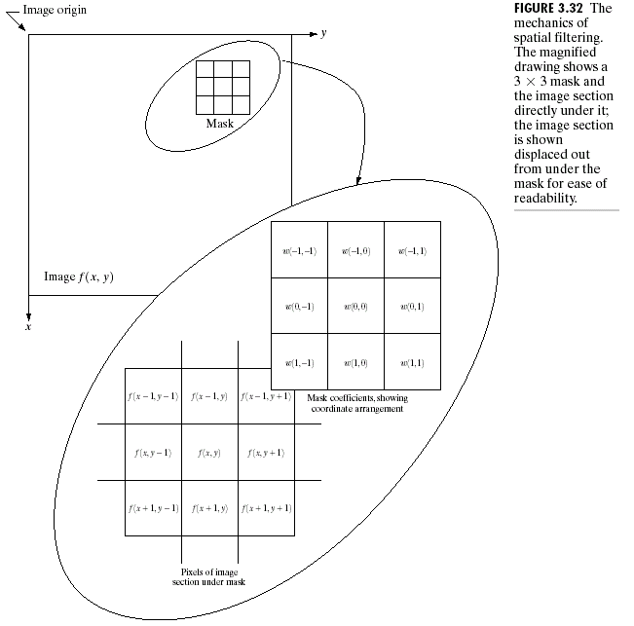
mask coefficients
X (product)
output
underlying neighborhood

Slide 31
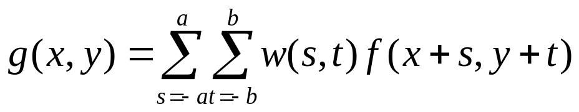
Basics of spatial filtering
Mathematical formula
Border issues
  Operate inside only
  Discard the mask at border
  Padding at image boundaries
    zero padding
    extension
convolution

Slide 32
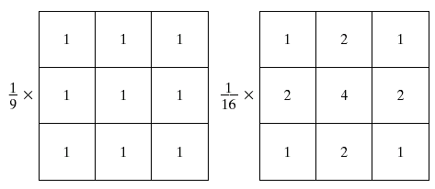
Smoothing spatial filtering
Used for blurring and for noise reduction
Smoothing linear filters
  Average filters, low-pass filters
average filter
weighted filter
這兩個效果差不多
因為3x3太小

Slide 33
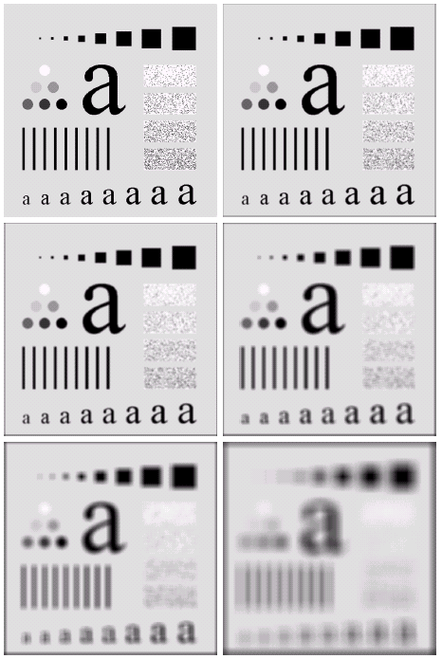
original
3x3
noise
reduced
5x5
9x9
small area
blended into
background
15x15
35x35
border
effects

Slide 34
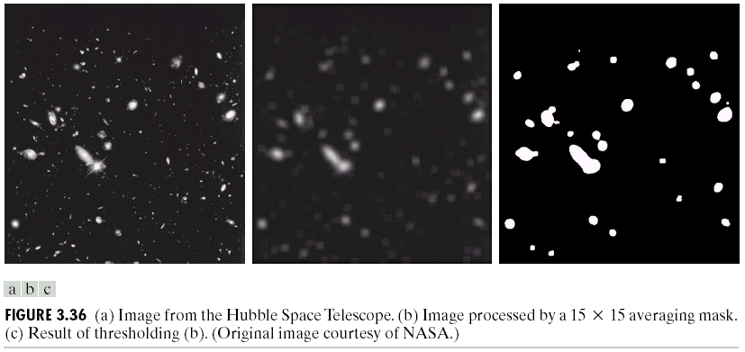
Smoothing: example
15x15 smoothing
thresholding

Slide 35
Order-statistics filters
Pixel neighborhood
f1 f2 f3
f4 f5 f6
f7 f8 f9
sort
f4 f3 f7 f6 f8 f2 f1 f9 f5
increasing order
min
filter
median
filter
max
filter
remove isolated
high(low) pixels

Slide 36

Median filter: example
original
3x3 average
3x3 median
salt-and-pepper noise

Slide 37
Outline: spatial domain
Histogram processing
Spatial filtering 空間濾波
  Smoothing filter
  Ordered statistics filter
  Sharpening filter

Slide 38
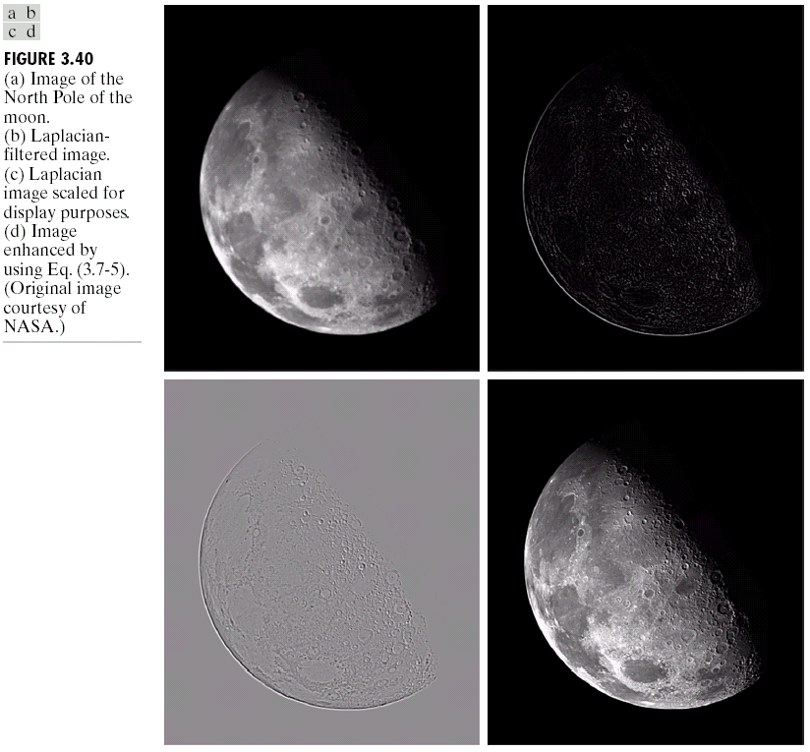
Sharpening filtering: example
original
Edge detection
scaled
sharpened

Slide 39
Sharpening spatial filters
Goal
  highlight fine detail in an image
    Spatial differentiation 微分
    Digital implementation => difference 差分
  de-emphasize regions with slowly varying gray levels

Slide 40
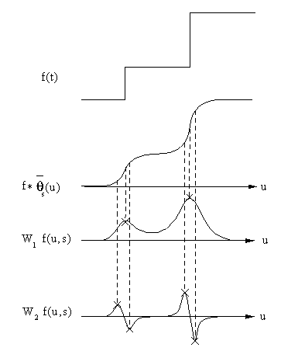
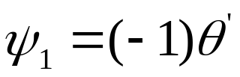
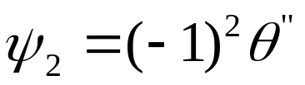
smooth

Slide 41
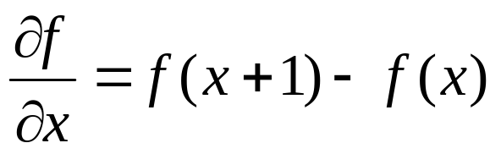
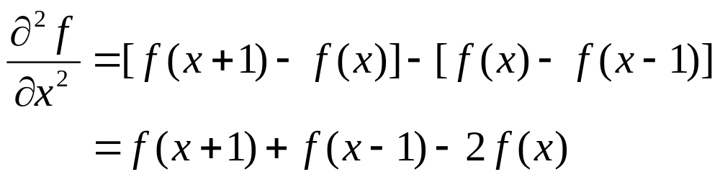
Sharpening: foundation
First and second-order derivatives in digital form => difference
一次微分
二次微分

Slide 42
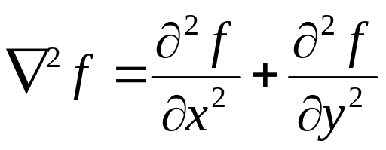
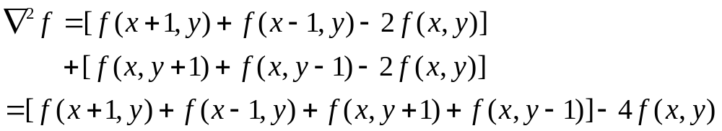
2nd derivatives for image
2-D 2nd derivatives => Laplacian
=>discrete formulation

Slide 43
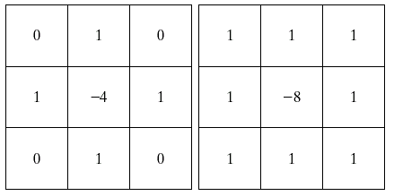
Definition of 2nd derivatives in filter mask
45⁰ rotation
invariant
(include
Diagonals)
90⁰ rotation
invariant
-
-
-
-
-
4
-
-
8
-
-
-
-
-

Slide 44
Laplacian filtering: example
original
Laplacian filtered image

Slide 45
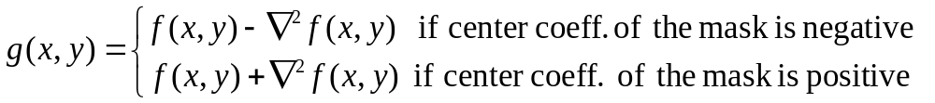
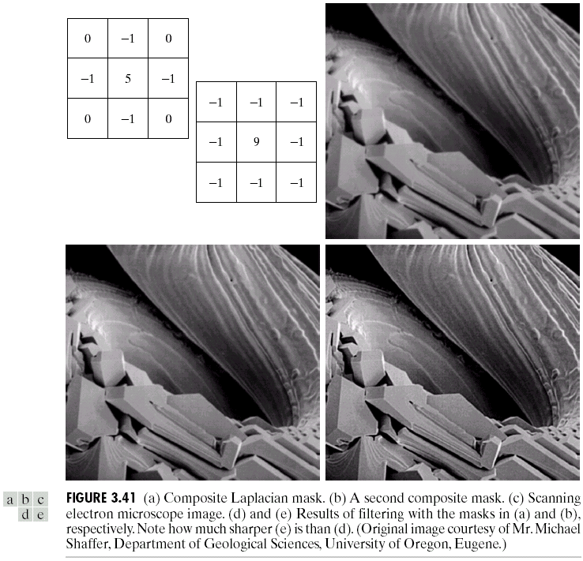
Sharpened result = original + Laplacian filtered image
original image
filtered image
=> resulting mask

Slide 46
Laplacian filtering: example
original
Laplacian
scaled
sharpened

Slide 47
original
right
mask
left
mask

Slide 48
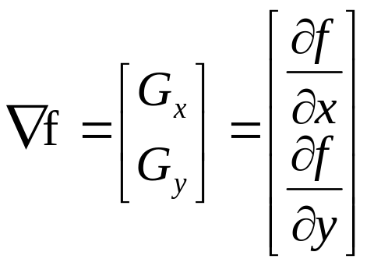
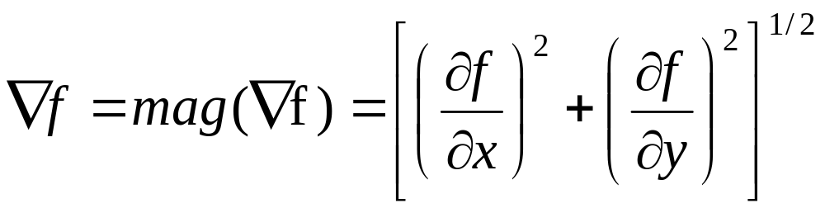
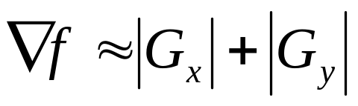
Use of 1st derivative: Gradient
Gradient
Magnitude of gradient
Simplified form =>

Slide 49
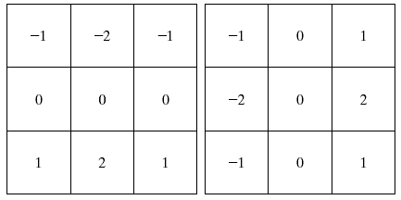
Definition of 1st derivative in mask filters
Sobel operators

Slide 50
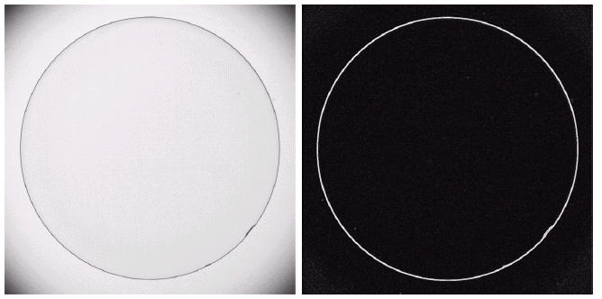
Gradient: example
*enhance defects and eliminate slowly changing background
original(contact lens)
Sobel gradient
defects

Slide 51
Summary
There is no general theory
Representative of spatial domain techniques
Learn the foundation, terminology, and some basic tools for image processing

