Slide 1
Basic Pixel Operations
CSC391/691
Fall 2016

Slide 2
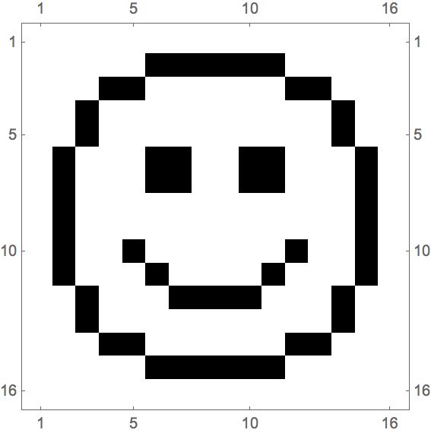
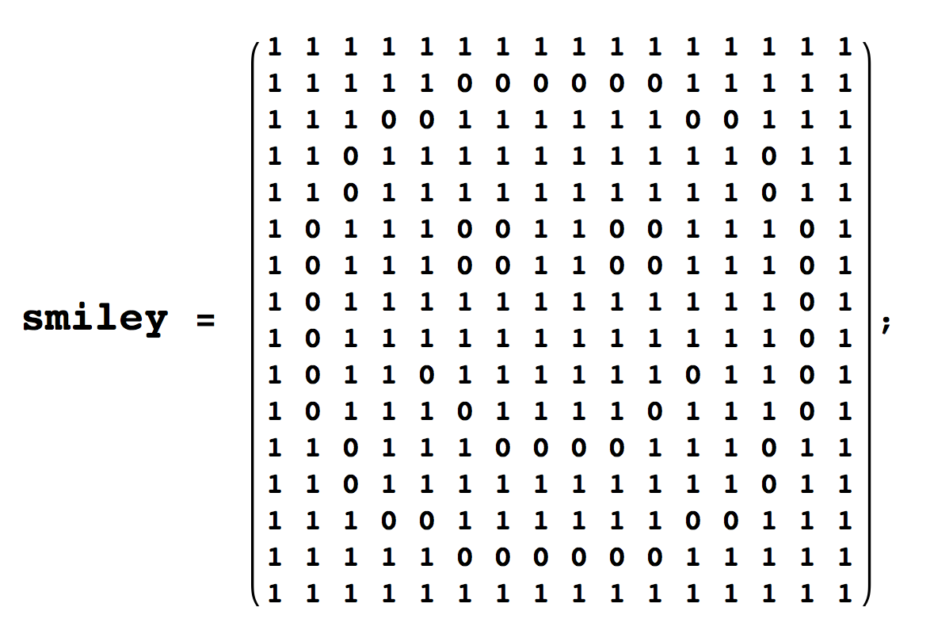
Digits to Image
?
Behind the scene:
Tune pixels’ brightness according to their values.

Slide 3
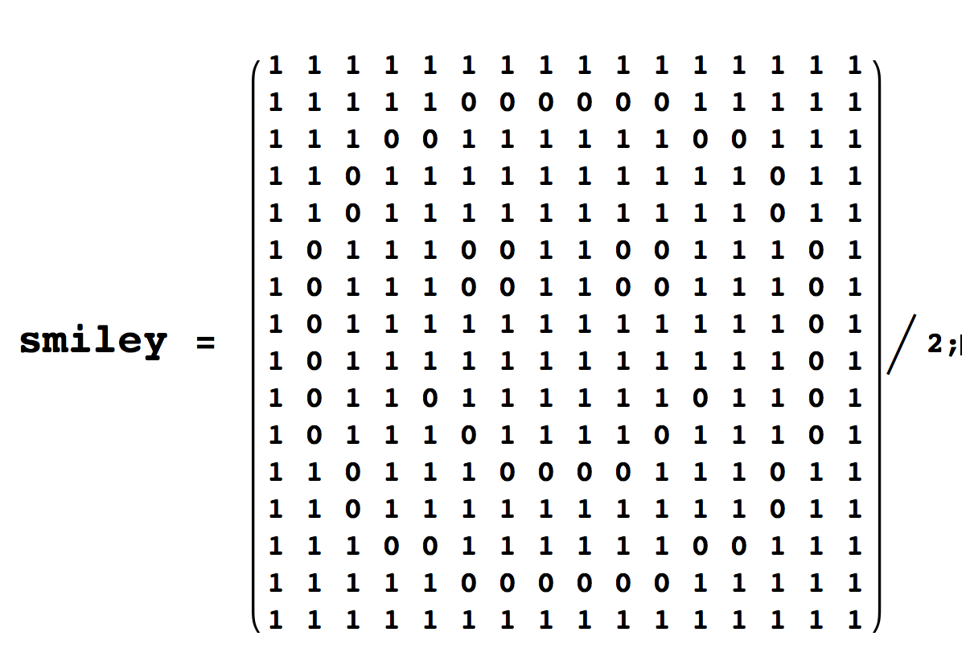
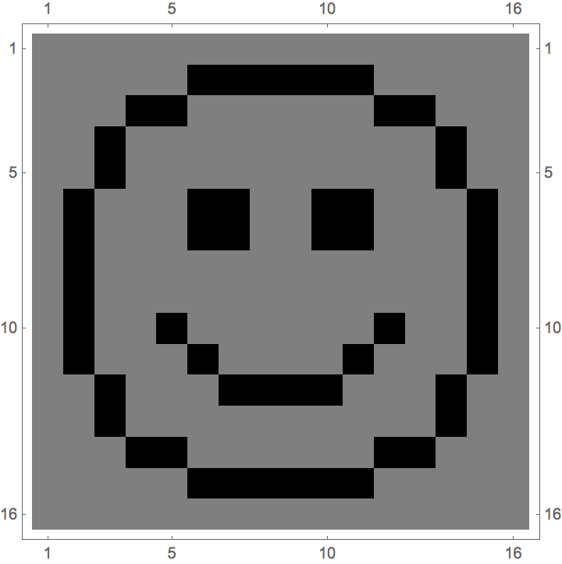
Division
?
Behind the scene:
smiley/2
Contrast is reduced!
Notes:
What about multiply? What if brightness becomes too large?

Slide 4
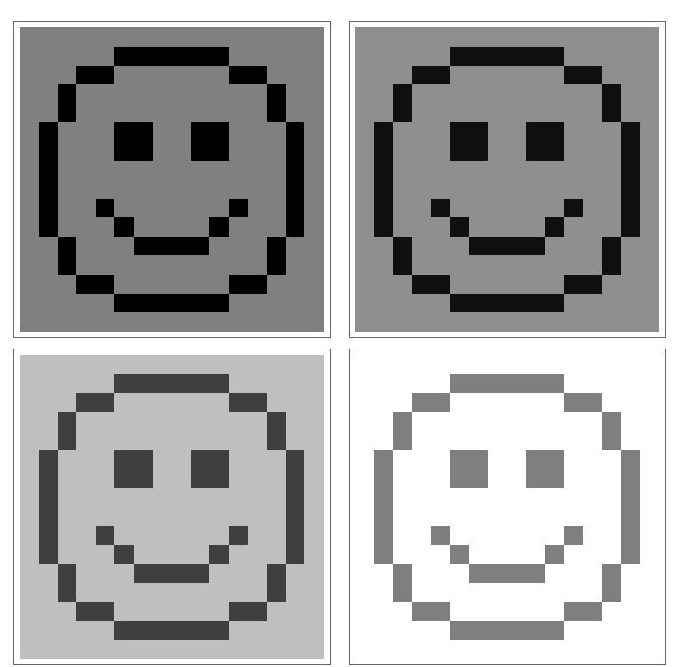
Brightness
Behind the scene:
smiley + brightness/2
Notes:
What if brightness becomes too large?

Slide 5
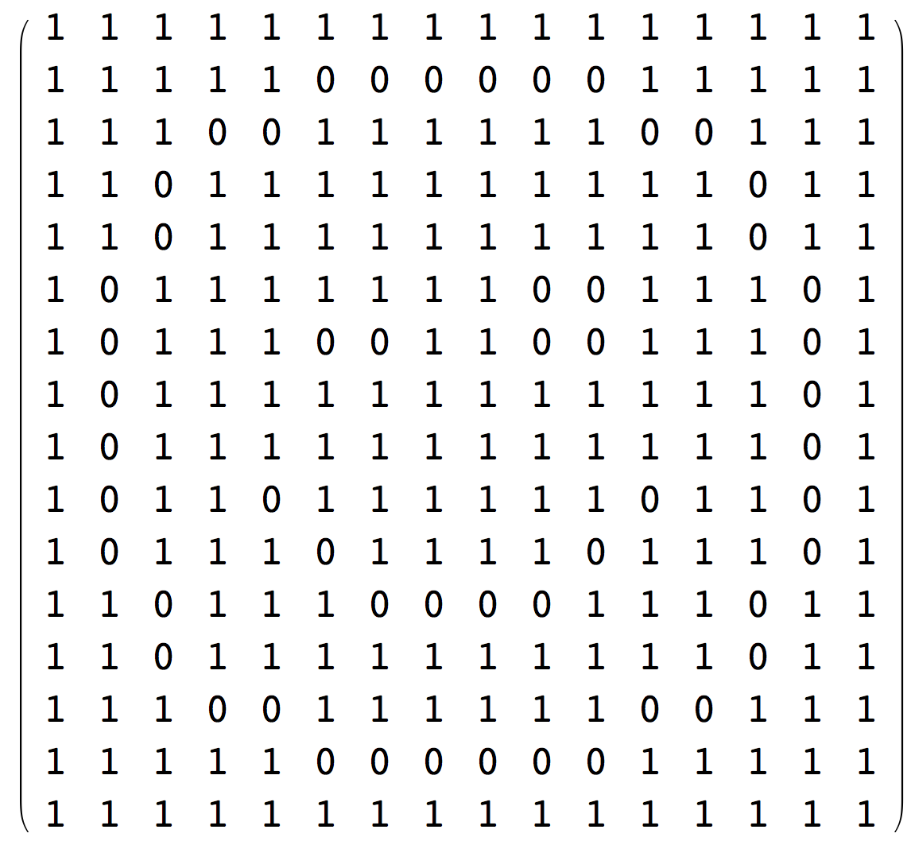

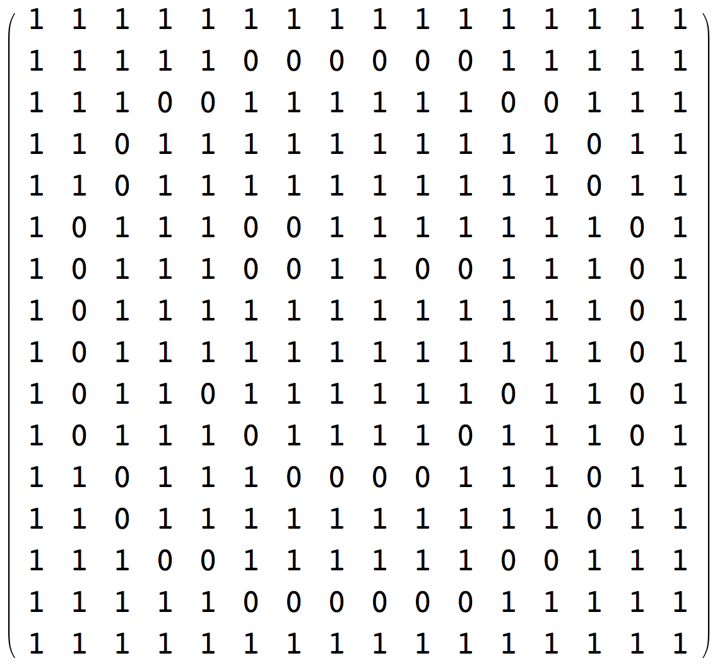

Flipping
Behind the scene:
Indexes are flipped!

Slide 6
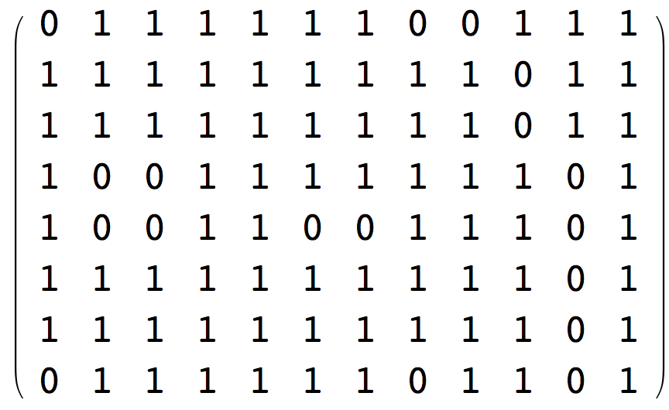
Cropping
Behind the scene:
Change the range of indexes

Slide 7



Rotation?
VS
Behind the scene:
Defining rotation center
Trigonometric functions, rotation matrix
Rounding error, aliasing
Defining the color of new area, or proper cropping
More complex than it looks(Parralization!)
Notes:
Some editor doesn’t provide straighten tool.
The length of Mario’s legs when walking?

Slide 8
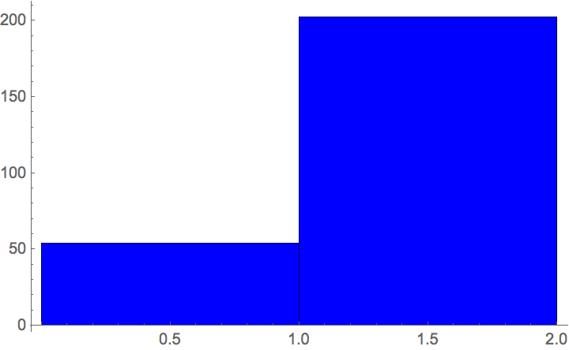
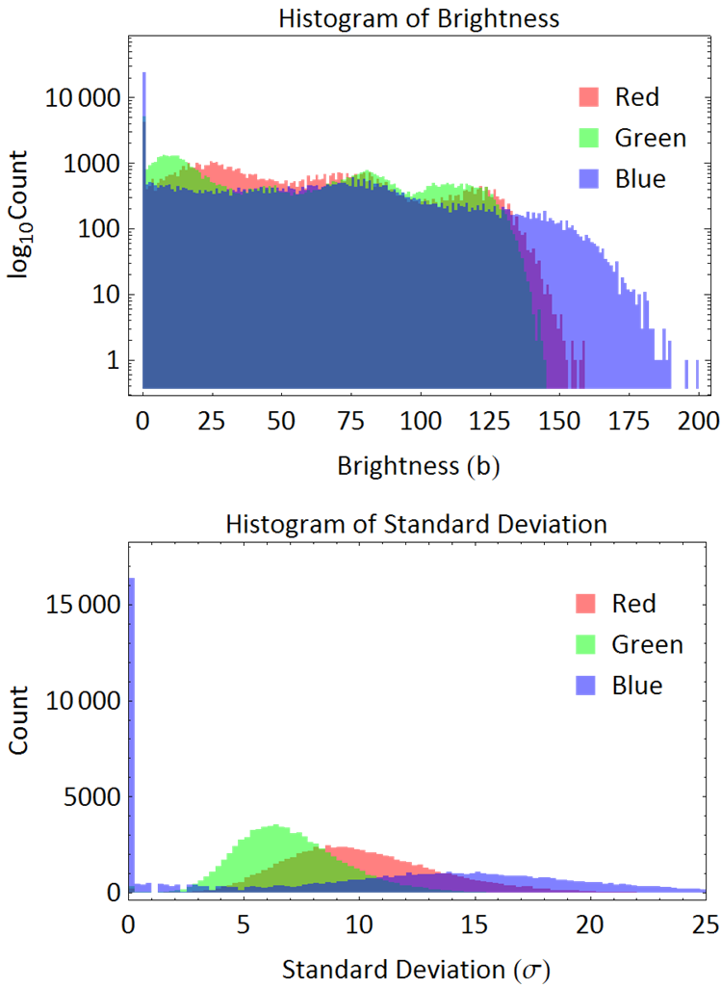
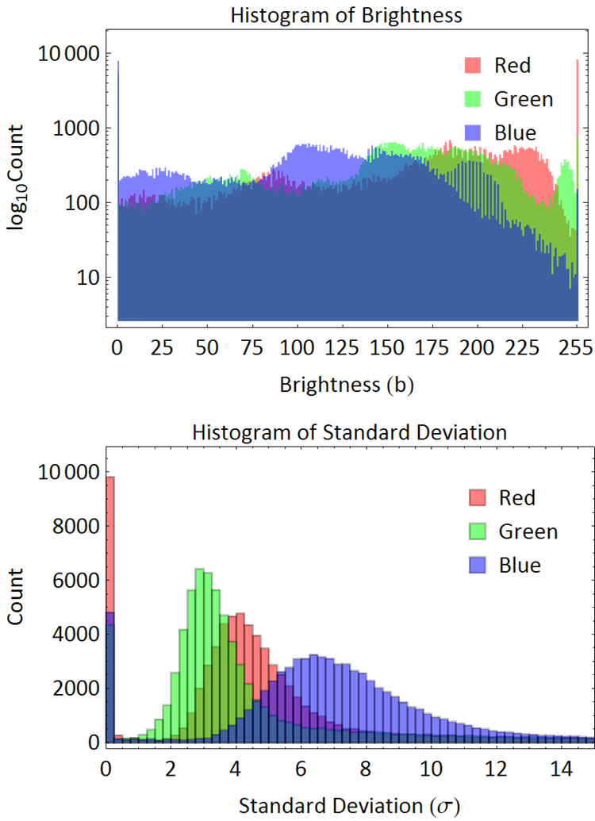
Global Statistics
Histogram:
Standard Deviation: 0.408773
Notes:
Randomness

Slide 9
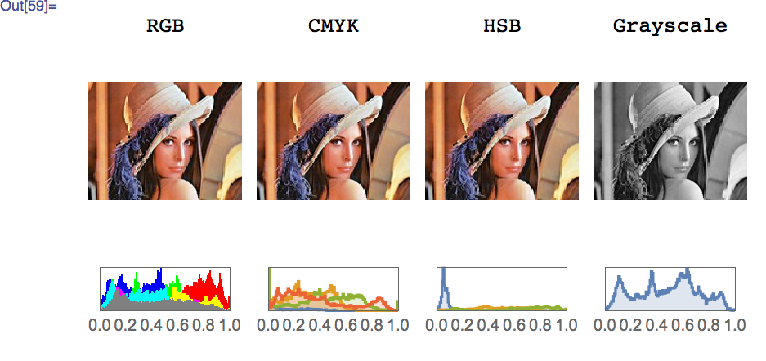
Color Space and Channels
Notes:
cyan, magenta, yellow and key
Web safe color

Slide 10
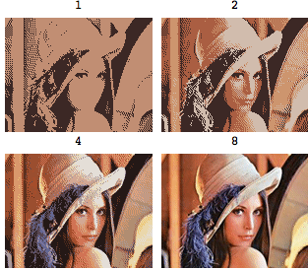
Color Depth
Possible brightness = 2^bits
2^1=2
2^2=4
2^4=16
2^8=256
Real [0,1] vs Int [0,255]?
0.125 vs 31
0.1255 vs 31.5
Behind the scene: Floor[brightness/(2^bits)]*(2^bits)
More bits, more information!
Note: This image has 3 channels
Notes:
32.128
Discrete nature of digital images

