Slide 1
Image Segmentation Based on Color

Slide 2
Image Segmentation
Segmentation is a process that partitions an image into regions.
Segmentation subdivides an image into its constituent regions or objects.
The Level of detail to which the subdivision is carried depends on the problem being solved.

Slide 3
Image Segmentation
Image segmentation, based on color, can be achieved by 2 methods:
1) Segmentation in HSI Colour Space
A Thresholding function based on colour information in H and S components.
We rarely use I component for colour image segmentation.
2) Segmentation in RGB Vector space
A thresholding function based on distance in a colour vector space.

Slide 4
The HSI Colour space
The HSI colour model represents every colour with three components:
Hue ( H )
Saturation ( S )
Intensity ( I )
The Hue component describes the colour itself in the form of an angle between [0,360] degrees. 0 degree mean red, 120 means green 240 means blue. 60 degrees is yellow, 300 degrees is magenta.
The Saturation component signals how much the colour is polluted with white colour. The range of the S component is [0,1].
The Intensity range is between [0,1] and 0 means black, 1 means white.

Slide 5
Segmentation in HSI Colour Space
Colour Image Hue
1
2
3
4
Saturation Intensity

Slide 6
Segmentation in HSI Colour Space
Binary thresholding of S component with T = 10%
Product of 2 and 5
5
6
7
8
Histogram of 6
Segmentation of red color pixels

Slide 8
Procedure:
Suppose that it is of interest to segment the reddish region in the lower left of the image.
The 2nd,3rd, and 4th images are its HSI component images. Note that by comparing 1 and 2 the region of interest has relatively high values of hue, indicating the colors are on the blue-magenta side of red.
The 5th image shows a binary mask generated by thresholding the saturation image with a threshold value of 10% of the maximum value in that image. Any pixel value greater than the threshold value was set to 1 (white). All others were set to 0 (black).

Slide 9
Procedure:
The 6th image shows the product of the mask with the hue image while the 7th image is a histogram of the product image
We see in the histogram that the high values (the values that are of interest) are grouped at the very high end of the gray scale, near 1.0
The result of thresholding the product image with threshold value of 0.9 resulted in the binary image in the last, i.e. 8th image.
The spatial location of the white points in the image identifies the points in the original image that have the reddish hue.

Slide 10
Drawbacks:
This method is far from perfect there are points in the original image that we certainly would say have a reddish hue, but were not identified.
The regions shown in the final image are about the best that this method can achieve.

Slide 11
SEGMENTATION IN RGB VECTOR SPACE

Slide 12
RGB Color Model
In RGB model each color appears in primary spectral color
Red (R)
Green (G)
and Blue (B)
The Model is based on Cartesian Co-ordinate System
Different colors are on the cube or inside the cube which are represented by RGB vectors
Primary color values RGB are located at three corners , Secondary colors cyan, magenta and yellow are at other three corners whereas black is located at origin and white is located farthest from origin

Slide 13
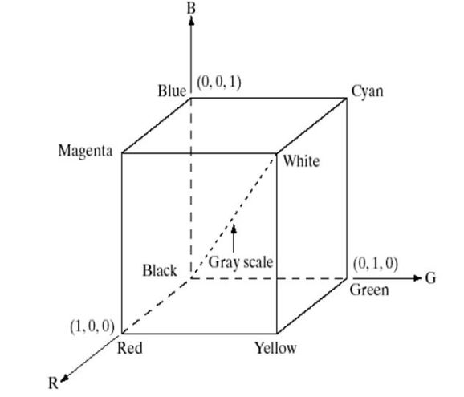
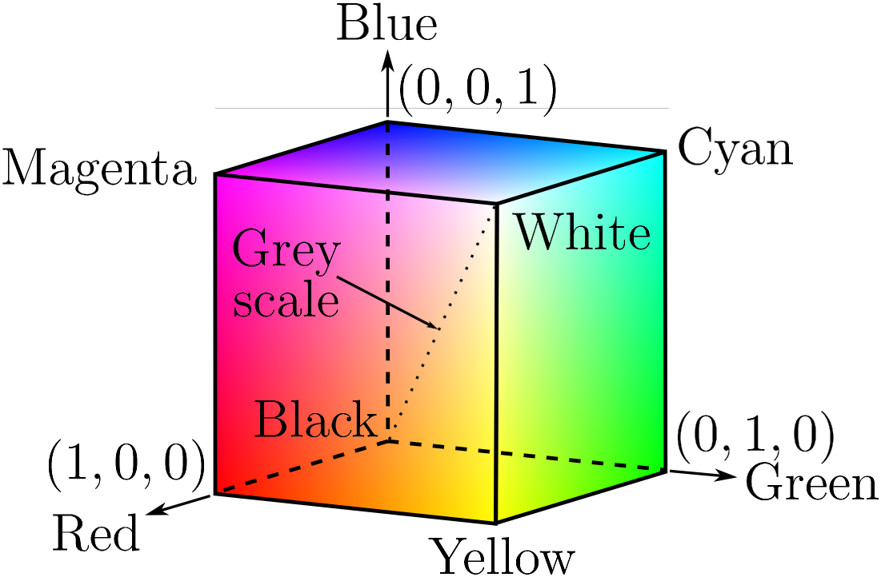

Slide 14
Images represented in RGB color model consists of three component images one for each primary color
These images are combined to create composite color image
The number of bits used to represent each pixel in RGB space is called pixel depth
If in an RGB image in which each of the red, green and blue images is an 8-bit image then the RGB color pixel is said to have a depth of 24 bits
The total number of colors in a 24 bit RGB image is (2⁸)³ = 16,777,216

Slide 15
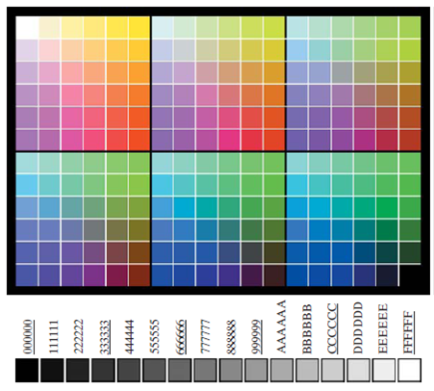
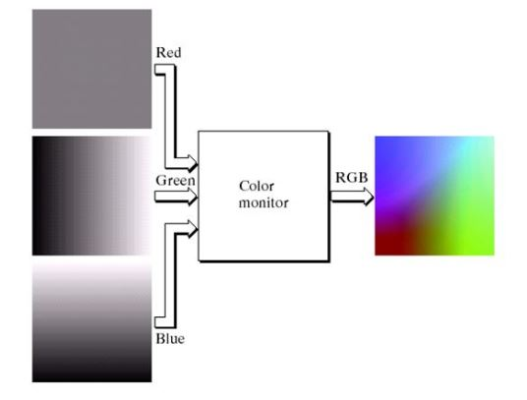

Slide 16
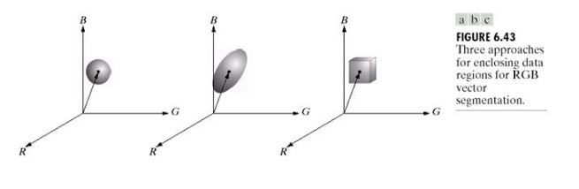
Color Segmentation in RGB Vector Space
The Objective is to segment objects of specified color range in an RGB image

Slide 17
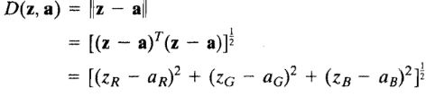
Steps for Segmentation in RGB Vector Space
Obtain estimate of the “average” color that needs to be segmented (denoted by a)
Classify each RGB pixel in a given image whether it falls in that specified range
In Order to check whether image lies within that range Euclidean Distance is used
Formula for Solid Sphere
Here z is an arbitrary point in RGB space and the subscripts R,G and B denote RGB components of vectors a and z

Slide 18

If D(z,a) <= D₀ here D₀ is radius of solid sphere
then points are contained within sphere else points are outside sphere
Generalized Formula for 3-D elliptical body
Here C is the covariance matrix of the samples representative of color we wish to segment
Similarly
If D(z,a) <= D₀
then points are contained within the elliptical body else points are outside the elliptical body

Slide 19
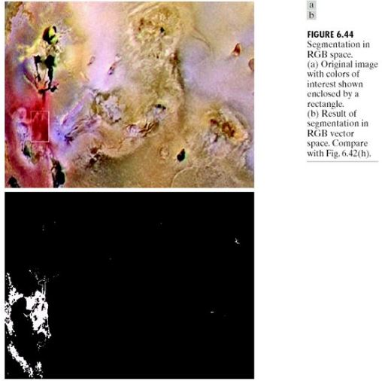

Slide 20
Color Edge Detection
Computing edges directly on an individual image basis, instead of computing edges directly in color vector space.
Edge detection by gradient operators will not work on these images as the gradient is not defined for vector quantities.
Since gradient is define only for a scalar image, there is no concept of gradient for a color image.
We can’t compute gradient of each color component and combine the results to get the gradient of a color image.

Slide 21

Color Edge Detection
We must define the gradient (magnitude and direction) of the vector c in the equation:
One way to compute the maximum rate of change of a color image which is close to the meaning of gradient is to use the following formula: Gradient computed in RGB color space:

Slide 22
Value of the rate of change at (x,y) in the direction of θ(x,y) is given by

Slide 23
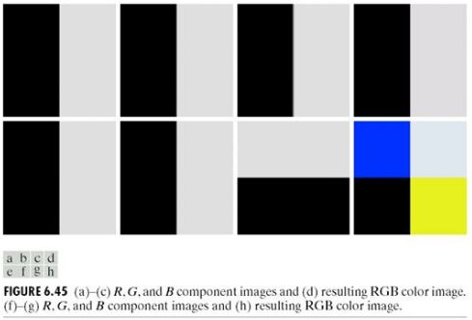

Slide 24
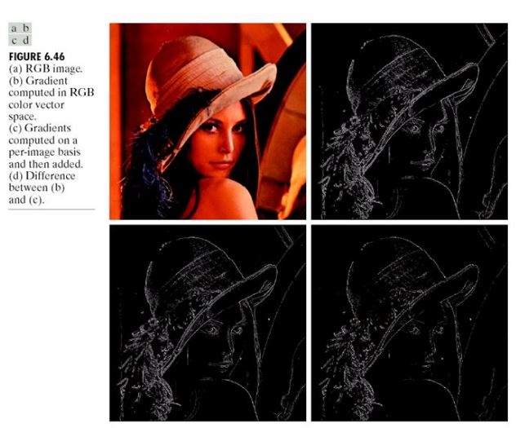

Slide 25
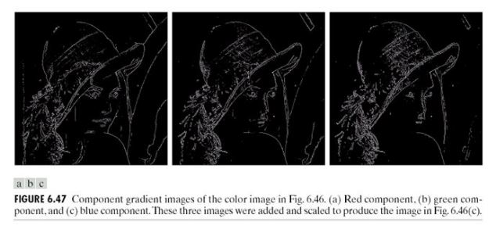

Slide 26


