Slide 1
Thresholding

Slide 2
Definition
Thresholding is the simplest method of segmenting images.
The threshold of image intensity (relative image lightness) is set manually at a specific value or automatically set by an application.
An image processing method that creates a bitonal (aka binary) image based on setting a threshold value on the pixel intensity of the original image. While most commonly applied to grayscale images, it can also be applied to color images.

Slide 3
How it work
Grey scale or colour image
Segmentation
Black and white pixels
Intensity threshold

Slide 4
Types of thresholding
- Band Thresholding
- Semi Thresholding
- Adaptive Thresholding
- Multi-spectral Thresholding

Slide 5
1.
Band Thresholding

Slide 6
Band Thresholding
Similar to basic thresholding, but has two threshold values and set the pixel
Value between minimum or maximum.
Histogram does not need to be divided into more than two to do correct.
It is the only method by which you get a correct result

Slide 7

In band thresholding two thresholds are used, one below and one above the object pixels:

Slide 8
In OpenCV, band thresholding can be implemented as follows:
threshold (image, binary_image1, low_threshold, 255, THRESH_BINARY);
threshold (image, binary_image2, high_threshold, 255,THRESH_BINARY_INV);
bitwise_and (binary_image1, binary_image2, band_thresholded_image);

Slide 9
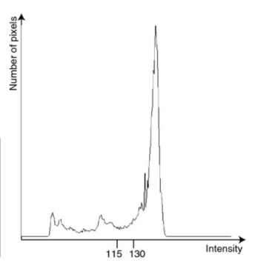
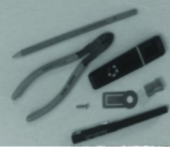
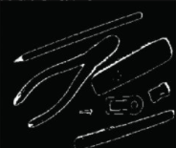

Slide 10
2.
Semi Thresholding

Slide 11
Semi thresholding is where object pixels retain their original grey-scale and background pixels are set to black.
g(i, j) = { f(i, j) for f(i, j) ≥ Threshold ,
0 for f(i, j) < Threshold .

Slide 12
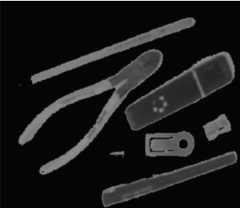
Semi-thresholding, to suppress background, useful in cases in which image is analysed by a human

Slide 13
In OpenCV, band thresholding can be implemented as follows:
threshold (gray_image, binary_image, threshold, 255, THRESH_BINARY);
bitwise_and (gray_image, binary_image, semi_thresholded_image);

Slide 14
Adaptive Thresholding

Slide 15
It’s used to solve the problem of a simple threshold were the problem for the different region which has different lighting values
Based on a small region around it.
Determines the threshold for a pixel
Different thresholds for different regions

Slide 16
Syntax

Slide 17
AdaptiveThreshold(src, dst, maxValue, adaptiveMethod, thresholdType, blockSize, C)
Max
Value
Dst
Parameters
Src
Adaptive
Method

Slide 18
Types of Adaptive Thresholding

Slide 19
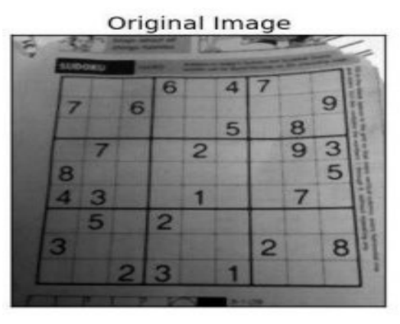
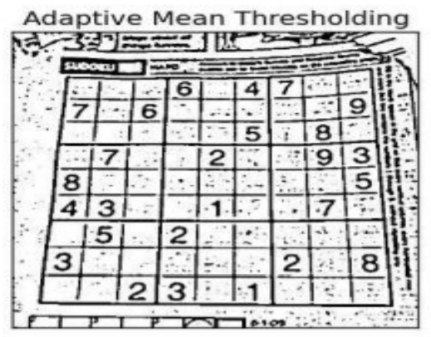
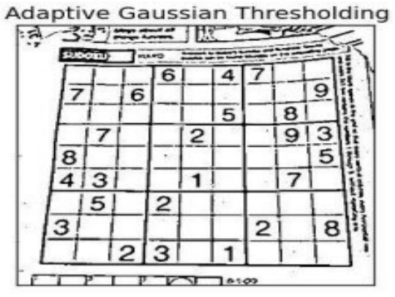
1
Adaptive Mean thresholding
2
Adaptive Gaussian thresholding

Slide 20
Code & Output

Slide 21
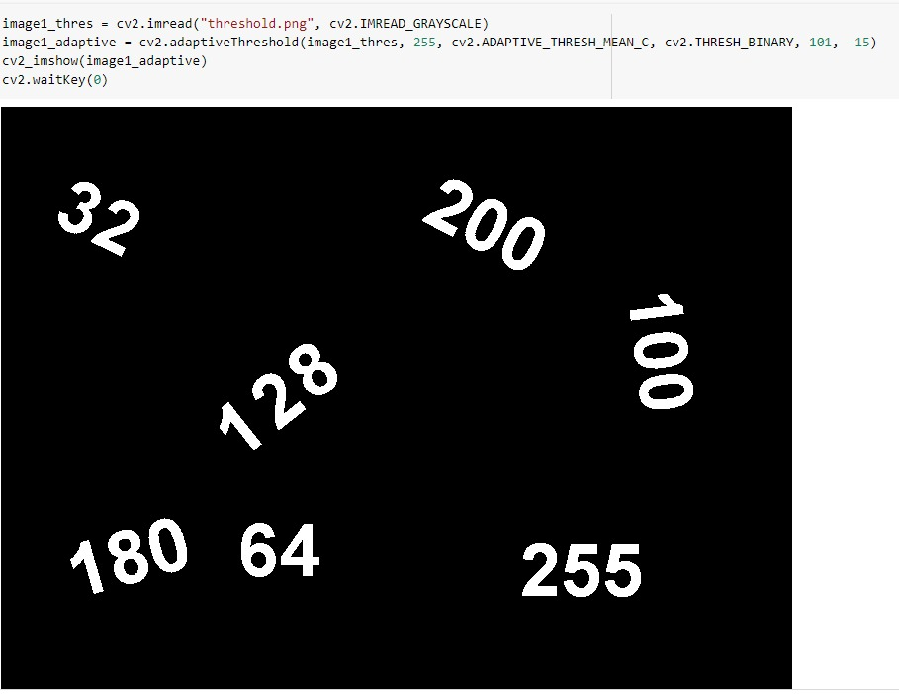

Slide 22
Multispectral Thresholding

Slide 23
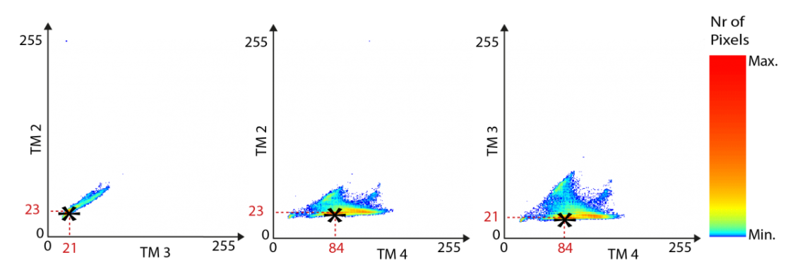
To do the thresholding jointly with several bands and in each of the bands, for visualizing this, we call it as multispectral thresholding.
Scattergram is used.

Slide 24
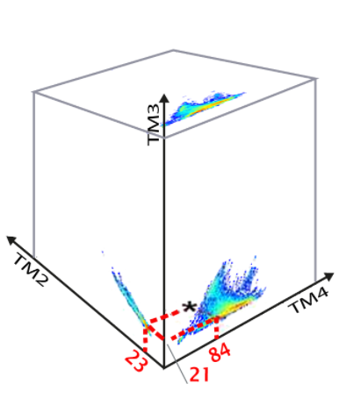
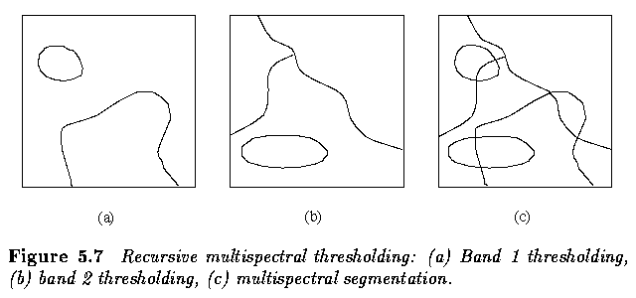

Slide 25
01
02
03
Initialize the whole image as a single region.
Compute a smoothed histogram for each spectral band.
Repeat step(2) for each region of the image until each region's histogram contains only one significant peak

Slide 26
THANKS!

