Slide 1

Application Password and Profile Management

Slide 2
About me
I am from B.Tech E.E.E, 2022 Pass Out.
I joined Data Analysis course, as Future is going to revolve around Data.
There is going to be a lot of data generated and necessity to deal with it.
2.7 years experience in React Native as Associate Software Developer.
LinkedIn
https://www.linkedin.com/in/venkata-srikar-potharaju-1746b2218/
Github:
https://github.com/vksrikarp

Slide 3
Agenda
Business problem
Introduction
Objective of the Project
Problem Statement
Concepts Used
Working of the System
Working Of Methods
Execution of Code
Conclusion
Q&A Slide

Slide 4
Business problem:
Business Problem
In many small organizations and training institutes, user profile management is often done manually or with unstructured systems.
Problems include:
Duplicate user registration
Weak password usage
Poor password update practices
Incomplete user profile data
This creates inconsistency, security risks, and poor user experience.

Slide 5
Problem Statement:
Problem Statement
Traditional user data handling often lacks:
password security rules
centralized record control
This project solves that by creating a structured Python-based user management system with password and profile controls.

Slide 6
Objectives:
Develop secure user registration system
Prevent duplicate usernames
Implement password strength validation
Enable OTP-based password change
Manage user profile fields dynamically
Apply OOP concepts in a practical project

Slide 7
Concepts Used:
Data Types
Conditional Statements
Loops
Functions
Dictionaries and List of Dictionaries
OOP Concepts:
Encapsulation
Inheritance
Abstraction
Class Method

Slide 8
Introduction:
This project provides a console-based Password and Profile Management System developed using Python.
It allows:
user registration
secure login
password validation and password change
profile update
The project is developed using Object-Oriented Programming principles for modularity and reusability.

Slide 9
System Architecture:
User → Registration/Login → Password Manager → Profile Manager → Dataset Update
Class Structure:
Innomatics ↓ Personal Account Manager ↓ Profile Management

Slide 10
Working of Program
User chooses operation from menu
Registration checks duplicate username
Default password generated
Login verifies credentials
Password can be changed using OTP
Profile fields updated one by one

Slide 11
Menu Flow Execution
Register
Login
Change Password
Edit Profile
Show Details
Logout
The system runs continuously in a while loop until logout.

Slide 12
Working of Methods
user_registration() → creates new user
login() → verifies credentials
changePassword() → validates strength + OTP
setName(), setEmail(), setAddress(), setPhoneNumber(), setUsername(), setCourseEnrolled() → updates fields
show_details() → displays profile in table format

Slide 13
User Registration:
New User Registration:
User provides name and username.
A default will be generated specifically `Inno@username2026`.
User is created in dataset.

Slide 14
Login of User
User’s presence is first checked in dataset.
If User is present in dataset, provided username and password are cross checked.
If credentials are matching user logs in successfully.
Further Operations are based on login.

Slide 15
Password Manager (Change Password)
Password must contain:
At least 1 special character
At Least 1 capital letter
At least 1 number
At least 1 lowercase letter

Slide 16
Password Manager
Strength Levels:
Weak
Moderate
Strong
Weak passwords are rejected until valid password is entered.
Password is changed after entering the otp.

Slide 17
Profile Manager
Profile Fields that can be edited:
Name,
Username,
Password (Not displayed when chosen show details option),
Email,
Address,
Phone Number,
Course Enrolled

Slide 18
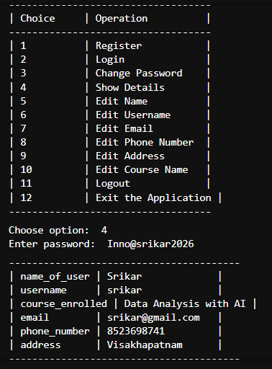
Show Details
Details are password protected.
Current User details are shown in
a tabular manner.

Slide 19
Logout
After Every operation User can opt to Logout.
Logout would not wipe the user’s data.
User has to login again to opt for any operation.

Slide 20
Future Enhancements:
Future Enhancements
Database integration
Password hashing
Email OTP
Profile Progress Percentage
Role-based dashboard
Login attempt restriction

Slide 21
Limitations:
Limitations
Console-based only
No database yet
Password stored in plain text
No session persistence

Slide 22
Conclusion
This project demonstrates how Python OOP can be applied to solve a real user authentication and profile management problem.
It integrates password control, profile tracking, and menu-driven execution in a structured and reusable way.

Slide 23
Q&A

Slide 24

THANK YOU

