Slide 1
Fermi motion in untagged J/ψ photoproduction on the deuteron
Bremsstrahlung beam from the 5 cm target · spectator model of the deuteron · yield ratio to a free neutron at rest
V. Kubarovsky, Jefferson Lab · 27 September 2026 · generator exclurad_py, branch jpsi-fermi, module generator/photo.py
0.994 ± 0.0003
2.55 %
60 M events
yield per neutron, deuteron / free neutron, E_γ > 8.6 GeV: Fermi motion changes it by less than 1 %
of the J/ψ yield on the deuteron comes from photons below the free threshold 8.20 GeV
three 20 M-event samples (deuteron, free n, free p), 35 minutes on ten cores, zero majorant violations

Slide 2
The generator: untagged photoproduction γ N → J/ψ N
No scattered electron in the event. The beam radiates in the target, the photon strikes a nucleon, the final state is written to LUND.
1
Photon energy E_γ drawn from the bremsstrahlung spectrum, Tsai thin-target shape × Schiff endpoint factor, 6.5–10.6 GeV (tabulated inverse CDF)
What is assumed on the hadron side
• the electroproduction model at Q² = 0: in the Hand convention σ_T(Q²=0) is the real-photon dσ/dt, so nothing new is assumed
• neutron model jpsin.roberts2026 = proton model relabelled, σ_n = σ_p
• deuteron machinery of the fermi branch reused unchanged (generator/fermi.py)
2
Target nucleon at rest, or AV18 spectator momentum p_s: struck nucleon (M_D − E_s, −p_s) with off-shell mass m*; draw rejected if m* < 0.10 GeV
3
Accept s = (k + p_N)²; accept with σ_tot(s) · (1 − β_z) / w_max. σ_tot tabulated once; w_max is the strict head-on maximum, so no overweights
Validation
• four-momentum conservation 5.5 × 10⁻⁹ GeV (the LUND precision), spectator on shell to 3 × 10⁻¹⁶
• free-proton E_γ spectrum vs n_γ(E_γ) σ_tot(W): χ²/ndf = 22.1/23
• t′ slope at 9.5 GeV: 1.64 vs the model’s 1.67 GeV⁻²
• speed 0.09 ms/event free nucleon, 0.65 ms/event deuteron (one core)
4
t and φ t from the exact inverse cumulative of dσ/dt at this s (401 points, physical limits), φ uniform
5
Kinematics J/ψ and recoil built in the γN centre of mass, boosted with the actual photon and nucleon four-vectors: k + p_D = J/ψ + N′ + p_s to 10⁻⁹ GeV
Run
python3 -m exclurad_py.generator.photo card.txt --jobs 10
• key = value card: model, ebeam, kmin/kmax, t range, nev, seed, fermi, fermi_mstar_min, target length and X₀, vz, maj_safety, outroot
• config.json per run: photons per electron, ⟨σ⟩, yield per electron per nucleon
6
Output LUND: beam pid 22 with E_γ in the header, target 2112 / 1000010020, J/ψ → e⁺e⁻, recoil, spectator, vertex z along the cell
V. Kubarovsky · Fermi motion in untagged J/ψ photoproduction · 27 September 2026
2

Slide 3
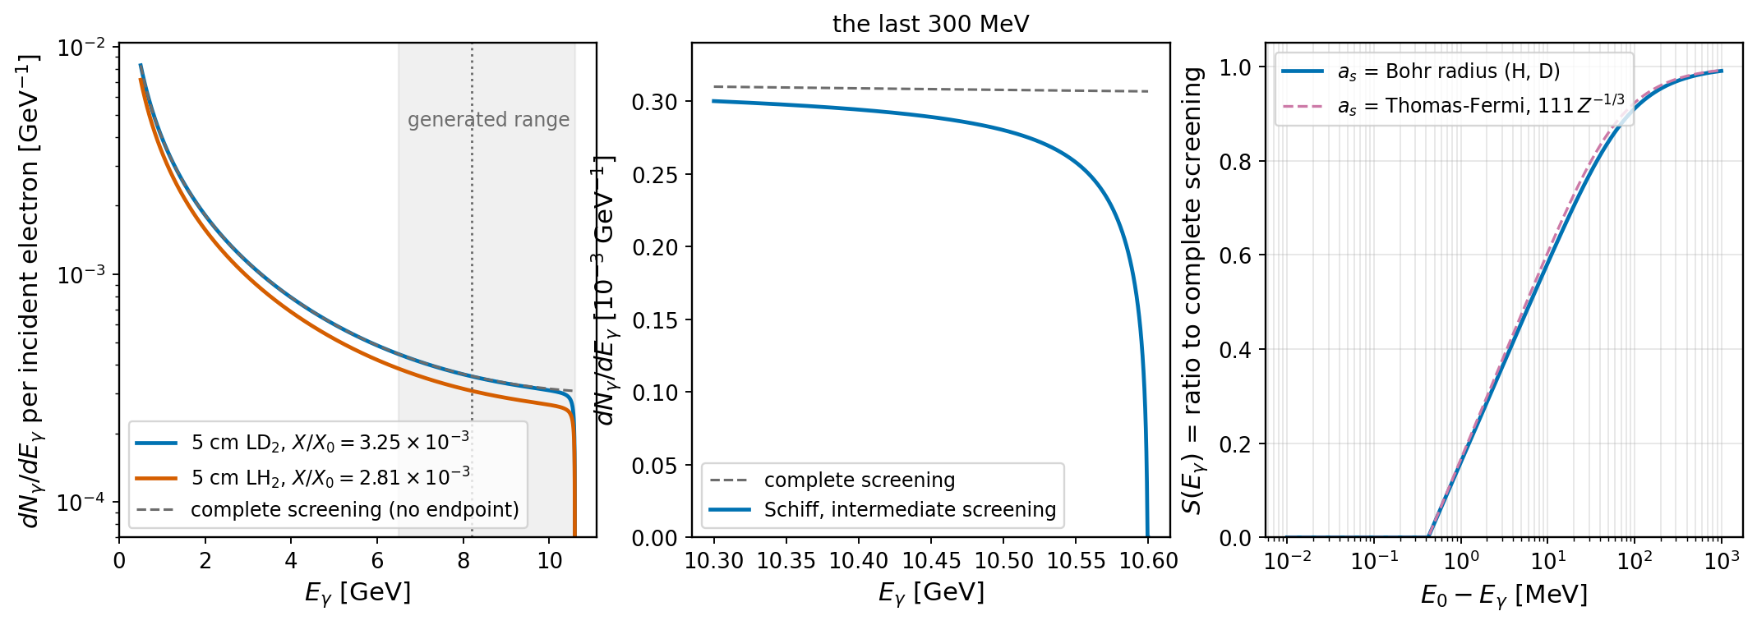
Photon beam: thin-target bremsstrahlung and the endpoint
Spectrum (Tsai, thin target)
• dN/dE_γ = (X/X₀)(1/E_γ)[4/3(1−y)+y²]·S(E_γ), y = E_γ/E₀
• X = L/2: vertex density ∝ upstream thickness; LD₂ 3.25 × 10⁻³, LH₂ 2.81 × 10⁻³
• 1.44 × 10⁻³ photons/e in 6.5–10.6 GeV, 0.77 × 10⁻³ above threshold
Endpoint: complete screening is wrong there
• q_min = m_e²E_γ/2EE′ outgrows 1/a_s as E′ → 0: screening switches off and Schiff’s bracket ln M + 1 − (2/b)arctan b falls through zero
• S(E_γ) = Schiff intermediate screening / complete-screening limit; screening radius = Bohr radius, 137 λ_C, for H and D
Size of the correction
• S = 0.97 / 0.91 / 0.77 / 0.58 / 0.36 at 300 / 100 / 30 / 10 / 3 MeV below E₀; zero at 0.42 MeV
• −1.24 % of the photons in 6.5–10.6 GeV; the last 100 MeV of the spectrum reshaped
• not included, each ≈ 1 MeV: dE/dx before radiating, beam spread, e–e endpoint
V. Kubarovsky · Fermi motion in untagged J/ψ photoproduction · 27 September 2026
3

Slide 4
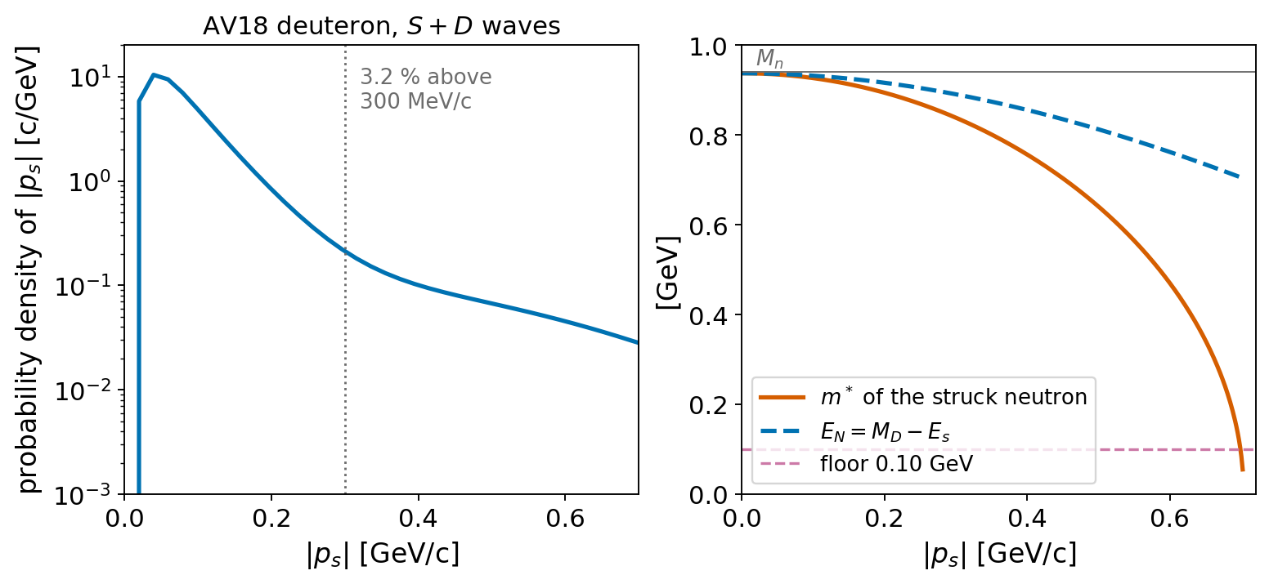
Fermi motion: plane-wave spectator model with the AV18 deuteron
Prescription
• deuteron at rest; spectator on shell, p_s from AV18 (S + D), isotropic
• struck nucleon p_N = (M_D − E_s, −p_s), off shell: m*² = p_N² < M_n²
• s = m*² + 2E_γ(E_N − p_N,z): a neutron running toward the photon raises s, one running away lowers it
• cross section evaluated at the free-nucleon mass and the event’s invariants; m* enters only where the event is built
• the free threshold 8.20 GeV is no threshold: γd → J/ψ n p opens at 5.66 GeV; generated range starts at 6.5
• floor m* ≥ 0.10 GeV: removes 0.01 % of the draws, bounds the boost to the struck-nucleon frame
• not included: FSI, coherent production, off-shell modification of the amplitude, D-wave tensor structure, σ_n ≠ σ_p
E_γ [GeV] | configurations above threshold | ⟨p_s⟩ [MeV/c] | p_s > 300 MeV/c | removed by floor 0.30 | floor 0.10
7.0 | 0.88 % | 373 | 60.8 % | 2.9 % | 0.11 %
7.5 | 4.44 % | 224 | 18.3 % | 0.7 % | 0.04 %
8.0 | 24.6 % | 117 | 4.4 % | 0.17 % | 0.01 %
8.2 | 44.3 % | 91 | 2.6 % | 0.10 % | 0.01 %
10.0 | 97.3 % | 86 | 1.9 % | 0.06 % | 0.00 %
Kinematics of the struck neutron for a photon along +z, AV18 unweighted (200 000 configurations): near threshold the high-momentum tail is the signal, so the m* floor was lowered from the π⁰/η value 0.30 GeV to 0.10 GeV.
V. Kubarovsky · Fermi motion in untagged J/ψ photoproduction · 27 September 2026
4

Slide 5
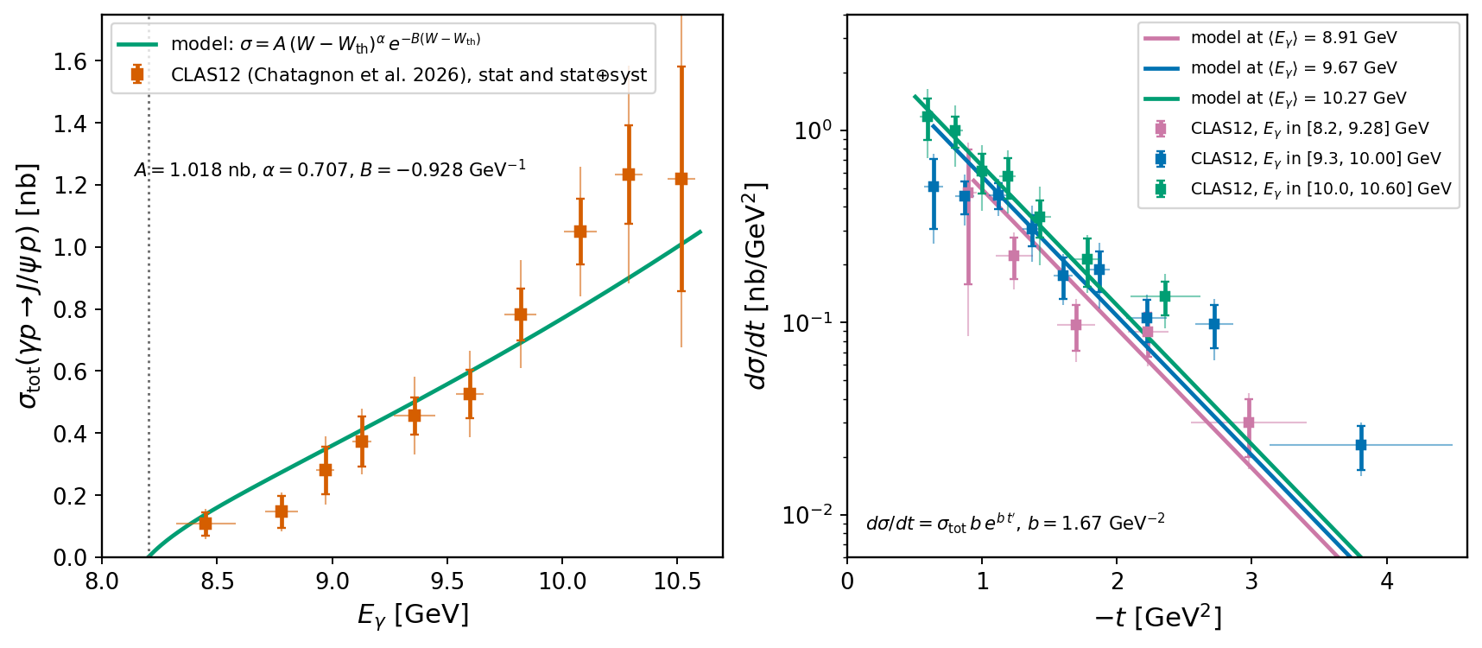
Cross section model: roberts2026 against the CLAS12 data
Model
• σ_tot = A (W − W_th)^α · exp[−B (W − W_th)]
• A = 1.018 nb, α = 0.707, B = −0.928 GeV⁻¹, W_th = M_N + M_J/ψ = 4.036 GeV
• dσ/dt = σ_tot · b · exp(b t′), b = 1.67 GeV⁻², t′ = t − t_min
• d ln σ/dW = 2.7 GeV⁻¹ at 10 GeV and diverges at threshold: shifts of s of 10⁻¹ GeV² are visible in the yield
• |t|_min = 1.8 / 0.62 / 0.36 GeV² at 8.5 / 9.5 / 10.5 GeV
Against CLAS12 (Chatagnon et al. 2026, arXiv:2602.22128, Appendix A)
• total cross section described within errors from threshold to 9.6 GeV; at 9.7–10.5 GeV the data lie 20–30 % above the curve, 1–2 σ per point
• t dependence: single exponential compatible with the data at |t| ≲ 2 GeV²; the points at 3–4 GeV² are a factor 2–3 above it
• the Fermi-motion ratio depends only on the slope of σ(W) near threshold, not on the normalisation; a refit of A, α, B, b is the next step for absolute yields
Why this shape
Near threshold σ ∝ (W − W_th)^0.7: convex and steep. That is what makes the deuteron yield sensitive to two small effects of opposite sign, binding and the flux-factor correlation (next slide).
V. Kubarovsky · Fermi motion in untagged J/ψ photoproduction · 27 September 2026
5

Slide 6
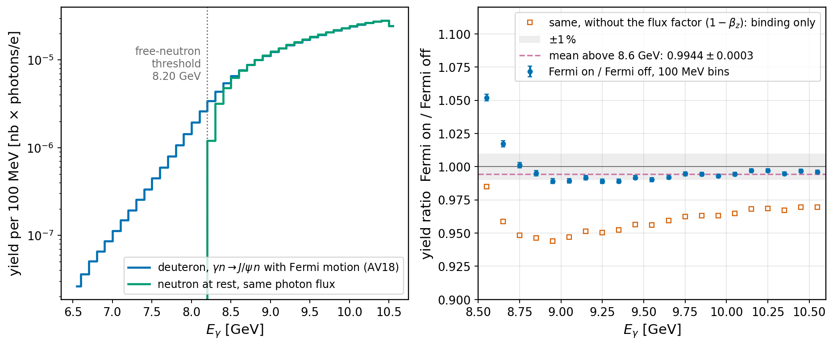
Result: J/ψ yield per neutron, deuteron over free neutron at rest
Two effects of 4 %, opposite sign
• weight = n_γ(E_γ) · n(p_s) · (1 − β_z) · σ(s)
• binding: E_N = M_D − E_s = 0.933 < M_n, m* < M_n, so ⟨s⟩ at fixed E_γ is lower by 0.16 GeV² (W by 18 MeV): −4 to −5 %
• flux factor (1 − β_z): the Møller relative velocity of the moving neutron; averages to 1 but is correlated with s: +4 %
• net: between 0.99 and 1.00 at every E_γ above 8.6 GeV
E_γ [GeV] | ratio | without flux factor
8.2–8.4 | 1.776 ± 0.005 | 1.62
8.4–8.6 | 1.088 ± 0.002 | 1.015
8.6–9.0 | 0.999 ± 0.001 | 0.949
9.0–9.5 | 0.990 ± 0.001 | 0.952
9.5–10.0 | 0.993 ± 0.001 | 0.961
10.0–10.6 | 0.996 ± 0.001 | 0.968
What it means
• above 8.6 GeV a generator without Fermi motion is as good as one with it, to better than 1 % at every photon energy; mean 0.9944 ± 0.0003
• within 400 MeV of threshold the ratio is 1.09 and 1.78; below 8.20 GeV only the deuteron produces J/ψ: the threshold of σ(W) is smeared over ± 300 MeV and must be unfolded
• the first samples lacked the flux factor and gave 0.96: the cancellation is real and easy to miss
V. Kubarovsky · Fermi motion in untagged J/ψ photoproduction · 27 September 2026
6

Slide 7
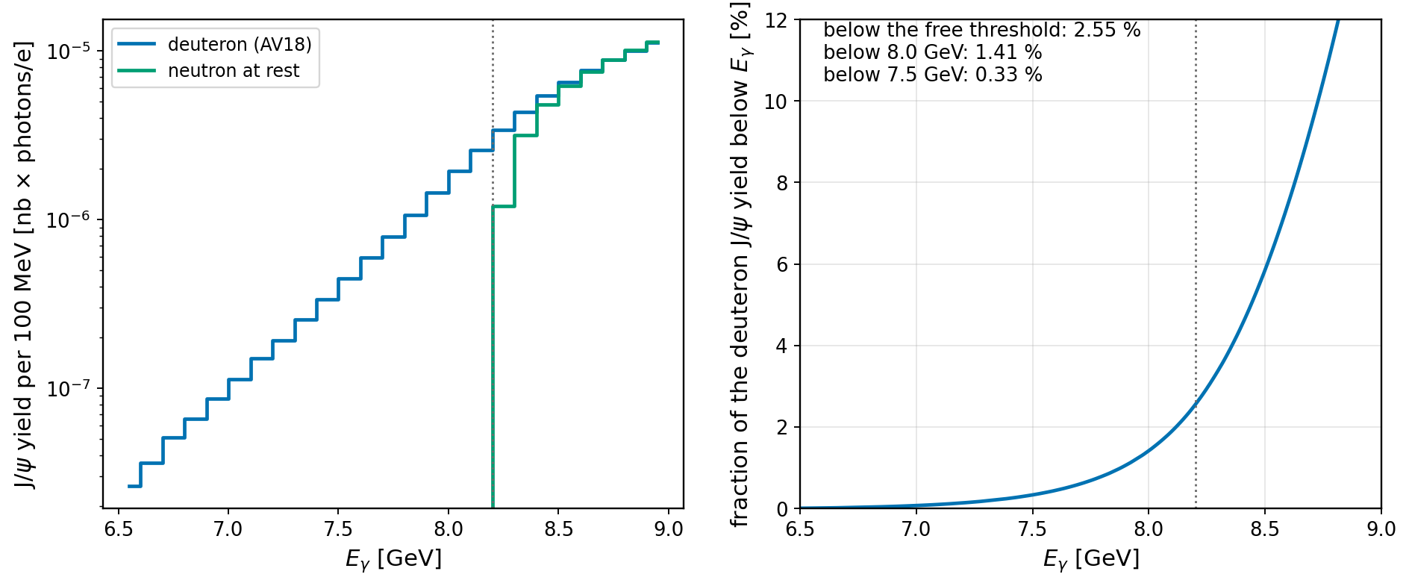
J/ψ below the free threshold
Numbers (20 M deuteron events)
• 2.55 % of the yield below 8.20 GeV, 1.41 % below 8.0, 0.33 % below 7.5
• 1.02 × 10⁻⁵ nb × photons/e per neutron below threshold
• 13 282 / 52 273 / 216 927 / 227 595 events in 6.5–7.0 / 7.0–7.5 / 7.5–8.0 / 8.0–8.2 GeV
• falls by an order of magnitude per 500 MeV: AV18 tail folded with the threshold rise of σ(W)
Reliability
• depends on exactly what is least certain: the AV18 tail beyond 300 MeV/c, the off-shell prescription, the absence of FSI
• read the sub-threshold yield as the plane-wave expectation, good to a factor of about two, not to percent
Consequences
• any threshold measurement on deuterium sees a smeared threshold; the generator provides the response to unfold it
• t below threshold: the events sit at the edge of phase space, |t|_min is large and the distribution is compressed toward it; the slope of a sub-threshold sample is not the elementary b
• the observable handle is the spectator proton (next slide)
V. Kubarovsky · Fermi motion in untagged J/ψ photoproduction · 27 September 2026
7

Slide 8
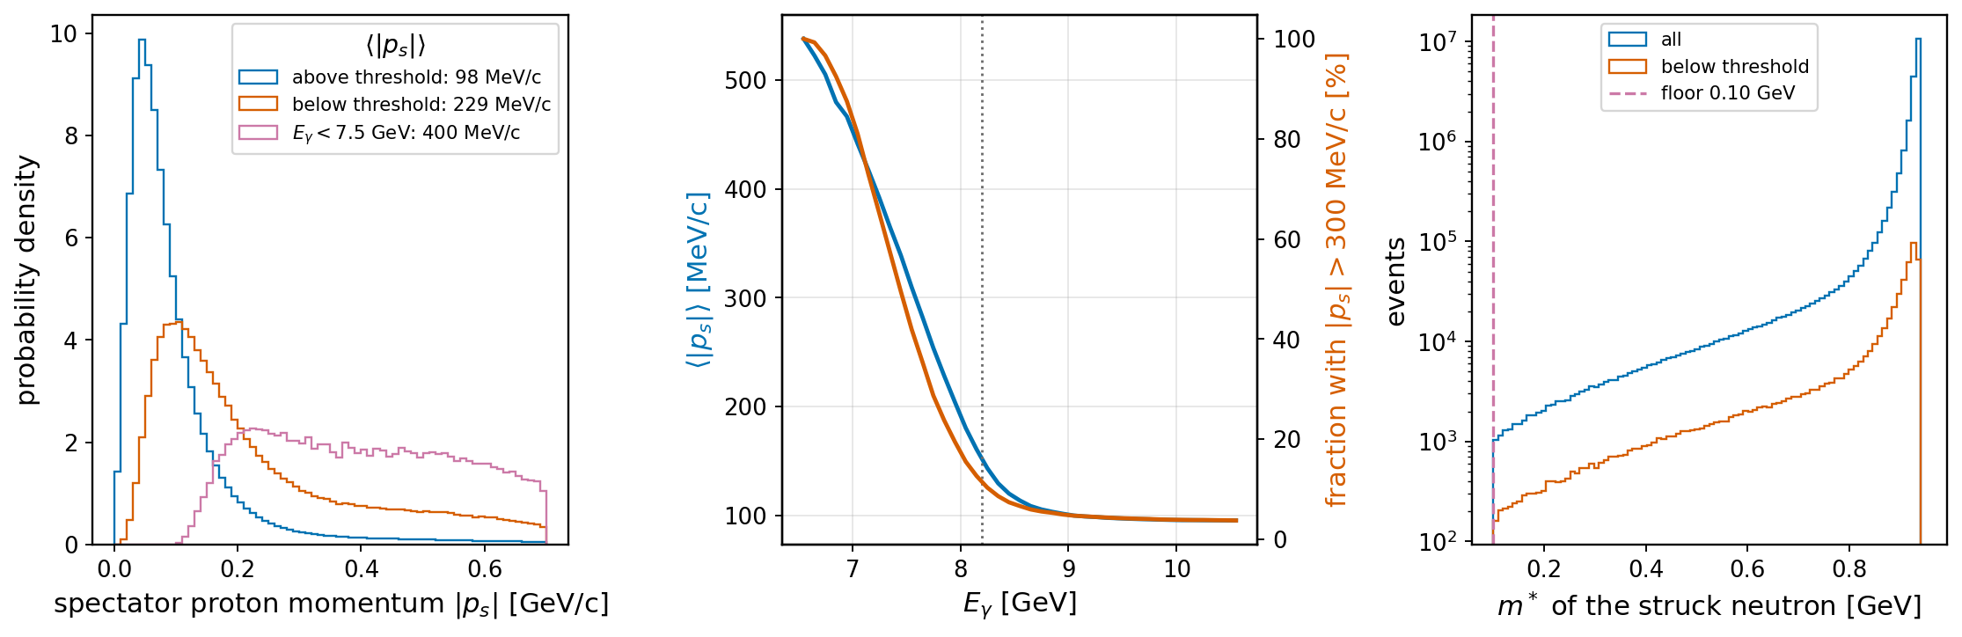
The spectator proton tags the sub-threshold events
Above threshold
• ⟨p_s⟩ = 99 MeV/c, 4.4 % above 300 MeV/c
• ⟨m*⟩ = 0.915 GeV
• the bulk of AV18; the spectator is mostly undetectable
Below threshold
• all: ⟨p_s⟩ = 229 MeV/c, 26 % above 300 MeV/c, ⟨m*⟩ = 0.84 GeV
• below 8.0 GeV: 278 MeV/c, 36 %; below 7.5 GeV: 400 MeV/c, 68 %, ⟨m*⟩ = 0.71 GeV
• a fast proton at large angle: inside the CLAS12 acceptance
In the sample
• the spectator is written in every deuteron LUND event
• the floor m* ≥ 0.10 GeV removes 0.01 % of the draws, invisible in every distribution
V. Kubarovsky · Fermi motion in untagged J/ψ photoproduction · 27 September 2026
8

Slide 9
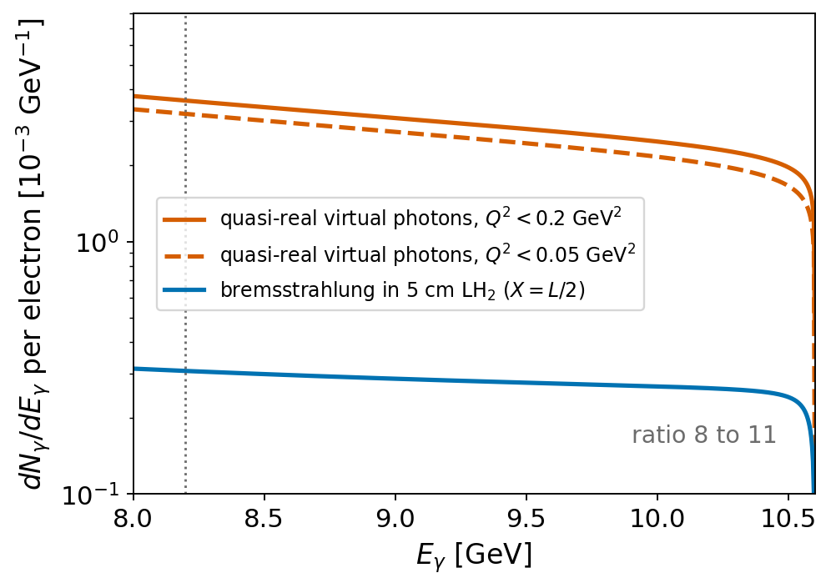
Do we need radiative corrections for photoproduction?
1 · Real-photon process γN → J/ψ N: no
• no lepton in the initial state, hence no initial-state radiation; the hadronic vertex corrections are absorbed in the measured σ
• what remains are flux corrections: endpoint (done), dE/dx before radiating, beam spread, thick-target multi-photon — each ≲ 1 % and only at the tip
2 · J/ψ → e⁺e⁻(γ) final-state radiation: yes, in every mode
• leading-log estimate: 21 % of the decays have m_ee < 3.0 GeV, 16 % below 2.9 GeV (μ⁺μ⁻: 7.5 % and 5.6 %)
• moves events out of a tight mass window and distorts the peak; GEMC does not radiate, so the generator must (PHOTOS-like decay radiation, channel independent)
• this is the radiative correction that matters for photoproduction
Untagged 10.6 GeV electrons on a thin target: the quasi-real virtual photons of electroproduction with the electron undetected (equivalent-photon flux, Q² below 0.05–0.2 GeV²) outnumber the bremsstrahlung photons from the target by 8 to 11. The real CLAS12 sample is mostly quasi-real electroproduction.
3 · The actual CLAS12 configuration: electroproduction with RC
• 90 % of the untagged photons are virtual: use the electro path of exclurad_py (Q² → Q²_min, electron not required) with its radiative tail; the electron ISR/FSR changes the effective flux by a few %
• for the Fermi-motion ratio it is irrelevant: the flux cancels. photo.py remains the right tool for the bremsstrahlung part and for tagged real-photon beams
V. Kubarovsky · Fermi motion in untagged J/ψ photoproduction · 27 September 2026
9

Slide 10
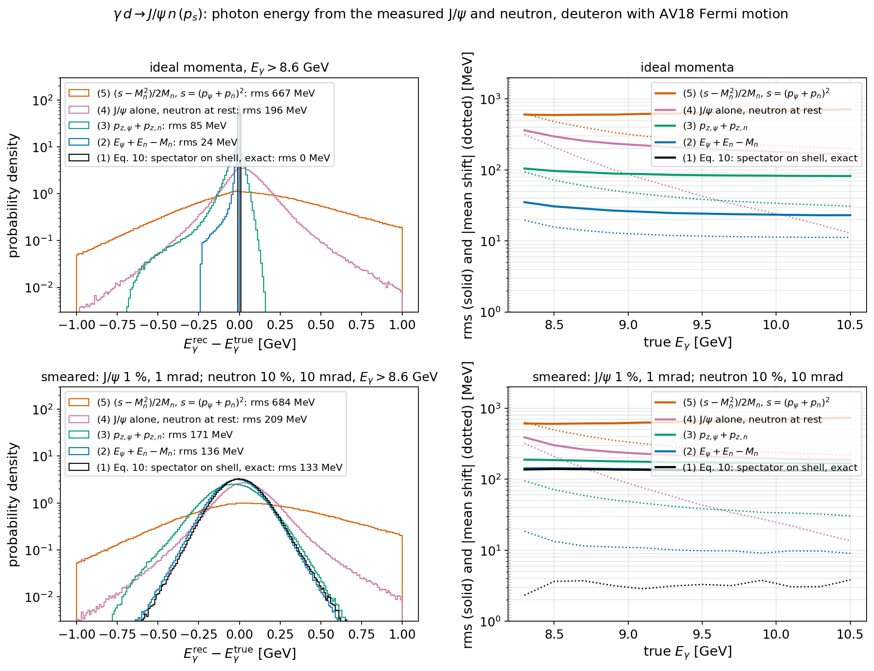
Photon energy from the final state: Eq. 10 of Liu et al., PRC 109, 065206
Exact: spectator proton on shell
• E_γ = [(E_ψ+E_n−M_d)² − |p_ψ+p_n|² − M_p²] / 2(E_ψ+E_n−p_zψ−p_zn−M_d)
• no Fermi-motion model; gives p_s and m* of the struck neutron event by event
• quasi-real photon: + 0.53 Q² (5 MeV at Q² = 0.01, 50 MeV at 0.1)
The other prescriptions (rms vs true E_γ)
• E_ψ + E_n − M_n: −12 ± 24 MeV (spectator kinetic + binding energy)
• p_zψ + p_zn: −38 ± 85 MeV
• J/ψ alone, neutron at rest: +40 ± 196 MeV, +250 next to threshold
• (s − M_n²)/2M_n: +245 ± 667 MeV — not an estimator of E_γ, it is the free-neutron energy for the measured W
• with resolution (J/ψ 1 %, neutron 10 %) Eq. 10 and the energy sum both give 135 MeV: the neutron momentum limits both
V. Kubarovsky · Fermi motion in untagged J/ψ photoproduction · 27 September 2026
10

Slide 11
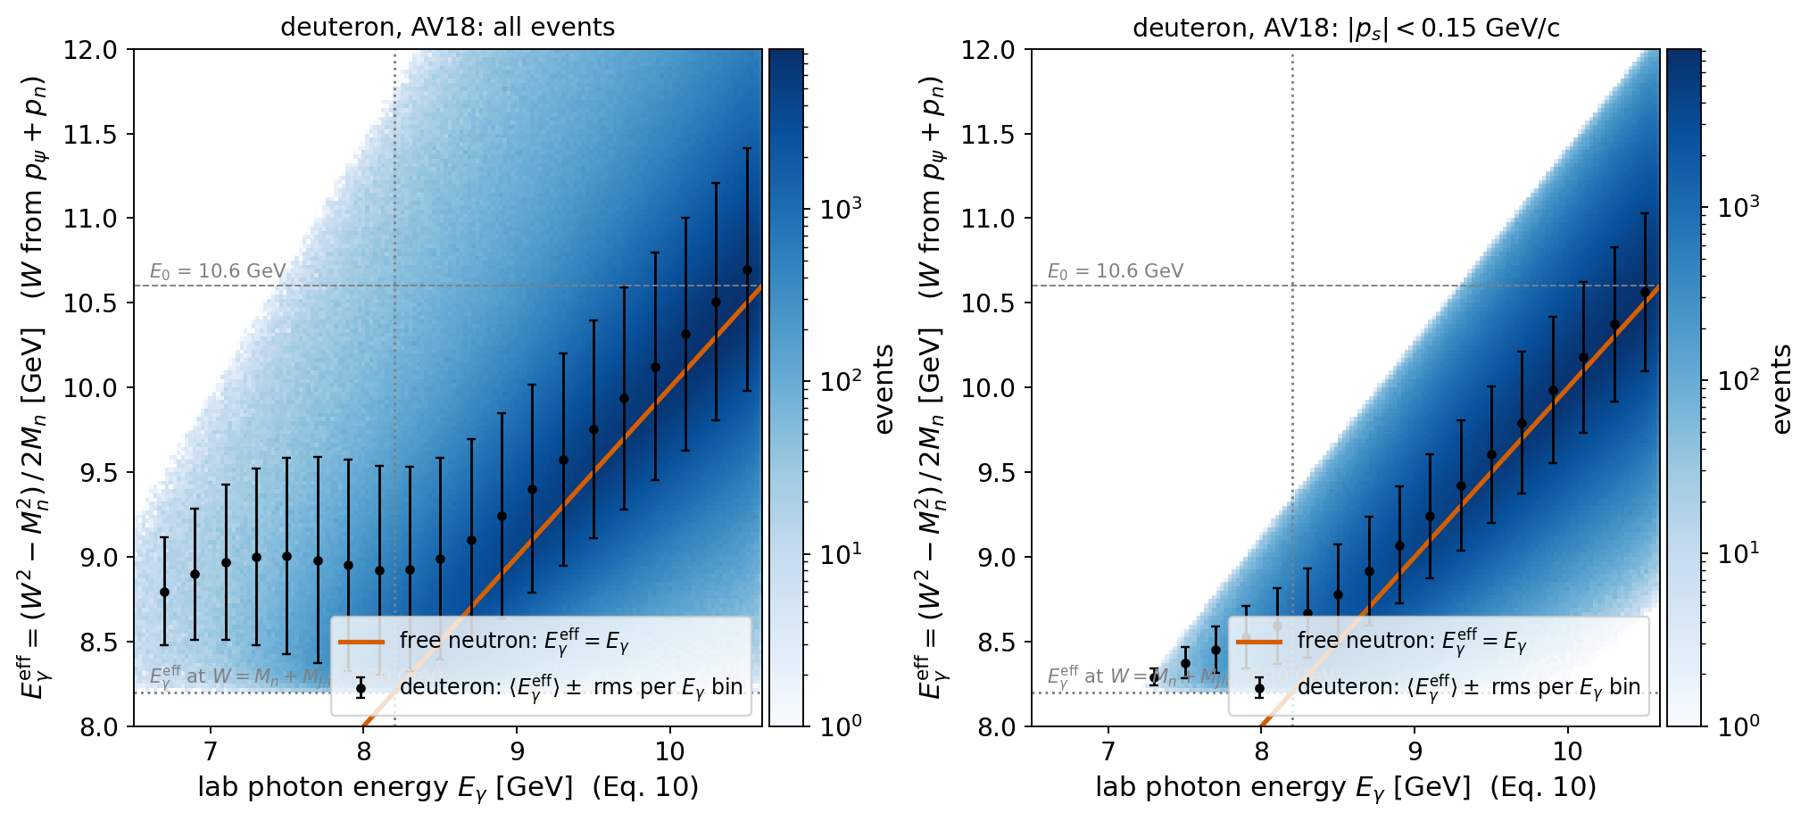
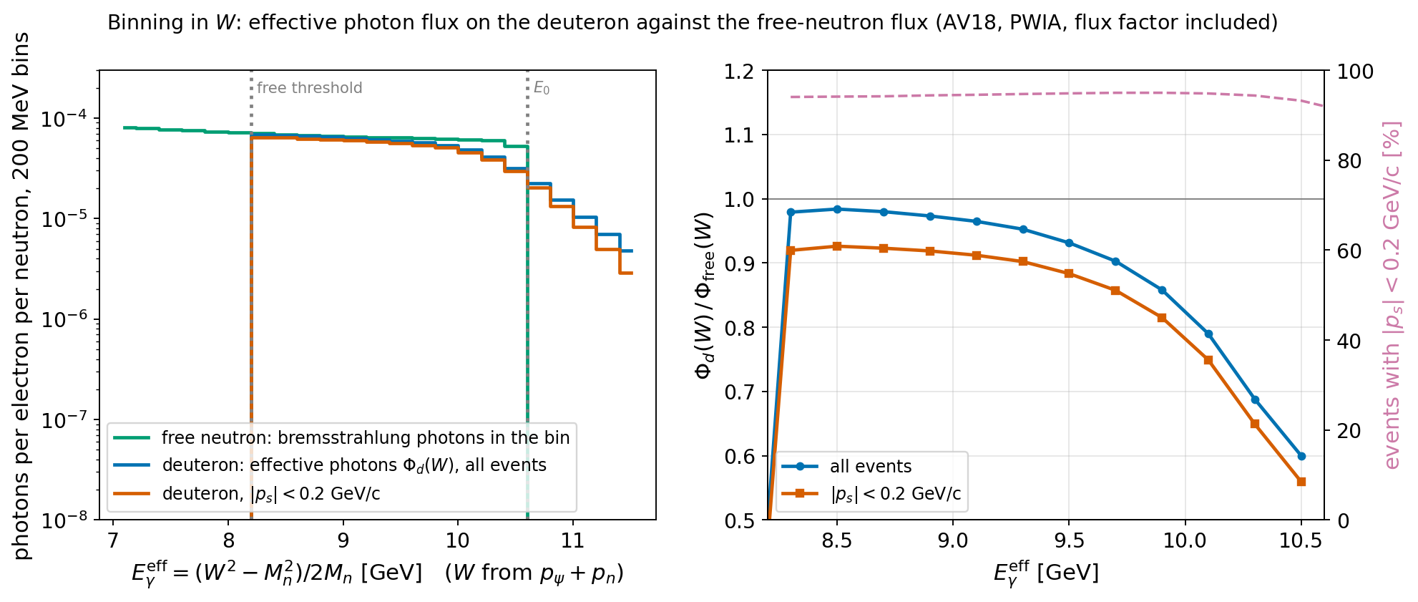
W rules the cross section; E_γ is a label on the deuteron
What the plots show
• one lab E_γ feeds a band of W: 0.13 GeV rms (0.6–0.7 GeV in photon-energy units); mean 40–50 MeV above the free line
• photons of 6.7–8.2 GeV produce the reaction at W = 4.17–4.22 GeV, the W of a 9 GeV photon on a free neutron: only the photon is sub-threshold
• 19 % of the events lie beyond the free-nucleon endpoint E₀
Recipe
• E_γ and p_s from Eq. 10; select |p_s| < 0.15 GeV/c (84 %, m* within 26 MeV of M_n)
• bin in W from p_ψ + p_n; divide by the effective flux Φ_d(W) from the generator: 2–3 % below the free flux up to 9 GeV, 10–40 % at the endpoint
• quote ⟨E_γ⟩ ± rms per W bin as a second column; show proton data at the same W
• systematics: prescription spread (10⁻³), wave function in Φ_d, stability of σ against p_s (pole limit)
V. Kubarovsky · Fermi motion in untagged J/ψ photoproduction · 27 September 2026
11

Slide 12
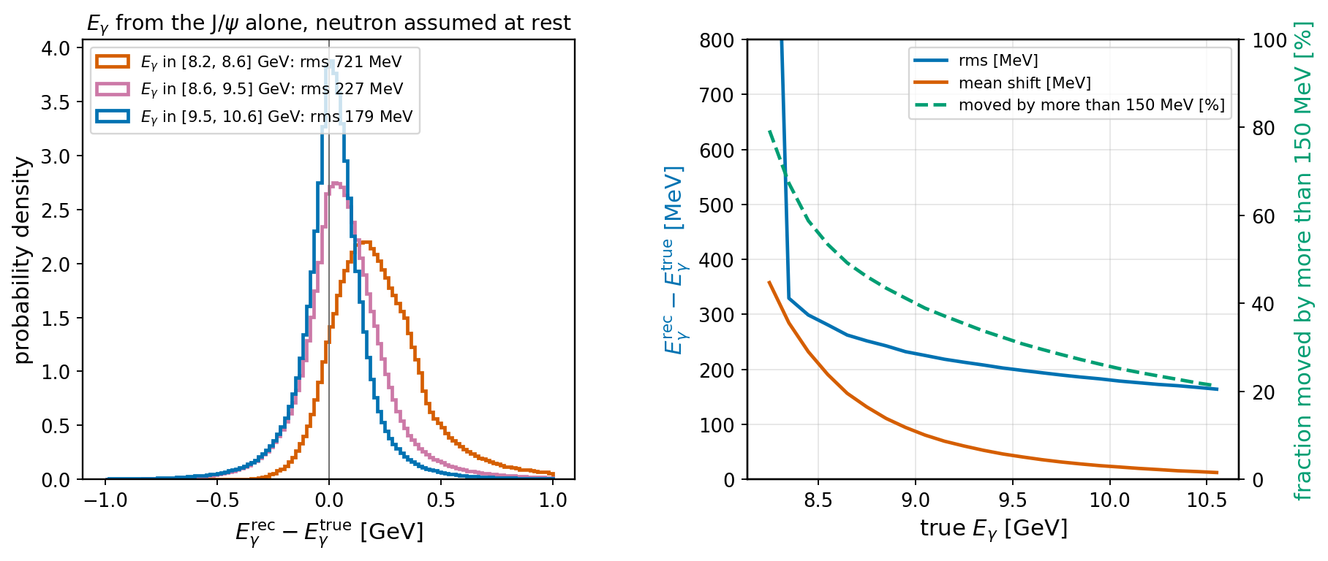
Conclusion: do we need a Monte Carlo with Fermi motion?
No, for the yield at the true E_γ
• above 8.6 GeV a free-neutron generator gives the yield per neutron to better than 1 % in every bin, and the same t distribution at the true s
Yes, for everything an analysis measures
• E_γ from the J/ψ alone (neutron at rest): smeared by 196 MeV rms above 8.6 GeV, shifted +120 MeV in 8.6–9.0 and +250 MeV next to threshold; 23–45 % of events move by more than 150 MeV
• t from the reconstructed photon: 0.24 GeV² rms, comparable to 1/b
• threshold region (ratio 1.09 and 1.78), the 2.55 % below it, spectator protons, exclusivity-cut efficiencies: all Fermi motion
Bottom line
Generate deuterium with Fermi motion always: it costs 0.65 ms per event and passes every acceptance test. The free-neutron sample keeps one role, the cross-check that isolates the effect. In the E_γ bins of the CLAS12 analysis (150–450 MeV wide) the migration from Fermi motion is larger than the detector resolution.
Next steps
• present σ(γn → J/ψ n) against W with Φ_d(W) from this generator · J/ψ → e⁺e⁻γ decay radiation (15–20 % of decays below 3.0 GeV) · flux factor (1 − β_z) in the electroproduction Fermi path · refit A, α, B, b to the CLAS12 tables · quasi-real electro twin with RC for absolute yields
V. Kubarovsky · Fermi motion in untagged J/ψ photoproduction · 27 September 2026
12

