Slide 1

Research
PROJECT PRESENTATION
“Prenatal Care Timing and Maternal Sociodemographic Factors Associated with U.S. Birth Outcomes”
HDS 5310 – Analytics and Statistical Programming
04-29-2025
Venkata Sai Krishna Kukkapalli

Slide 2
Background and Introduction:
This study investigates how maternal sociodemographic factors and timing of prenatal care initiation relate to birth outcomes in the United States.
Understanding the characteristics of mothers and the care they receive during pregnancy allows for a deeper exploration of factors influencing neonatal health, which could inform policy and intervention strategies to improve birth outcomes nationwide.

Slide 3
Population of Interest:
This study focuses on pregnant woman across the United States. The population is understood to be from diverse backgrounds according to the source we collected, National Center for Health Statistics (NCHS) database.
It offers a wider scope to understand and evaluate birth outcomes across key maternal characteristics like education, marital status, etc. which allows for identification of inequities and trends relevant to public health and prenatal care

Slide 4
Outcomes of Interest
The primary outcomes assessed in this study are birthweight (measured in grams) and gestational age (measured in weeks).
These outcomes are used in studies and clinical settings as indicators of neonatal health, with low birth weight (<2500g) and preterm birth (<37 weeks) being major risk factors for infant morbidity, long term developmental and health complications.

Slide 5
Independent Variables
Prenatal Care Start: The trimester in which prenatal care was first initiated (1st, 2nd, 3rd trimester, or no care)
Education Level: The mother’s highest education level (Less than
HS, HS Grad, Some College, College+)
Marital Status: Whether the mother is married or unmarried
Plurality: Whether the birth was a singleton or involved multiples (e.g., twins, triplets)
Delivery Method: The method of delivery (vaginal or C-section)
Maternal Age: The age of the mother in years at the time of delivery
BMI Category: The body mass index classification of the mother (Underweight, Normal, Overweight, Obese)

Slide 6
Existing Literature and Gaps
Reichman and Teitler (2005) found that initiation of prenatal care in the first trimester was associated with modest gains in birthweight and gestational age; however, they also concluded that prenatal care alone may not substantially reverse the effects of pre-existing risk factors.¹
Partridge et al. (2012) conducted a large retrospective analysis and reported that inadequate prenatal care substantially increased the risk of infant mortality and low birthweight.²
The existing knowledge also highlights the influence of maternal education and marital status on pregnancy outcomes, suggesting that social factors are also critical mediators of maternal and infant health and well-being.

Slide 7
Existing Literature and Gaps
While these studies show the importance of prenatal care and maternal characteristics, a few have explored the combined effects of sociodemographic and clinical variables using national, population-level data spanning multiple years.
most studies do not integrate predictors such as plurality (Single, Twin, Triplets, etc.) and delivery method into a unified multivariate framework.
Our study addresses this gap by examining the joint contribution of prenatal care timing, education, marital status and other maternal factors to birth outcomes across seven years of U.S. natality data (2017-2023).

Slide 8
Research Question and Hypothesis
RQ: “How does the timing of prenatal care initiation relate to birth outcomes (birthweight and gestational age) in the United States, after accounting for maternal sociodemographic factors?”
Hypothesis: earlier initiation of prenatal care is associated with more favorable outcomes like higher birthweights and longer gestational durations. Additionally, factors like higher maternal education level and being married during pregnancy also have positive effects on birth outcomes.

Slide 9
Data Source
The dataset we are working on contains data about birth outcomes in the US between 2017 and 2023. It was sourced from the National Center for Health Statistics (NCHS), a database of natality data containing birth related information managed by Centers for Disease Control and Prevention.³
When we collected the data, we had over 25 million observations across seven years (2017-2023), so we sampled data only to 70000, which is 10000 observations for each year.

Slide 10
Variables
Dependent: Birthweight, Gestational Age.
Independent: Prenatal Care Start, Mother’s Education, Marital Status, Plurality, Delivery Method, Maternal Age and Mother’s BMI

Slide 11
Descriptive Statistics
Table 1. Descriptive Characteristics of the Study Sample (n=70000)
VARIABLE N=70000
Mean(SD)
Maternal Age
29.3(5.8)
Birthweight (grams)
3252.3(592.3)
(Missing)
57
Gestational weeks
38.5(2.5)
(Missing)
52
n(%)
Prenatal Care Start
1st Trimester
52,841 (77%)
2nd Trimester
11,135 (16%)
3rd Trimester
3,103 (4.5%)
No Prenatal Care
1,353 (2.0%)
(Missing)
1,568

Slide 12
Marital Status Married | 36,708 (60%)
Unmarried | 24,934 (40%)
(Missing) | 8,358
Education Level ≤8th grade | 2,162 (3.1%)
9–12, no diploma | 6,040 (8.8%)
Associate | 5,787 (8.4%)
Bachelor | 14,704 (21%)
Doctorate | 2,007 (2.9%)
HS Grad | 18,117 (26%)
Master | 6,904 (10%)
Some College | 13,185 (19%)
(Missing) | 1,094

Slide 13
Maternal BMI
Normal | 27,417 (40%)
Obesity I | 10,897 (16%)
Obesity II | 5,462 (8.0%)
Obesity III | 3,976 (5.8%)
Overweight | 18,683 (27%)
Underweight | 2,032 (3.0%)
(Missing) | 1,533
Plurality
Quadruplet
2 (<0.1%)
Singleton
67,737 (97%)
Triplet
63 (<0.1%)
Twin
2,198 (3.1%)

Slide 14
Apgar Score
0–3 | 424 (0.6%)
4–6 | 1,053 (1.5%)
7–8 | 9,273 (13%)
9–10 | 58,924 (85%)
(Missing) Delivery Method | 326
C-Section | 22,580 (32%)
Vaginal | 47,363 (68%)
(Missing) | 57
Table 1: Continuous variables are presented as mean (standard deviation). Categorical variables are presented as
number (percentage). Maternal age is reported in years, birthweight in grams, and gestational age in completed weeks.

Slide 15
Data Handling and Management
Before proceeding with the Bivariate and Multivariate tests we performed data cleaning, Observations with missing or unknown values were excluded.
Rare categories like, plurality (triplets or higher) were clubbed together into “Triplets+” group. These were done to variables where necessary, before performing the Bivariate or Multivariate tests.

Slide 16
I(a): Bivariate Analysis - One-way ANOVA
One-Way ANOVA: Birthweight vs. Prenatal Care Start.
To check the normal distribution, we did a visual inspection of Histogram which indicated normal distribution. Levene’s test for homogeneity of variances was non-significant (p > 0.05), confirming that the assumption of equal variances was satisfied. Therefore, standard ANOVA was appropriate.
The ANOVA revealed a statistically significant difference in mean birthweight between the groups (F(3, 68384) = 114, p < 2e-16), indicating that timing of prenatal care initiation is associated with differences in birthweight.
Post hoc analysis using Tukey’s Honest Significant Difference (HSD) test showed Second trimester care births weighed significantly less than those with first trimester care (mean difference = –48.8g, p < 0.001).

Slide 17
Table I(a):
One-Way ANOVA and Post Hoc Analysis: Birthweight by Prenatal Care Start Timing
One-way ANOVA comparing group means; post hoc Tukey HSD results included for all pairwise comparisons.
Comparison | Mean Difference (g) | 95%CI (Lower, Upper) | Adjusted p- value
2nd Trimester – 1st Trimester | –48.8 | (–64.5, –33.0) | <0.001
3rd Trimester – 1st Trimester | –15.4 | (–43.2, 12.5) | 0.49
No Prenatal Care – 1st Trimester | –278.4 | (–320.1, –236.8) | <0.001
3rd Trimester – 2nd Trimester | +33.4 | (2.8, 64.0) | 0.026
No Prenatal Care – 2nd Trimester | –229.6 | (–273.2, –186.1) | <0.001
No Prenatal Care – 3rd Trimester | –263.1 | (–312.3, –213.8) | <0.001

Slide 18
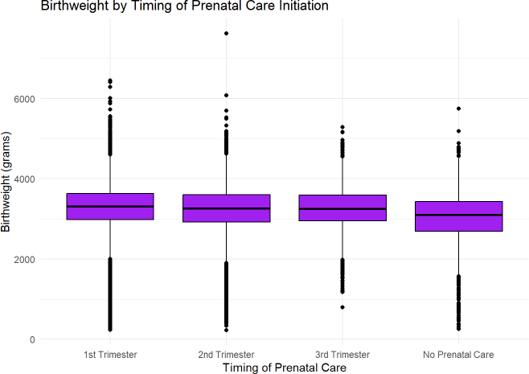
Figure I(a): Boxplot of Birthweight by Timing of Prenatal Care Initiation
Distributions show median, interquartile range, and outliers.
Birthweight measured in grams.

Slide 19
I(b): Bivariate Analysis – Chi-Square Test
Chi-square test: Plurality vs Delivery Method.
Assumptions for the chi-square test were checked and satisfied. Specifically, all expected cell frequencies were greater than five, and observations were independent. Therefore, the Pearson’s Chi-square test was appropriate for this analysis.
The test revealed a statistically significant association between plurality and delivery method, χ²(2, N = 69,943) = 2034.2, p < 2.2e-16.
Cesarean delivery was more common in multiple births.

Slide 20
Table I(b): Chi-Square Test: Observed Counts of Delivery Method by Plurality
Values reflect the number of births by mode of delivery. Pearson’s chi-square test p-value < 2.2e-16.
Plurality | C-Section | Vaginal | Total
Singleton | 20,867 | 46,813 | 67,680
Twin | 1,648 | 550 | 2,198
Triplet+ | 65 | 0 | 65
Total | 22,580 | 47,363 | 69,943

Slide 21
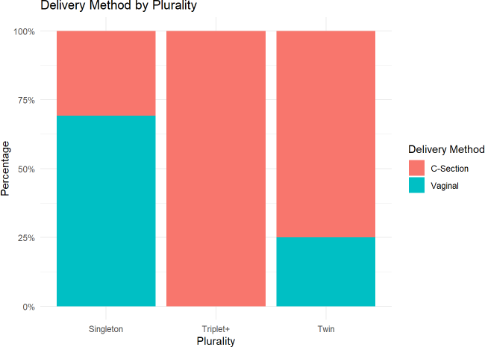
Figure I(b): Stacked Bar Chart of Delivery Method by Plurality
Each bar represents the proportion of deliveries by mode for each plurality category. Cesarean delivery is more common in multiple births.

Slide 22
II: Multivariate Analysis – Linear Regression
We conducted a multivariable linear regression to evaluate how maternal demographic, and clinical factors influence infant birthweight. Predictors included maternal age, marital status, education level, prenatal care timing, BMI category, delivery method, plurality, and gestational age.
Assumptions of linearity, homoscedasticity, and normality of residuals were verified using residual plots and Q-Q plots.
The overall model was significant (F(21, 58,651) = 1423, p <2.2e-16), Adjusted R² = 0.337 (Good model fit).

Slide 23
Gestational weeks (B = +116.22, 95% CI: [114.59, 117.84]) and maternal BMI (e.g., Obesity III: B = +117.17, CI: [100.11, 134.23]) were the strongest positive predictors of birthweight.
Being a twin (B = –578.81, CI: [–601.52, –556.09]) or
triplet+ (B = –818.79, CI: [–952.65, –684.94]) significantly
reduced birthweight.
No prenatal care was associated with a 107.74g reduction (CI: [–136.38, –79.11], p < 0.001), while marital status and lower educational attainment also showed significant negative associations.

Slide 24
Predictor | Estimate (g) | 95% CI (Lower, Upper) | p-value
Intercept | –1278.61 | (–1351.06, –1206.17) | <0.001
Maternal Age (years) | +2.11 | (1.34, 2.88) | <0.001
Unmarried | –88.79 | (–97.90, –79.68) | <0.001
Education: 9–12, no diploma | –38.23 | (–64.14, –12.32) | 0.0038
Education: Associate | +2.18 | (–23.70, 28.05) | 0.869
Education: Bachelor | +22.07 | (–1.97, 46.12) | 0.072
Education: Doctorate | +7.85 | (–24.30, 39.99) | 0.632
Education: HS Grad | –27.11 | (–50.67, –3.55) | 0.024
Education: Master | +23.15 | (–2.64, 48.94) | 0.078
Education: Some College | –20.57 | (–44.55, 3.42) | 0.093
2nd Trimester Prenatal Care | +4.12 | (–6.44, 14.67) | 0.444
3rd Trimester Prenatal Care | +7.20 | (–11.43, 25.83) | 0.449
No Prenatal Care | –107.74 | (–136.38, –79.11) | <0.001
BMI: Underweight | –139.53 | (–163.11, –115.94) | <0.001
BMI: Overweight | +72.69 | (63.06, 82.32) | <0.001
BMI: Obesity I | +100.04 | (88.54, 111.54) | <0.001
BMI: Obesity II | +108.94 | (93.87, 123.99) | <0.001
BMI: Obesity III | +117.17 | (100.11, 134.23) | <0.001
Vaginal Delivery | +3.73 | (–4.86, 12.31) | 0.395
Twin | –578.81 | (–601.52, –556.09) | <0.001
Triplet+ | –818.79 | (–952.65, –684.94) | <0.001
Gestational Weeks | +116.22 | (114.59, 117.84) | <0.001
Table II: Multivariable Linear Regression Predicting Birthweight (grams)
Coefficients represent changes in birthweight relative to reference categories.

Slide 25
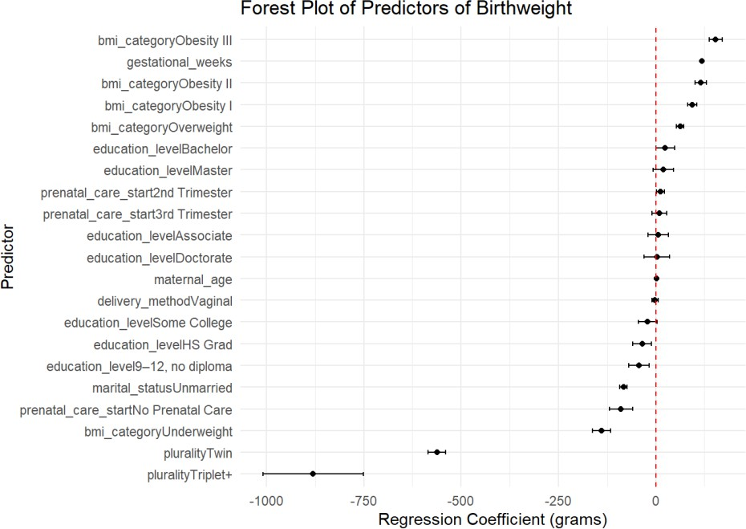
Figure II: Forest Plot of Adjusted Regression Coefficients for Predictors of Birthweight
Each dot represents the regression coefficient for a predictor variable. Error bars indicate 95% confidence intervals. The red dashed line represents the null value (0 g).

Slide 26
Results Summary
In conclusion, this study demonstrates that early prenatal care, maternal
education, marital status, and clinical characteristics such as BMI, gestational age, and plurality are significant contributors to birthweight. These results support the use of sociodemographic variables in public health surveillance and maternal- child health programming. By identifying high-risk groups and reinforcing the importance of early intervention, healthcare systems and policymakers can better allocate resources to improve neonatal outcomes across the United States.

Slide 27
Discussion and Conclusion
Importance of early prenatal care interventions.
Socioeconomic disparities persist in outcomes.
Need for targeted public health strategies.

Slide 28
References
JO; RN. Timing of enhanced prenatal care and birth outcomes in New Jersey’s Health Start program. Maternal and child health journal. Accessed April 29, 2025. https://pubmed.ncbi.nlm.nih.gov/15965620/.
HA; PSJC. Inadequate prenatal care utilization and risks of infant mortality and poor birth outcome: A retrospective analysis of 28,729,765 U.S. deliveries over 8 years. American journal of perinatology. Accessed April 29, 2025. https://pubmed.ncbi.nlm.nih.gov/22836820/.
DATA Source: Data Access - Vital Statistics Online. Centers for Disease Control and Prevention. April 10, 2025. Accessed April 29, 2025. https://www.cdc.gov/nchs/data_access/vitalstatsonline.htm.

Slide 29
Thank You!
-Venkata Sai Krishna Kukkapalli

