Slide 1
Analyst, Sales & Operations Planning
Business Case
Vandita Kulkarni
Thursday, June 13, 2024

Slide 2
Agenda
Business Case
Objective
Data insights and trends
Forecast review
Forecast performance metrics and accuracy
ARIMA model
Purchase order quantity
Q&A
Appendix

Slide 3
Business Case:
Data set for 11 products across 4 printing supplies
Lead time: 4 months
Beginning of the month inventory level at Company and Partner
25 months sales data
Rolling forecast data for 6 months
Flag for promotion
Objective:
Insights & trends
Forecast performance & ways to improve forecast
Calculate next PO quantity

Slide 4
Insights & trends

Slide 5
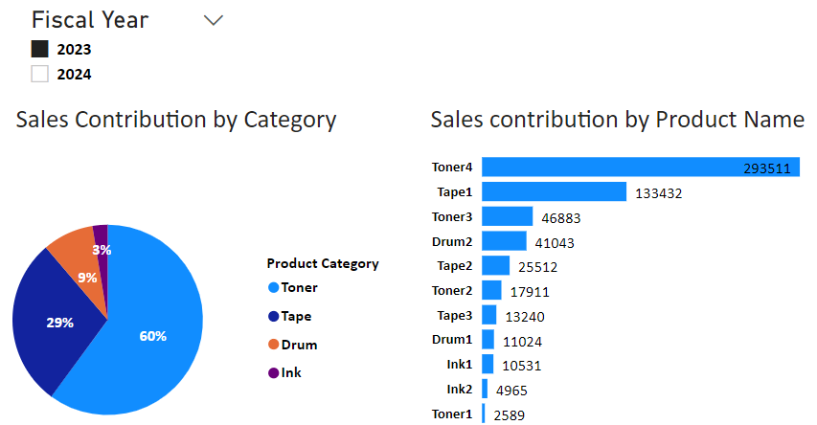
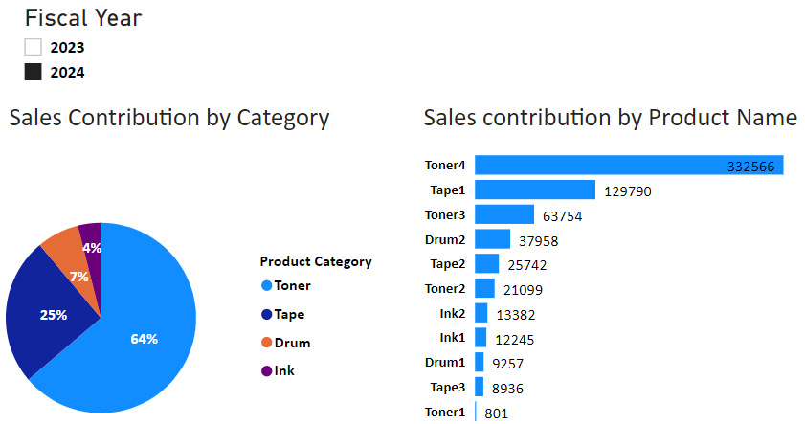
Product category-Toner and Tape contributes 89% of the total.
Top-5 products contributing maximum sales are same for both *fiscal year 2023 & 2024.
Assumption- fiscal year from May to Apr
Tool : Power BI desktop

Slide 6
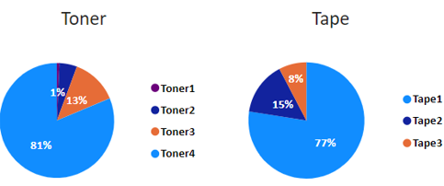
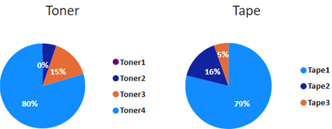
Sales contribution of the segments within the Product category is same for fiscal year 2023 & 2024
Insight: We can prepare category level aggregated data for forecasting and distribute demand to segments withing the category.
* Assumption- fiscal year from May to Apr
Tool : Power BI desktop

Slide 7
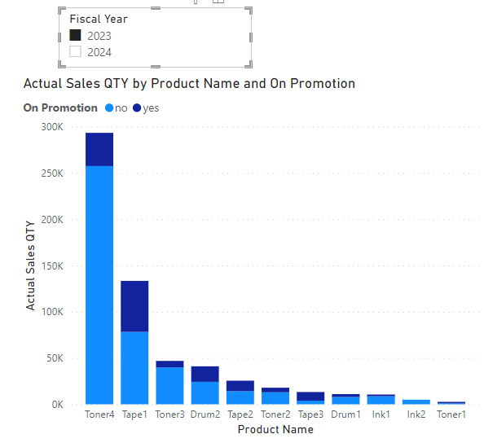
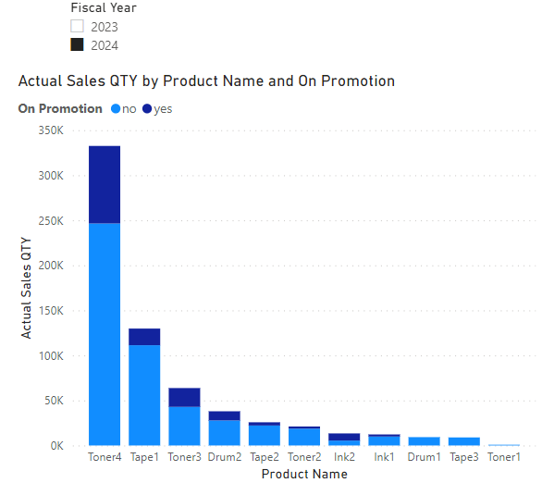
Sales lift by Product Name by Promotion
Sales lift percentage: 50% for Toner4 at May-23 calculated by considering sales average as baseline
Tool : Power BI desktop

Slide 8
Sales growth by Product Category
Overall sales growth is 9%
Observation: Sales trending negative for Product category Tape and Drum in terms of quantity.
Ink is the high performing category and sales increased by 65%
Tool : MS Excel

Slide 9
Sales growth by Product Name
Tool : MS Excel

Slide 10
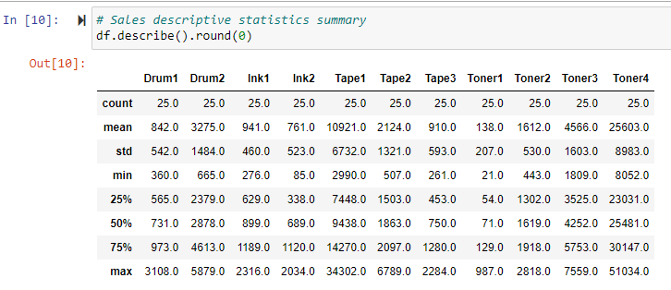
Descriptive statistics summary of sales data
Tool : Jupyter Notebook, Python code

Slide 11
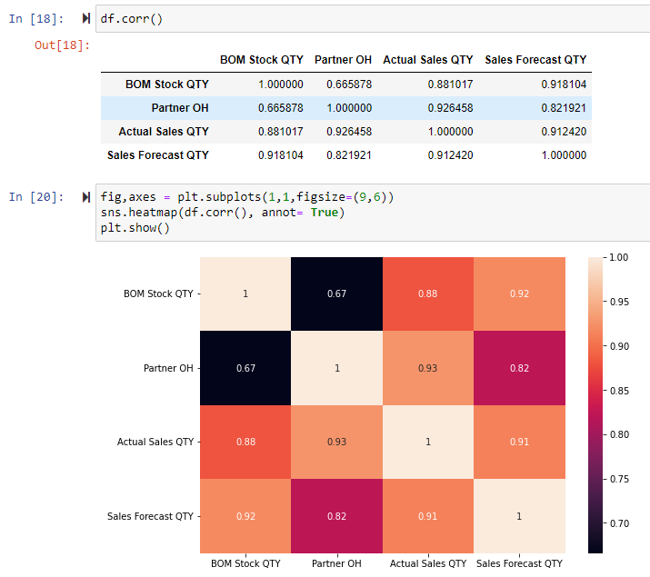
Correlation factor
Insight :
Partner OH data is highly correlated with actual sales.
If high inventory at Partner location and if the product is on sale, we can anticipate sales lift in the demand.
Correlation factor used to select variables for regression analysis.
Tool : Jupyter Notebook, Python code

Slide 12
Trends:
Category level aggregated demand data have no periodic seasonality.
Demand data has both Level and trend element for all four categories.
Same demand pattern segments for each category.
Promotion has direct effect on sales
May & June-22 high sales that impacting overall trend for Tape- product category
Tool : MS Excel

Slide 13
Forecast

Slide 14
Insight: Aggregated forecast is biased
Tool : MS Excel

Slide 15
Forecast Performance Metrics by Product: MAPE vs Accuracy
To measure the quality of forecast we can performance metrics like MPE, MAPE, WMPAR, RMSE.
Forecast for product-Toner4 has lowest MAPE that means high accuracy of the forecast.
Tool : MS Excel

Slide 16
Forecast Performance Metrics by Category: MAPE vs Accuracy
Category level aggregated forecast has lower MAPE compared to product level forecast.
Aggregated forecast data are more accurate
Forecast for product category Toner is most accurate.
Tool : MS Excel

Slide 17
Ways improve forecast accuracy
Prepare category level forecast and then distribute demand to product level
Prepare baseline forecast and then account effect of promotion on sales by considering sales lift
Prepare and compare different forecasting models and consider the model which has lowest MAPE.
Use right numbers of observations. It can measure by ex post forecast.
Track impact of touch points on the statistical forecast and track when it gets override based on information.
More frequent check points and evolution of forecasting metrics.
Use point of sales data, if possible, which is more stable.
Eliminate SKU with different pattern

Slide 18
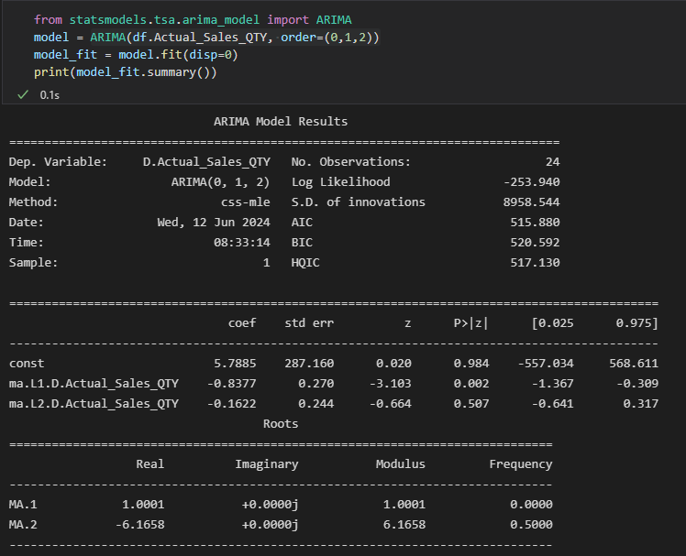
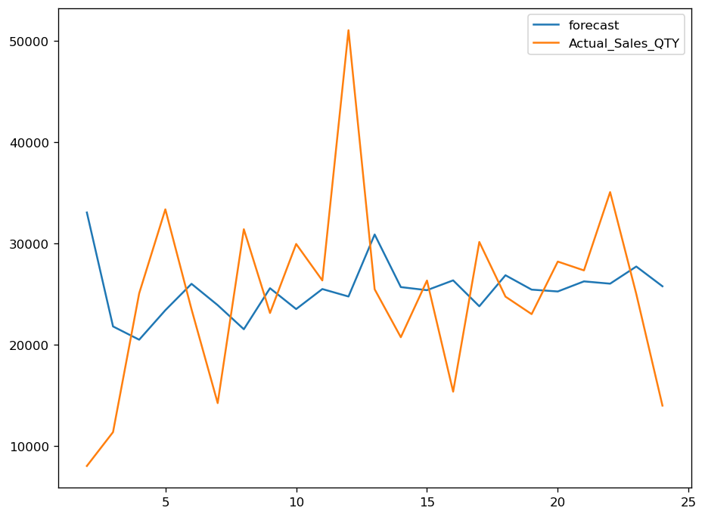
ARIMA Model
Checked MAPE using ARIMA model in Python for Toner4 product and checked the cause-and-effect regression model to evaluate effect of the promotion on the sales.
The p-value for both model is higher than the allowed range. MAPE is also higher than the current forecast.
R square is 0.56 cause-and-effect regression model that means only 56% of the observations are defined by the model.
Tool : Jupyter Notebook, Python code

Slide 19
Purchase Order Quantity

Slide 20
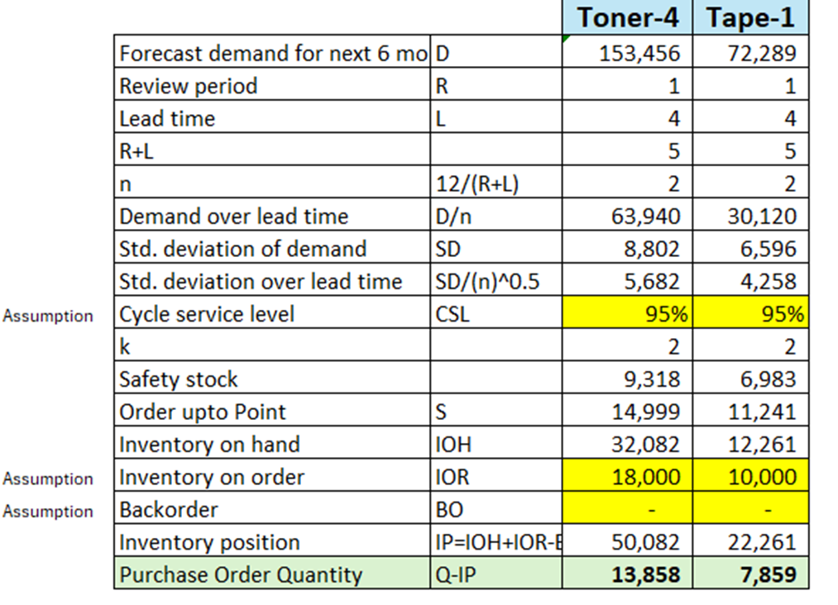
Periodic Inventory replenishment cycle
Assumption:
Planning horizon – 6 months
Demand- Variable, Known and continuous
Leadtime- Constant and deterministic
Dependence of another segment- No
Capacity constraints- None
Discounts from the supplier- None
Next PO quantity in 1 month review period
Toner4= 13858
Tape1=7859
Tool : MS Excel

Slide 21
Q&A

Slide 22
Thank You

Slide 23
Appendix

Slide 24
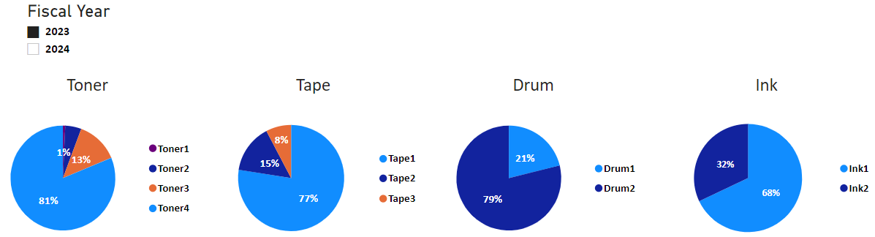
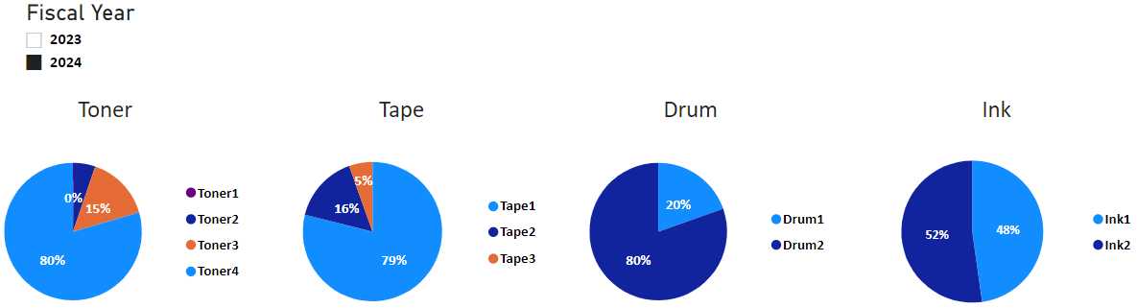

Slide 27
Summary
Insights:
Overall Sales growth 9%
Sales for all three products within Tape category has decreased compared to previous fiscal year
Sales has increased for all
Top 5 selling products in terms of quantity remain same for 2023 & 2024 fiscal year.
We can use aggregated category sales data for forecasting for Tone, Tape and Drum categories as their product sales ratio has changed slightly except for Ink.

