Slide 1
Key Factors That Influence Housing Market in Boston, MA

Slide 2
Introduction
Among all critical economic pointers, house prices top the list because they directly influence the quality of life and investment decisions along with the course of urban development.
The better understanding of the variables influencing housing prices will help
Homebuyers understand what makes properties in some neighborhoods more valuable than others.
Real Estate Investors who are looking for profitable investment opportunities based on emerging trends in property prices.
Urban Planners to address disparities in housing affordability and guide development projects.
Policymakers address socioeconomic disparities by targeting crime reduction, educational improvements, and infrastructure development.

Slide 3
Variables used for the analysis
CRIM: Crime rate per capita.
RM: Average number of rooms per dwelling.
AGE: Proportion of owner-occupied units built before 1940.
RAD: Index of accessibility to radial highways.
MEDV: Median value of owner-occupied homes (the target variable).
CHAS: Charles River variable (binary: 0 or 1, treated as numeric).

Slide 4
Problem Statement
How factors like crime rate, proximity to the Charles River, Average number of rooms and distance to highway access affect Boston housing prices?

Slide 5
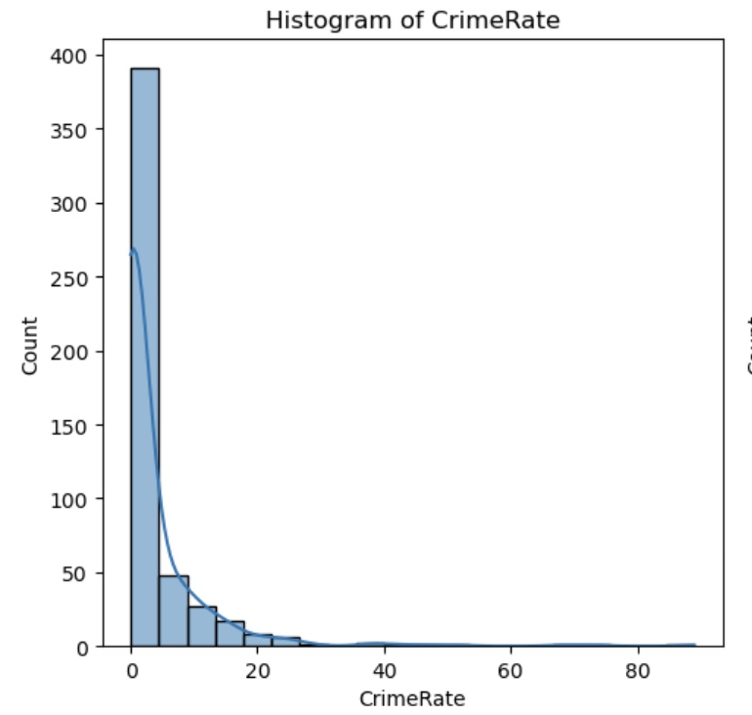
Summary And Analysis for variable "Crime Rate"
Mean of 3.61 indicates high skewness that suggests most properties have crime rates below the mean, with a few extreme high values inflating the average.
Mode of 0.01501 suggests that majority of neighborhoods have low crime rates.
Spread of 88.97 indicates a large variability in crime rates across neighborhoods.
Tails/Skewness of 5.22 indicates it is highly right-skewed, indicating a long tail on the higher end of crime rates.
Outliers are significantly higher than the general distribution. They can be handled by choosing to either retain, transform or exclude from further analysis.
Mean | 3.61
Mode | 0.01501
Spread | 88.97
Skew | 5.22
Outliers | 13.5222, 18.4982, and 19.6091

Slide 6
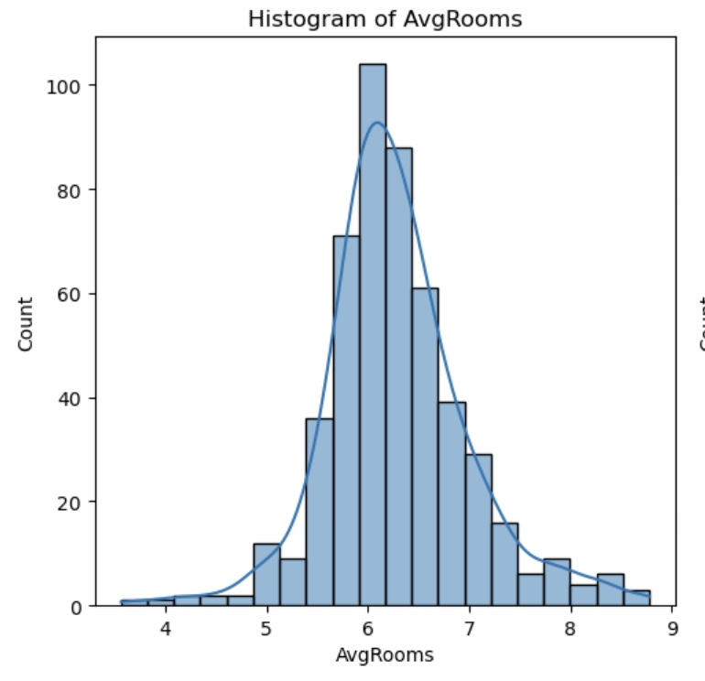
Summary And Analysis for variable "Average Rooms"
Mean of 6.28 indicates that most properties cluster around this value.
Mode of 5.713 suggests a slight concentration of properties with fewer rooms.
Spread of 5.22 indicates variation in property sizes but within a realistic range for the area.
Tails/Skewness of 0.40 indicates slight right skewness suggesting more properties with fewer rooms.
Outliers suggest homes with an unusually high number of average rooms compared to typical properties in the dataset. They can be handled by choosing to either retain, cap values or remove if there is evidence suggesting they are errors.
Mean | 6.28
Mode | 5.713
Spread | 5.22
Skew | .40
Outliers | 8.069, 8.375

Slide 7
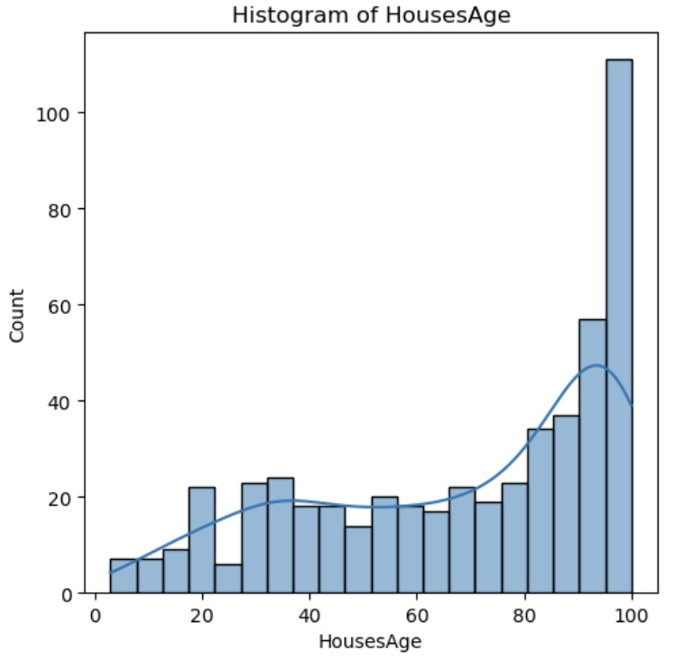
Summary And Analysis for variable "Houses Age"
Mean of 68.57 shows that on average, properties are quite old.
Mode of 100 shows many properties reach the maximum value
Spread of 97.1 indicates a wide variation in the age of properties, from very new to nearly a century old.
Tails/Skewness of -0.60 shows slight left skewness indicating a small proportion of newer properties compared to older ones
Mean | 68.57
Mode | 100
Spread | 97.1
Skew | -0.60
Outliers | No outliers were identified

Slide 8
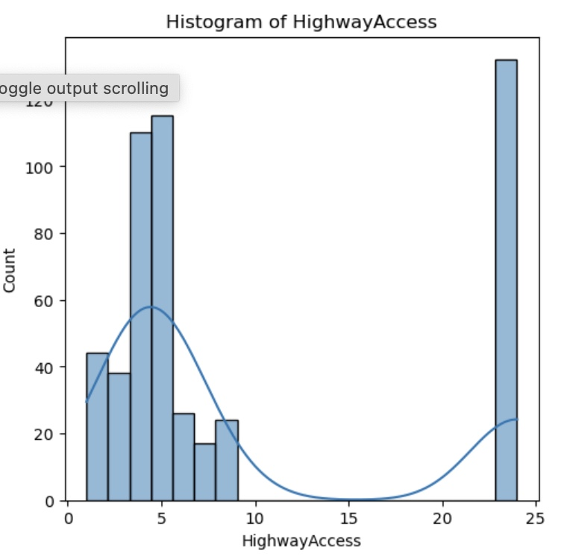
Summary And Analysis for variable "Highway Access"
Mean of 9.55 shows that on average, properties have moderate access to highways.
Mode of 24 suggests clusters of properties with very high highway access, likely concentrated in urban areas.
Spread of 23 shows variation in highway accessibility across neighborhoods, from minimal to very high.
Tails/Skewness of 1.00 shows moderate right skewness indicating more properties with low highway access compared to high access.
Mean | 9.55
Mode | 24
Spread | 23
Skew | 1.00
Outliers | No outliers were identified

Slide 9
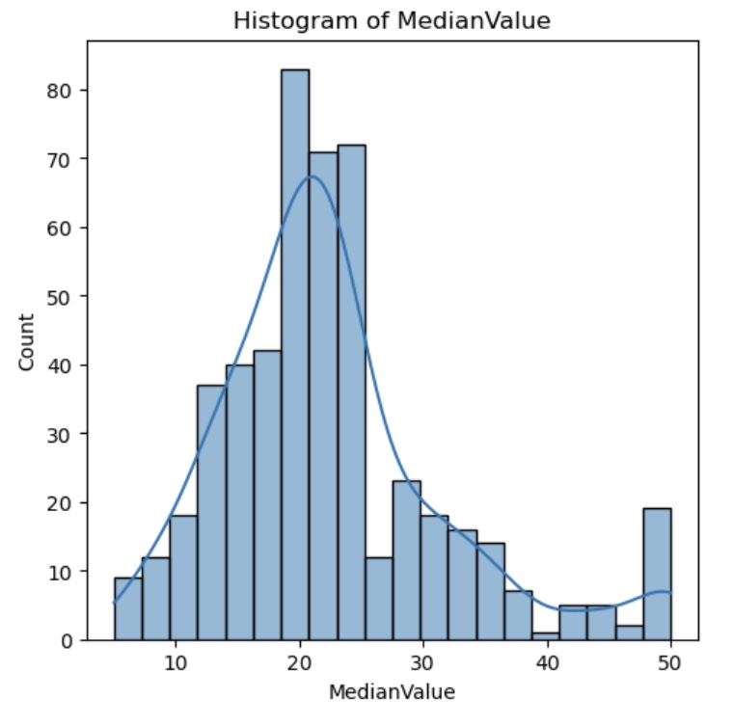
Summary And Analysis for variable "Median Value"
Mean of 22.53 provides a general sense of the housing market's central tendency.
Mode of 50.0 shows a significant number of properties hit the maximum value.
Spread of 45.0 indicates a broad spectrum of home values, from lower-end to high-end properties.
Tails/Skewness of 1.11 shows moderate right skewness, suggesting some higher-end properties push the distribution tail upward.
Outliers Identified is likely the upper limit or cap for median home values in the dataset. It can be handled by choosing to either retain, impute or transform.
Mean | 22.53
Mode | 50.0
Spread | 45.0
Skew | 1.11
Outliers | 50.0

Slide 10
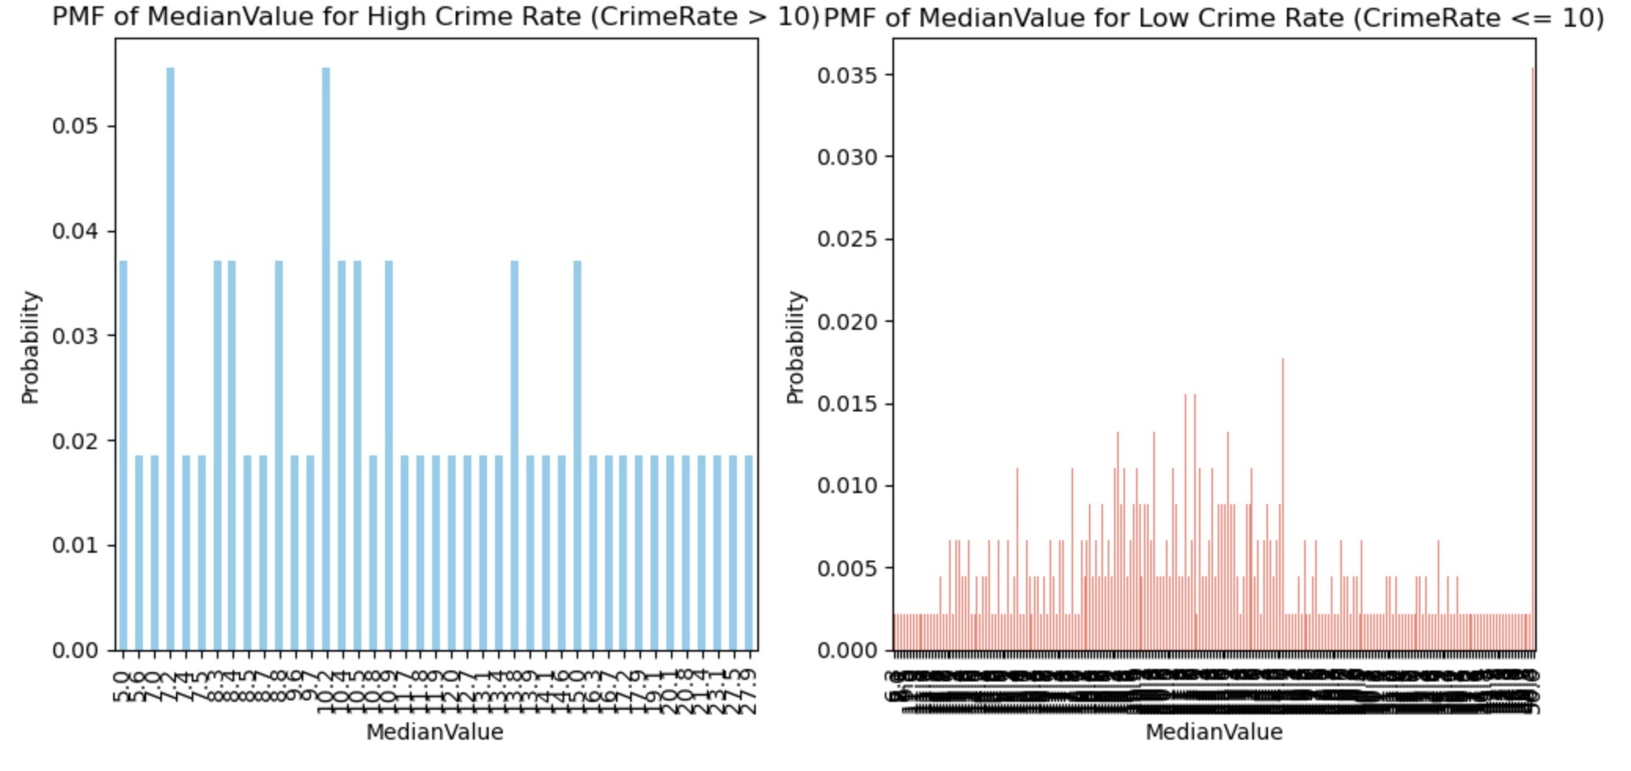
Compare two scenarios using a PMF (Compare homes in areas with high crime rates and low crime rates)
PMF for High Crime Rate (CrimeRate > 10) shows no clear central peak that indicates property values are dispersed across different ranges without a dominant value.
Whereas for Low Crime Rate (CrimeRate ≤ 10), there is a peak at the higher end of property values suggesting that neighborhoods with lower crime rates tend to have higher property values.

Slide 11
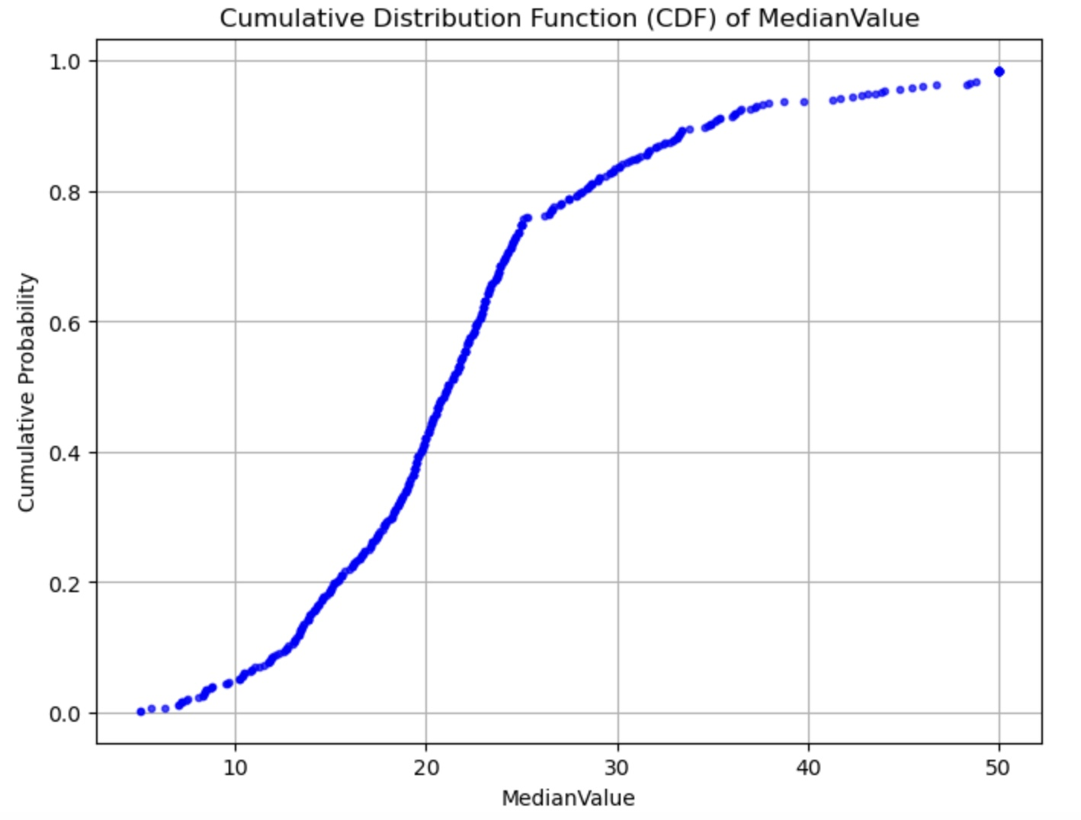
CDF with one of the variable "Median Value"
CDF results provide valuable insights into the distribution of Median value
CDF curve steepens at MedianValue of 20 to 30, which means a large portion of the data falls within this range. This suggests that most median property values in this dataset fall between $20,000 and $30,000 with relatively fewer properties valued at lower or higher ends
As MedianValue approaches the upper range 50, the CDF flattens out, suggesting fewer properties at higher values. So, the housing market is moderately concentrated around mid-range property values, with fewer low-cost or high-cost homes.

Slide 12
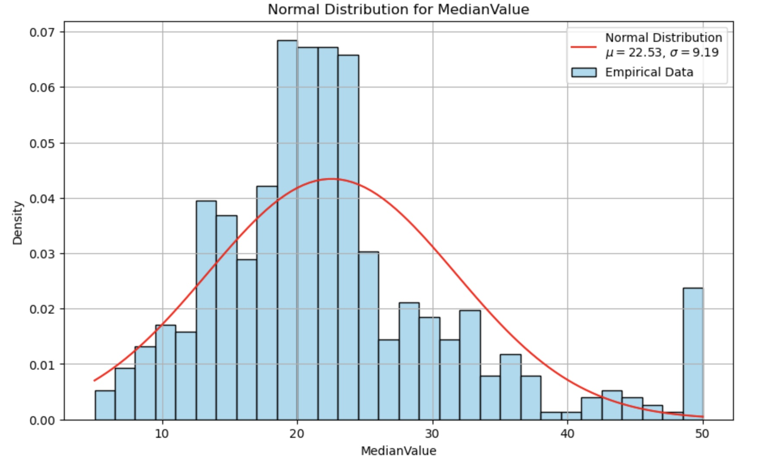
Normal Distribution for "Median Value"
The mean suggests that the typical value is around 22.53.
Standard deviation of 9.19 indicates moderate variability, meaning data points are reasonably dispersed around the mean.
Data appears skewed as we notice right tail and high frequency at 50. This suggests the distribution is not perfectly normal and may require transformations or alternative distributions for better modeling.

Slide 13
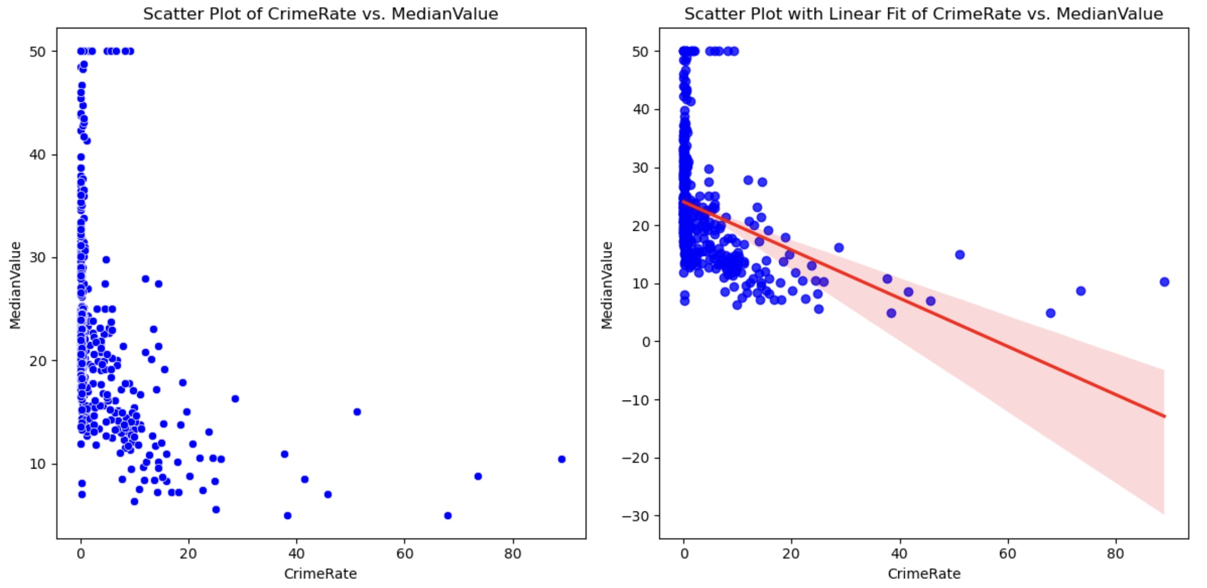
Two scatter plots comparing two variables "Crime Rate" and "Median Value"
Scatter plot shows a general negative trend: As Crime Rate increases, Median Value tends to decrease.
In Scatter Plot with Linear Fit, the regression line confirms the negative linear relationship.
The shaded red region represents the 95% confidence interval, showing that predictions become less reliable at higher Crime Rates due to greater scatter in the data.
The covariance is -30.72, which indicates that when Crime Rate increases, Median Value tends to decrease.
The Pearson correlation coefficient is -0.39 meaning there is a weak-to-moderate linear relationship between the two variables. However, Crime Rate alone is not a strong predictor of Median Value; other factors likely play a role.

Slide 14
Hypothesis Test Using Chi-Square Test
Null Hypothesis (H₀): There is no association between the variables ("Charles River" and "Highway Access" are independent)
Alternative Hypothesis (H₁): There is a significant association between the variables ("Charles River" and "Highway Access" are dependent)
Chi-Square Statistic: 13.90 suggests no significant association between the two categorical variables "Highway Access" and "Charles River"
P-value: 0.084 is slightly greater than 0.05 which suggests that there is insufficient evidence to conclude that Highway Access is significantly associated with Charles River.
Fail to reject the null hypothesis: There is no significant association between Highway Access and Charles River.

Slide 15
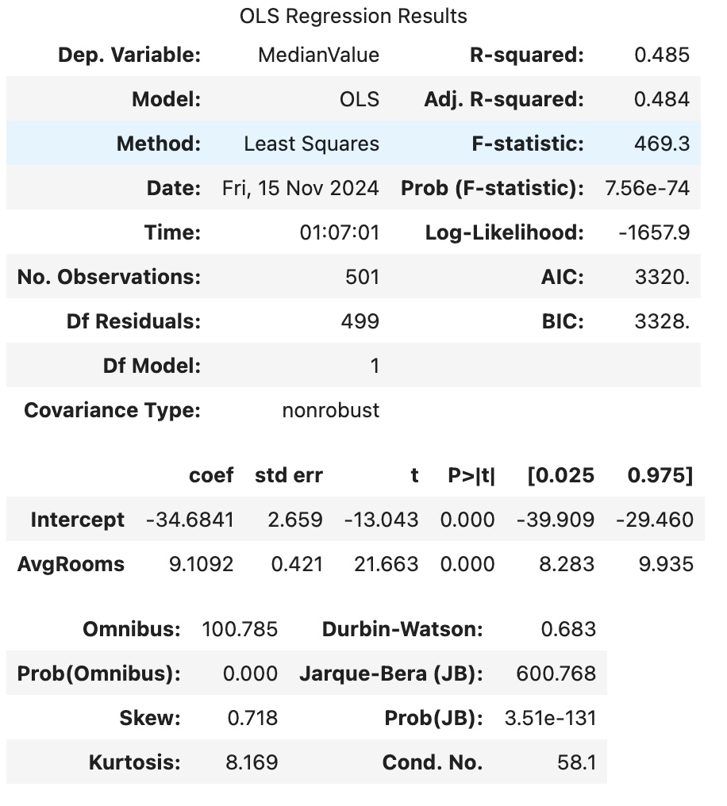
Simple Linear Regression
R-squared shows that 48.5% of the variability in the "Median Value" is explained by variable "Average Rooms". This is a moderate level of fit.
Extremely small p-value indicates that the overall model is highly significant.
However, autocorrelation, non-normality, and skewness, suggests that this model may not be capturing all the underlying patterns in the data.
Further diagnostic checks or transformations may be needed to improve model assumptions

Slide 16
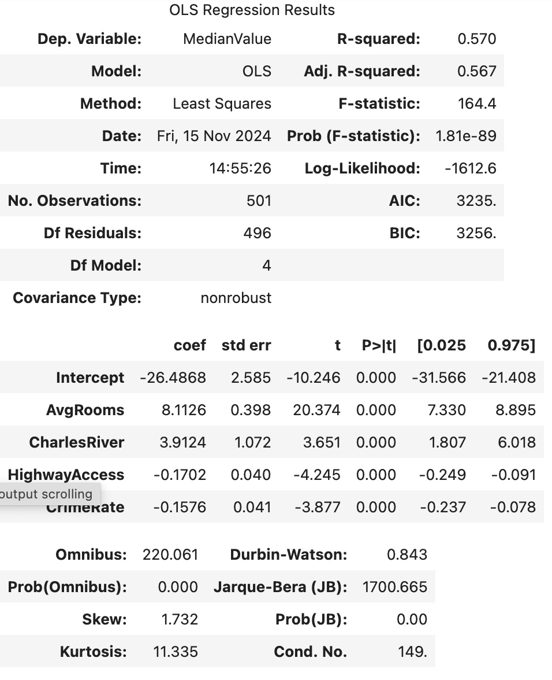
Multiple Linear Regression
Improved Model Fit: Compared to the first model, this multiple variable regression model explains a higher proportion of the variance in "Median Value" (R-squared = 0.570 vs. 0.485).
The additional predictors (Charles River, Highway Access, and Crime Rate) significantly improve the model’s explanatory power.
Autocorrelation, non-normality of residuals, and high kurtosis indicates that there is still room to improve the model.
These issues could be addressed with model adjustments (e.g., transforming variables, adding interaction terms, or considering alternative regression models).

Slide 17
Additional steps to improve/build on this analysis
Using an updated and more comprehensive data set
Using Advanced Modeling Techniques
Exploring Multivariate Relationships
Handling Outliers and Skewed Data
Applying cross-validation techniques

Slide 18
Conclusion
This analysis underscores the value of data in supporting strategic decisions in the housing market.
Policies aimed at creating attractive, safe, and accessible neighborhoods can directly influence housing demand and boost local property markets.
Lower crime rates correlate strongly with higher property values, suggesting safety as a top priority for homebuyers.
Proximity to the Charles River emphasizes the importance of natural amenities.
Moving forward, future projects could enrich this analysis by incorporating additional steps listed above which opens pathways for further exploration.

