Slide 1
Employee Segmentation on Absenteeism
Presented by : Vinod A. Korachgaon Batch : DA172S17+ML22S2 Client : Komilla Bhatia Date : 01-03-2024

Slide 2
Problem Statement:
Some employees are frequently absent during work hours, impacting daily progress.
Objective :
Analyze and create employee clusters to identify and address the main contributors to absenteeism.
Description of the Dataset :
The Absenteeism dataset has 706 rows and 23 columns . It provides information on reasons for absence , month of absence ,day of the week, seasons, age, work load , transportation expenses, distance from residence to work , service time , hit target, absenteeism time in hours , weight , bmi , social drinker , social smoker.

Slide 3
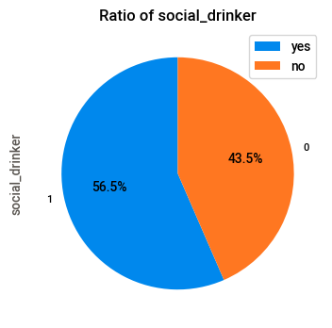
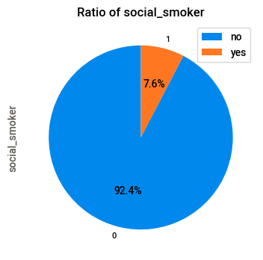
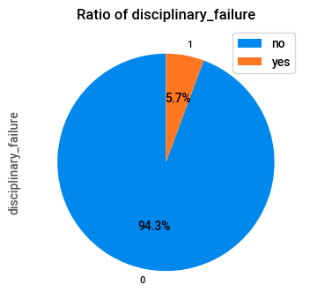
Ratio of social drinker , smoker and Disciplinary Failure
Social Drinkers are more 56.5%
Social Smokers are 7.6%
Disciplinary Failures are 5.7%

Slide 4
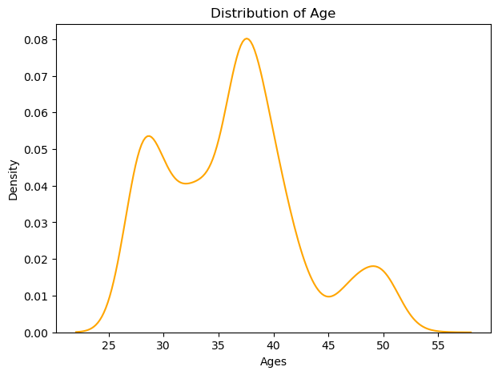
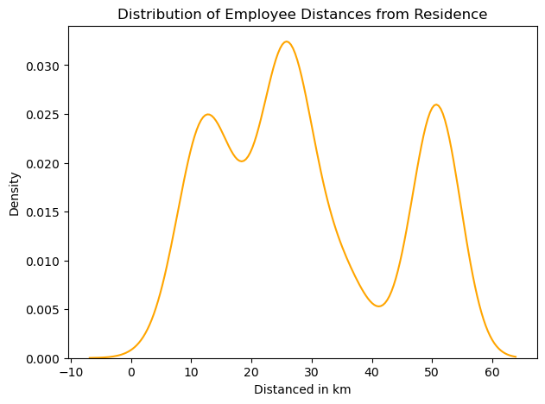
Distribution of the Age
Distribution of the Employee Distance from Residence
Most of the employees are between 35 to 40 years old
Most of the Employees Distance from Residence is between 20 to 30 km

Slide 5
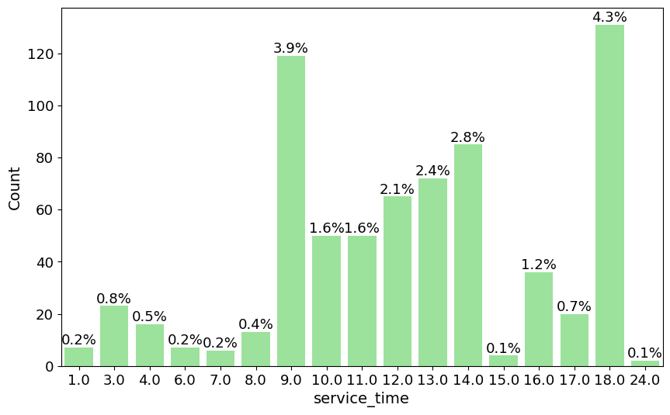
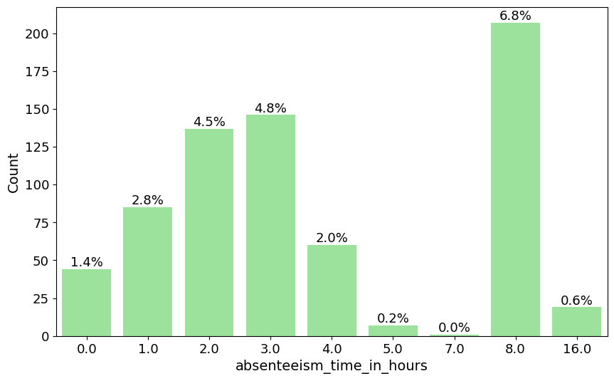
Employee Service Duration
Highest Absenteeism Time in hours
Employee Service Time
Employee Absenteeism Time hours
Most Employees Have Worked for 18
hours – (4.3%) and 9 hours – (3.9%)
Most of the employees have been absent for 8 hours – (6.8%) and 3 hours (4.8%)

Slide 6
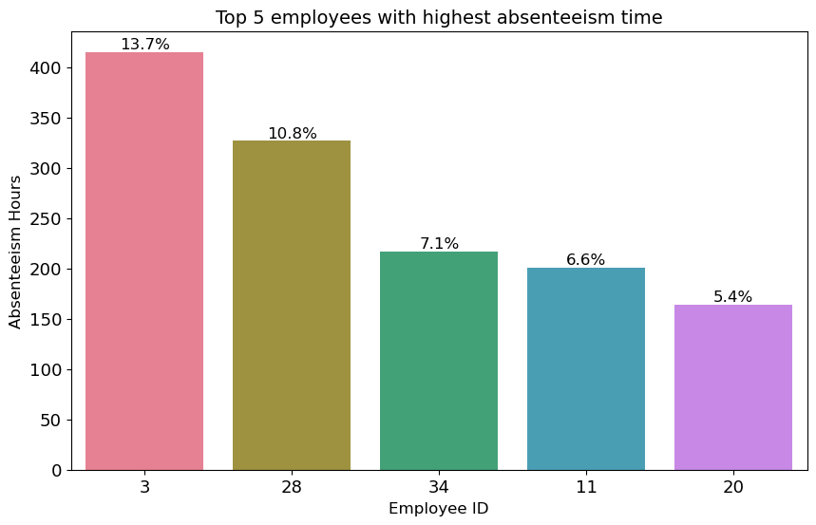
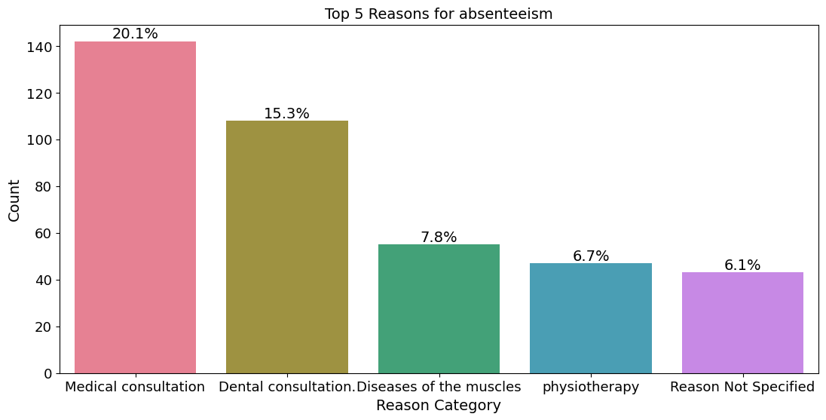
Top 5 Employees with Highest Absenteeism Time
Top 5 Employees ID based on Highest Absenteeism Time
Top 5 Reasons for Absenteeism
Top 5 Employees with highest Absenteeism Time in hours :
1] EMP ID : 3 ,Ratio - 13.7 % , Absenteeism Time - 415 hours
2] EMP ID : 28 ,Ratio -10.8% , Absenteeism Time - 327 hours
3] EMP ID : 34 ,Ratio -7.1% , Absenteeism Time – 217 hours
4] EMP ID : 11 ,Ratio – 6.6% , Absenteeism Time – 201 hours
5] EMP ID : 20 ,Ratio-5.4%,Absenteeism Time -164 hours
Top 5 Reasons for Absenteeism :
1] Medical Consultation
2]Dental Consultation
3]Diseases of the muscles
4] Physiotherapy
5] Reason not Specified

Slide 7
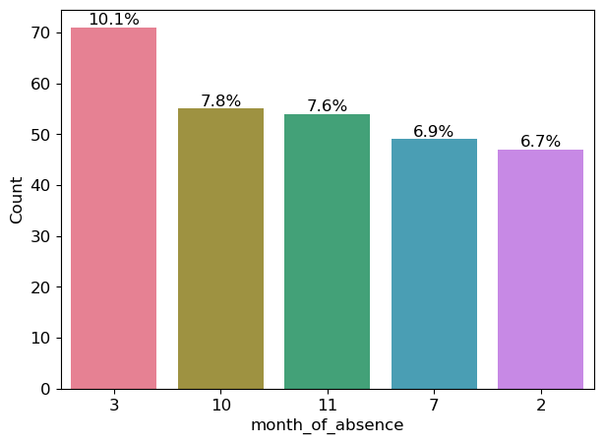
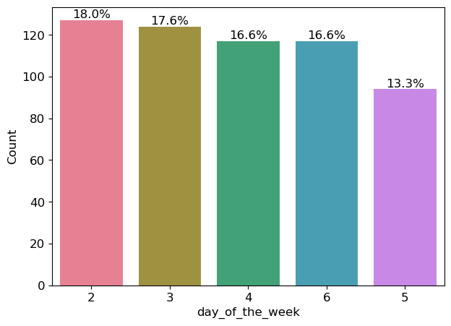
Month wise Absenteeism
Day wise Absenteeism
Month wise Absenteeism
Day wise Absenteeism
High Absenteeism Rate is in the
March : 10.1%
High Absenteeism Rate
Monday : 18%

Slide 8
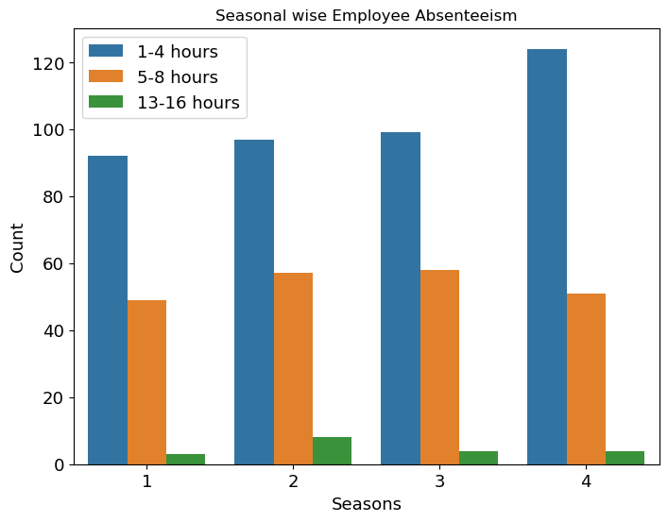
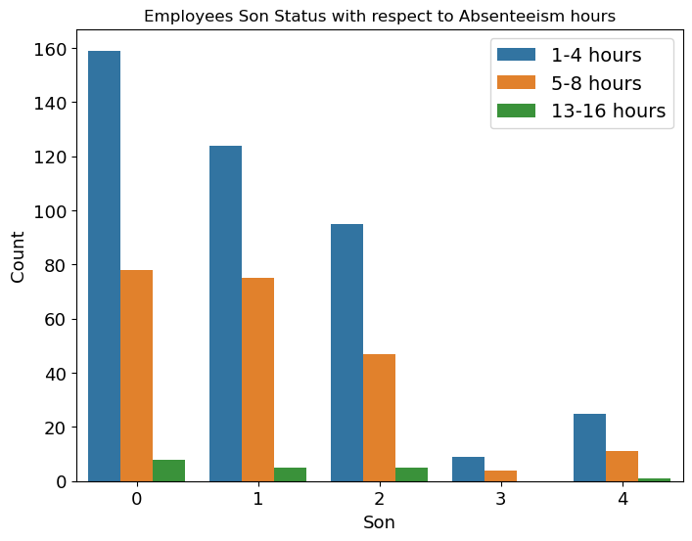
Season wise Absenteeism Hours
Employees son status with respect to Absenteeism hours
1-4 hours of absences are more in the spring season
5-8 hours of absences are more in the autumn and winter season
13-16 hours of absences are more in the Autumn season.
1-4, 5-8, and 13-16 hours of absence are more in employees who are without sons

Slide 9
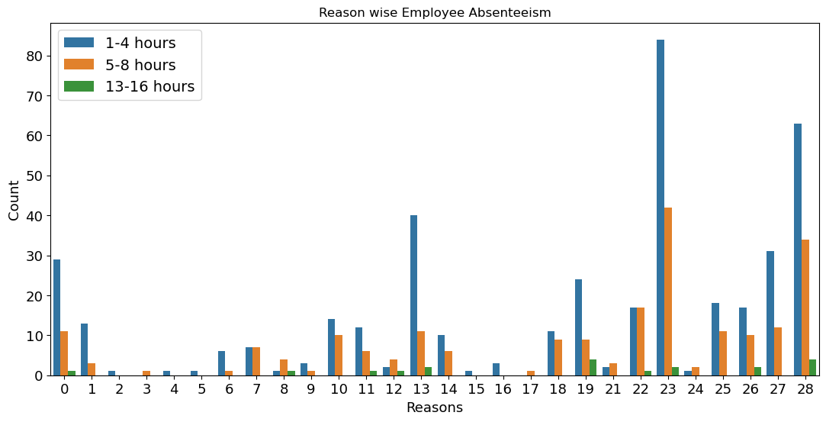
1-4 and 5-8 hours of absences more with medical consultation reason
13-16 hours of absences are more with injury, poisoning and Dental consultation reasons

Slide 10
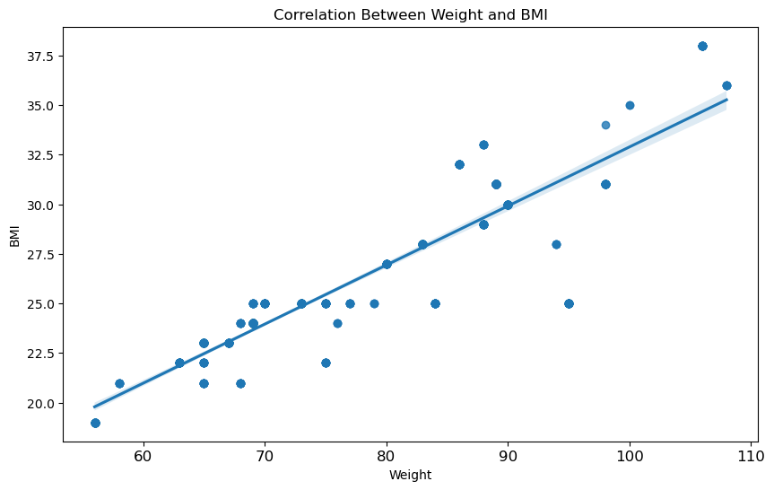
Correlation shows how two things are connected with each other
Weight and body mass index are Strongly correlated with each other (0.9)

Slide 11
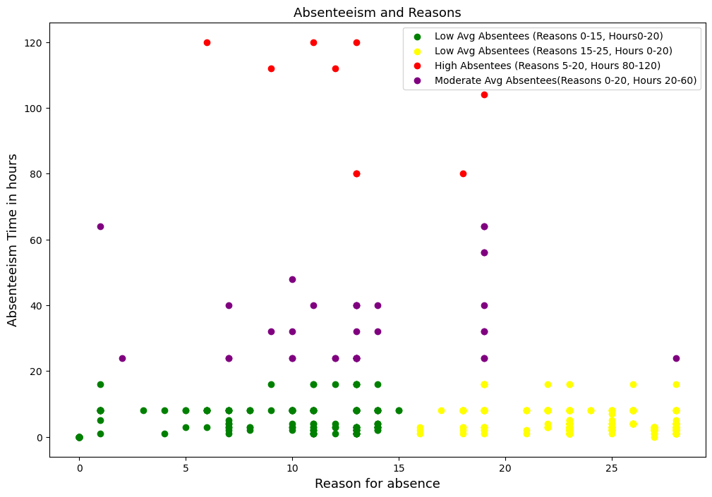
Absenteeism Time and Reasons
Top 5 Reasons for Absenteeism : 1] Medical Consultation 2]Dental Consultation 3]Diseases of the muscles 4] Physiotherapy 5] Reason not Specified Green and Yellow segments: Less absenteeism (0-20 hours). Purple segment: Moderate absenteeism (20-60 hours) - Send awareness mail. Red segment: High absenteeism (80-120 hours) - Take action on employees.

Slide 12
Algorithms
Used Principal Component Analysis For Dimensionality Reduction technique
Using PCA, we reduced the dimension of the data with minimal information loss.5%
Algorithms silhouette score Performance
KMeans 41% Giving labels with no outliers
Agglomerative 42% Giving labels with no outliers
DBSCAN 30% Giving labels with too many outliers

Slide 13
C
O
N
C
L
U
S
I
O
N
Top 5 Reasons for Absenteeism :
1] Medical Consultation
2]Dental Consultation
3]Diseases of the muscles
4] Physiotherapy
5] Reason not Specified
Top 5 Employees Based on highest Absenteeism Time in hours :
1] EMP ID : 3 ,Ratio - 13.7 % , Absenteeism Time - 415 hours ,Top Reason –Laboratory examination
2] EMP ID : 28 ,Ratio -10.8% , Absenteeism Time - 327 hours, Top Reason - Medical consultation
3] EMP ID : 34 ,Ratio -7.1% , Absenteeism Time – 217 hours, Top Reason - Dental consultation
4] EMP ID : 11 ,Ratio – 6.6% , Absenteeism Time – 201 hours, Top Reason - Injury, poisoning
5] EMP ID : 20 ,Ratio-5.4%,Absenteeism Time -164 hours, Top Reason - medical consultation
Unjustified Absenteeism
1] EMP ID : 5 ,Ratio – 0.6% % , Absenteeism Time - 55 hours
2] EMP ID : 11 ,Ratio -0.4% , Absenteeism Time - 30 hours
3] EMP ID : 36 ,Ratio -0.1% , Absenteeism Time – 16 hours
Report to the Management
2% of the Employees have been absent for more than 90 hours
Fire Employees : ID : 3 and 5
Make sure management received leave proof from the employees (id : 28,34,11,20) if they are given then
Send a alert mail to the employees that, frequently absent during work hours, impacting daily progress.
Please be present in the office . If proof is not submitted, send a warning that repetition may result in termination..
For Emp ID : 11,36 , Tell employee 11,36 to get permission before taking leave and show proof for why.

Slide 14


