Slide 1


TMDB Movie Data Set Analysis
Presented by: Vinod A. Korachgaon
Batch : ML22S2

Slide 2



PROJECT OBJECTIVE
Description of the dataset
Analyze a movie dataset to uncover trends and insights.
predict movie ratings using some predictive models.
Categorize movies by genre and identify top-performing films.
The TMDB Movie Dataset contains 4,803 rows and 26 columns. It offers details on movie genres, titles, budgets, revenues, runtime, actors' names, directors, producers, writers, vote counts, production companies, and production countries.

Slide 3
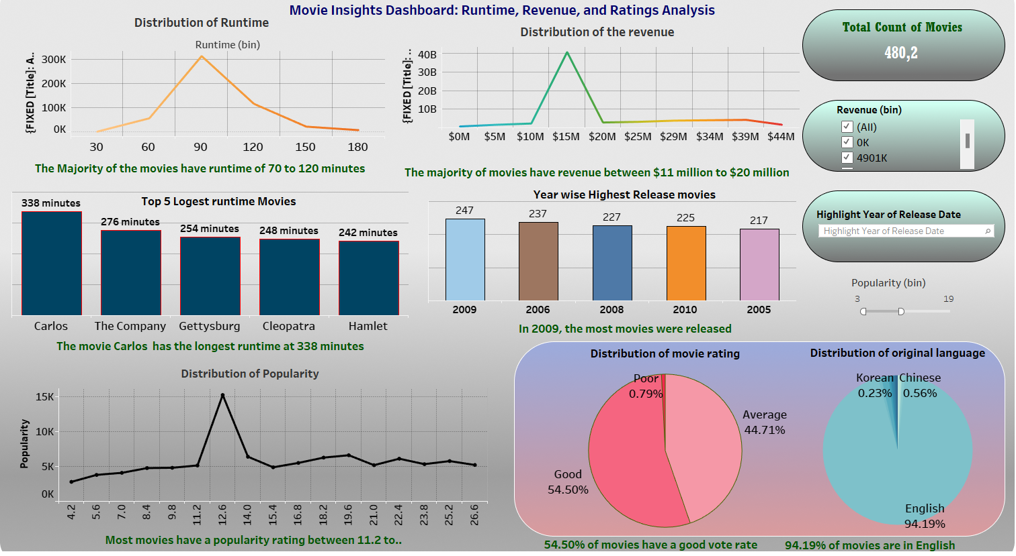

Slide 4
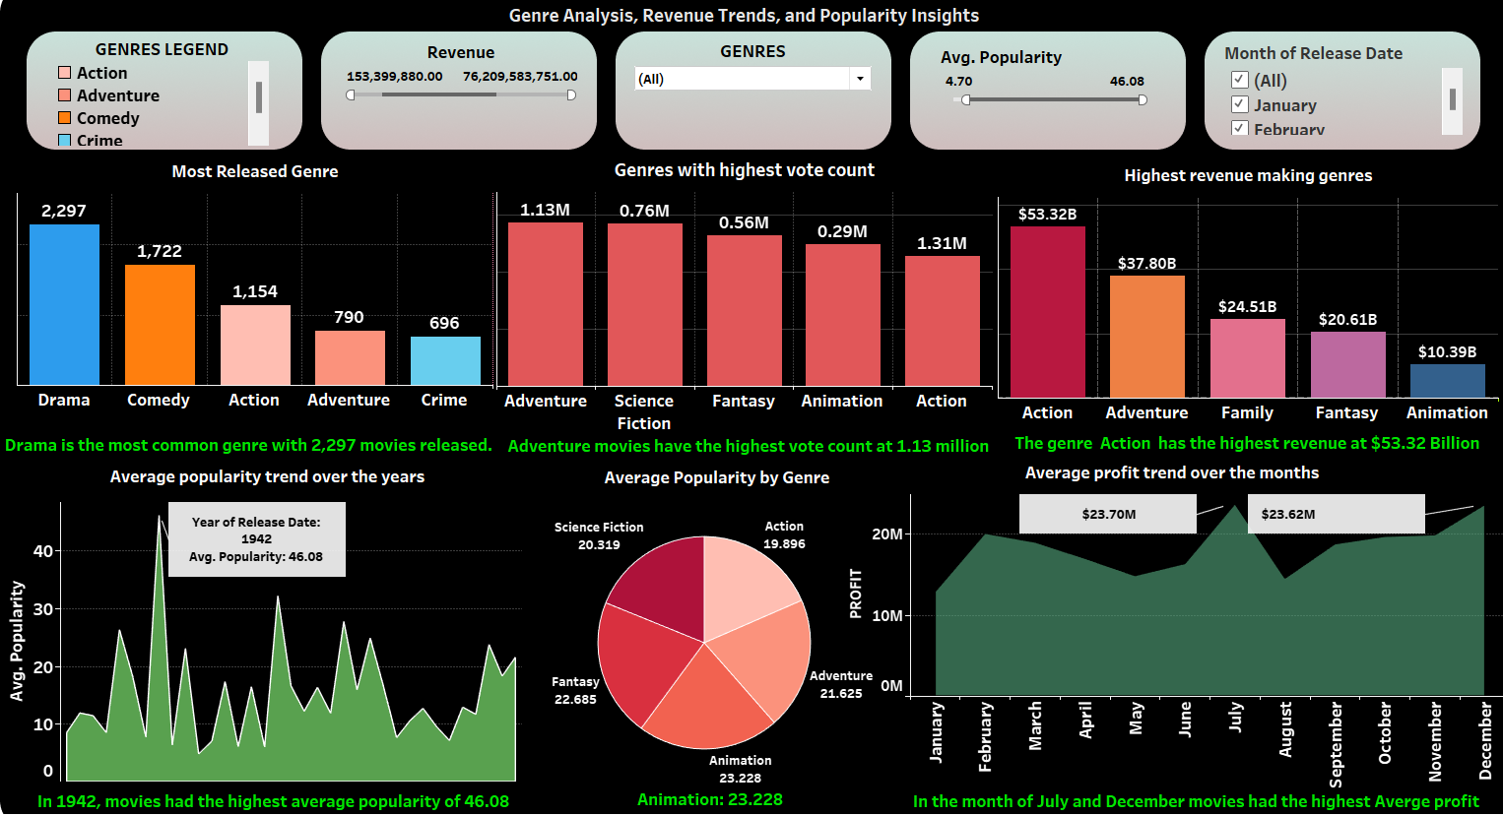

Slide 5
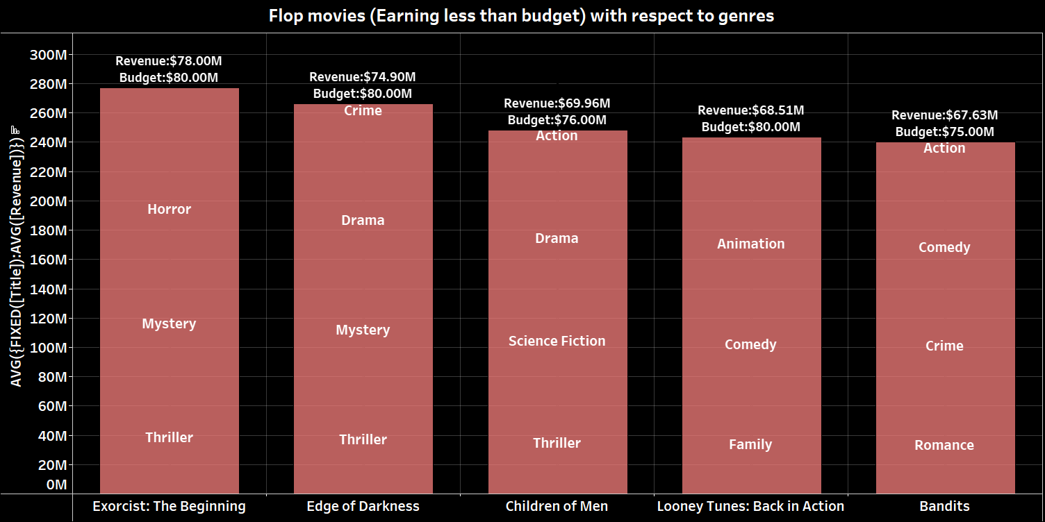
Exorcist : The Beginning loss with $ 2 million

Slide 6
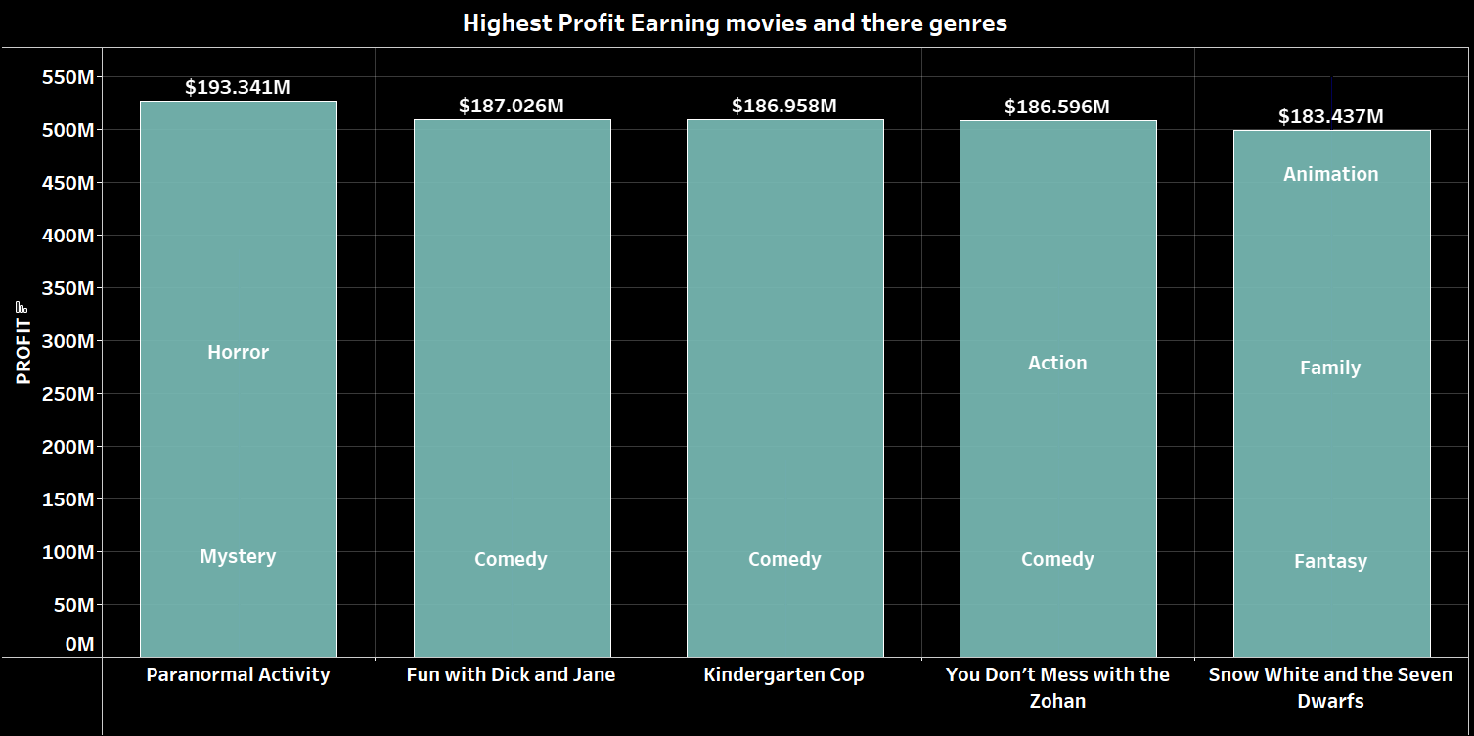
Paranormal Activity made profit $193.341 million

Slide 7
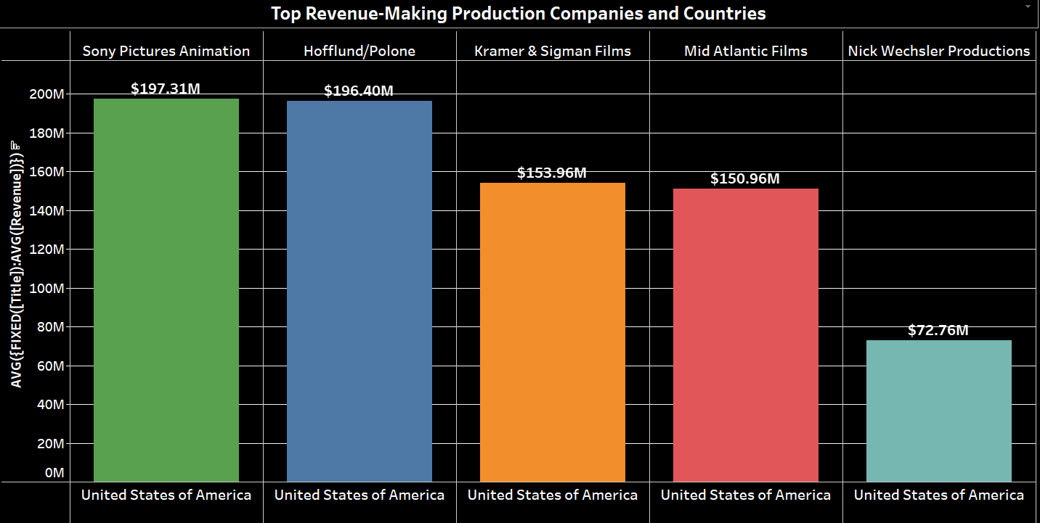
Company: Sony pictures Animation and Country USA earned highest Revenue $197.31million

Slide 8
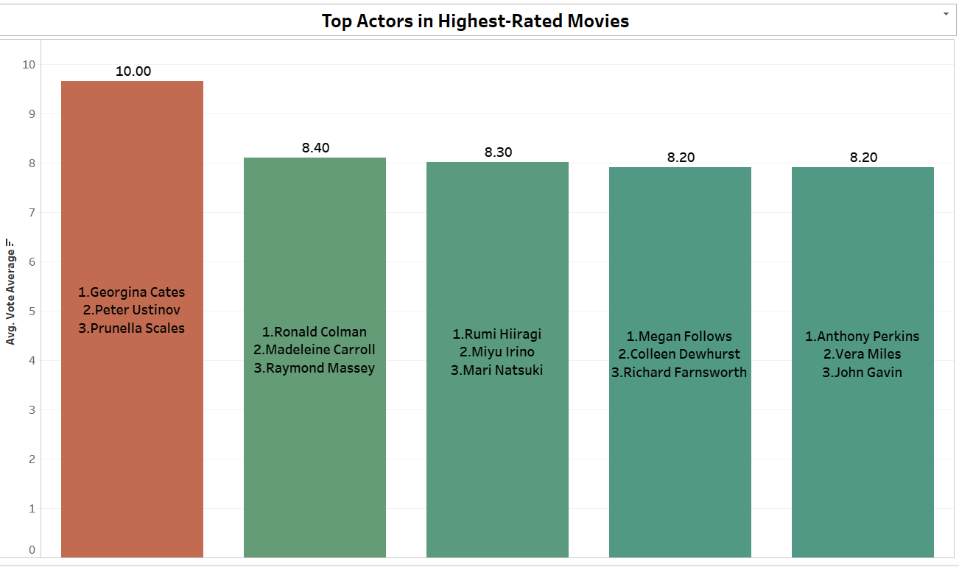
1] Georgina Cates 2] Peter Ustinov 3] Prunella Scales
Actors of Highest Rated Movie

Slide 9
Machine learning
Machine Learning Task | Algorithm Used | Training Performance | Testing Performance | Additional Metrics | Interpretation
Classification on Genres | XGBClassifier | 95.52% | F1 Score - 96.60% |  | The XGBClassifier model performs well with high score on both training and testing sets.
Regression on Revenue | RandomForestRegressor | 87.98% | r^2 - 88.12% | MSE: 1.88 | The RandomForestRegressor model shows good predictive power for movie revenue, with moderate error.
Classification on Categorical Rating | Random Forest | Cross-val score: 97% | OOB Score: 94% |  | Random Forest rates movies accurately with good reliability.

Slide 10
Predicted Categorize Ratings for Two Movies
Movie | Signed, Sealed, Delivered | My Date with Drew
Budget | $15,000,000 | $15,000,000
Original Language | English | English
Popularity | >= 1.44 | >= 1.92
Vote Average | >= 7.0 | >= 6.3
Runtime | >= 120 minutes | >= 90 minutes
Actor | Eric Mabius | Drew Barrymore
Predicted Rating | Average | Average

Slide 11
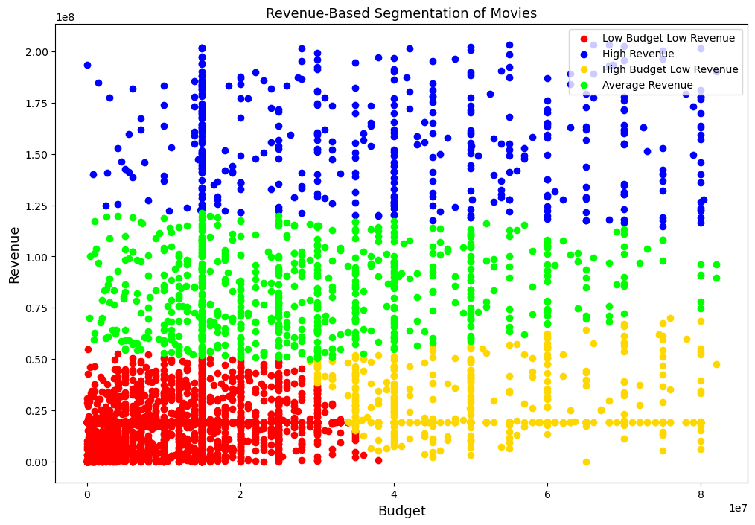
9
clusters
Red zone clusters belongs to low budget and low revenue
Yellow zone clusters belongs to high budget and low revenue
Lime cluster belongs to average revenue
Blue clusters belongs to high revenue

Slide 12
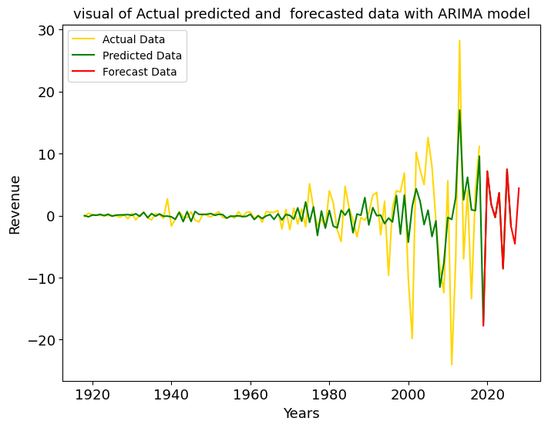
Time series
Model | MSE | RMSE
ARIMA | 23.95 | 4.89
The time series analysis aimed to forecast future revenue trends based on historical data to guide strategic business decisions and
Relatively low MSE and RMSE values in our time series analysis, it suggests that our model is performing well in forecasting revenue based on release date. Therefore, we can expect future revenue to follow a similar trend as the historical data

Slide 13
Top Revenue movies : Crew , and Production Details
Title | Writer | Director | Producer | Production Company | Production Country | Revenue
Everest | Not Available | Baltasar Kormakur | Evan Hayes | Universal Pictures | Iceland | $203.43M
Vanilla Sky | Not Available | Cameron Crowe | Cameron Crowe | Paramount Pictures | United States of America | $203.39M
Need for Speed | Not Available | Scott Waugh | Patrick O'Brien | DreamWorks SKG | Philippines | $203.28M
Battle: Los Angeles | Christopher Bertolini | Jonathan Liebesman | Ori Marmur | Columbia Pictures | United States of America | $202.47M
Patch Adams | Not Available | Tom Shadyac | Marvin Minoff | Universal Pictures | United States of America | $202.29

Slide 14
conclusion
Genre Strategy: Drama and Adventure genres dominate the market. Investing further in these genres could yield higher returns and audience engagement.
Release Timing: Movies released in July and December consistently show higher profitability. Aligning major releases with these months could optimize profits.
Revenue Leaders: Action movies stand out in revenue generation. Collaborating with successful action movie directors and writers could boost revenue.
Geographical Focus: The United States of America remains a key player in high revenue movies. Exploring opportunities in this market can be beneficial.
Production Partnerships: Establishing or strengthening partnerships with top production companies like Universal Pictures and Paramount Pictures can enhance movie quality and revenue potential.

Slide 15
Business Implementation Report
Genre Choice : Pick genres like drama, comedy, and action that most people enjoy to boost the movie's chances of success.
Best Timing : Release the movie in July or December, the months when audiences are most active, to make more money.
Actor Selection : Cast popular actors like Georgina Cates and Peter Ustinov to attract more viewers and improve the movie's reputation.
Partner Up : Collaborate with companies like Universal Pictures and Paramount Pictures to get more attention and reach a wider audience.
Director Decision : Hire directors like Baltasar Kormakur and Cameron Crowe known for making great movies to ensure the movie turns out well.

Slide 16


