Slide 1
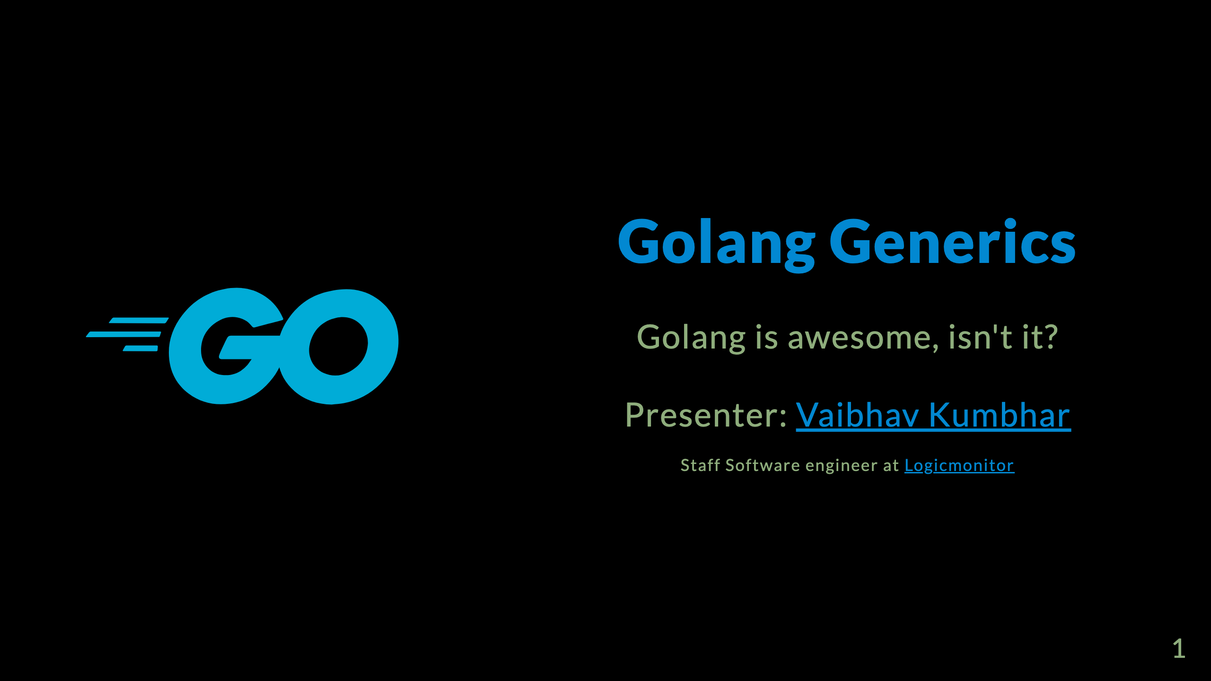
Notes:
Cheers to the Golang community!

Slide 2
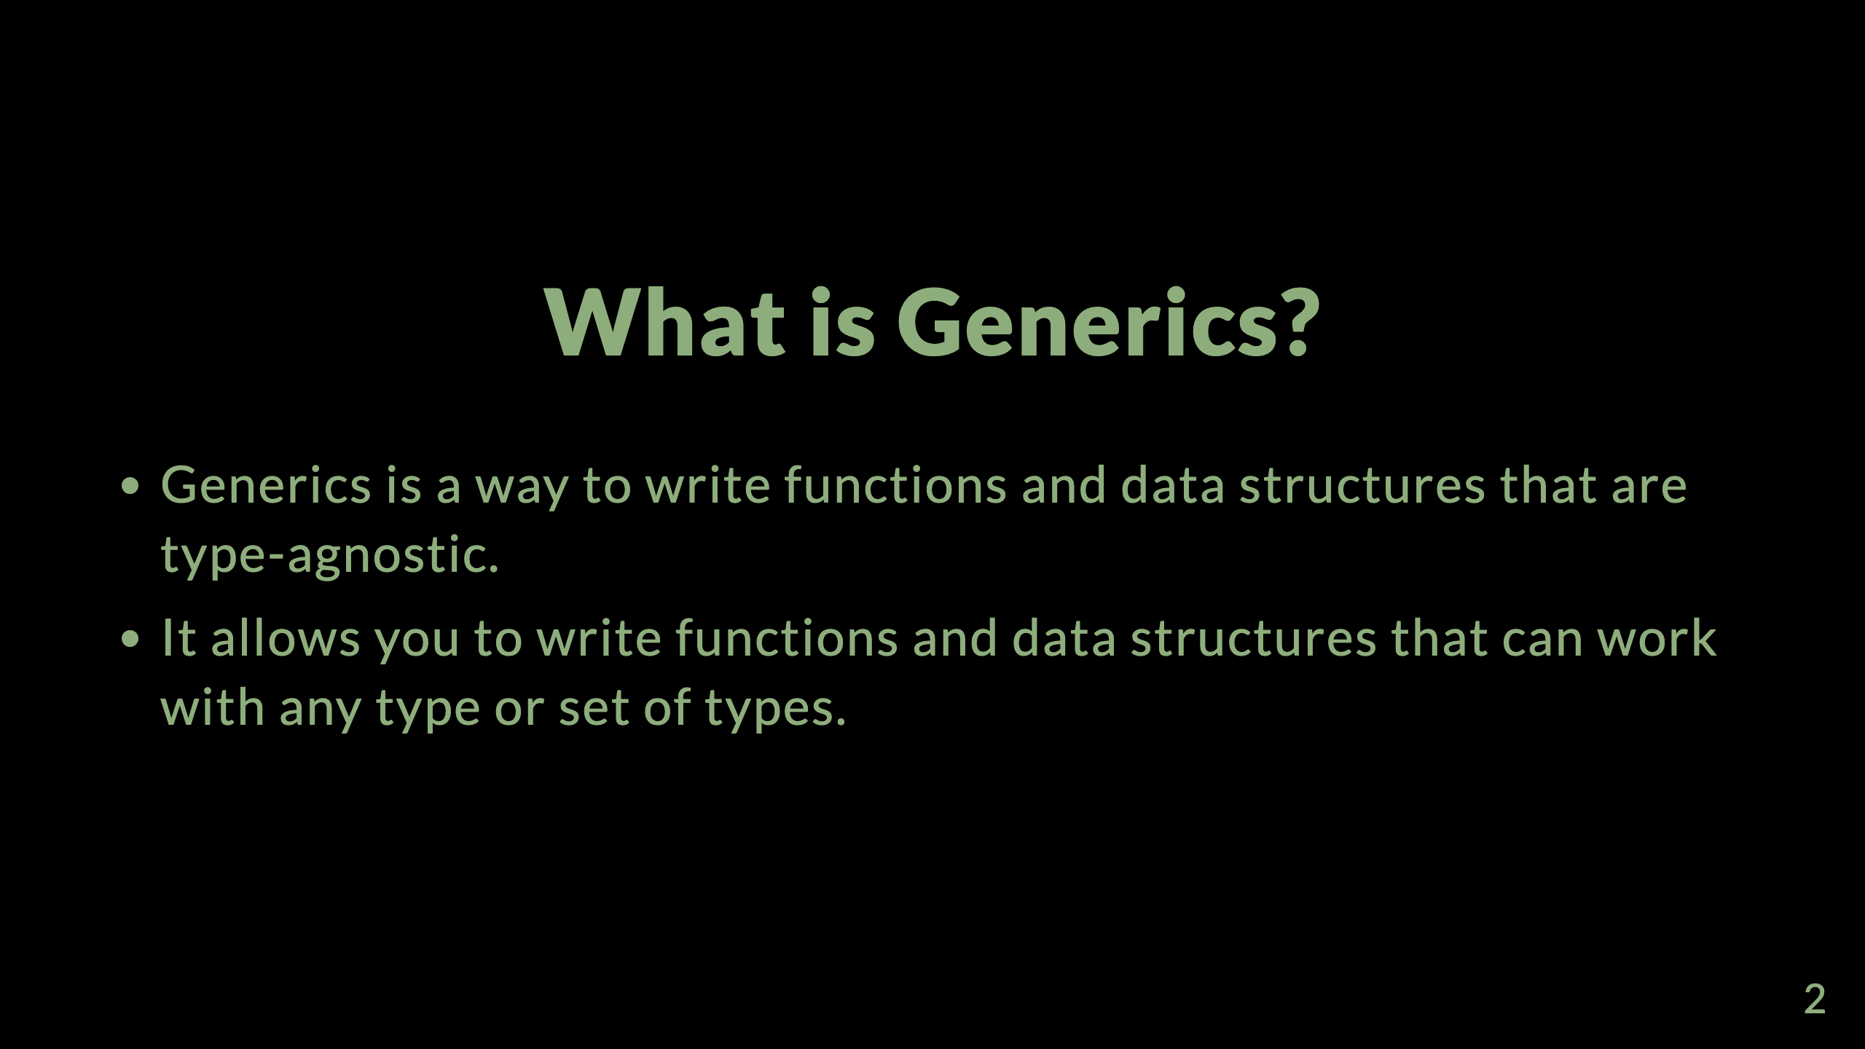

Slide 3
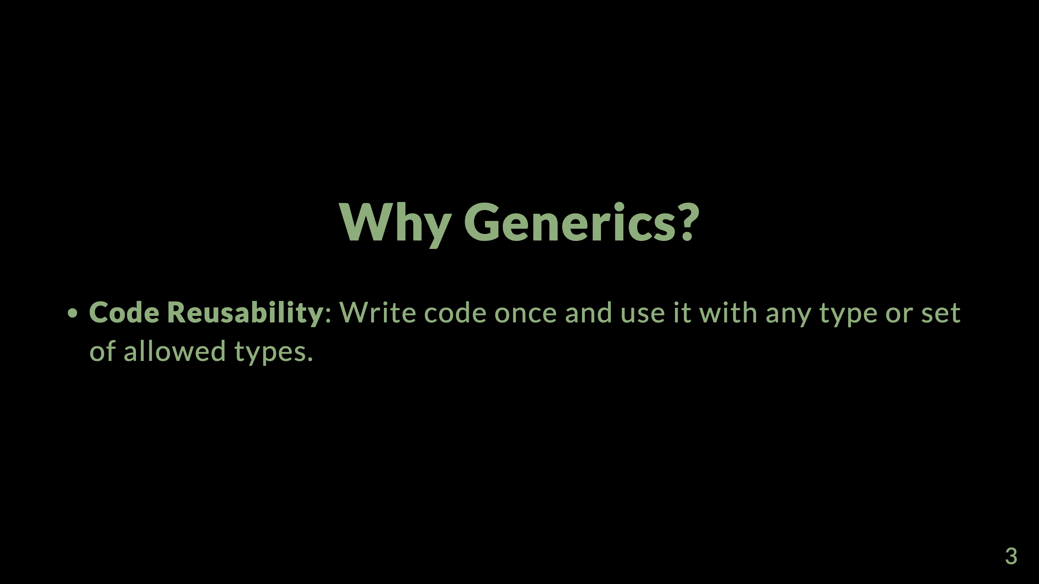
Notes:
- writing the same code for different types is a waste of time and effort. - library functions to work on different types. - structs that can hold any type of data without having to use interface{}

Slide 4
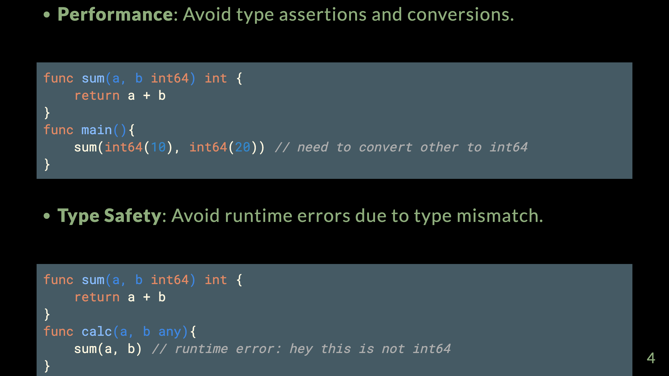
Notes:
- type assertion and conversion are expensive operations. - avoid type assertion and conversion - type mismatch errors are caught at compile time. - avoid runtime errors due to type mismatch.

Slide 5
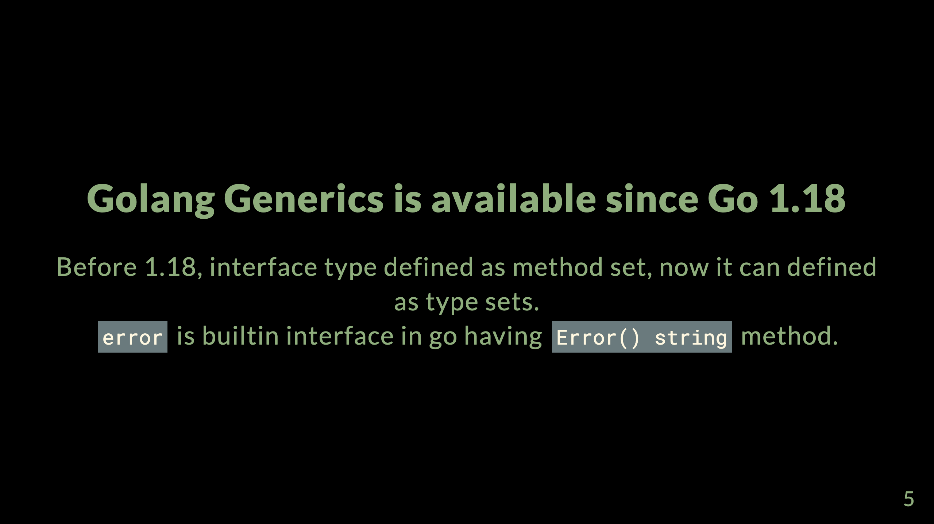
Notes:
- Go 1.18 is released on 16th Feb 2022. - Go 1.18 is the first release to support generics.

Slide 6
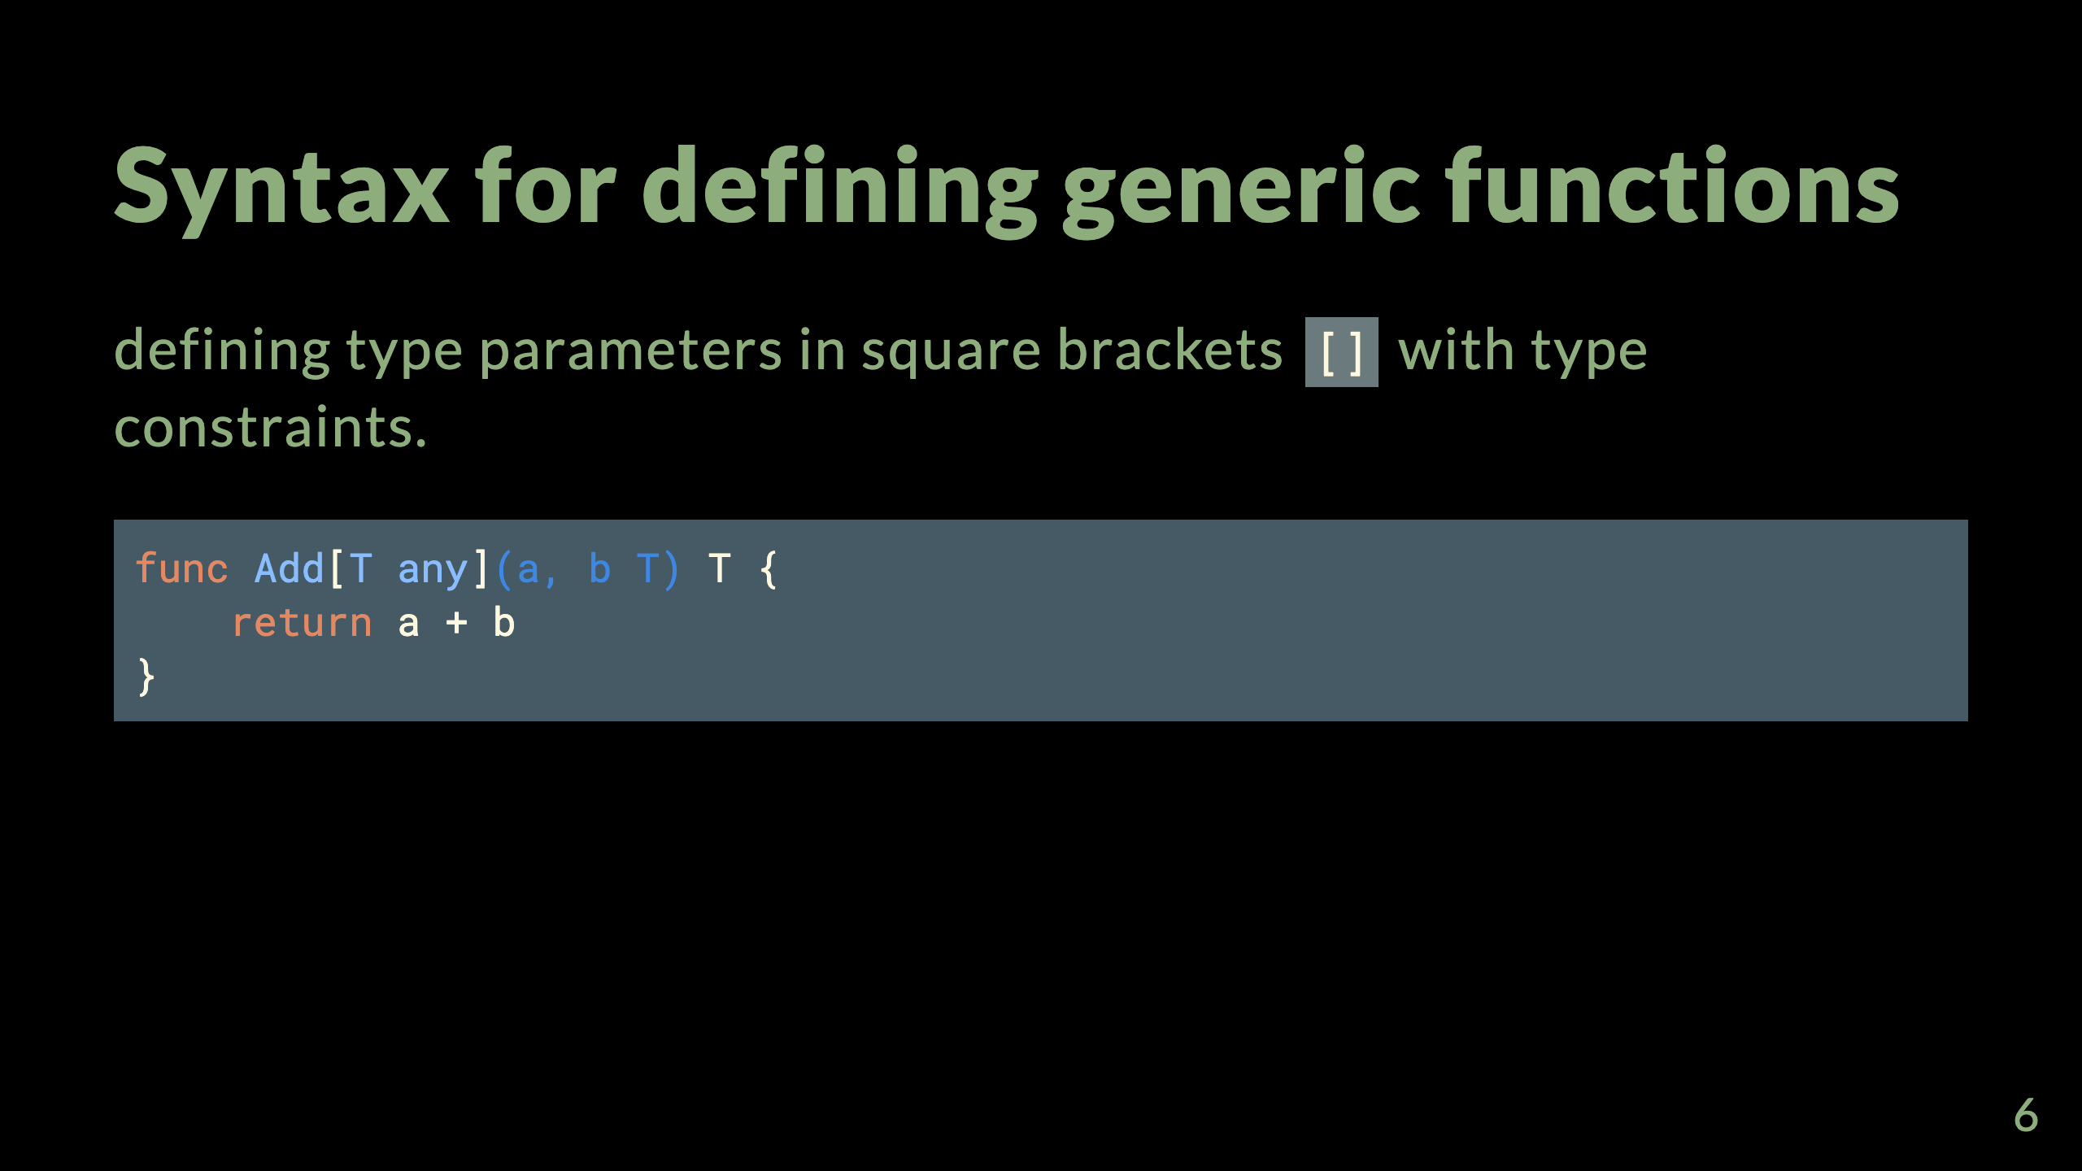
Notes:
Let's see demo examples [here]() - add link. - go [intro-generics](https://go.dev/blog/intro-generics)

Slide 7
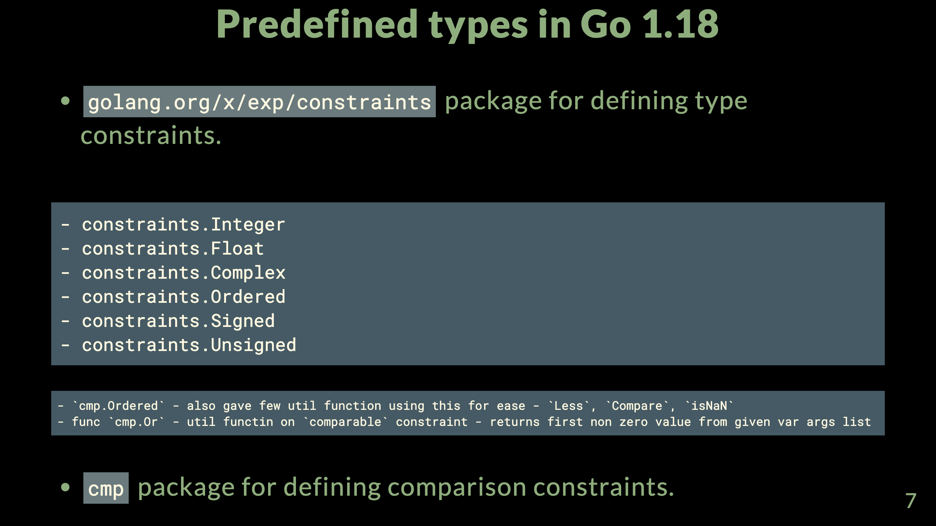
Notes:
- a is Less < b - compare -1,0,1 return value - isNan - check if value is NaN

Slide 8
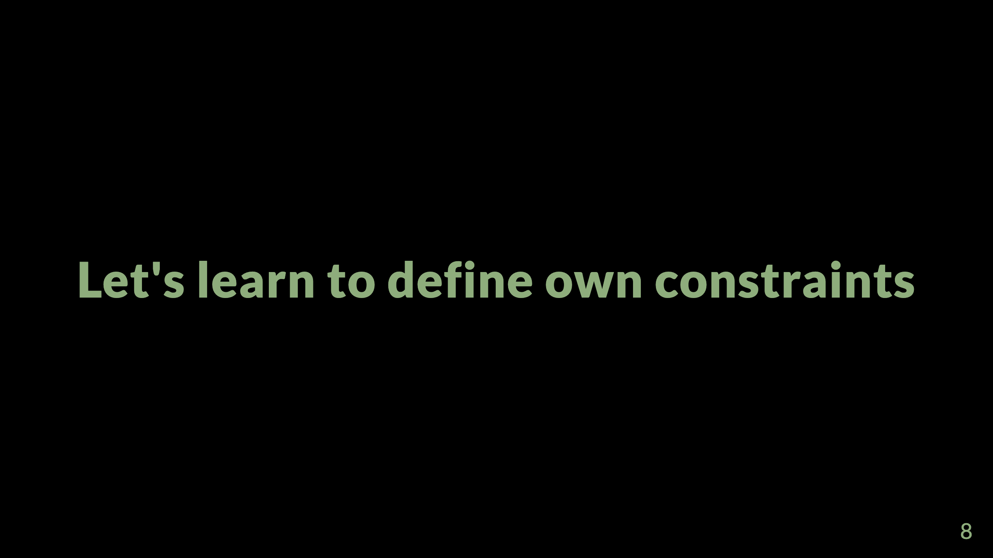

Slide 9
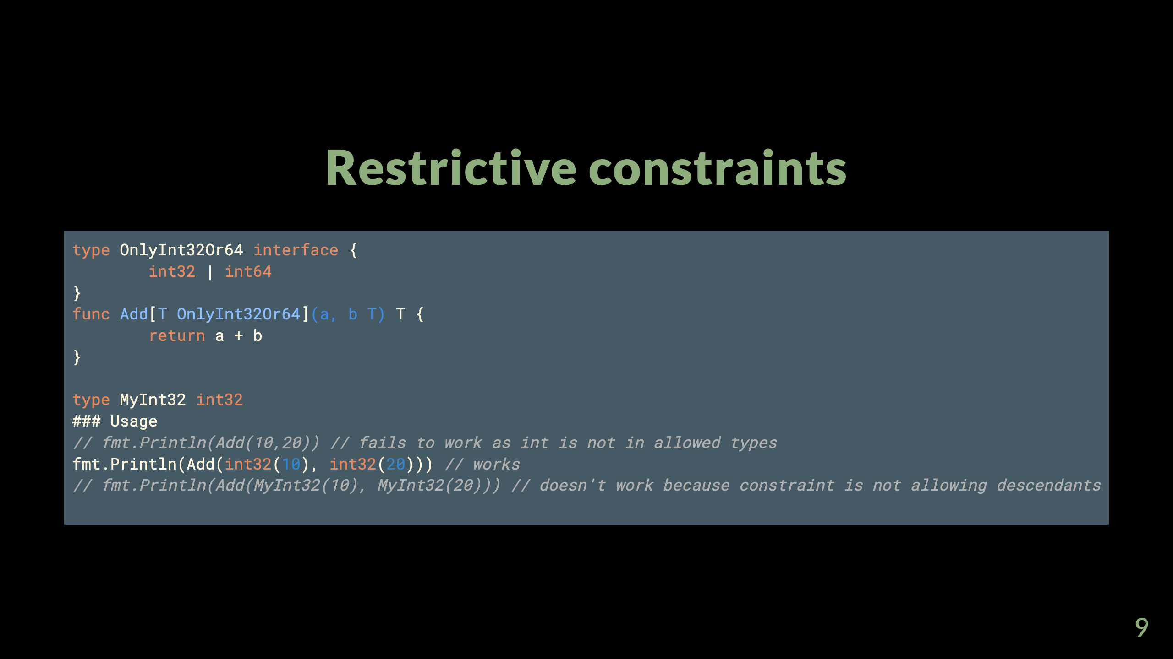
Notes:
- defining constraints without tilde prefix `int32` (`~int32`) - tilde allows all descendants also - will see in next slide

Slide 10
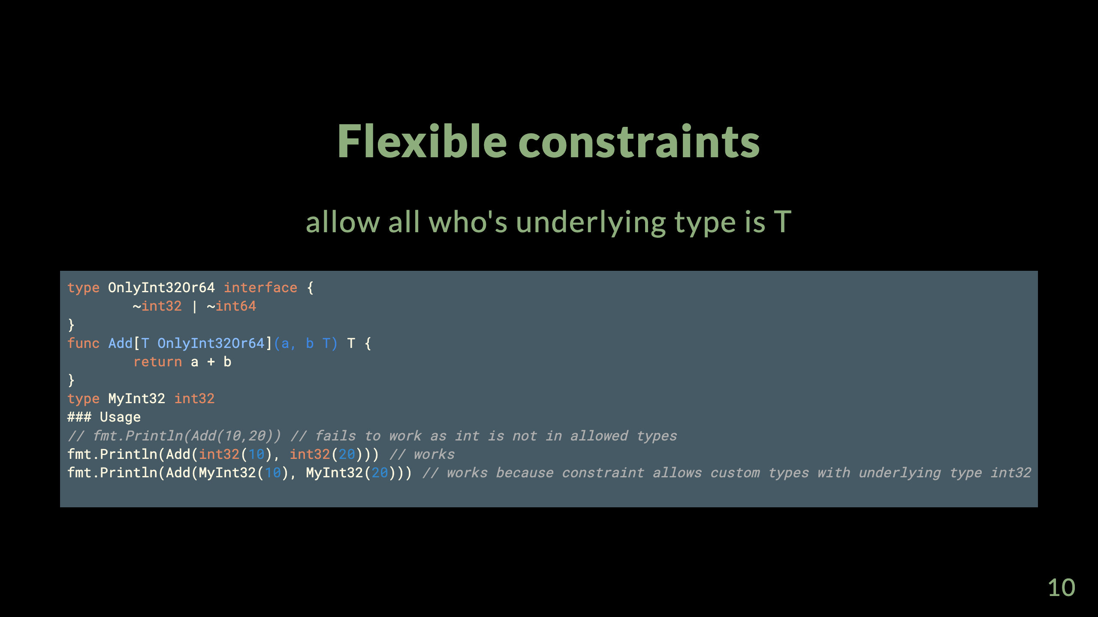

Slide 11
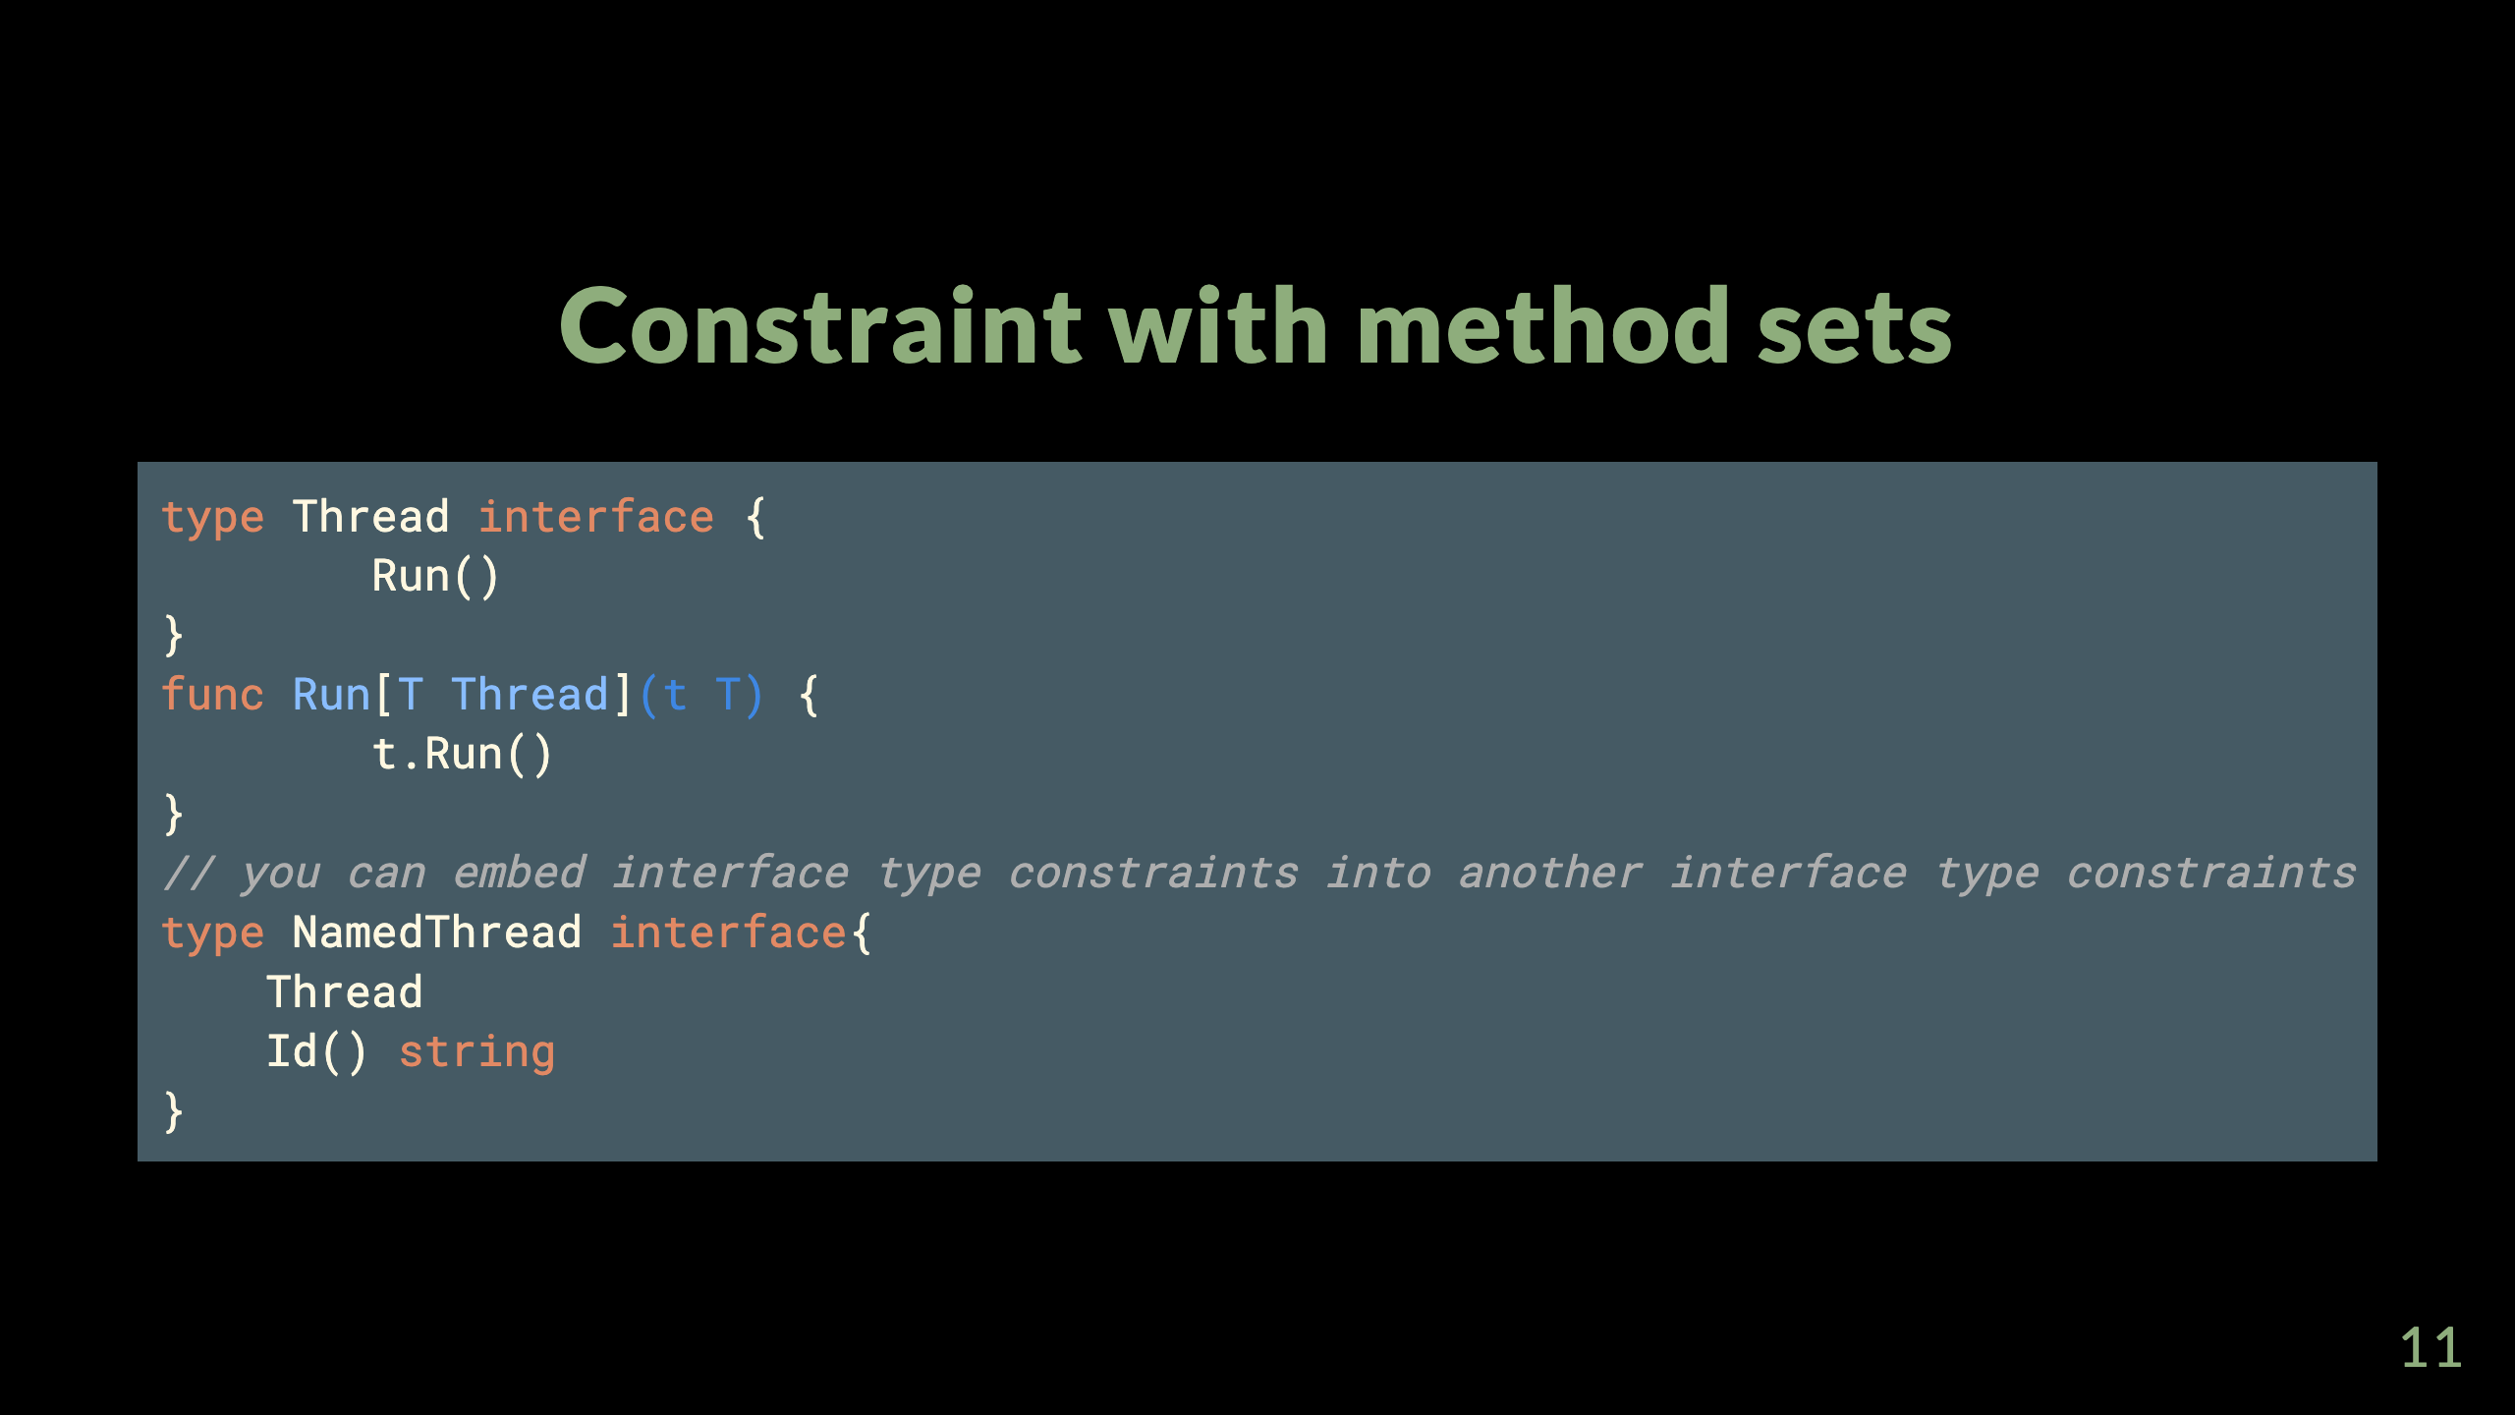

Slide 12
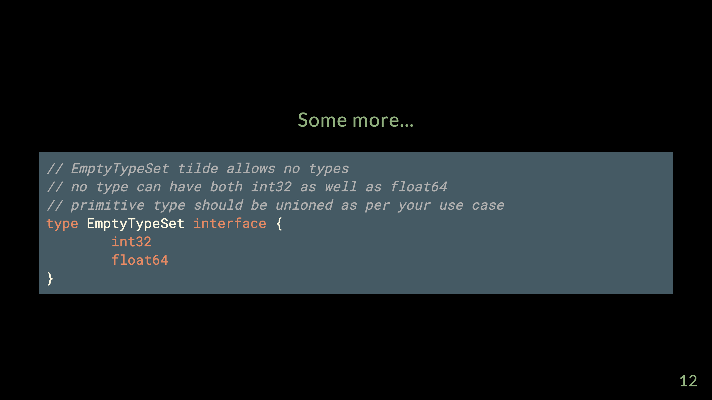

Slide 13
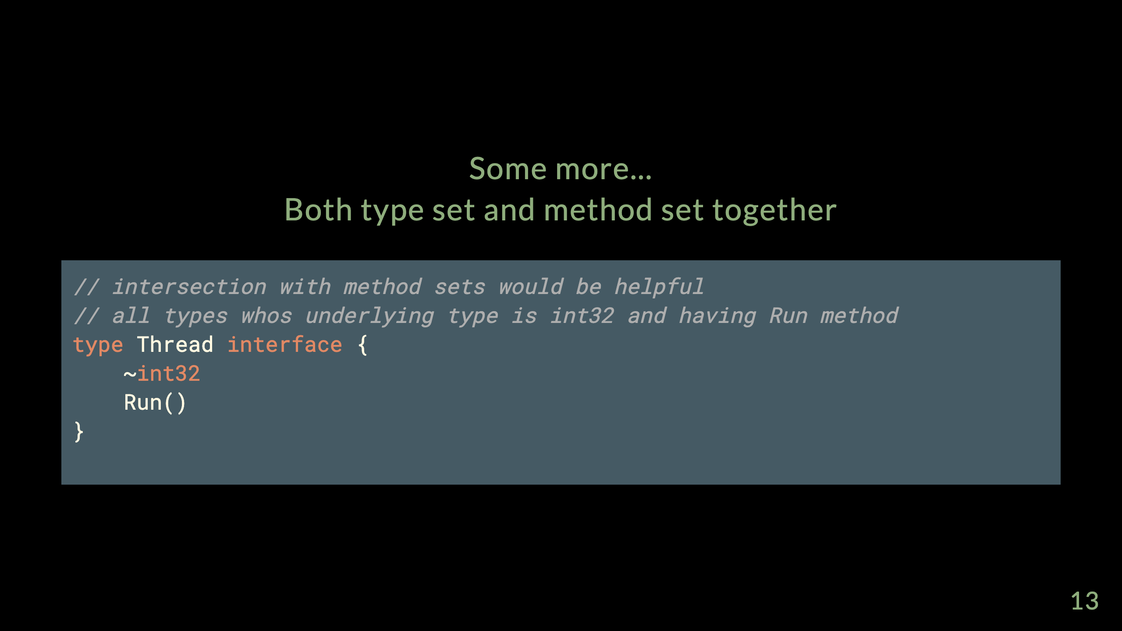

Slide 14
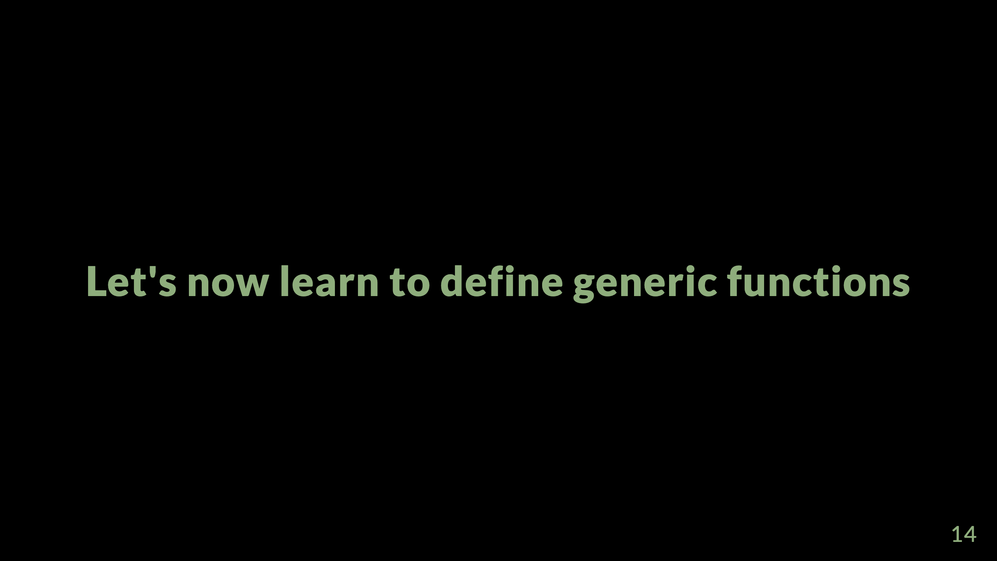

Slide 15
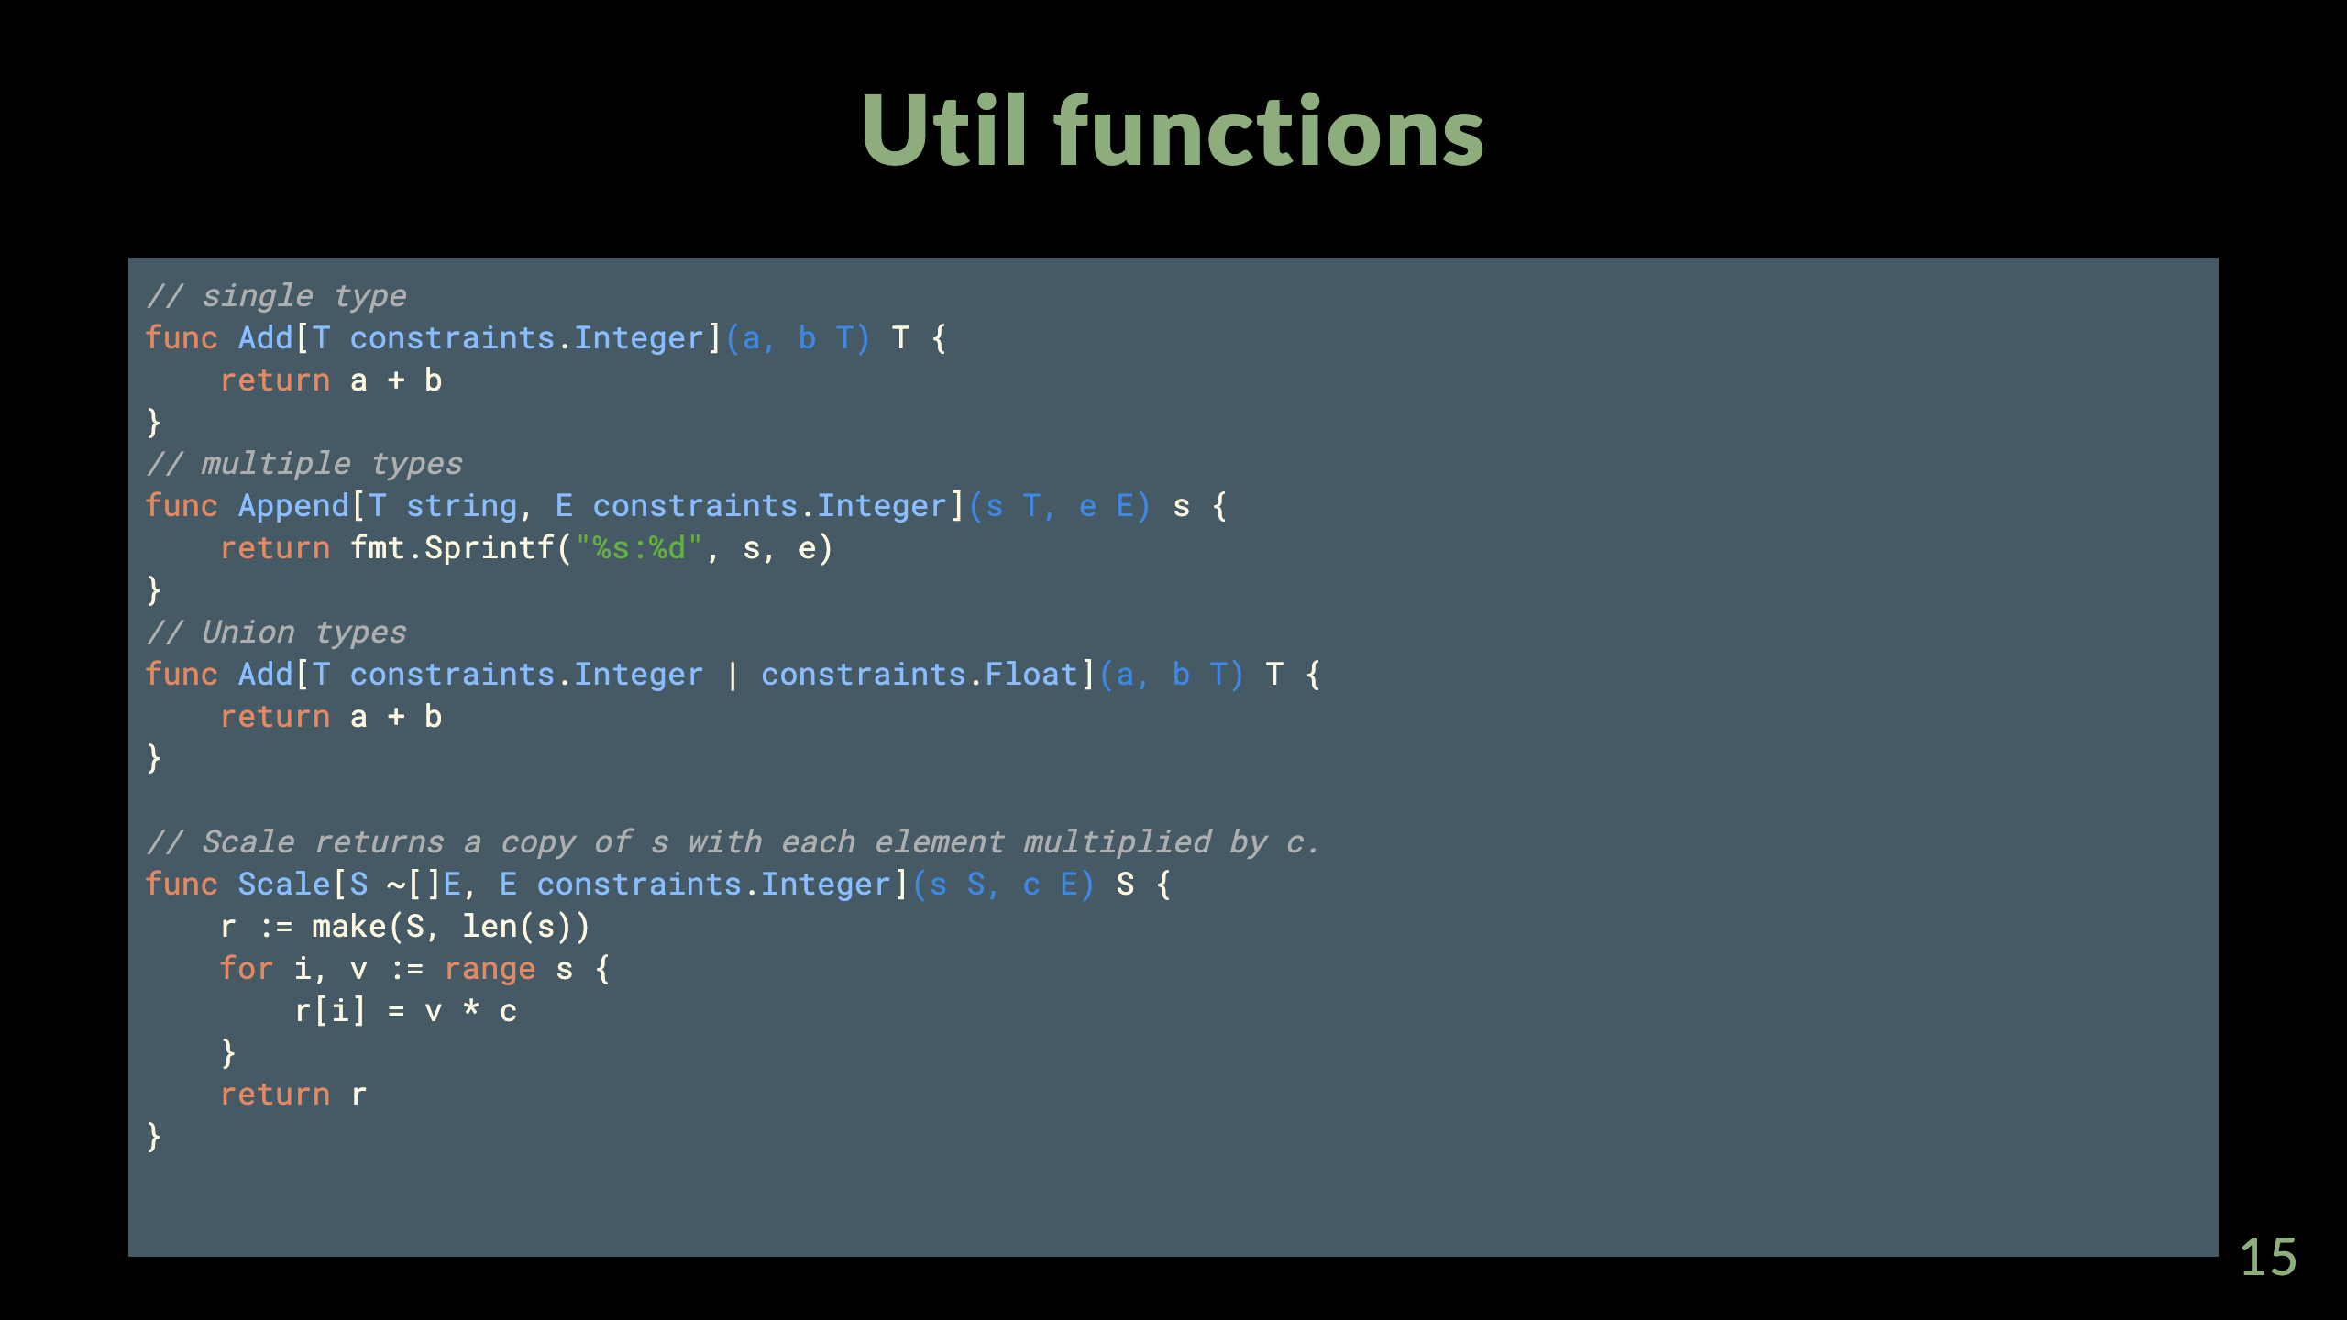

Slide 16
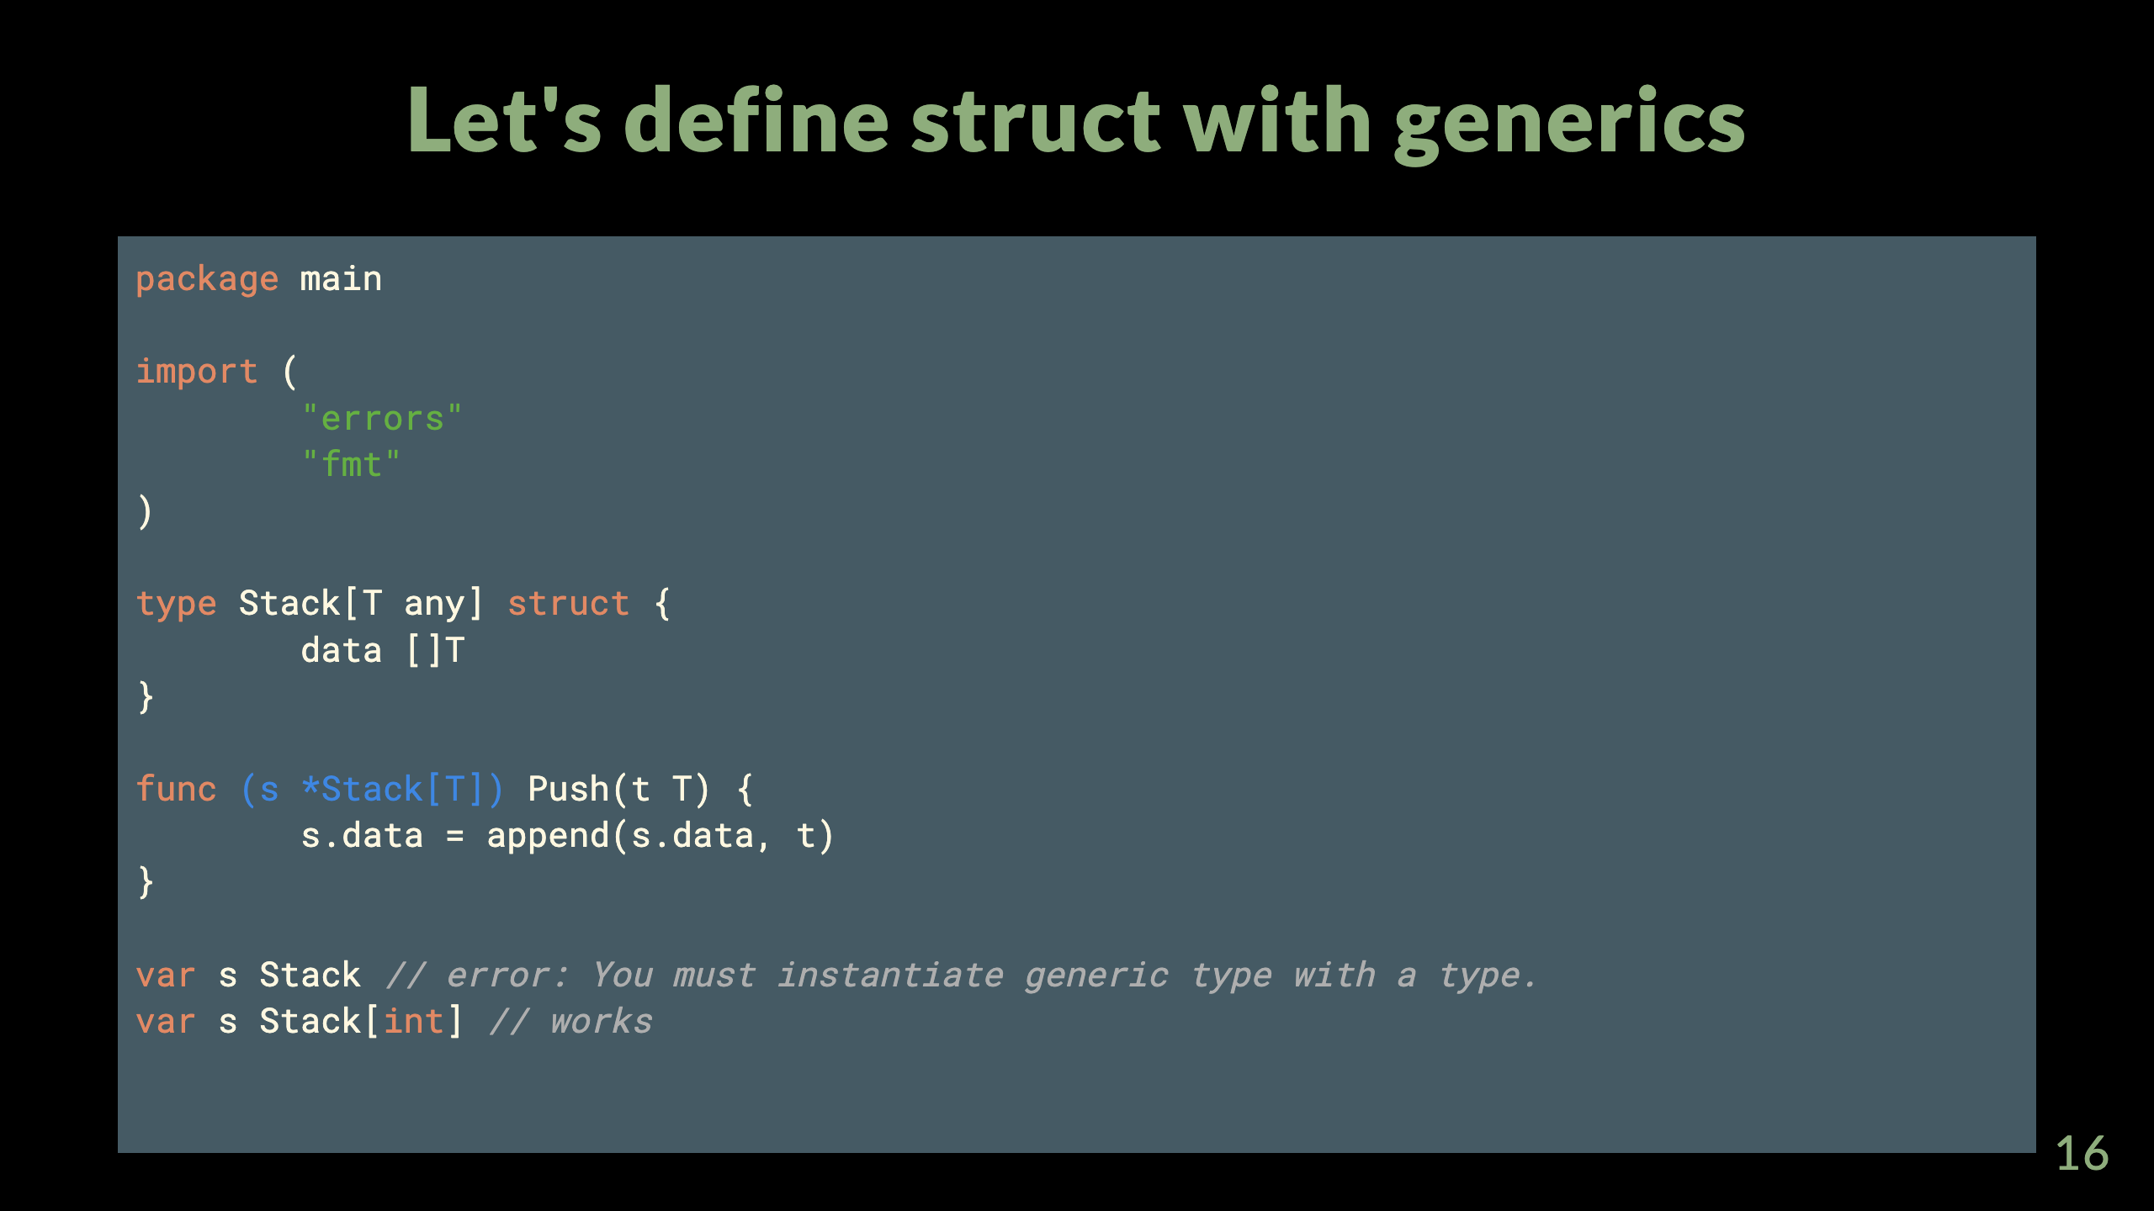
Notes:
package main import ( "errors" "fmt" ) type Stack[T any] struct { data []T } func (s *Stack[T]) Push(t T) { s.data = append(s.data, t) } func (s *Stack[T]) Pop() (T, error) { if len(s.data) == 0 { var zero T return zero, errors.New("empty stack") } t := s.data[len(s.data)-1] s.data = s.data[:len(s.data)-1] return t, nil } func (s *Stack[T]) Peek() (T, error) { if len(s.data) == 0 { var zero T return zero, errors.New("empty stack") } return s.data[len(s.data)-1], nil } func main() { /** You must instantiate generic type with a type. You cannot do like `var s Stack` **/ var s Stack[int] s.Push(1) s.Push(2) s.Push(3) fmt.Println(s.Peek()) fmt.Println(s.Pop()) fmt.Println(s.Pop()) fmt.Println(s.Pop()) fmt.Println(s.Pop()) }

Slide 17
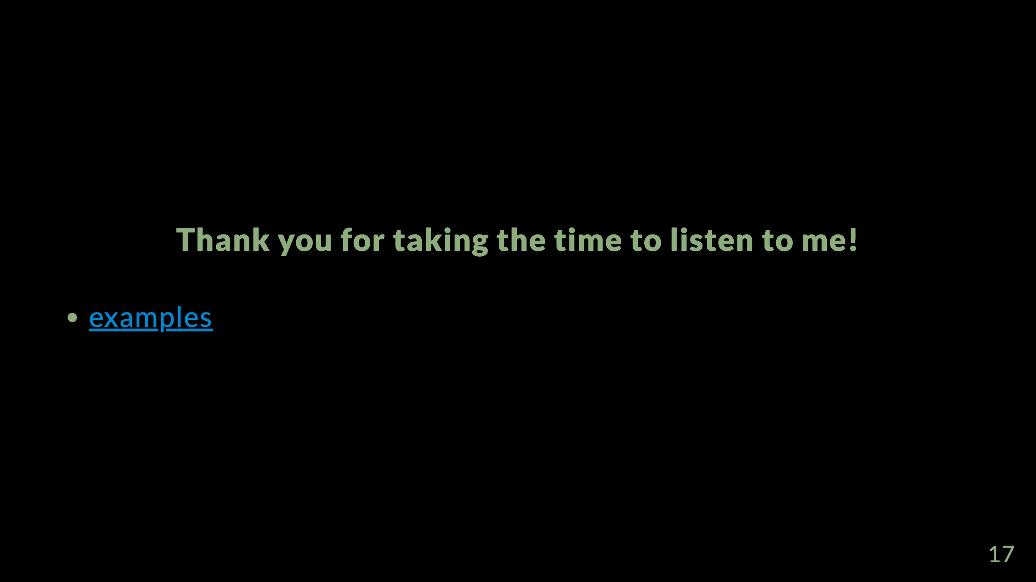

Slide 18
