Slide 1
What is a Servlet
Java technology for Common Gateway Interface (CGI)
Servlets are Java programs that serve as an intermediating layer between an HTTP request of a client and applications in the Web server

Slide 2
For Example
Programs that runs on the server:
  Should sometimes access a database
  Should sometimes access the file system
  Should create of Web pages online

Slide 3
Using Servlets
Reading the data that the user sent (HTTP request)
Receiving information from the HTTP request
Running an application with respect to the given input
The application creates a document for the response (e.g., HTML document)
Parameters are defined for the HTTP response
The created document is sent to the user

Slide 4
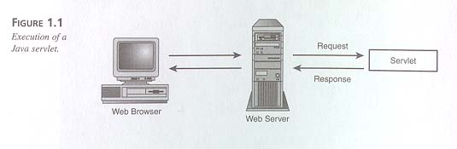
A Java Servlet
Sending a
request and
receiving a
response

Slide 5
Servlets
Servlets most common usages:
  1. Used to extend Web servers
  2. Used as replacement for CGI that is
    secure, portable, and easy-to-use
A servlet is a dynamically loaded module that services requests from a Web server
A servlet runs entirely inside the Java Virtual Machine

Slide 6
Supporting Sevlets
The Web server must support servlets:
  Apache Tomcat
  Sun’s JavaServer Web Development Kit (JSWDK)
  Allaire Jrun – an engeine that can be added to IIS, PWS, old Apache Web servers etc…
  Sun’s Java Web Server
  …

Slide 7
Tomcat
A Web Server that Support Servlets and Java Server Pages (JSP)

Slide 8
Installing Tomcat
Choose the installation directory (tomcat_home)
> tomcat setup in the installation directory
You get the directories:
  conf/
  lib/
  logs/
  my-webapps-template-dir/
  webapps/

Slide 9
Working with Tomcat
In the installation directory:
  Use the command tomcat start to start the server
  Use the command tomcat stop to stop the server
  You get to the server by requesting on a web browser http://<host>:port/
    Host is the machine on which you started tomcat
    Port is the port number according to the configuration

Slide 10
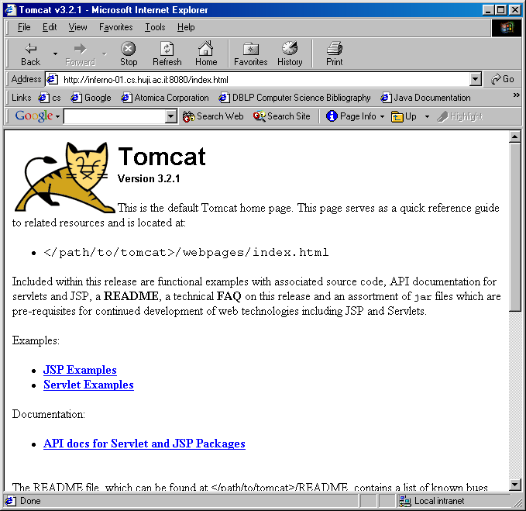

Slide 11
Definitions and Configuration
Definition files are in the directory tomcat_home/conf/
The definition of the port number of the server is in the file tomcat_home/conf/server.xml

Slide 12
Changing the Port
server.xml
<!-- Normal HTTP -->
<Connector className=
"org.apache.tomcat.service.PoolTcpConnector">
<Parameter name="handler"
value="org.apache.tomcat.service.
http.HttpConnectionHandler"/>
<Parameter name="port"
value="8080"/>
</Connector>

Slide 13
MIME-Types Mappings
tomcat_home/conf/web.xml
<mime-mapping>
<extension>txt</extension>
<mime-type>text/plain</mime-type>
</mime-mapping>
<mime-mapping>
<extension>html</extension>
<mime-type>text/html</mime-type>
</mime-mapping>
…

Slide 14
Servlets Class Files
Place for the servlet files:
  tomcat_home/webapps/ROOT/WEB-INF/classes
    Standard place for servlet classes
  tomcat_home/user_dir/WEB-INF/classes
    User defined position for servlet classes
  tomcat_home/lib
    Position for JAR files with classes

Slide 15
User Defined Directories
The definition is in the file server.xml inside the tag <ContextManager … >,
<Context path="/dbi"
docBase="webapps/dbi"
crossContext=“true"
debug="0"
reloadable="true" >
</Context>

Slide 16
Mapping Directories
<Context path="/dbi"
docBase="webapps/dbi"
… >
</Context>
http://host:8080/dbi/servlet/MyServlet
tomcat_home/webapps/dbi/
WEB-INF/classes/MyServlet.class

Slide 17
Servlet Package
javax.servlet
The Servlet interface defines methods that manage servlets and their communication with clients
Client Interaction: when it accepts call, receives two objects that implements
  ServletRequest
  ServletResponse

Slide 18
Architecture
Servlet
Generic Servlet
HttpServlet
YourOwnServlet

Slide 19
Creating a Servlet
Extend HTTPServlet
Implement doGet
Implement doPost
The methods
should get an input (the HTTP request)
Should create an output (the HTTP response)

Slide 20
Creating a Servlet
ServletRequest
HTTPServletRequest
Implement doGet
Implement doPost
ServletResponse
HTTPServletResponse

Slide 21
Hello World Example
import java.io.*;
import javax.servlet.*;
import javax.servlet.http.*;
public class HelloWorld extends HttpServlet
{
public void doGet(HttpServletRequest req, HttpServletResponse res) throws ServletException, IOException
{
res.setContentType("text/html");
PrintWriter out = res.getWriter();
out.println ("<!DOCTYPE HTML PUBLIC \”-//W3C//DTD HTML
4.0 Transitional//EN\”>");
out.println("<HTML><HEAD><TITLE>Hello
World</TITLE></HEAD>");
out.println(“<BODY><BIG>Hello World
</BIG></BODY></HTML>");
out.close();
}
}

Slide 22
Hello World Example
import java.io.*;
import javax.servlet.*;
import javax.servlet.http.*;
public class HelloWorld extends HttpServlet
{
public void doGet(HttpServletRequest req, HttpServletResponse res) throws ServletException, IOException
{
res.setContentType("text/html");
PrintWriter out = res.getWriter();
out.println ("<!DOCTYPE HTML PUBLIC \”-//W3C//DTD HTML
4.0 Transitional//EN\”>");
out.println("<HTML><HEAD><TITLE>Hello
World</TITLE></HEAD>");
out.println(“<BODY><BIG>Hello World
</BIG></BODY></HTML>");
out.close();
}
}

Slide 23
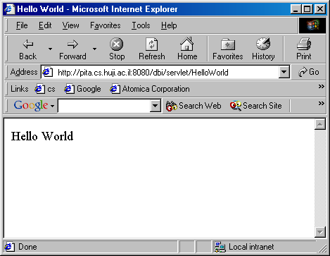

Slide 24
Calling the Servlet
Calling the servlet is done from the Web browser:
http://host:port/servlet/ServletName
For servlets that are positioned under
webapps/ROOT/WEB-INF/classes

Slide 25
Packages
Add packege packageName to the java code to create a package
Put the classes files under tomcat_home/webapps/ROOT/WEB-INF/classes/packageName
Call the servlet with http://host:port/servlet/packageName.servletName

Slide 26
Servlet Life Cycle
No main() method!
The server loads and initializes the servlet
The servlet handles client requests
The server can remove the servlet
The servlet can remain loaded to handle additional requests
Incur startup costs only once

Slide 27
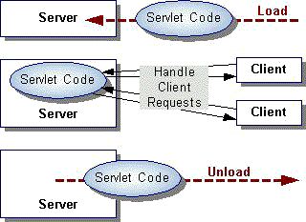
Life Cycle Schema

Slide 28
Servlet Life Cycle
Servicing requests by
calling the
service method
Calling the
init method
Destroying the servlet
by calling the
destroy method
ServletConfig
Initialization
and Loading
Garbage
Collection
Servlet Class

Slide 29
Important Note
When you change the servlet, usually it is not enough just to compile it – why?
What should you do?
You need to stop tomcat and restart tomcat to make tomcat reload the servlet and not use the old version stored in memory

Slide 30
Starting Servlets
Initialization:
  Servlet’s init(ServletConfig) or init() methods
  Called when the servlet is called for the first time from a client
  A code for initialization that is called only once (e.g., creating the tables of the database)
  Initialization parameters are server specific

Slide 31
The Configuration Parameters
The configuration parameters are taken from the file web.xml that is under tomcat_home/dir_path/WEB-INF/

Slide 32
<?xml version="1.0" encoding="ISO-8859-1"?>
<!DOCTYPE web-app
PUBLIC "-//Sun Microsystems,Inc.//DTD Web Application 2.2//EN"
"http://java.sun.com/j2ee/dtds/web-app_2.2.dtd">
<web-app>
<servlet>
<servlet-name>InitExample</servlet-name>
<servlet-class>ServletInit</servlet-class>
<init-param>
<param-name>dbi</param-name>
<param-value>http://www.cs.huji.ac.il/~dbi</param-value>
</init-param>
<init-param>
<param-name>db</param-name>
<param-value>http://www.cs.huji.ac.il/~db</param-value>
</init-param>
</servlet>
</web-app>

Slide 33
HTTP Methods
POST:
  Data sent in two steps
  Designed for Posting information
    Browser contacts server
    Sends data
GET:
  Contacts server and sends data in single step
  Appends data to action URL separated by question mark
  Designed to get information

Slide 34
Other Methods
HEAD: Client sees only header of response to determine size, etc…
PUT: Place documents directly on server
DELETE: Opposite of PUT
TRACE: Debugging aid returns to client contents of its request
OPTIONS: what options available on server

Slide 35
Servicing a Servlet
Every call to the servlet creates a new thread that calls the service method
The service methods check the type of request (GET, POST, PUT, DELETE, TRACE, OPTION) and call the appropriate method: doGet, doPost, doPut, doDelete, DoTrace, doOption
It is recommended to implement doPost and doGet instead of implementing service. Why?
The method doPost can call doGet in order to reuse code

Slide 36
HttpServlet Request Handling
Web Server
HttpServlet subclass
GET request
service()
doGet()
response
POST request
doPost()
response

Slide 37
The Single Thread Model
Usually there is a single instance of a servlet and a thread for each user request
The doGet and doPost methods must synchronize the access to data structures and other resources
If it is required to prevent a concurrent access to an instance of a servlet you should use the single thread model

Slide 38
SingleThreadModel
SingleThreadModel is a marker interface
  No methods
  Tells servlet engines about lifecycle expectations
Ensure that no two threads will execute concurrently the service method of that servlet
This is guaranteed by maintaining a pool of servlet instances for each such servlet, and dispatching each service call to a free servlet

Slide 39
SingleThreadModel
SingleThreadModel let you break servlet functionality into multiple methods
Can rely on “instance state” being uncorrupted by other requests
Can’t rely on singletons (static members) or persistent instance state between connections
  The same client making the same request, can get different instances of your servlet

Slide 40
Destroying Servlets
Destroying:
  destroy() method
  make sure all service threads complete

Slide 41
Getting Input From the User
HTML Forms

Slide 42
Handling a User Request
The servlet gets parameters from HTML forms
<form action=… method=…> …</form> comprise a single form
  action – the name of the processing server
  method – the HTTP method to use when passing parameters to the server
  enctype – the encription used to send the parameters

Slide 43
The <input> Tag
Inside a form, INPUT tags define fields for data entry
Standard input types include: buttons, checkboxes, password field, radio buttons, text fields, image-buttons, text areas, hidden fields, etc.
They all associate a single (string) value with a named parameter

Slide 44
Example
<HTML>
…
<form method=“GET”
action=“http://pita.cs.huji.ac.il:8090/servlet/update”>
…
<INPUT name=“x” type=“text”>
<INPUT name=“y” type=“text”>
<INPUT type=“submit”> <INPUT type=“reset”>
</form>
…
</HTML>
http://pita.cs.huji.ac.il:8090/servlet/update?x=19&y=104

Slide 45
Getting the Parameters Values
request.getParameter(“x”);
request.getParameter(“y”);
If there can be multiple values for the parameter, use
getParameterValues
If you don’t know the names of the parameters, use
getParameterNames

Slide 46
<!DOCTYPE HTML PUBLIC "-//W3C//DTD HTML 4.0 Transitional//EN">
<HTML>
<HEAD>
<TITLE>Sending Parameters</TITLE>
</HEAD>
<BODY BGCOLOR="#CC90E0">
<H1 ALIGN="LEFT">Please enter the parameters</H1>
<FORM ACTION=“dbi/servlet/SetColors” METHOD=“GET”>
<TABLE>
<TR><TD>Background color:</TD>
<TD><INPUT TYPE="TEXT" NAME="bgcolor"></TD></TR>
<TR><TD>Font color:</TD>
<TD><INPUT TYPE="TEXT" NAME="fgcolor"></TD></TR>
<TR><TD>Font size:</TD>
<TD><INPUT TYPE="TEXT" NAME="size"></TD></TR>
</TABLE>
<BR>
<INPUT TYPE="SUBMIT" VALUE="Show Page">
</FORM>
</BODY>
</HTML>
tomcat_home/webapps/ROOT/colors.html

Slide 47
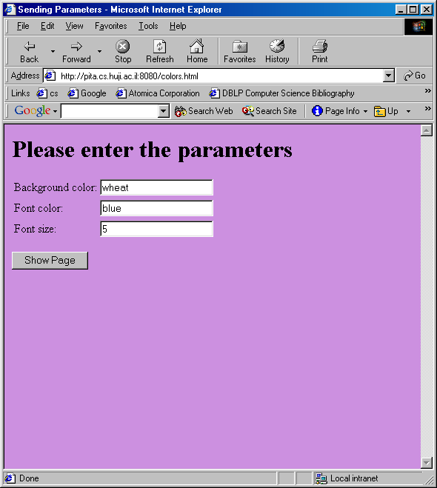
http://pita.cs.huji.ac.il:8080/colors.html

Slide 48
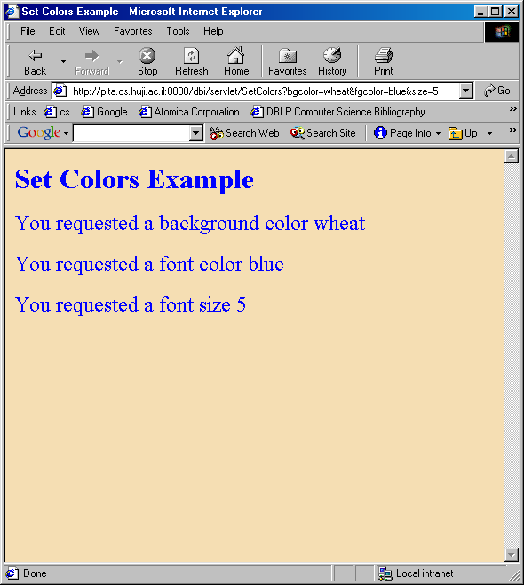
http://pita.cs.huji.ac.il:8080/dbi/servlet/
SetColors?bgcolor=wheat&fgcolor=blue&size=5

Slide 49
import java.io.*;
import javax.servlet.*;
import javax.servlet.http.*;
/**
* Creates a page according to the parameters
* given from a form
*/
public class SetColors extends HttpServlet {
public void doGet(HttpServletRequest request,
HttpServletResponse response)
throws ServletException, IOException {
String title = "Set Colors Example";
response.setContentType("text/html");
PrintWriter out = response.getWriter();
String bg = request.getParameter("bgcolor");
String fg = request.getParameter("fgcolor");
String size = request.getParameter("size");

Slide 50
out.println("<HTML><HEAD><TITLE>" + title +
"</TITLE></HEAD>");
out.println("<BODY text='" + fg +
"' bgcolor='" + bg + "'>");
out.println("<H1>" + title + "</H1>");
out.println("<FONT size='" + size + "'>");
out.println("You requested a background color " +
bg + "<P>");
out.println("You requested a font color " +
fg + "<P>");
out.println("You requested a font size " +
size + "<P>");
out.println("</FONT></BODY></HTML>");
}
}

Slide 51
Handling Post
<FORM ACTION=“dbi/servlet/SetColors” METHOD=“POST”>
public void doPost(HttpServletRequest request,
HttpServletResponse response)
throws ServletException, IOException {
doGet(request, response);
}

Slide 52
Information on Client Request
request.getHeader(“Accept”);
request.getHeaderNames();
getCookies
getContentLength
getContentType
getMethod
getProtocol
…

Slide 53
Creating the Response of the Servlet

Slide 54
HTTP Response
The response includes:
  Status line: version, status code, status message
  Response headers
  Empty line
  Document
HTTP/1.1 200 OK
Content-Type: text/plain
Bla Bla Bla

Slide 55
Buffer
server
Servlet
Buffer
response
setBufferSize
getBufferSize
isComitted
flushBuffer
reset
client
request

Slide 56
Setting the Response Status
The status code of the HTTP response can be set by the setStatus method of HTTPServletResponse
The status should be defined before sending content through the PrintWriter of the HTTPServletResponse
The status can be defined after setting headers of the HTTPServletResponse

Slide 57
Shortcuts
An automatic response is created by
  sendError(int code, String message)
    Returns the status code with the message
    Usually status code 404 (HTTPServletResponse.SC_NOT_FOUND)
  sendRedirect(String url)
    Creates a response with status code 302 (HTTPServletResponse.SC_MOVED_TEMPORARILY) with a Location header that includes the given url

Slide 58
Using Redirect
You can create a servlet that
  Gets a url from a user (e.g., from a form)
  Return a redirect message with the given url
Or
  Get a list of words from the user
  Return a redirect message to a search engine with the given words as parameters

Slide 59
Setting Response Headers
Headers can be defined
  using setHeader(String header, String value) of HTTPServletResponse
  using setIntHeader(String header, int value)
  using setDateHeader(String header, long milliseconds) (translate to GMT)
The headers must be defined before the first time the buffer content is sent

Slide 60
More Headers Methods
You can use
  containsHeader to check existence of an header in the response
  setContentType
  setContentLength
  addCookie

Slide 61
Servlet Description
To allow server to display information about servlet you should implement getServletInfo
public class MyServlet extends HttpServlet {
...
public String getServletInfo() {
return new String(“The invisible servlet\n“ + “Author: Danny Din\n” + “Description: A servlet to show things that cannot be seen”;
}
}

