Slide 1
Secure Data Hiding in Images Using Steganography
CAPSTONE PROJECT
Presented By: VAIDHYARAJ KUNCHUM
Student Name : VAIDHYARAJ KUNCHUM
College Name & Department : SREYAS INSTITUTE OF ENGINEERING AND TECHNOLOGY. DEPARTMENT IS ELECTRONICS AND COMMUNICATION ENGINEERING

Slide 2
OUTLINE
Problem Statement
Technology used
Wow factor
End users
Result
Conclusion
Git-hub Link
Future scope

Slide 3
Problem statement
With the growing concern for digital privacy, ensuring the confidentiality of sensitive information has become crucial. This project aims to implement a secure method to hide messages inside images using steganography. The process is divided into separate encryption and decryption modules to enhance security and modularity.

Slide 4
Technology used
This project is developed using:
Python – Core programming language
OpenCV – For image processing
ASCII Encoding – Converts characters into numerical format for embedding
Steganography Techniques – Least Significant Bit (LSB) modification for data hiding

Slide 5
Wow Factor (Unique Features)
Steganographic Data Hiding: The project implements a pixel-based method to embed messages into an image without noticeable distortion.
Password-Protected Encryption: Only users with the correct passcode can decrypt and retrieve the hidden message.
Separation of Encryption & Decryption: The encryption and decryption processes are modularized into separate scripts, improving security and usability.
Minimal Image Alteration: The encryption process ensures that the image quality remains intact, making the hidden message undetectable.
Automated Message Length Handling: The system automatically determines the message length and encodes it into the image for accurate retrieval.

Slide 6
End users
This steganography-based project is useful for:
Cybersecurity Professionals – Ensuring secure digital communication
Law Enforcement Agencies – Concealing sensitive investigative data
Journalists & Whistleblowers – Enabling confidential information exchange
Individuals Seeking Private Communication – Protecting personal conversations
Military & Intelligence Agencies – Securely transmitting classified information

Slide 7
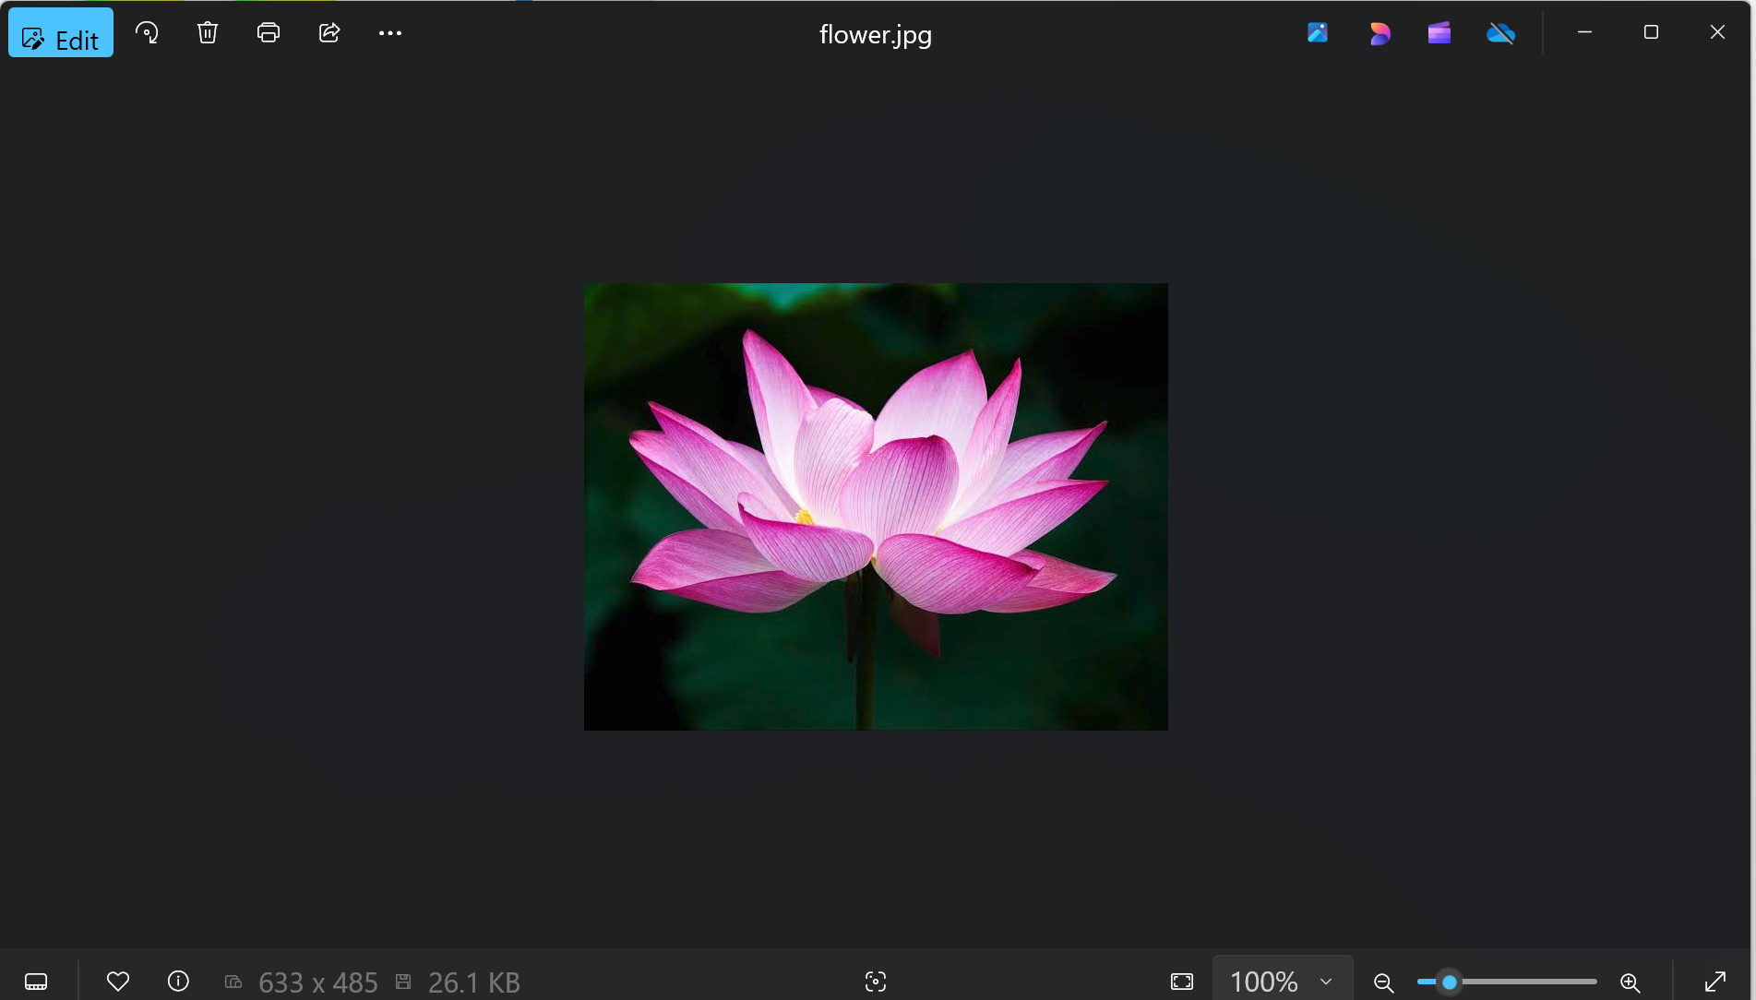
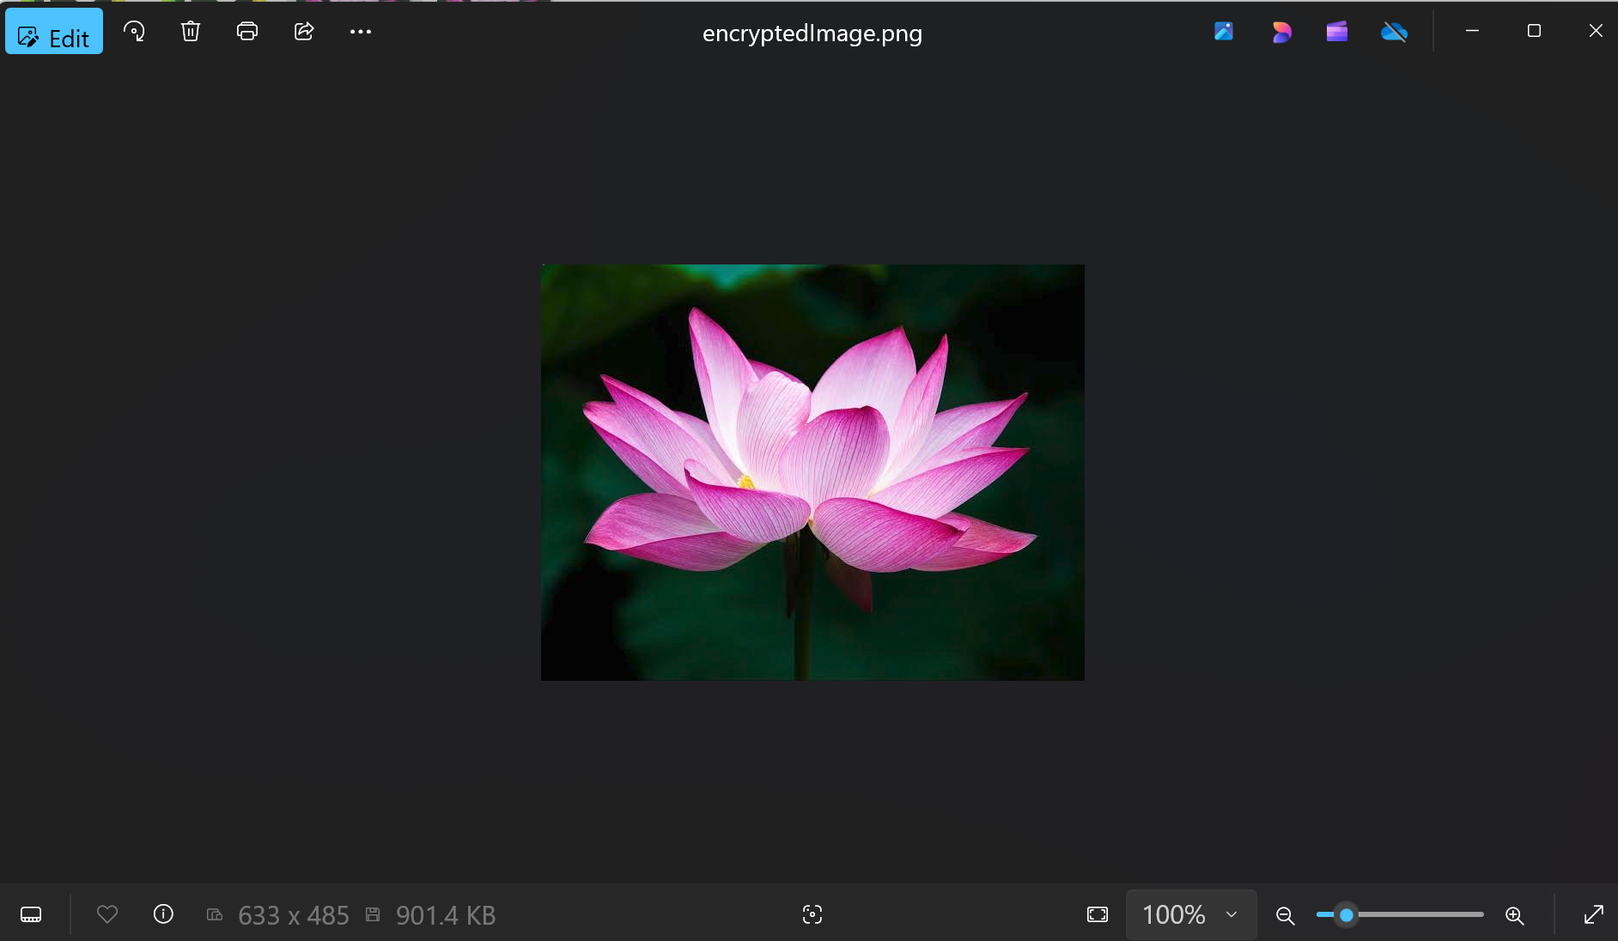
Results: Screenshots of the outcome

Slide 8
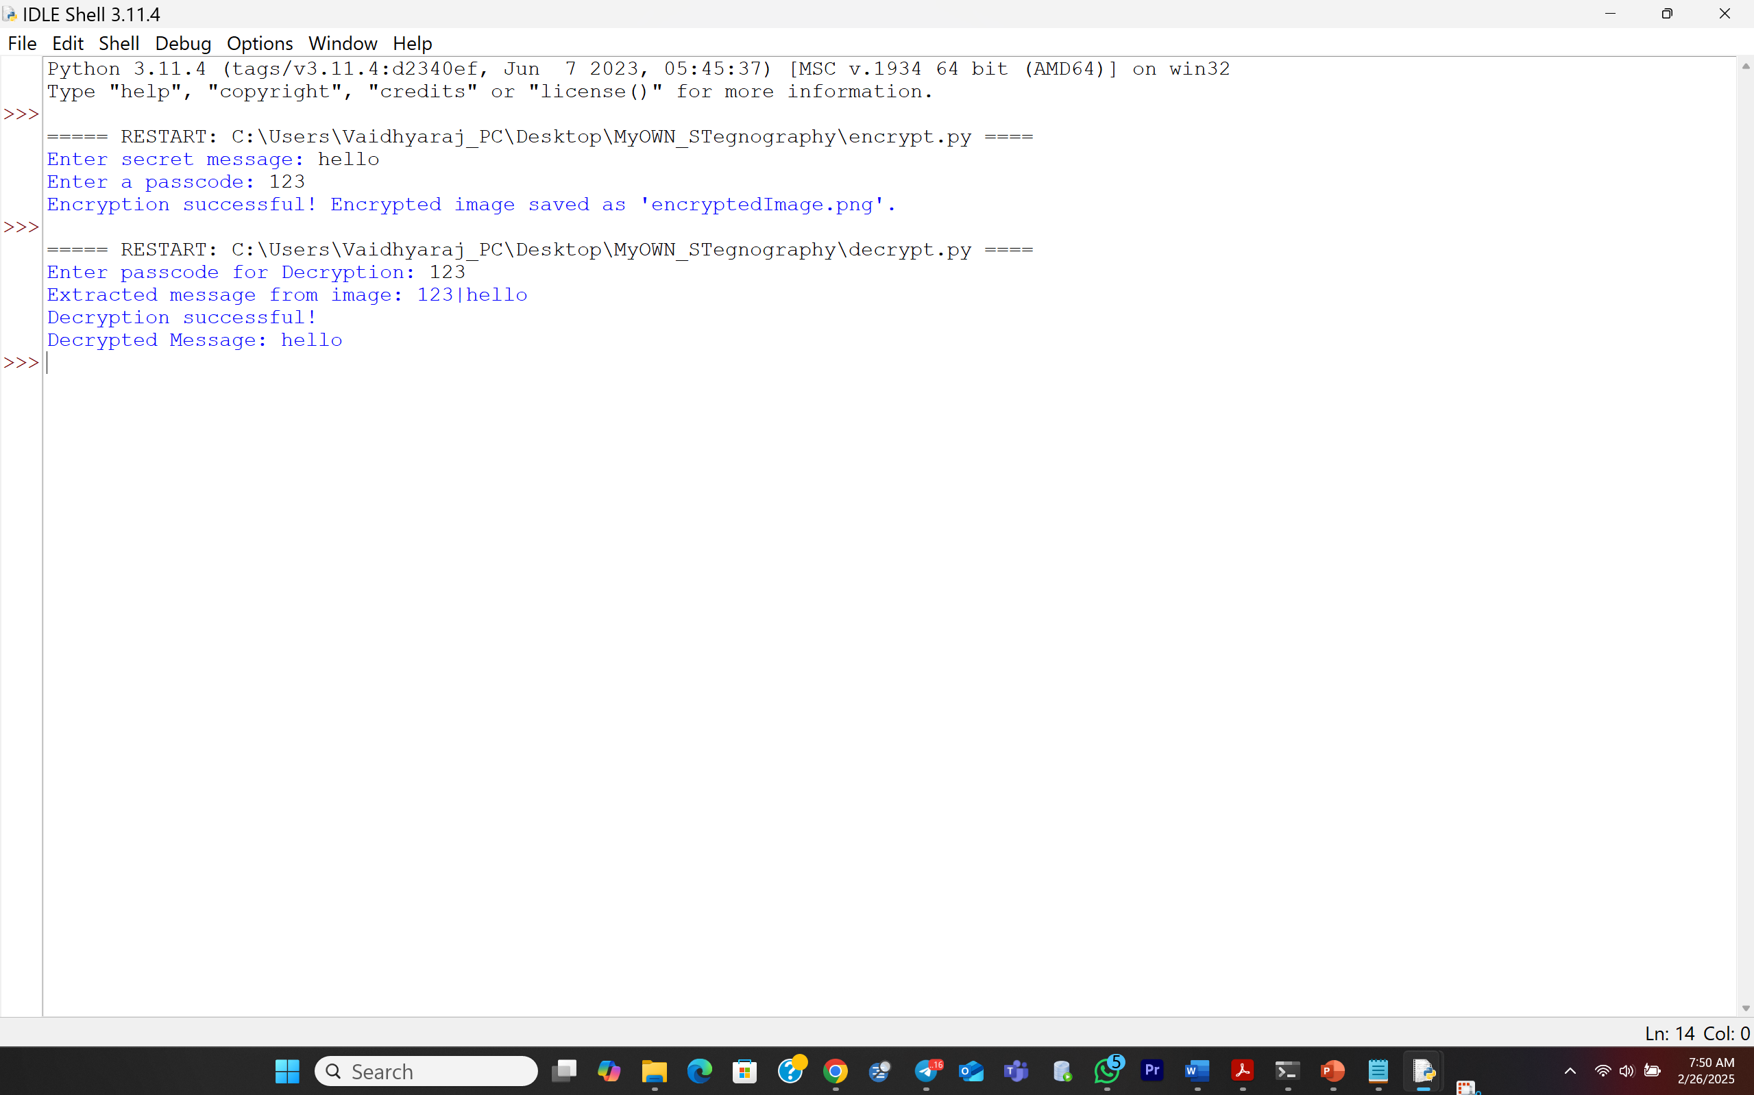
Decrypted message successfully extracted from image

Slide 9
Conclusion:
This project successfully demonstrates the secure embedding and retrieval of messages within digital images using steganography. By separating encryption and decryption, the system enhances modularity and security. The implementation ensures that only authorized users with the correct passcode can retrieve the hidden information. The method provides an effective way to protect sensitive communications without raising suspicion.

Slide 10
Provide the GitHub repository link after uploading the project.
https://github.com/vkunchum/AICTE_CyberInternship_Project.git

Slide 11
Future scope(optional)
AES Encryption Integration: Adding AES encryption before embedding the message for an additional layer of security.
Improved Steganographic Techniques: Implementing adaptive steganography to distribute message bits across the image more securely.
GUI-Based Implementation: Developing a user-friendly graphical interface for better usability.
Multi-Image Steganography: Expanding the approach to distribute a hidden message across multiple images to enhance security.
Support for Video Steganography: Extending the concept to embed messages inside video frames, allowing larger data concealment.

Slide 12
THANK YOU

